Slide 1
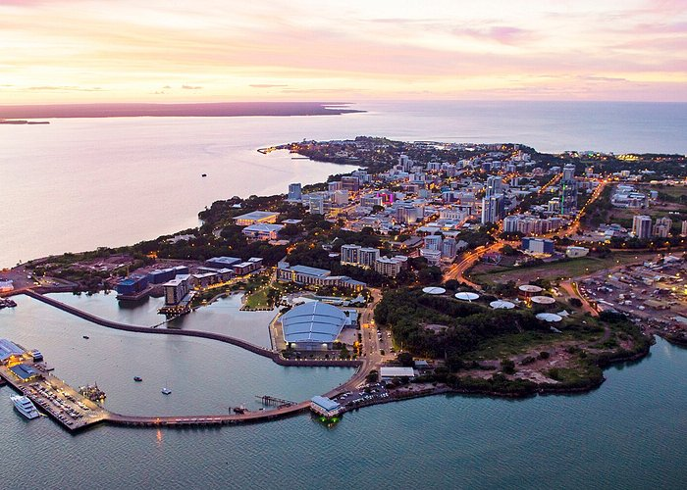
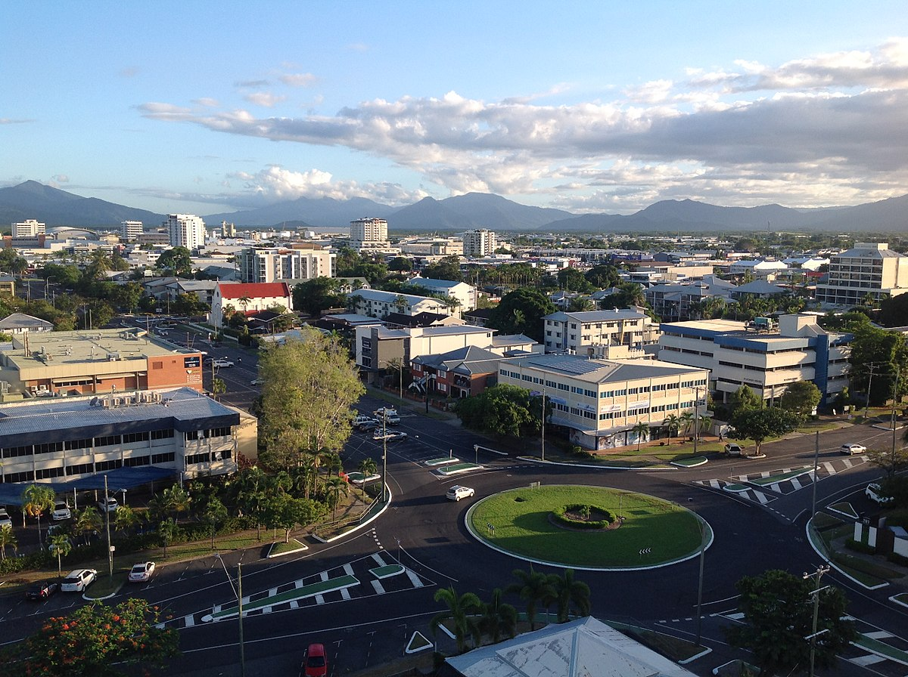
AUSTRALIA

Slide 2
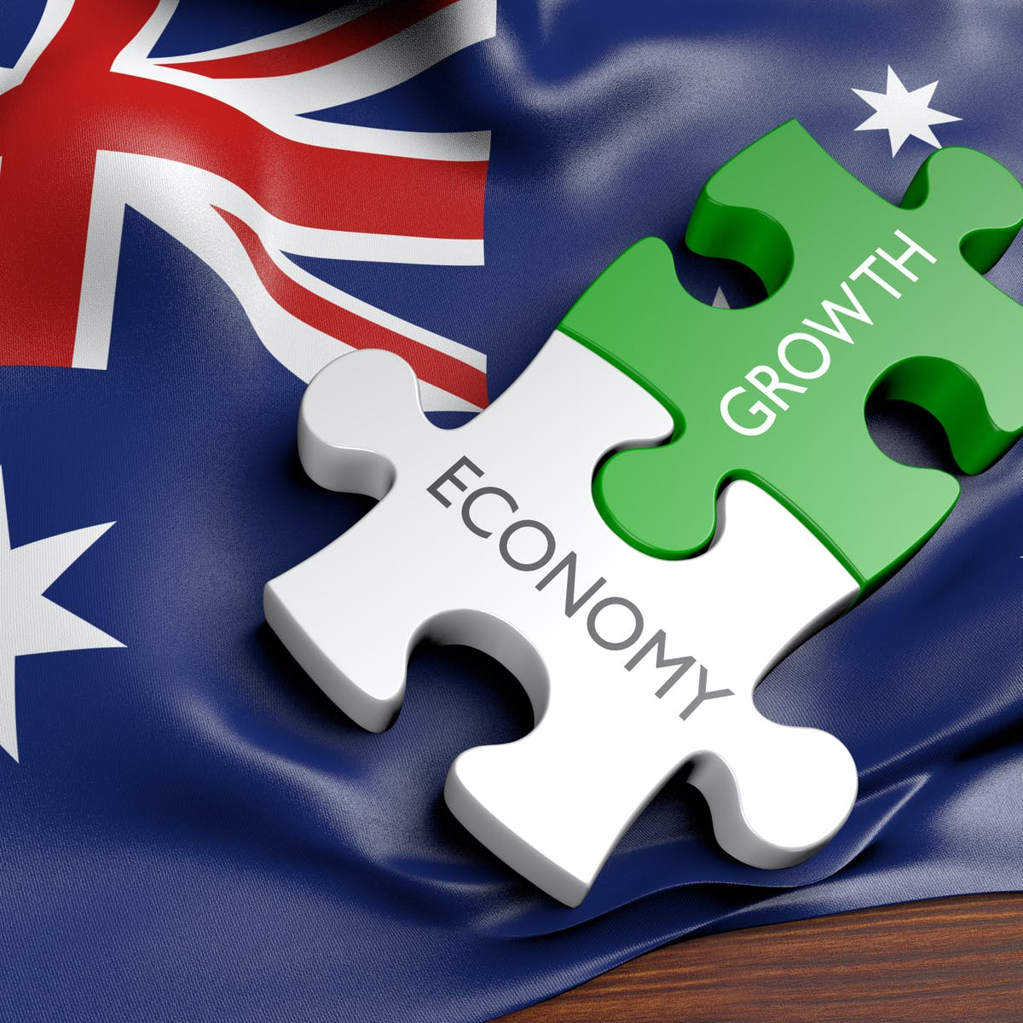
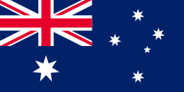
The name Australia comes from the Latin phrase terra australis incognita. The capital is Canberra. It consists of the Australian continent, Tasmania and numerous islands.

Slide 3
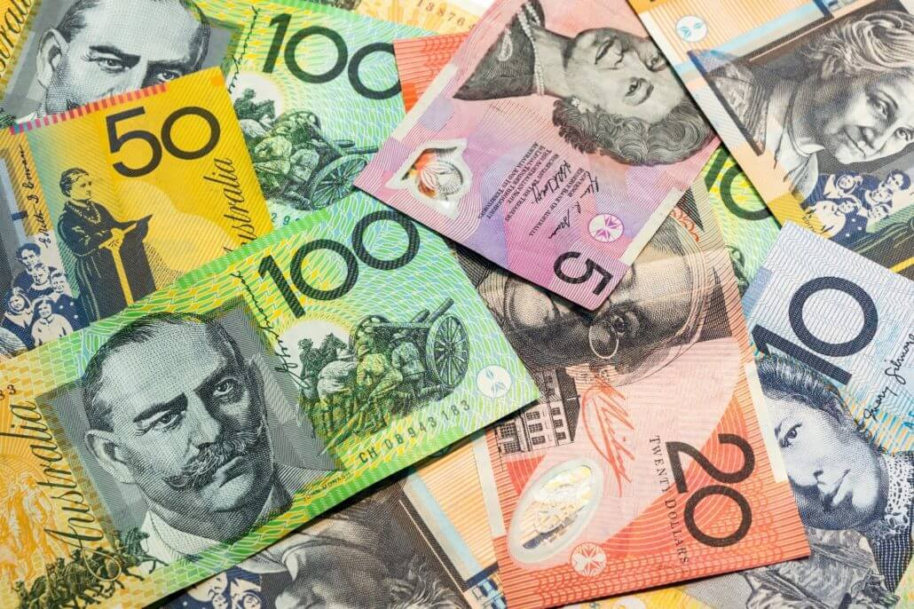
Αlmost all the inhabitants of Australia speak English as the first or second language,while the indigenous languages that resemble each other and are divided into two large groups,the Vietnamese immigrants, whose language are among the ten main languages of the country. The currency of the country is the Australian dollar.

Slide 4
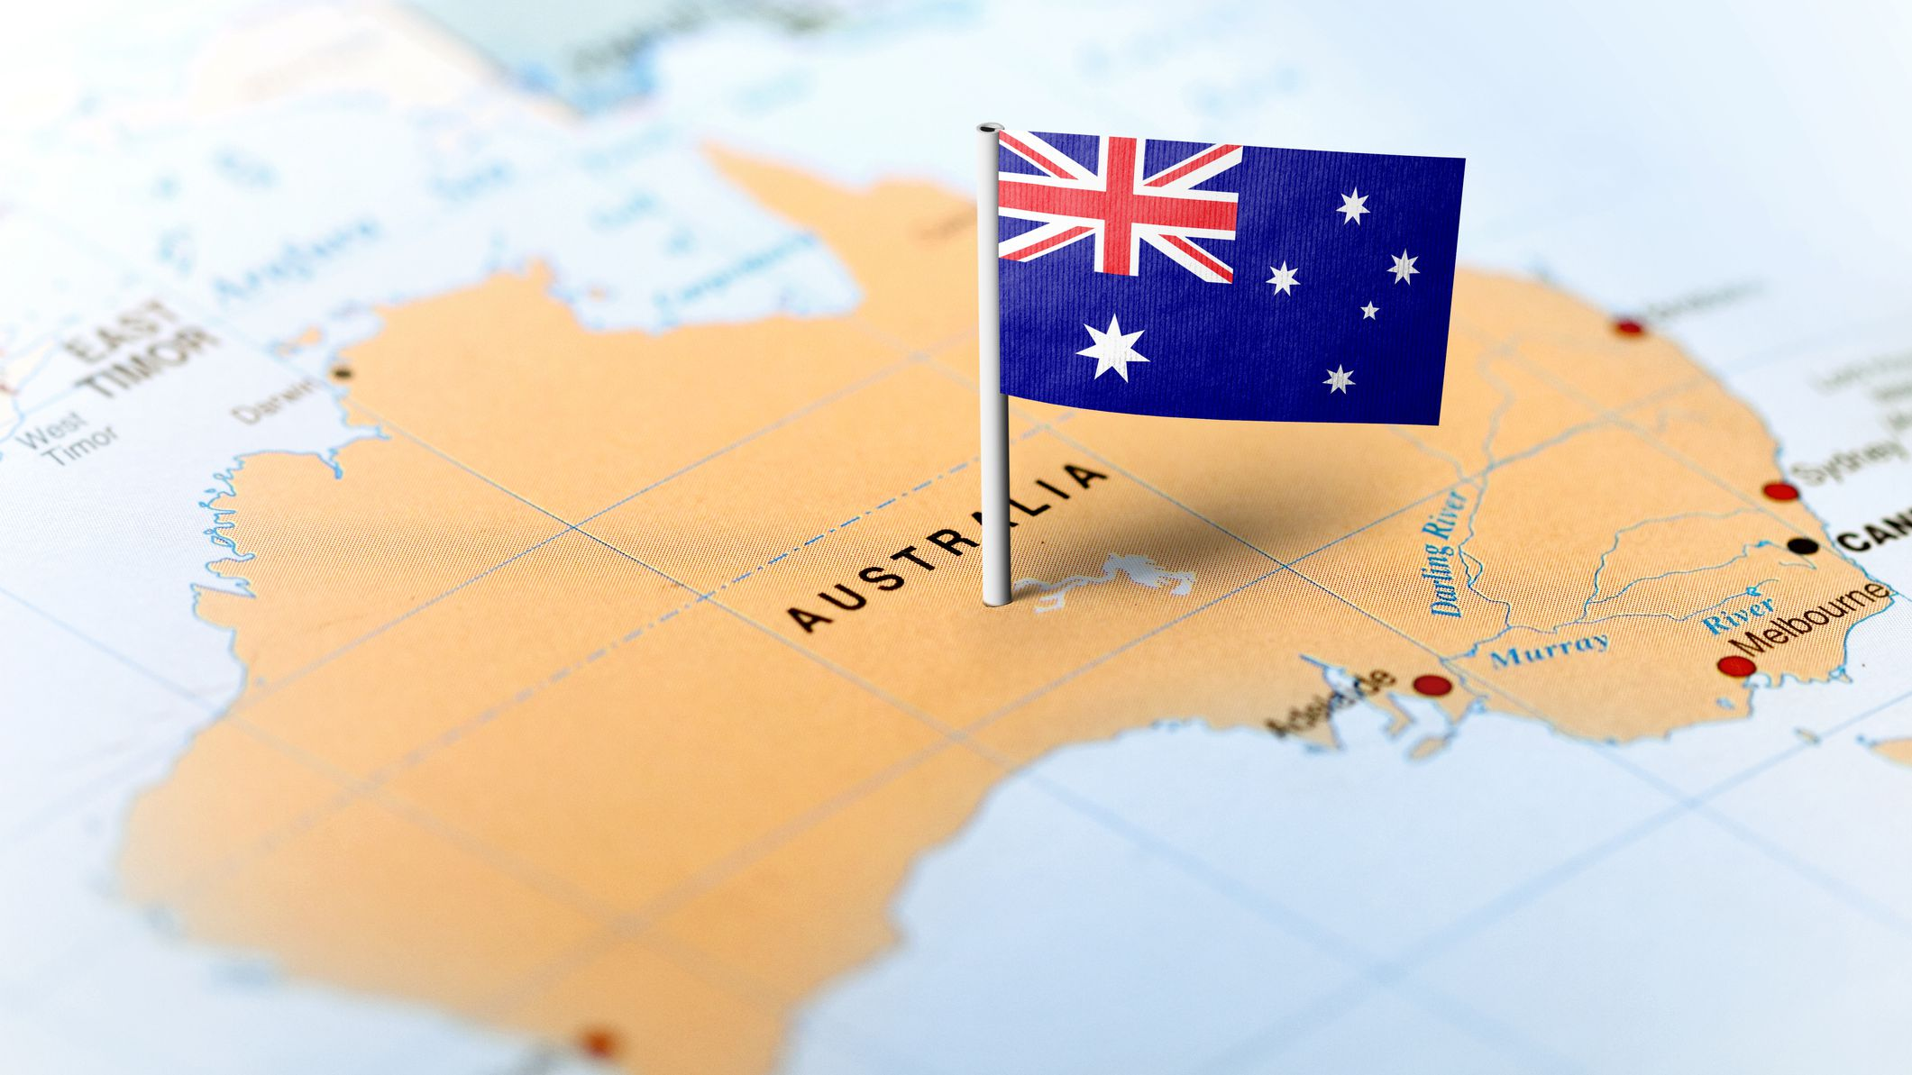
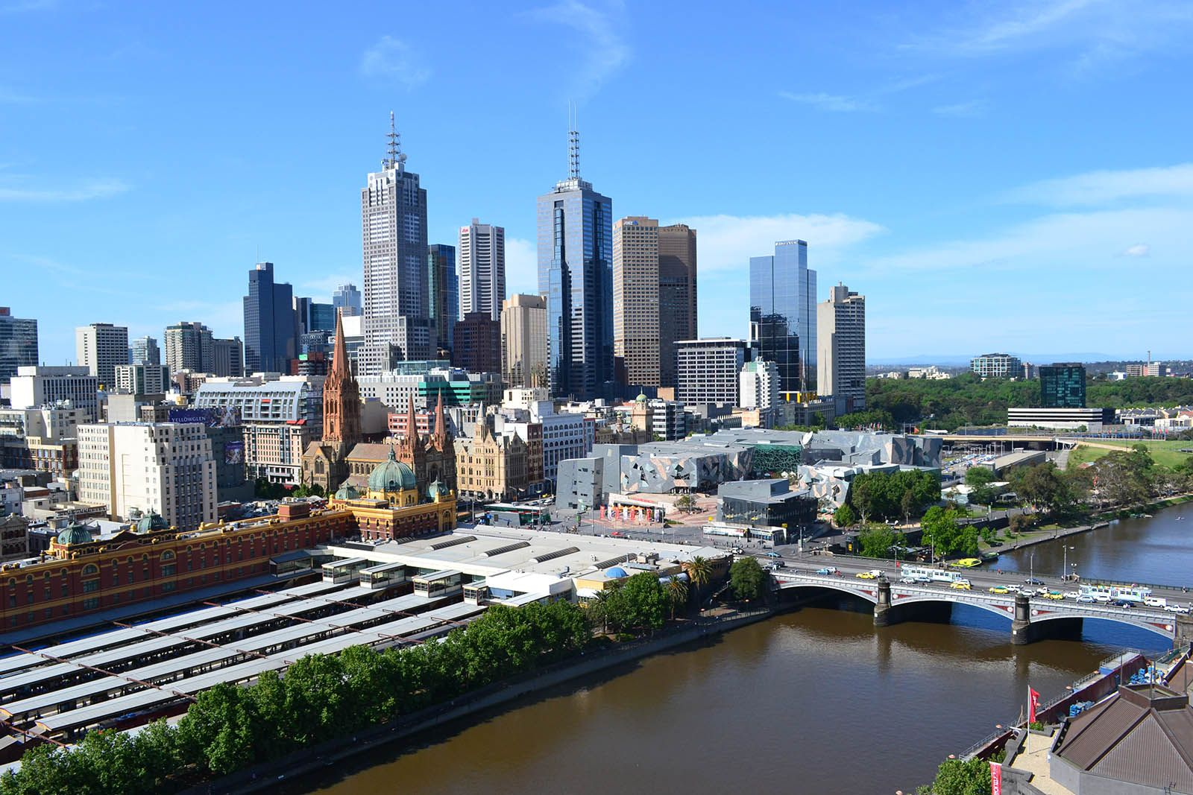
Australia is located in the southern of the eastern hemisphere and is washed by sea . From the north it is washed by the Arafura Sea and the Timor Sea , to the east by the Pacific Ocean (Tasmanian sea and Carla Sea) and to the west and south by the Indian Ocean.Australia is the sixth largest country in terms of its total area and depending on the definition , it is considered the smallest continent or the largest island in the world.

Slide 5
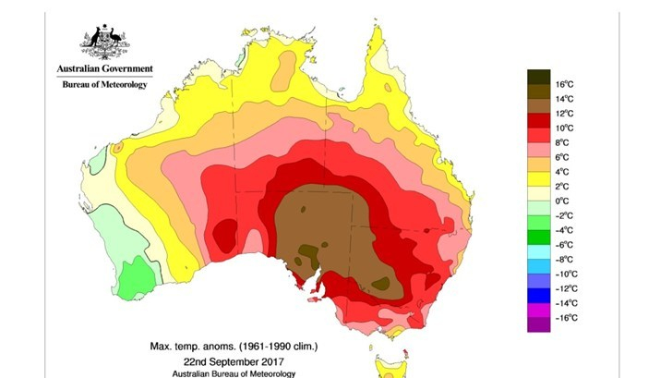
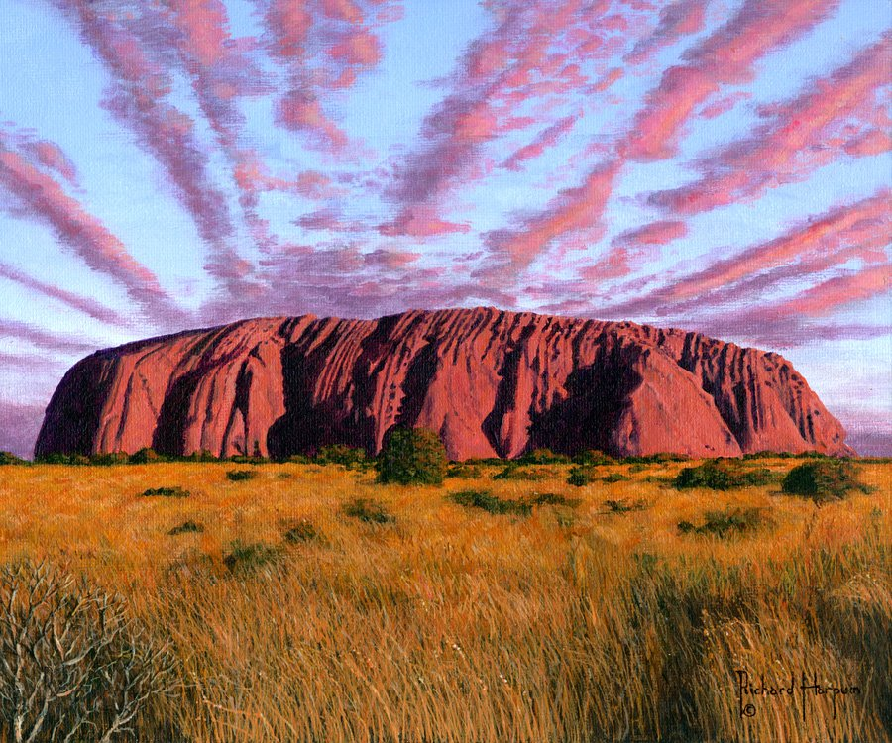
The climate of climate is different from place to place. In general, although there are many rains, dry winds often blows that contribute to the lack of rains for many years .In these times of drought the soils are completely deserted.Australia’s climate is very healthy and does not favour epidemic diseases, such as tuberculosis, but it favours malaria. The country announced in December 2008 that by the year 2020 it will have reduced greenhouse gas emissions by at least 5% compared to 2000 levels.

Slide 6
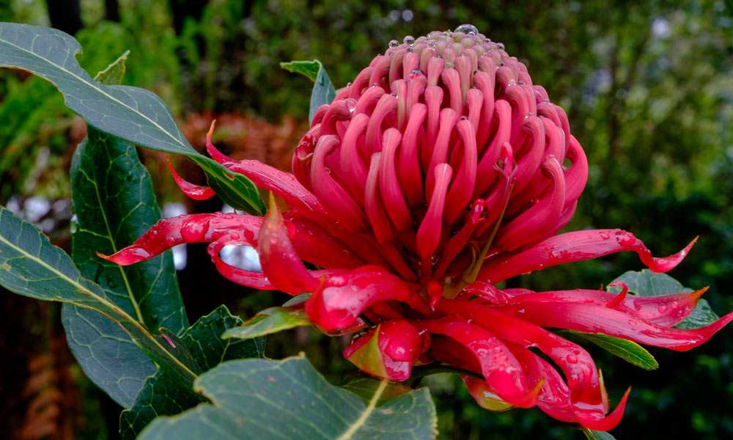
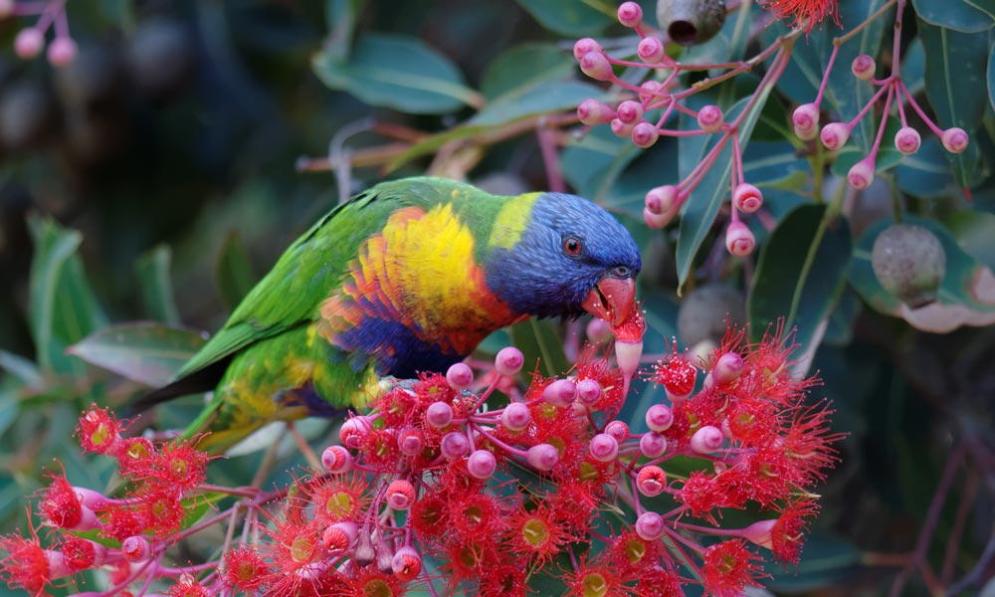
Also, Australia has the greatest diversity of reptiles of any countries,with 755 species . Vegetation, as well as plant species , differ depending on climatic conditions. Thus, in the northern part, many species of palm trees and climbing plants planted. In the southwestern part there are many features of the continent plants. In the south-eastern part there is rich vegitation in eucalyptus trees reaching 135 species, melanoleuces, acacias soil, there are only bushy plants. Of the fruit most have brought them from other countries, espadrilles European ones.

Slide 7
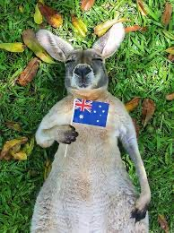
The mammalian animals of Australia are the most marsupials that are divided into 100 species such as the kangaroo and the koala . Some of them are fruit-eaters , others insectivorous and other rodents .But there arealso non-marsupial mammals , such as the dingo dog,21 species of bat,31 species of mice.It is also the only place on Earth where monotremas live,I.e. mammals that lay eggs.Two species are known,the echidna and the platypus.More variety are birds, such as h woodpecker, the finch ,the pheasant, the vulture, the lyre ,manyspecies of parrots.There are many species of snakes and even poisonous as well as lizards On the coast,in the rivers and in the lakes there are crocodiles and sea turtles. Animals that were transported from elsewhere in Australia, such as the rabbit, were enraged there . In Australia the sleep , which today is one of the largest sources of wealth for the country?the wool of its sleep is considered the best in the world and has given enormous enormous economic growth to Britain’s woollen industries

Slide 8
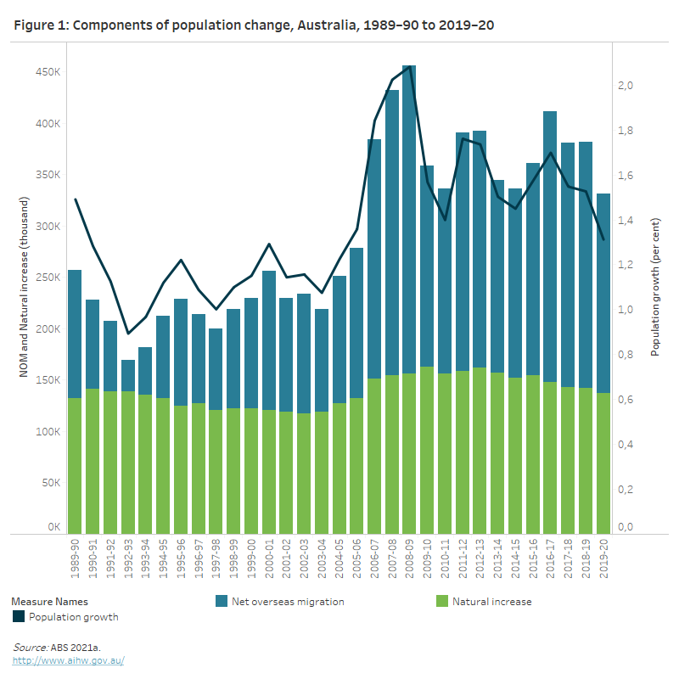
The existence of humans on the Australian continent is estimated to have begun 42.000 to 48.000 years ago, possibly with the migration of people from land bridges and small sea passages from present day Southeast Asia. These first inhabitants may have been the ancestors of modern indigenous Australians. At the time of European colonisation they were hunters and gatherers, with a complex oral tradition and spiritual values based on the worship of the land and the existence of the age of dreams. The Torresislanders, ethnologically Melanesians, were originally hunters gatherers. On the norther coast of Australia sporadic fishermen from the island Southeast Asia arrives sporadically.

Slide 9
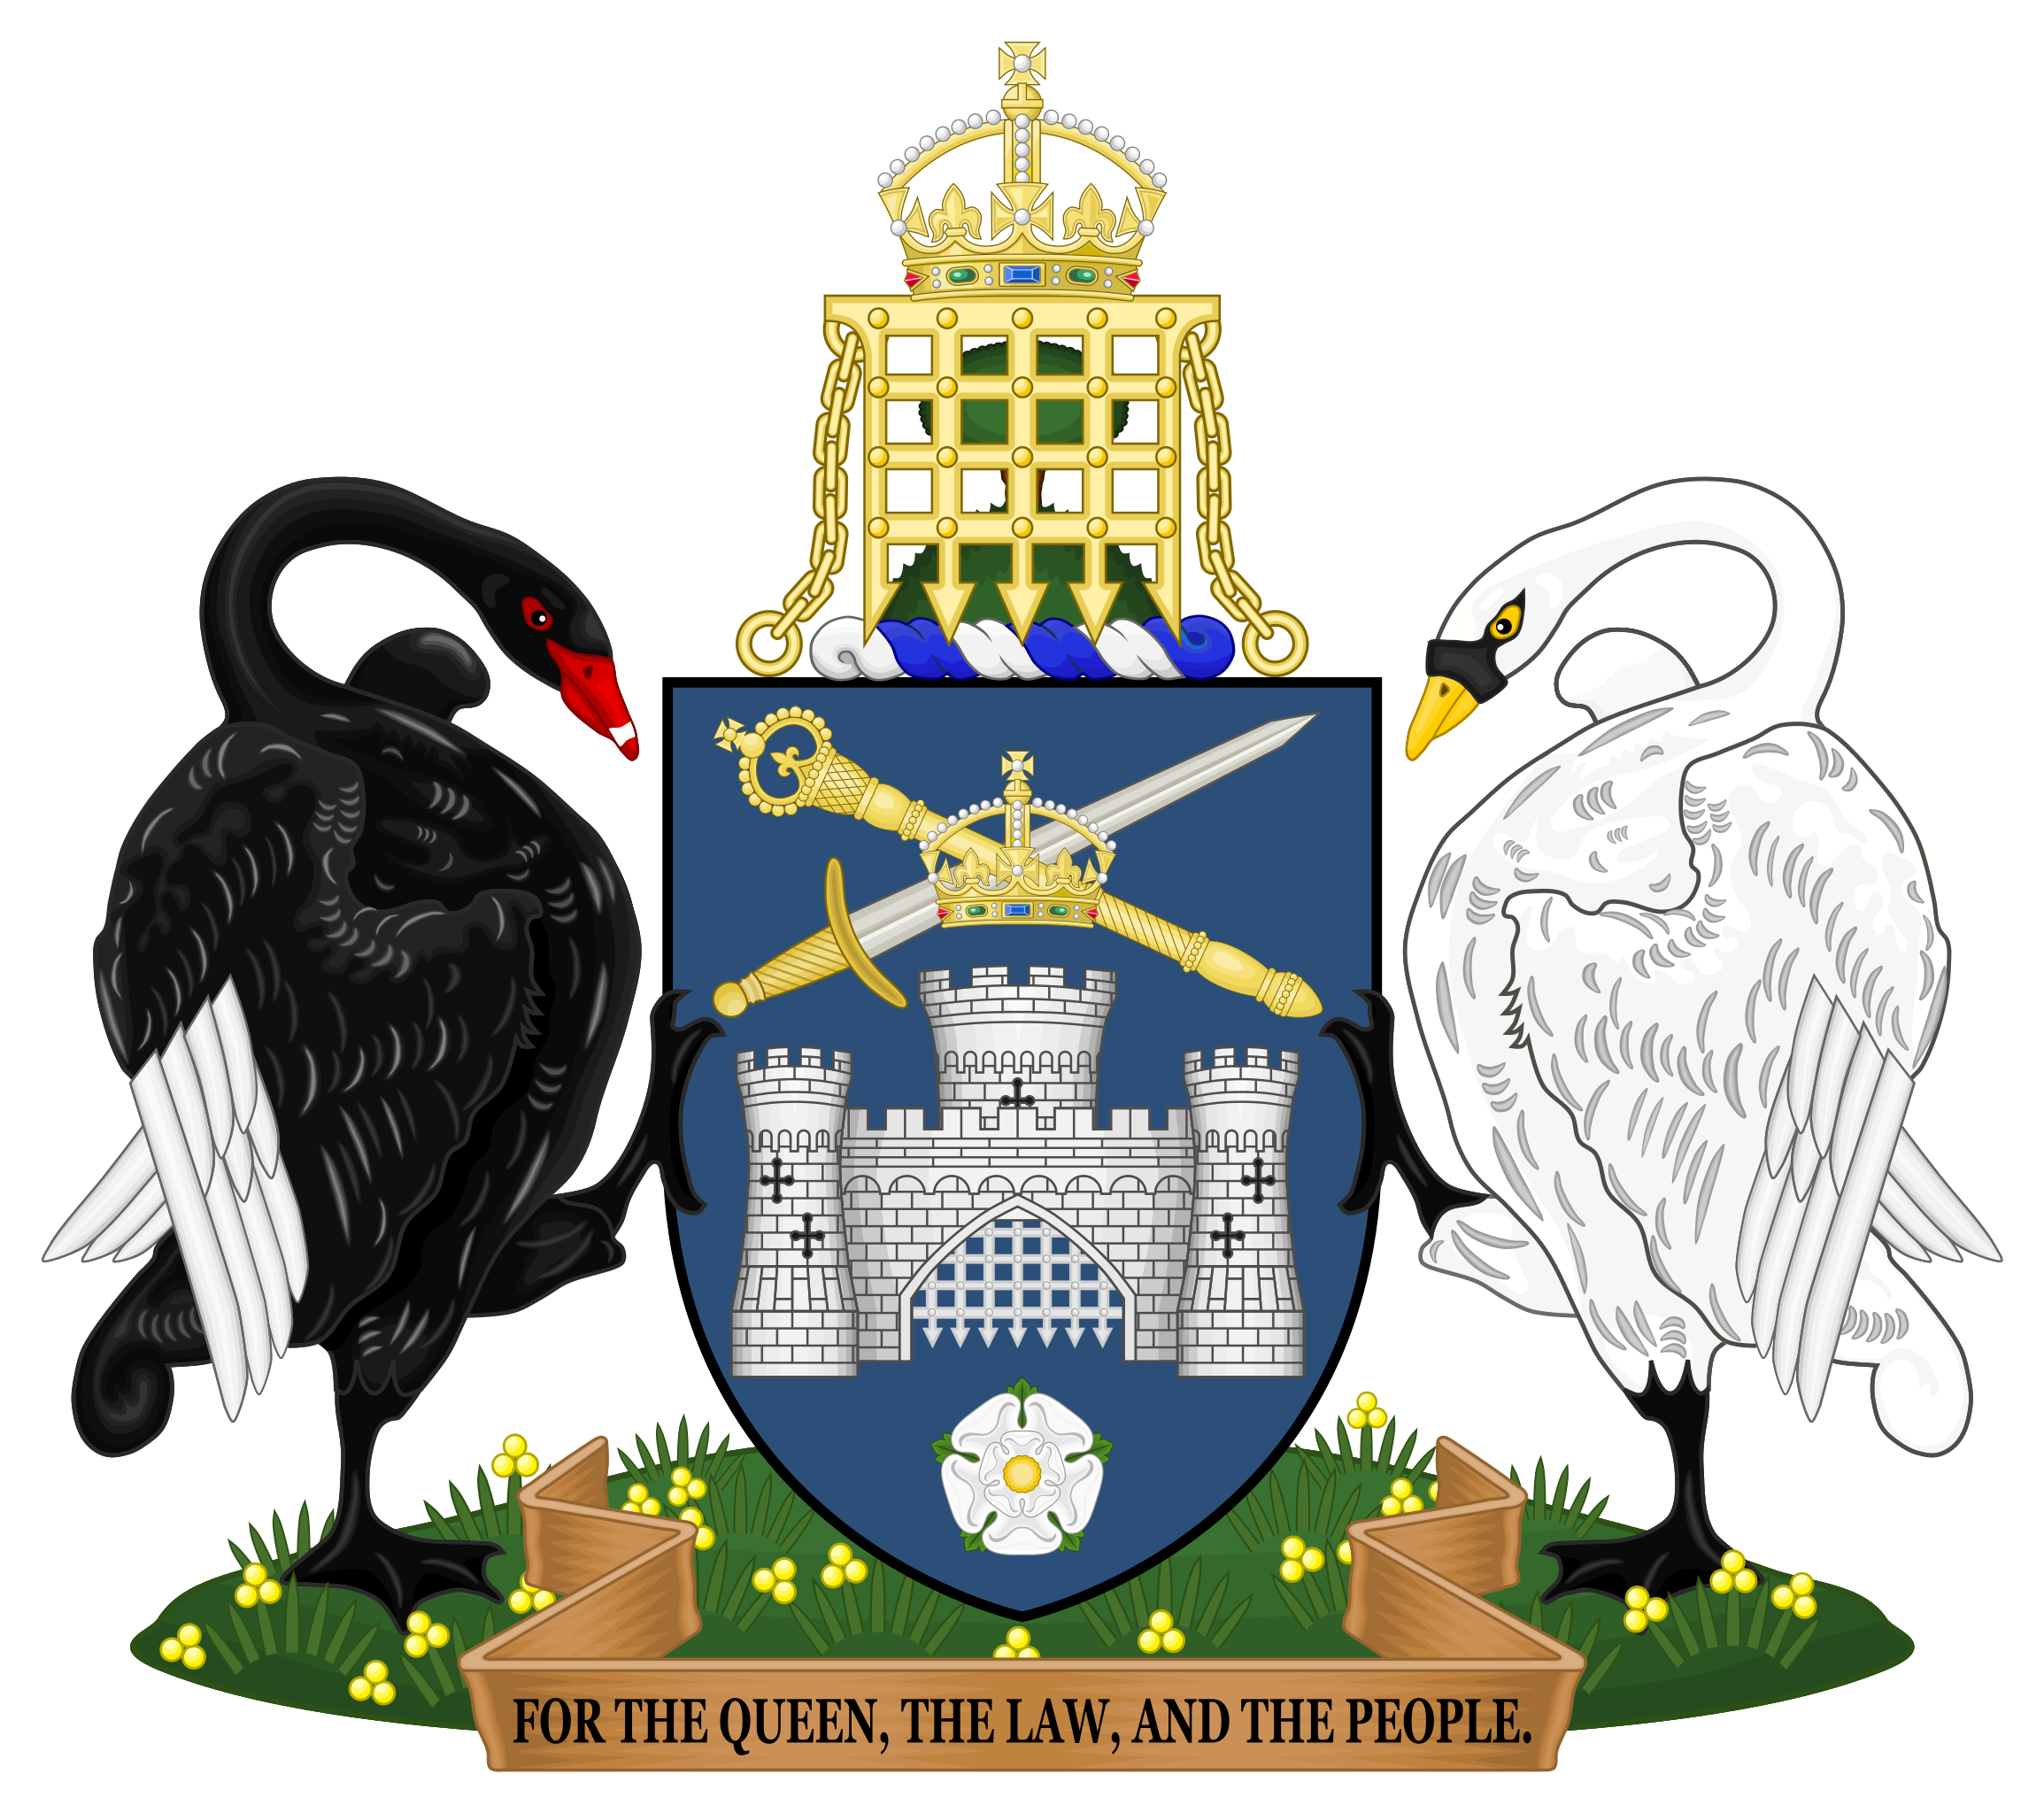
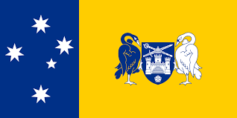
On January 1, 1901,a federation of colonies was formed after a decade of planning consultation and voting. This established the Commonwealth of Australia as an acquisition of the British Empire.The Federal Capital Territory later called the Australian Capital Territory was created in 1911 on the future capital Canberra.Melbourne was the temporary seat of government from 1901 to 1927 while Canberra was being built .In 1914,Australia fought alongside Britain during World War I.. the Australians participated in many of the great battles of the western front. Of the 416.00 soldiers, about 60.000 were killed and 152.00 wounded. Many Australians consider the defeat of Australian and New Zealand troops in the Gallipoli campaign the birth of the nation, its first major military action.

Slide 10
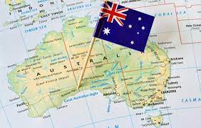
Thank you very much!!!!!
Chara Kogetzidi
Maria Korbaki
Eleni Klamponi
Elina lazari
Andriana Makri
Catherine Mpampali

