Slide 1
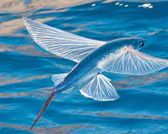
ENDANGERED ANIMALS
THE FLYING FISH

Slide 2
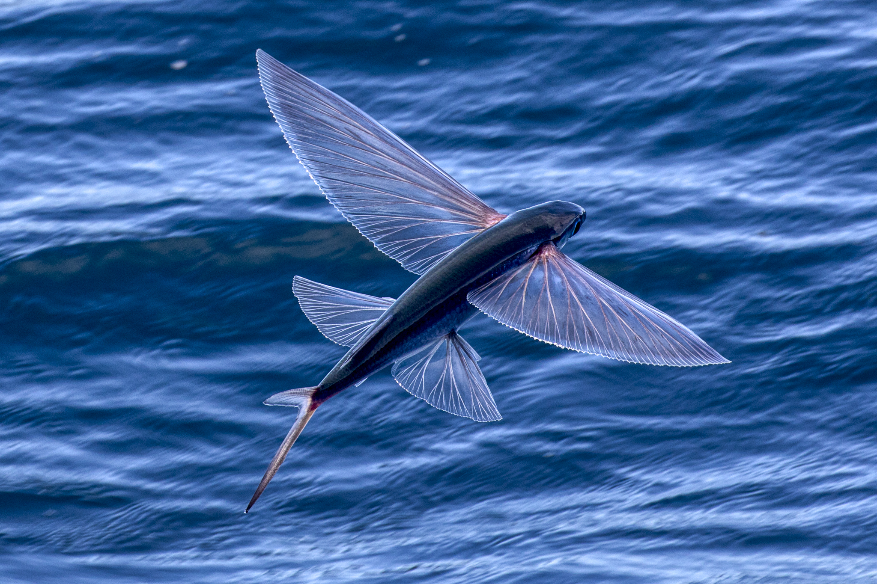
THE FLYING FISH
The flying fish or flying cod or the Exocoetidae are a family of marine fish in the order Beloniformes class Actinopterygii. They often travel in groups of 9. While they cannot fly in the same way a bird does, flying fish can make powerful, self-propelled leaps out of the water where their long wing-like fins enable gliding for considerable distances above the water's surface.

Slide 3
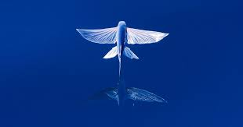
The main reason for this behavior is thought to be to escape from underwater predators, which include swordfish, mackerel, tuna, and marlin, among others, though their periods of flight expose them to attack by avian predators such as frigate birds.
Barbados is known as "the land of the flying fish", and the fish is one of the national symbols of the country. The Exocet missile is named after them, as variants are launched from underwater, and take a low trajectory, skimming the surface, before striking their targets.

Slide 4
One reason that they have gone extinct is because many fishermen search for them is because they cost a lot of money in foreign countries(for example in Great Britain it solds for 400$ or 354 pounds)
And lastly, they are endangered because many predators such as swordfish tune etc.

Slide 5




