Slide 1
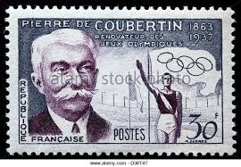
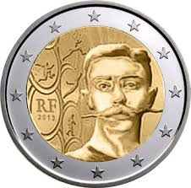
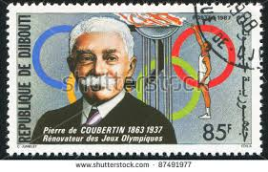
Pierre de Coubertin

Slide 2
Pierre de Coubertin (1 January 1863 – 2 September 1937), born Pierre de Frédy, also known as Baron de Coubertin, was a French educator and historian, and founder of the International Olympic Committee.
He is considered the father of the modern Olympic Games. Born into a French aristocratic family, he became an academic and studied a broad range of topics, most notably education and history.

Slide 3
THE FOUNDER OF THE MODERN OLYMPICS
The ambitious plans of Coubertin to revitalize the educational system of France never really materialized, but his travels began to inspire him with a far more ambitious plan. He began thinking about having countries compete in athletic events based on the Olympic festivals of ancient Greece.
In 1892, at a jubilee of the French Union of Athletic Sports Societies, Coubertin introduced the idea of a modern Olympics. His idea was fairly vague, and it seems that even Coubertin himself did not have a clear idea what form such games would take.
Two years later, Coubertin organized a meeting which brought together 79 delegates from 12 countries to discuss how to revive the Olympic games. The meeting established the first International Olympic Committee, and the basic framework of having the games every four years, with the first to take place in Greece, was decided upon.

Slide 4
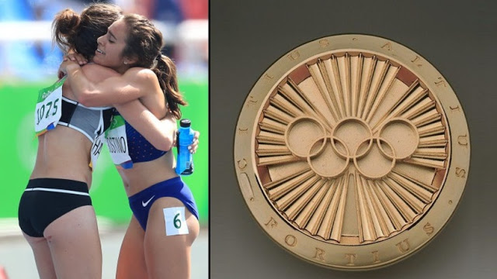
The Pierre de Coubertin medal (also known as the Coubertin medal or the True Spirit of Sportsmanship medal) is an award given by the International Olympic Committee to athletes that demonstrate the spirit of sportsmanship in the Olympic Games.

Slide 5
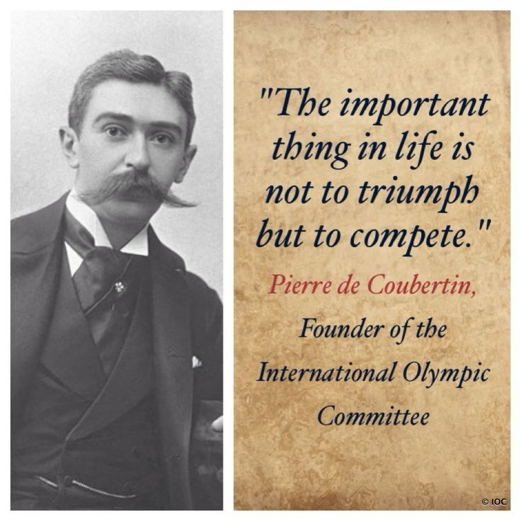
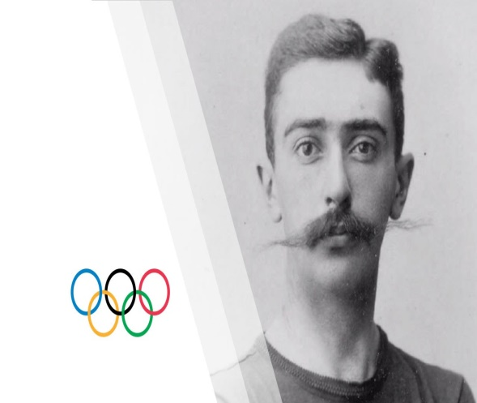
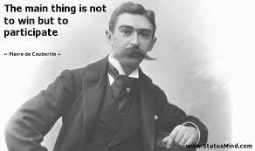

Slide 6
sources
https://www.thoughtco.com/modern-olympics-founder-pierre-de-coubertin-1773993
https://en.wikipedia.org/wiki/Pierre_de_Coubertin

