Slide 1

SOCIAL INTERPRISE
DESIRE PROJECT
March 2022

Slide 2
Social Interprise
Social responsibility: Environmental & social issues will be taken into account in all our actions
Social inequality: Everyone has unequal access to products & different human rights
Social needs: Solve the social problems
Social impact: Change of aspects, relationships & social conscience

Slide 3

Social Problems in Greece
During the last decade, Greece has been
suffered from various social issues:
Economical crisis
Refugees
Ecological & environmental issues
COVID-19

Slide 4


Our vision
Strengthen the action of non- govermental organisation named “Kivotos”
Protection of the stray animals
Support the action of non- govermental organisation named “Iliaktida”
Prevent immigrants and children with special needs from being excluded from society

Slide 5
Our actions
Re-usable / recycled items
Recyclable glass jars
Wooden musical instruments
Bracelets and necklaces from stone and shells
Recyclable metal robots
Hagiographies made of stones and legumes
Wooden decorative items with wood that students collected from beaches
Our students will sale their handmade products and toys in Christmas & Easter bazaars

Slide 6
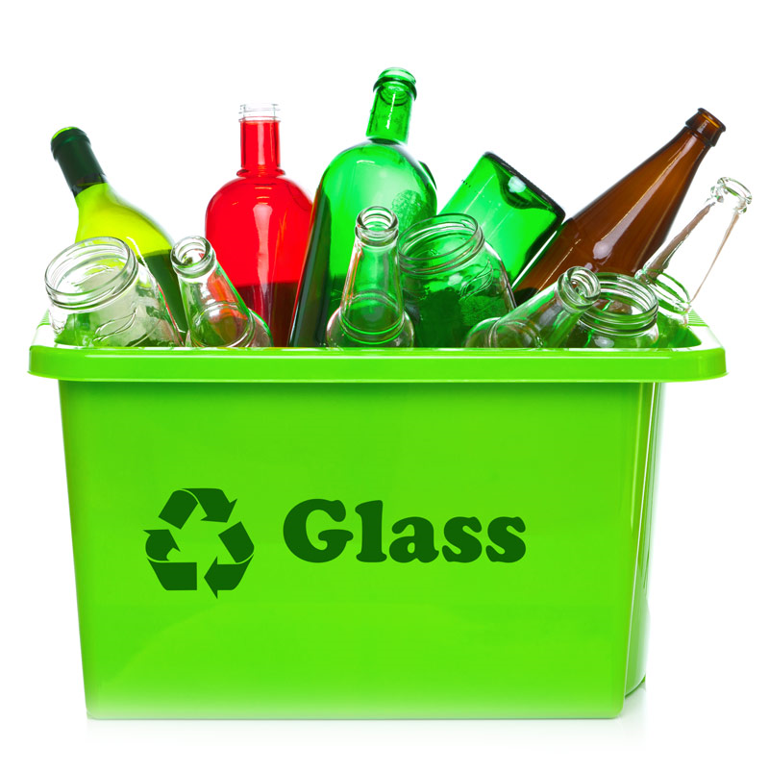

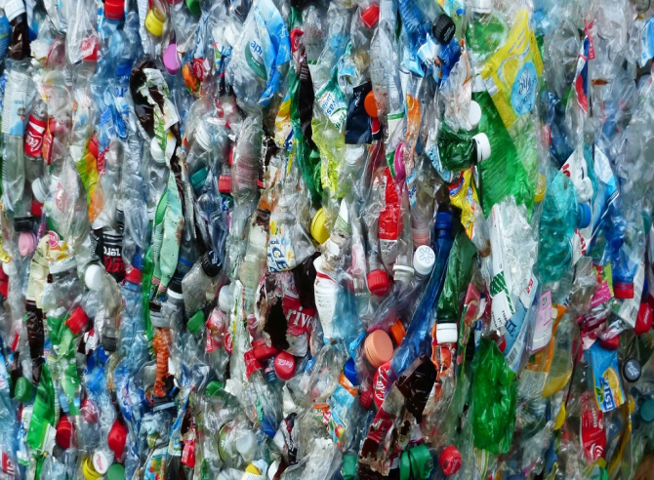
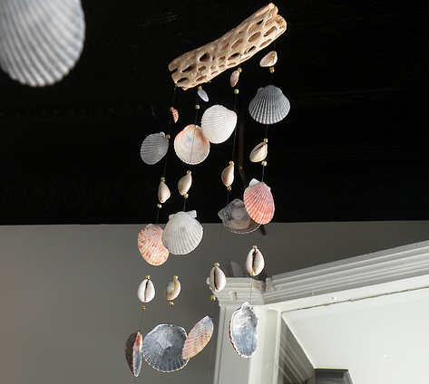
Material
Wood
Glass
Stone
Shell

Slide 7
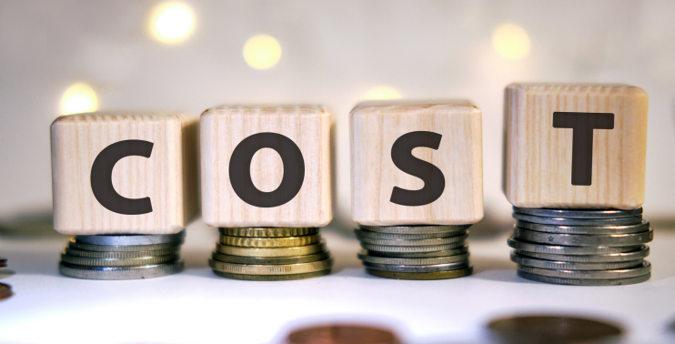
Cost Planning
Our students will use recycled and reusable material
The aim is to reduce the cost of new creations and products at minimum
Another target is to raise students’ awareness on environmental issues
As the result of all the above, this is expected to be a low-cost budget procedure

Slide 8

Co operations
Below you can find members and organisations that are expected to work with us in the implementation of DESIRE project:
Department of Environment- University of the Aegean
Council of Parents and Guardians
Teachers
Local newspaper

Slide 9

Points of Sales & Consumers
Our school will organize Christmas & Easter Bazaars, where students can sell their products
Parents & Guardians will buy students’ creations
Citizens of Mytilene area can also purchase products

Slide 10

Profits
All the incomes from the sales are going to be donated in
two non- govermental organisations:
“Kivotos” for the protection of stray animals
“Iliaktida” for the support and inclusion of immigrants and children with special needs

Slide 11
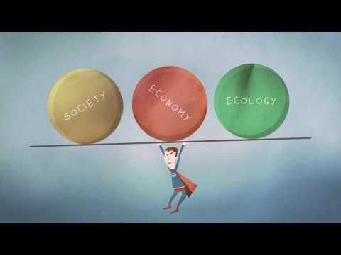
Social benefits
The whole project is expected to raise students’
awareness and leads in changes regarding:
Environmental issues (recycling, protection, eliminate waste)
Social impact (in all fields of human’s life, interpersonal, interaction)
Change of the attitude, lifestyle change

Slide 12
The main target for our society is to value people above the profits
Primary School Vareia- Mytilene

