Slide 1
What can an animal do?

Slide 2
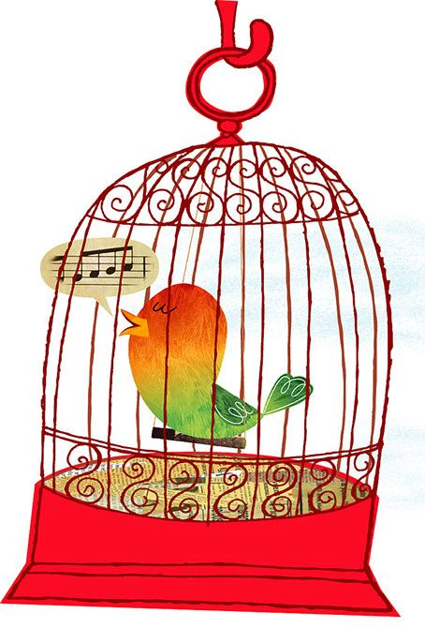
A bird sings in a cage

Slide 3
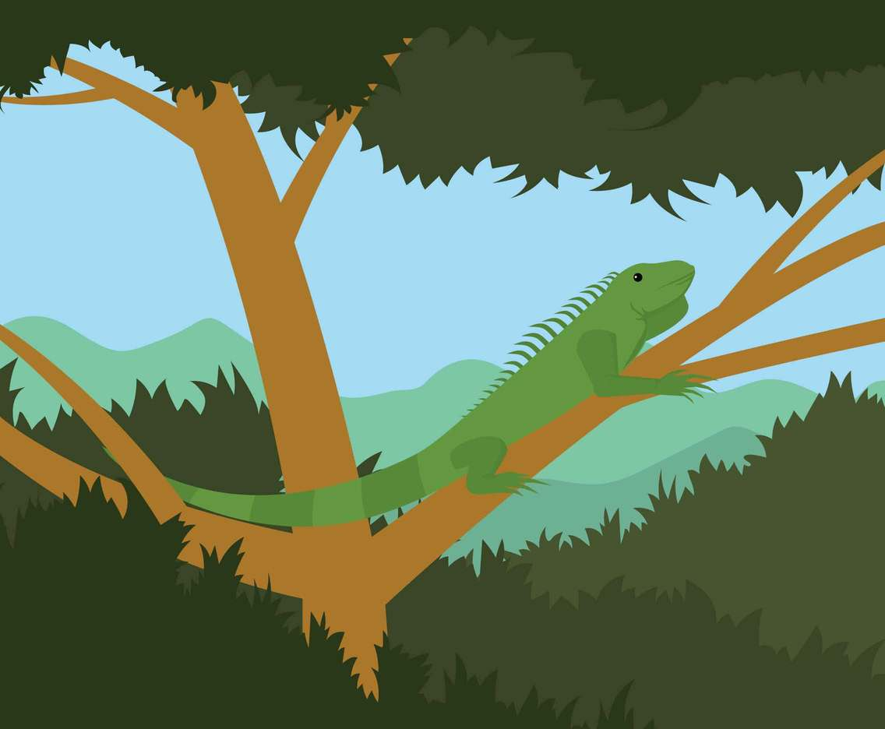
An iguana climbs trees

Slide 4
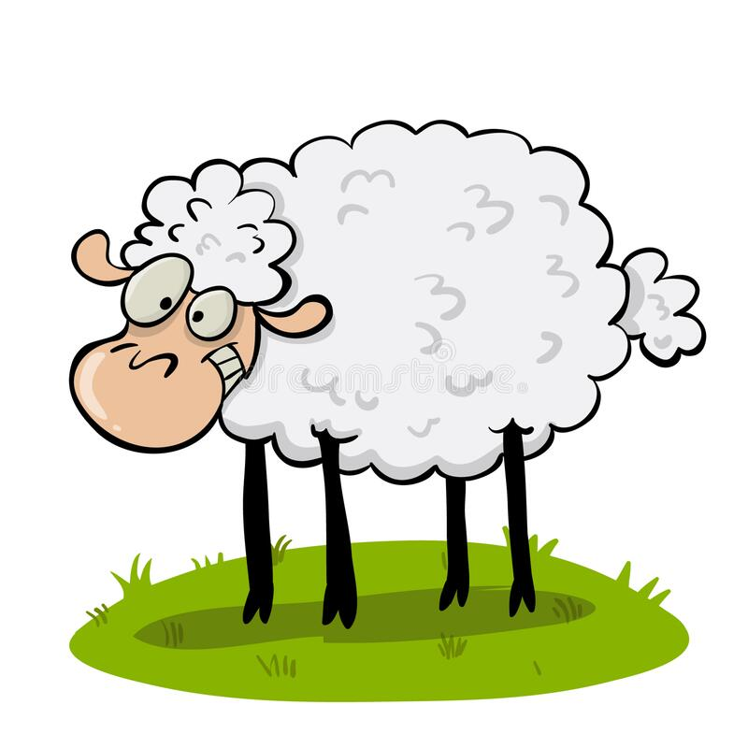
A sheep eats grass

Slide 5
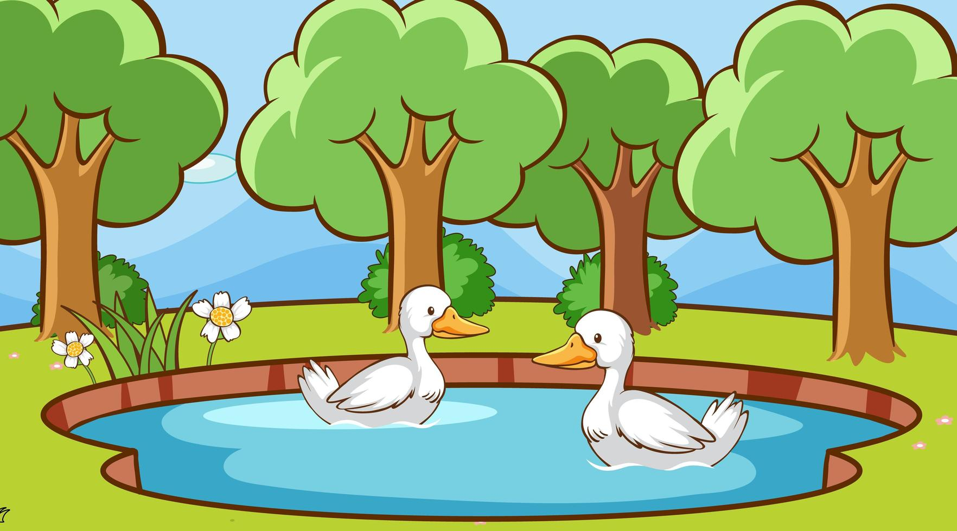
A duck swims in a pond

Slide 6
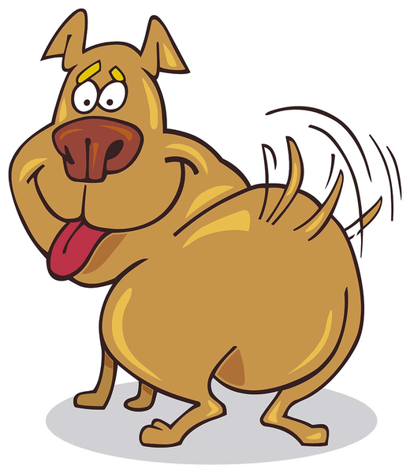
A dog wiggles his tail

Slide 7
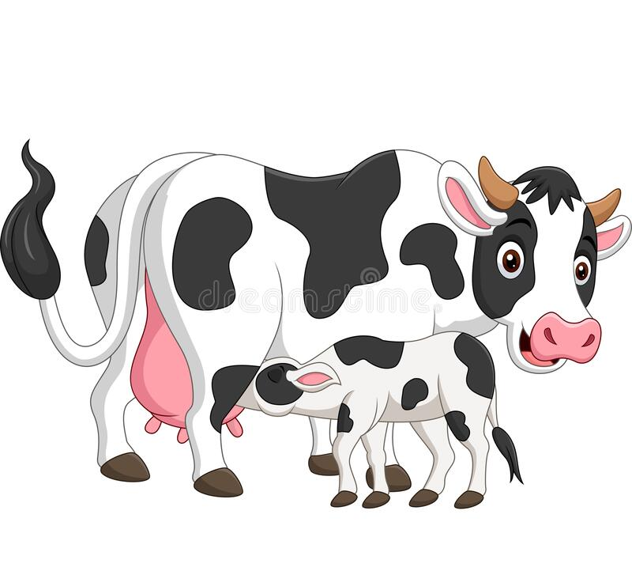
A cow makes milk

Slide 8
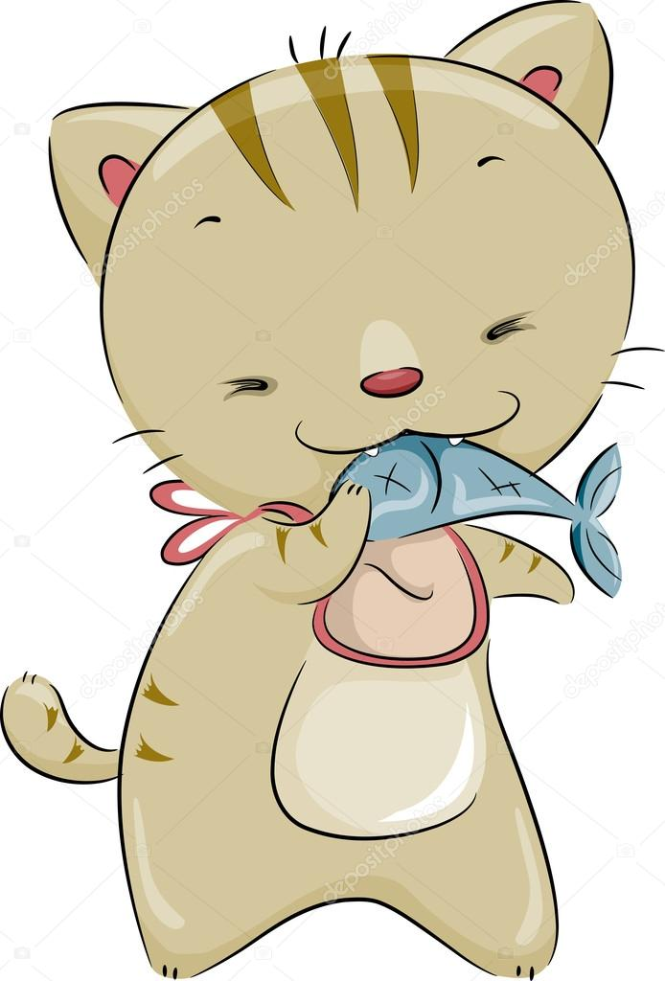
A cat likes fish

Slide 9
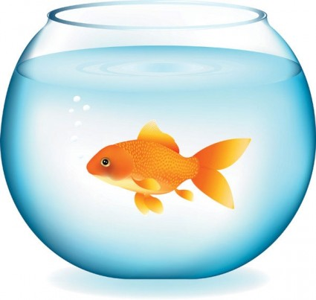
A goldfish swims in a bowl

Slide 10
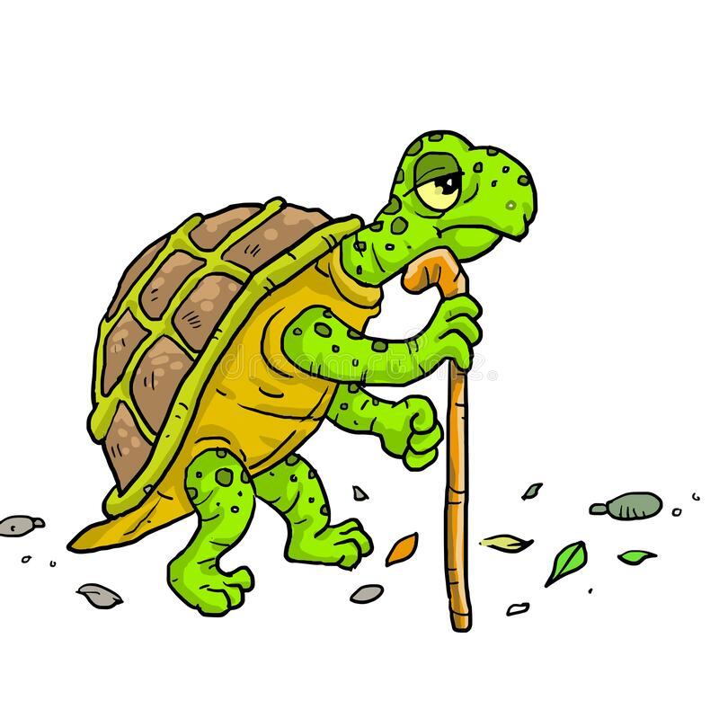
A tortoise walks slowly

