Slide 1
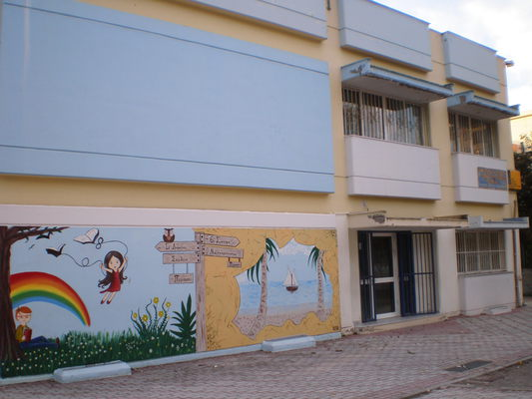
Our school
This is our school. It is in the eastern suburbs of the city of Thessaloniki , in Northern Greece.
Our school has got thirteen classrooms, a computer lab, a library, a music room, assembly hall, a dining room, a basketball court, a volleyball court, a football field, a big playground, a head teacher’s office, a teacher’s office and a sick room.

Slide 2
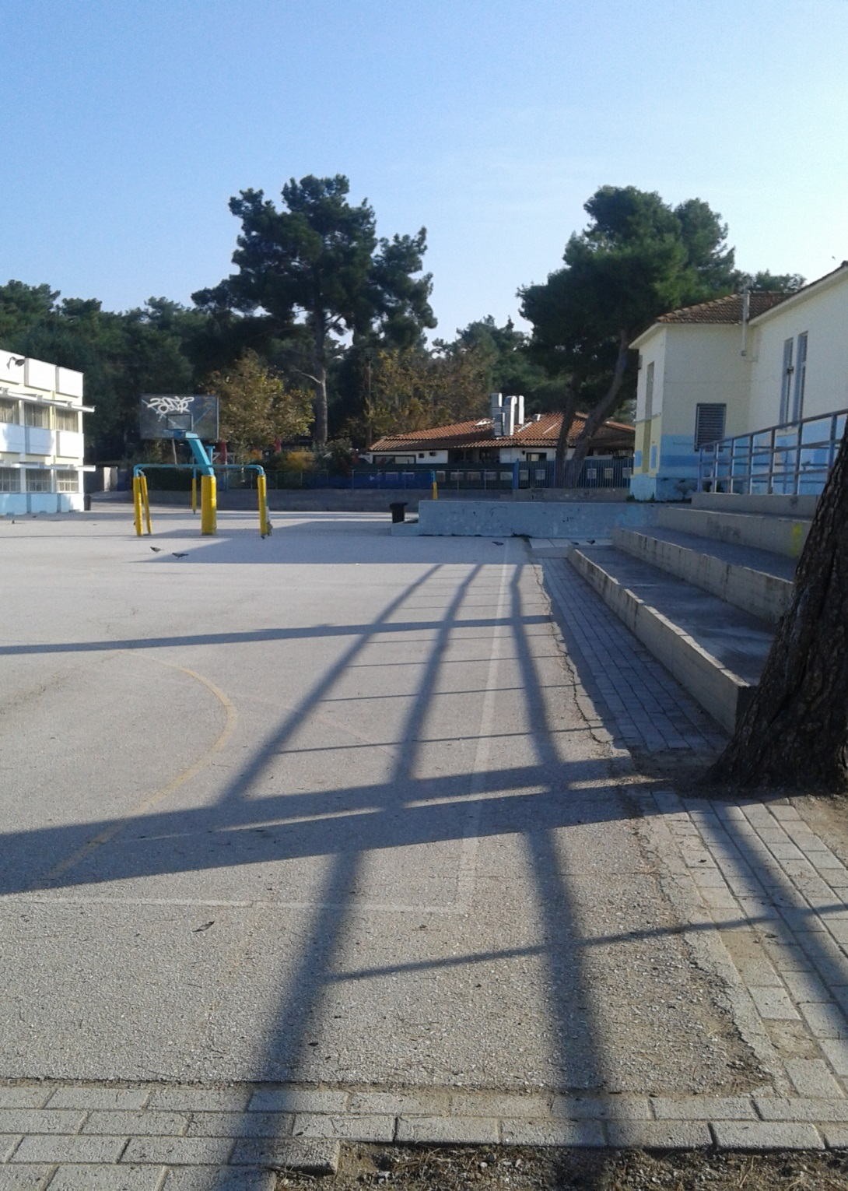
The playground
This is our playground. Our playground is big and it has got a lot of trees. It has many different courts . It has a basketball court, a volleyball court and a football field.

Slide 3
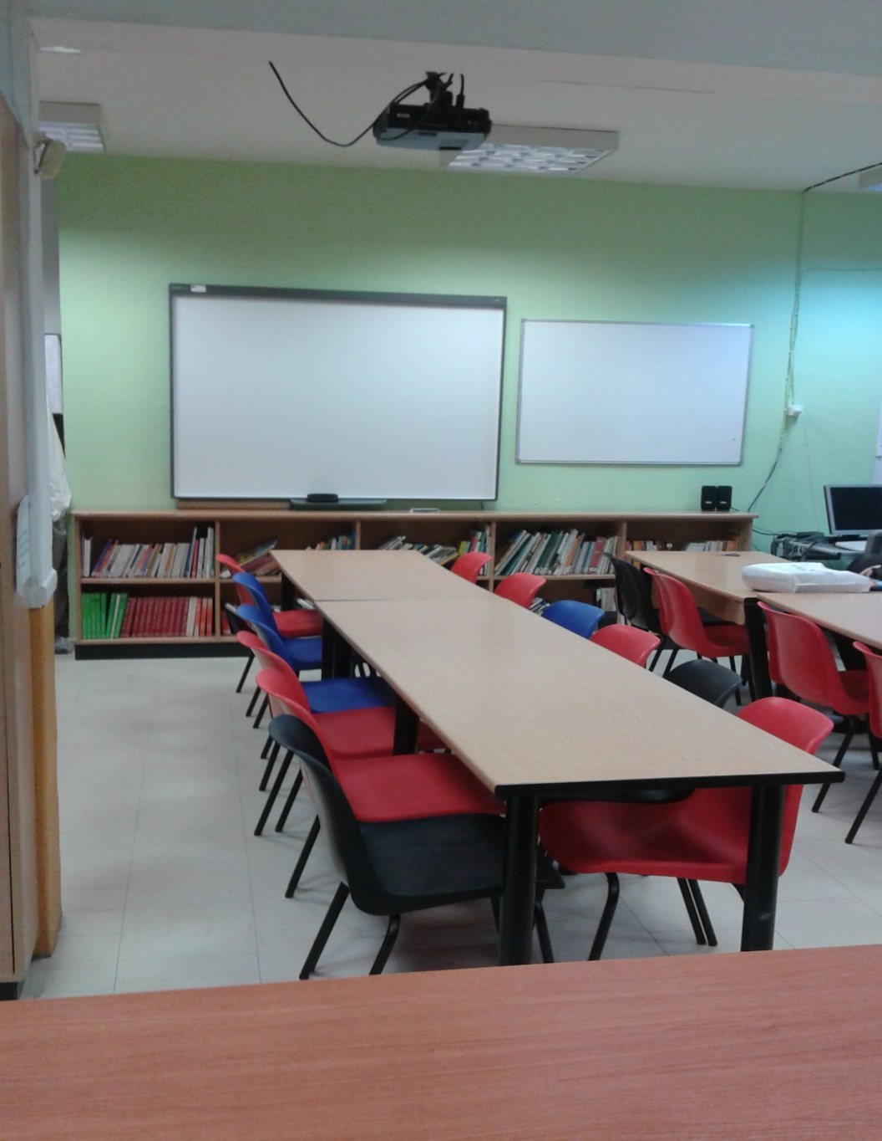
The library and study hall
The study hall is a place where we have lots of books and board games like chess, scrabble etc. We have a projector so we can watch videos for our lessons.

Slide 4
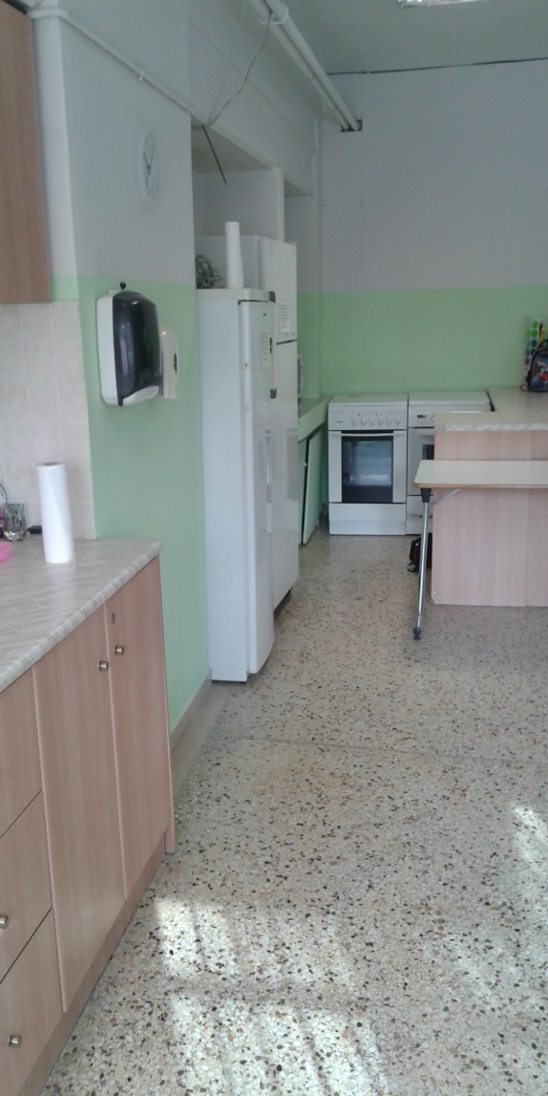
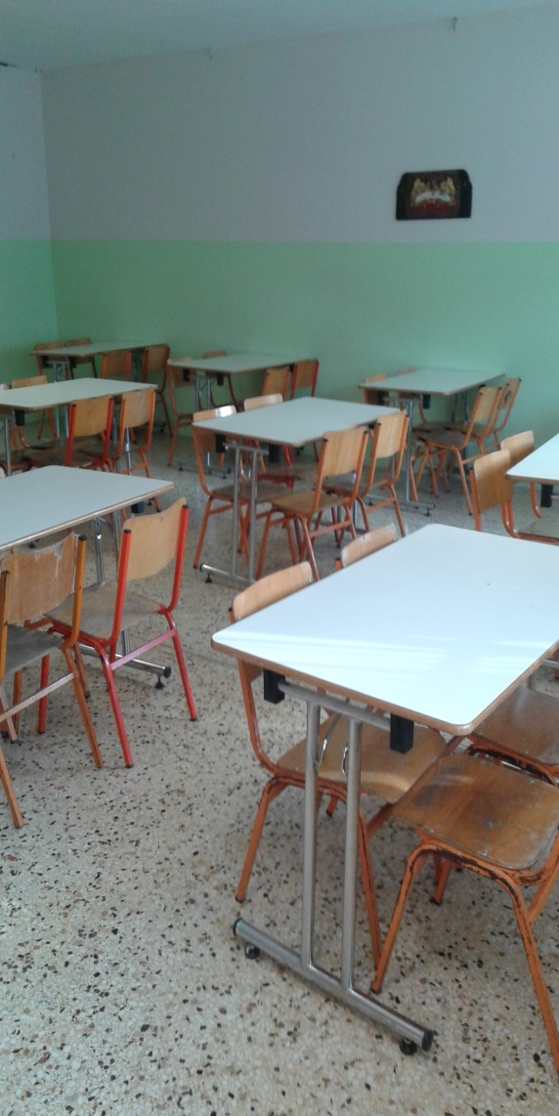
The dining room and kitchen
This is the dining room. Here we eat lunch after the morning classes of school. We chat with our friends, we tell funny jokes and we can play : YES or NO.
Only the students which attend the “All day school” have their lunch here.
The kitchen has a fridge, two ovens etc. Here, the Cook gives as our lunch and she is very good.

Slide 5
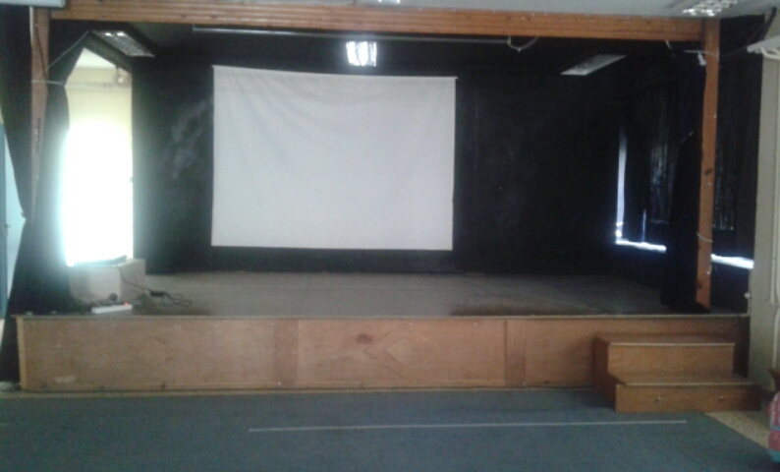
The theatre
This is the theatre which is also the Assembly Hall. Here, we stage plays on special days e.g. Christmas. We wear funny costumes and we learn our lines.
We also dance traditional dances. We learn dances when we have Physical Education.
Sometimes, we watch movies. Generally, we spend a lot of time in here

Slide 6
Our classroom 6th Class (1)
This is our classroom. In here, we study the Greek language, Maths, Music, German, French, Art, Physical Education, Religion, Geography, History and English.
We have a lot of fun with our teachers and they are good to us. We haven’t got too much homework. So, we have a lot of free time.
We also play games in the class when we finish our lessons early.

Slide 7
Our classroom 6th Class (2)
This is our classroom. It has got 14 desks, 1 teacher’s desk and a bookcase. We also have drawings on the walls and a beautiful small tree. We have a computer, too!

Slide 8
Flowers fade but friends are forever!

Slide 9
We love e-Twinning!
We love e-Twinning, because we can take part in projects with other schools and that is exciting. Now, our class is writing about our school and it is sharing this information with other schools of all over Europe.

