Slide 1
E-twinning
My school

Slide 2
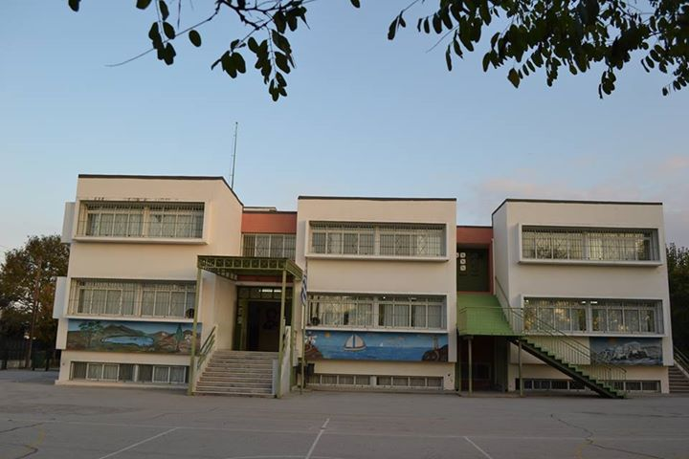
My school is on Georgikis Scholis’ street. It’s near the green lights neighborhood

Slide 3
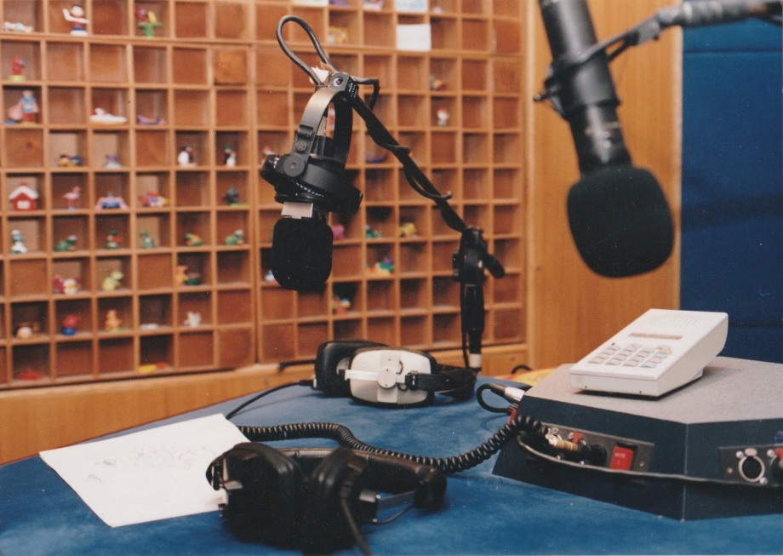
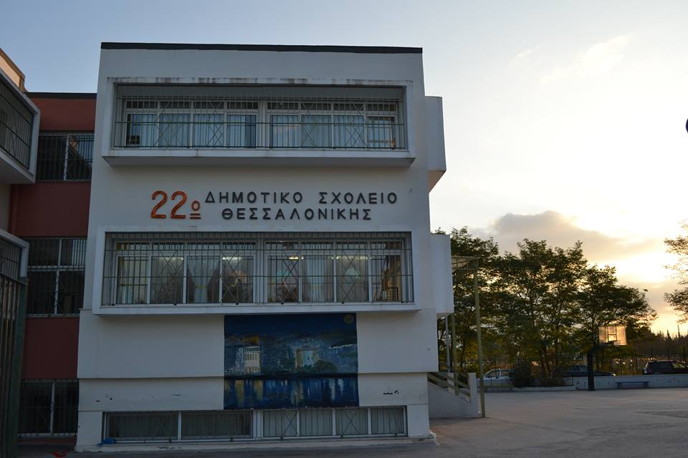
My school used to be a TV channel (ERT’s) studio.
But now it is the best school!!!

Slide 4
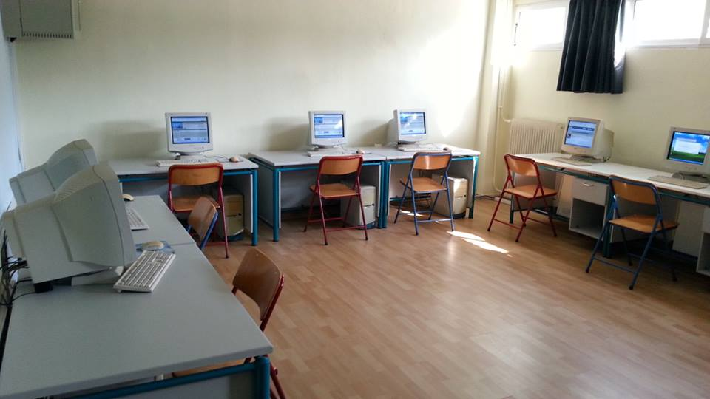
In my school, we have 13 classrooms. On the first floor we have the headmistress’ office, the teachers’ office, the toilets, the library and four classrooms. On the second floor we have toilets and five classrooms. And in the basement, we have the little theater, the computer room and three classrooms.

Slide 5
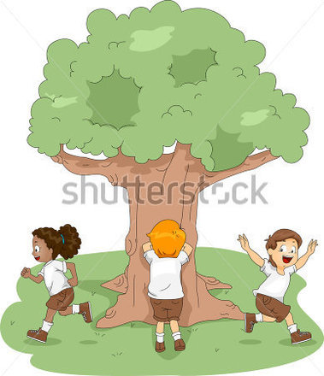
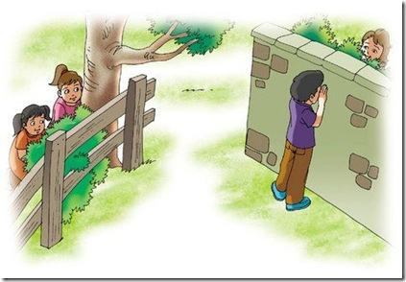
In my school we play a lot of games.(during the breaks)

Slide 6
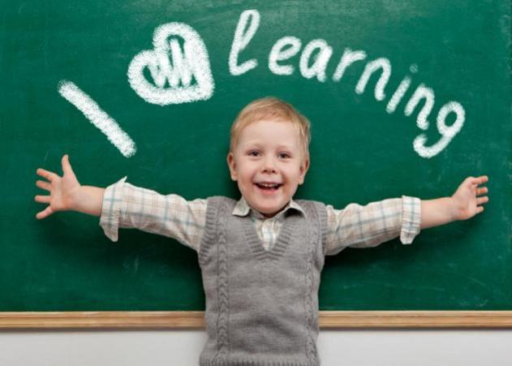
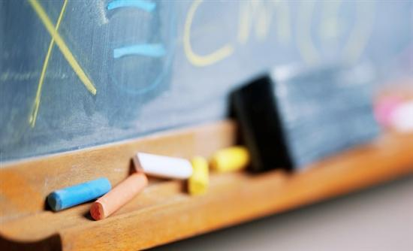
But we also study a lot!

Slide 7
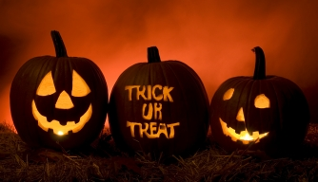
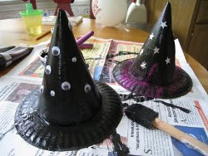
On Halloween we make pumpkins and we do lots of constructions. (This isn’t a Greek tradition but we like it!)

Slide 8
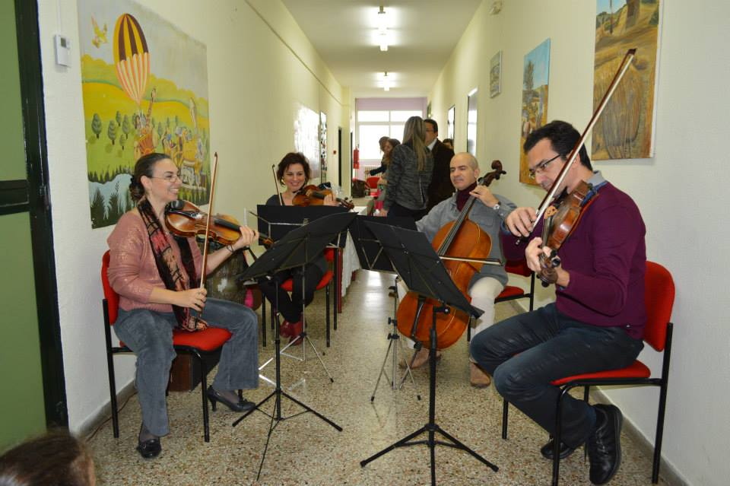
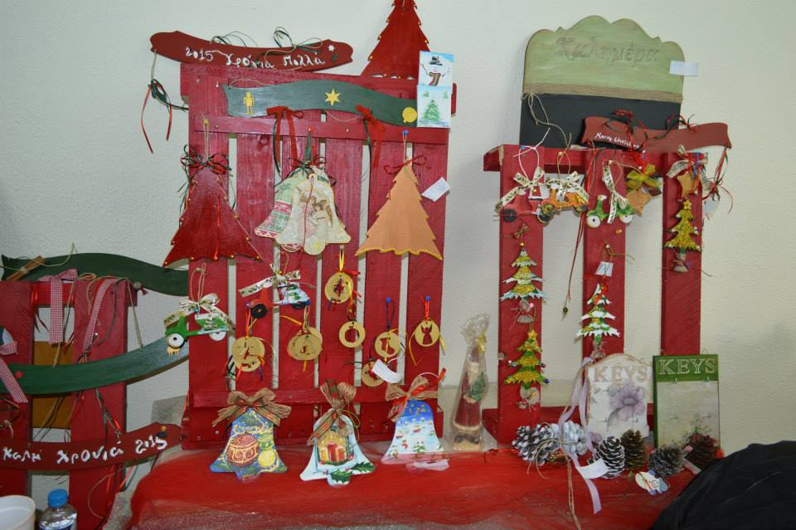
At Christmas we put on a little theatrical play and make amazing drawings. Also, in every class we decorate the Christmas tree. Some of our teachers are musicians, too, so they go to every class and sing a Christmas carol!

Slide 9
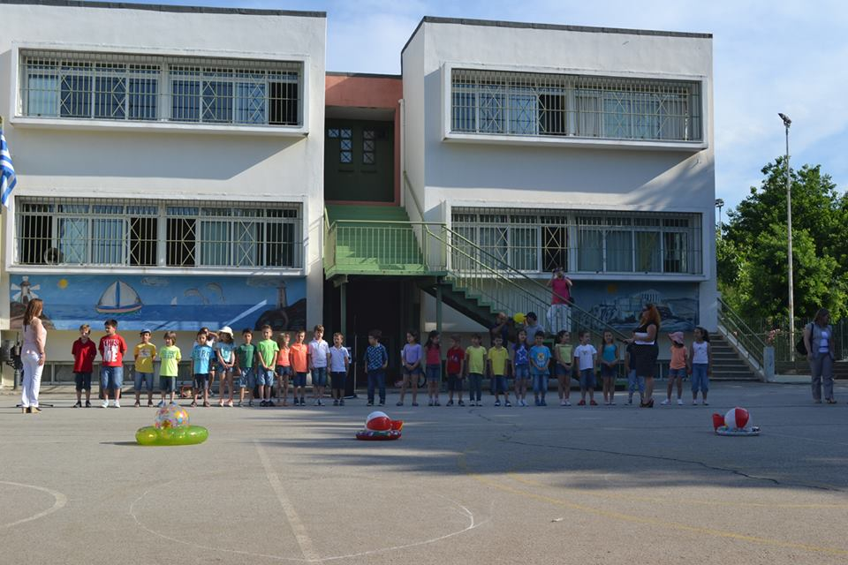
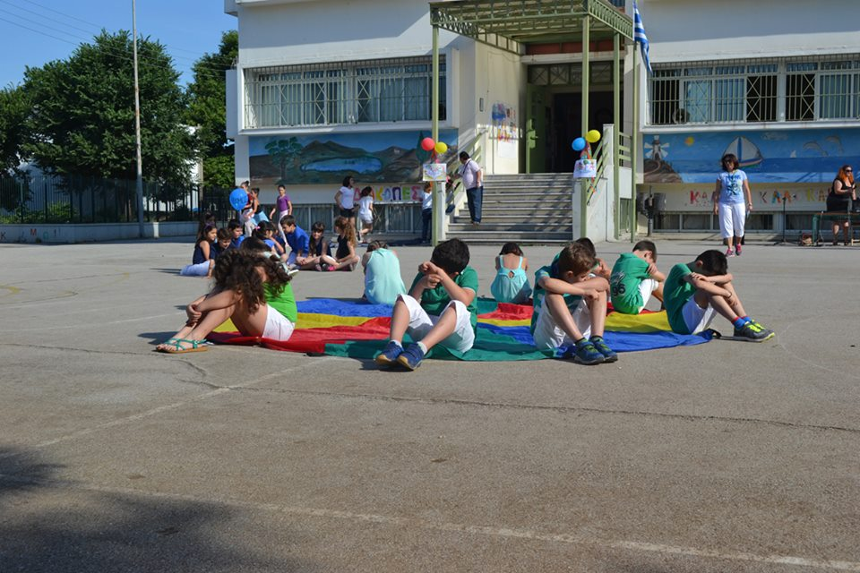
In the summer we rehearse lots of traditional games and traditional dances and then we show them to our parents

Slide 10

I think my school is the best! We have the best teachers, the best schoolyard and most importantly, we have the best kids!!!!

Slide 11
Thank you for watching!!!!!

