Slide 1
MY COUNTRY

Slide 2
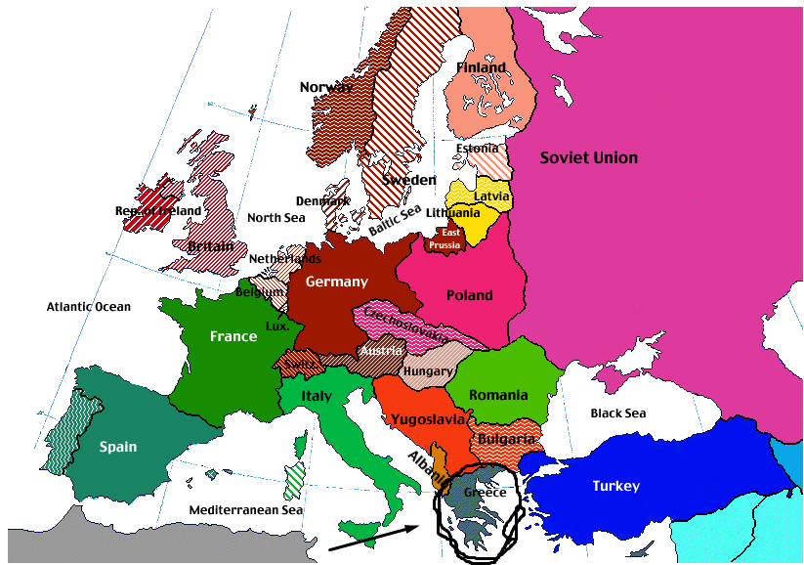
Global Map

Slide 3

GREECE

Slide 4
People visit Greece to learn about our Ancient History

Slide 5
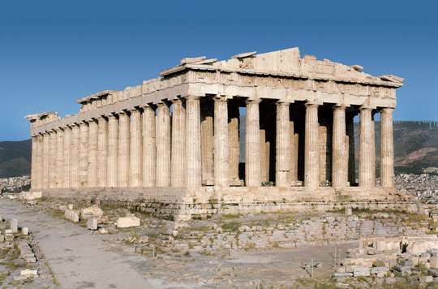
This is acropolis- Parthenon in Athens (Capital of Greece)

Slide 6
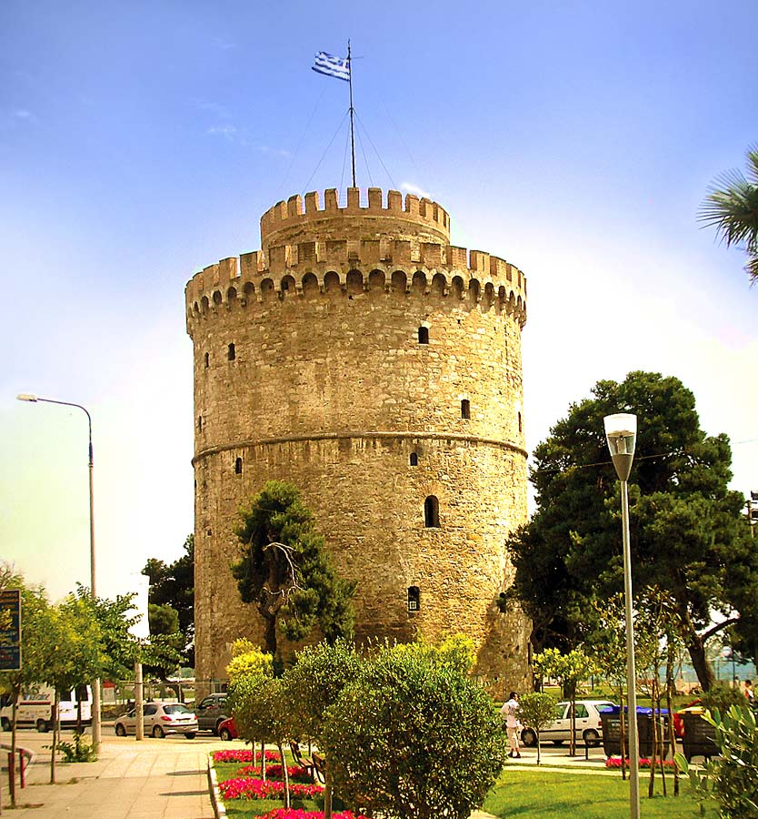
White Tower

Slide 7
Tourists also visit my country to enjoy and swim in the beautiful beaches

Slide 8
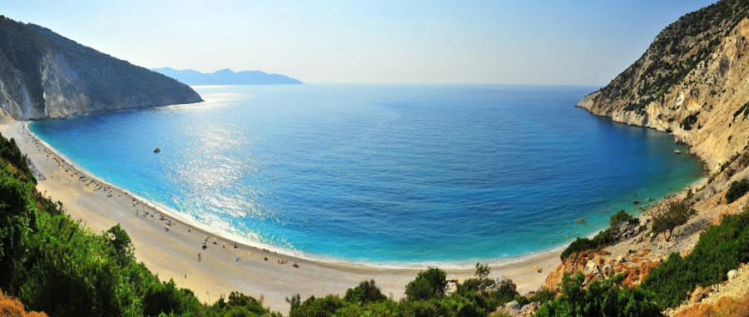
This is one of the most beautiful beaches of My Country (Myrtos-Kefalonia)

Slide 9
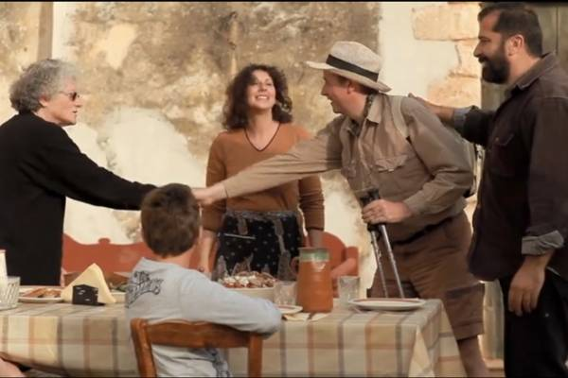
Greek people are globally known for their hospitality!!!

Slide 10
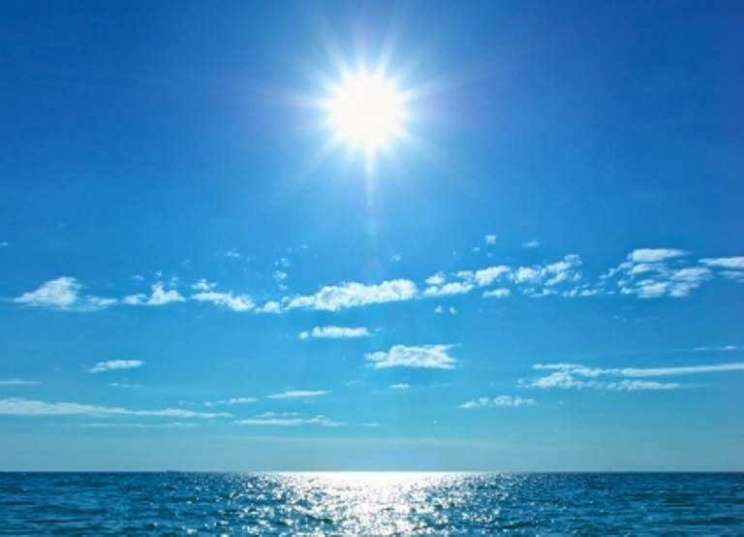
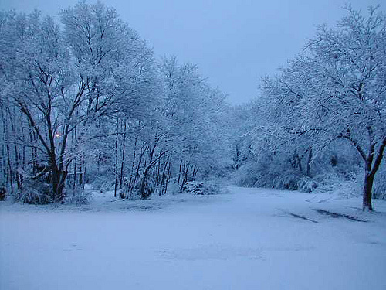
In the Summer the weather is very sunny but in Winter the weather is very windy.
SUMMER
WINTER

Slide 11
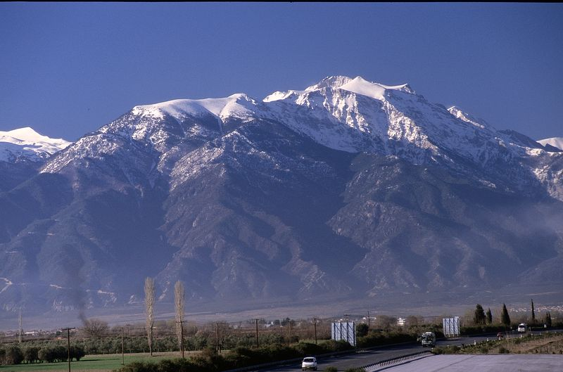
This is Olympus the largest mountain in Greece

Slide 12
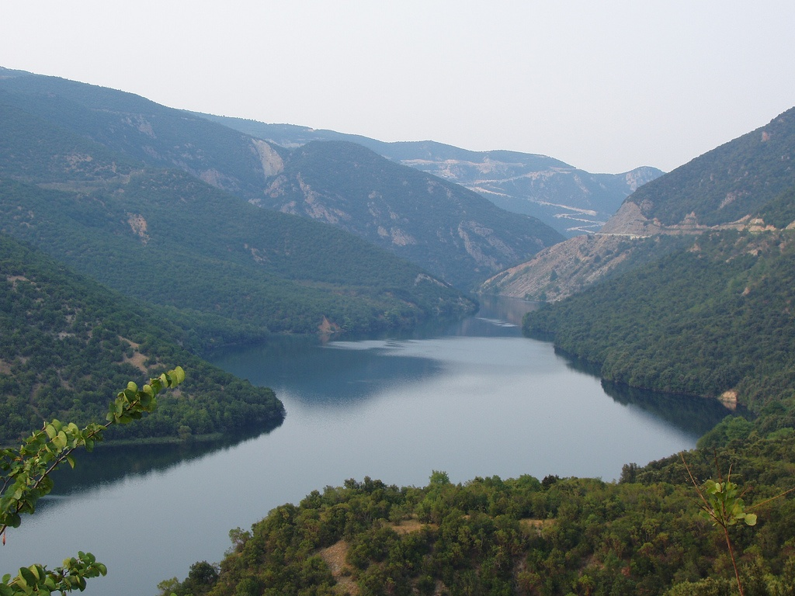
This is Aliakmonas the largest river in Greece

Slide 13
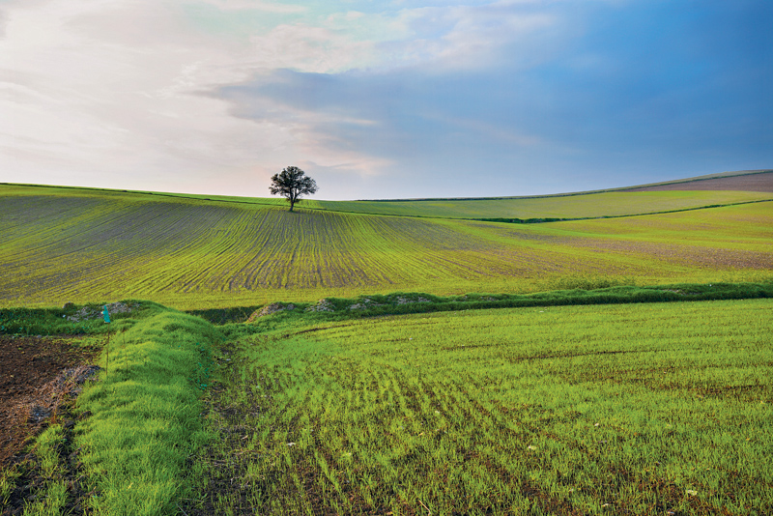
Greece has got very big plain

Slide 14
THANKS FOR WATCHING
By Chris Lappas

