Slide 1
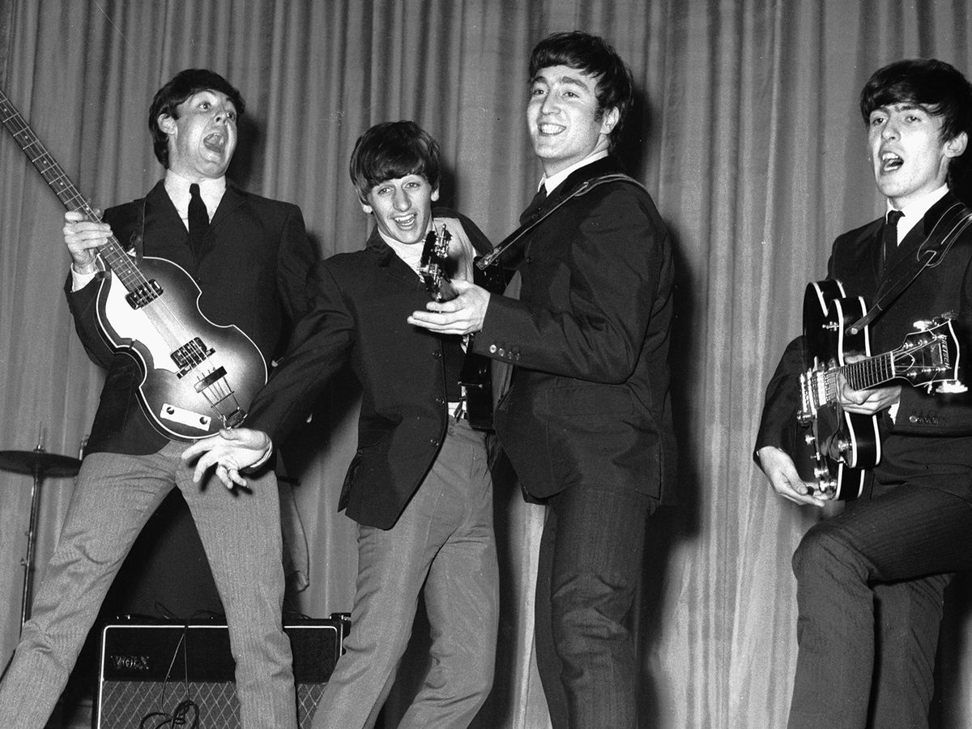
The 60’s
At the beginning of the 1960s, pop and rock 'n roll trends from the 1950s continued before developing into a more electric style. By the end of the decade, a folk-influenced style of rock music dominated the scene, featuring singer-songwriters such as Bob Dylan, Willie Nelson and Joni Mitchell.

Slide 2
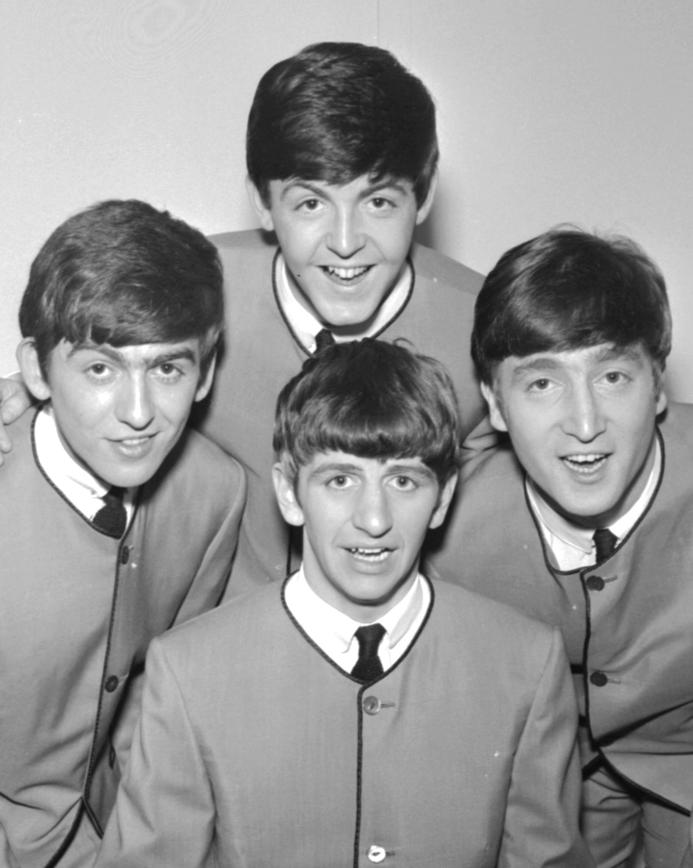
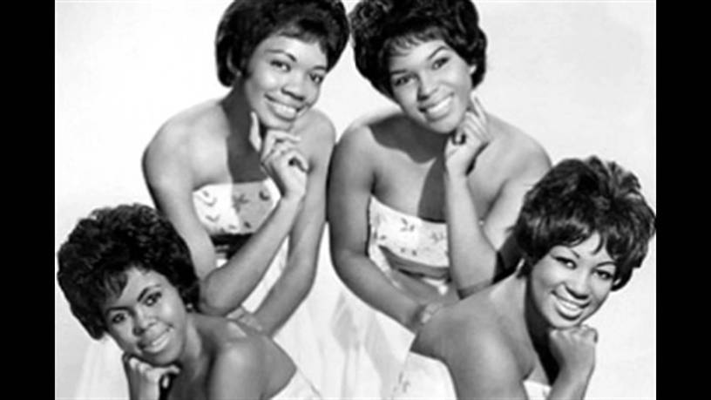
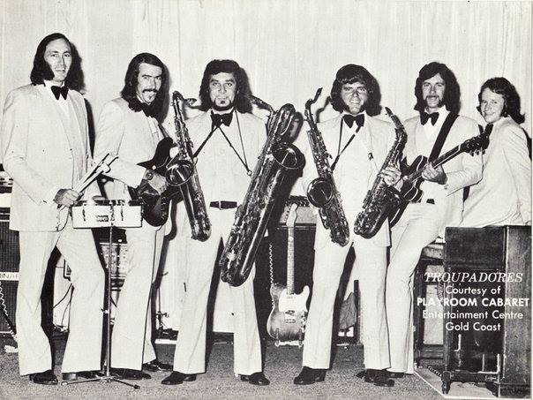
The bands of 60’s
Many bands created at the decade of 60’s, but The Beatles led the British Invasion in the '60s to become the most influential rock group of the '60s.

Slide 3
How was the life?
How was life in the 1960s? Life in the 1960s involved protests to fight for social reform and equal rights. Young Americans spoke out against racial disparities and the lack of women's rights. The 1960s was also a time of peace, love, and rock and roll as pop culture trends moved to vibrant colors and styles.

Slide 4
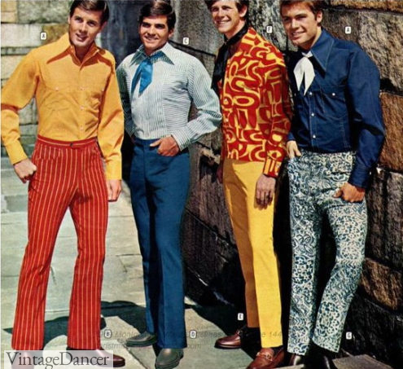
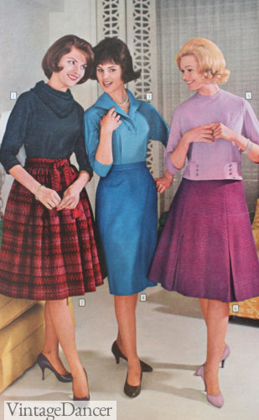
What about the clothes?
Ponchos, moccasins, love beads, peace signs, medallion necklaces, chain belts, polka dot-printed fabrics, and long, puffed "bubble" sleeves were popular fashions in the late 1960s. Both men and women wore frayed bell-bottomed jeans, tie-dyed shirts, work shirts, Jesus sandals, and headbands.

Slide 6
We are…
Maria
Alkis
Max

