Slide 1
THE 60’s
The 60’s where the decade that people were partying a lot,
Lets see!!!
\

Slide 2
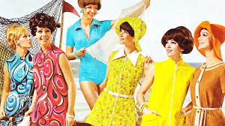
The 60’s fashion
Woman in the 60’s used to have short hair and wear colorful clothes, mostly dresses.

Slide 3
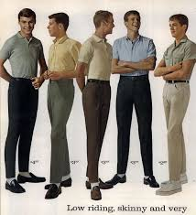
Men used to wear colorful t-shirts and darker jeans, they also had their hair short.

Slide 4
The 60s music and bands
In the 60s, they mostly used to listen to jazz, pop and rock and roll. Some famous bands were the Beatles, the beach boys, the rolling stones etc.

Slide 5
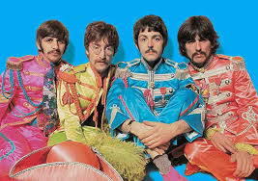
The beatles
The beatles were very famous in the 60’s.They were a group of four and their genre was rock n roll.

Slide 6
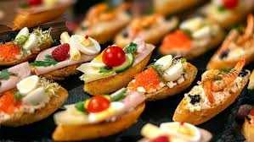
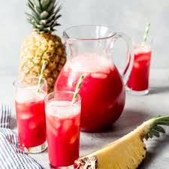
The 60’s Parties
The parties back then were very often, mostly young people made parties. The foods and drinks they used to have, were fruit punch and canapes etc.

