Slide 1

The 60’s.
Here are some cool things that were invented in the 60’s.

Slide 2
Inventions in the 60’s
In the 60’s a lot of things were invented and created and I will just list some of them accompanied by a few pictures.
1. In the 60’s computers were invented and had many uses to the every day life.
2. The ATM, which changed the world completely as you could withdraw money easily without human contact and hours of waiting to get to a representative.

Slide 3
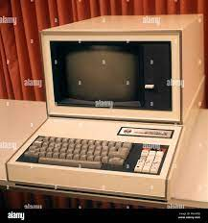
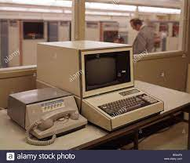
Here are some pictures of the worldwide known computer in the 60’s.

Slide 4
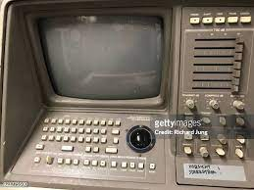
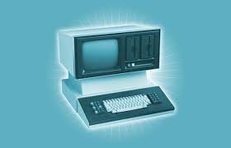

Slide 5
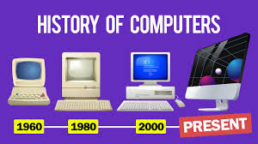
And here is the evolution of computers for the people wondering.

Slide 6
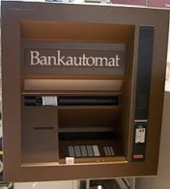
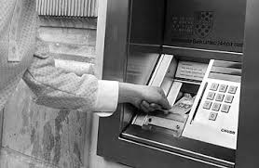
Here are some pictures of the ATM in the 60’s

Slide 7
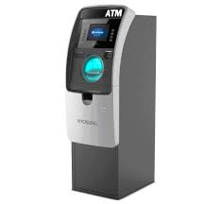
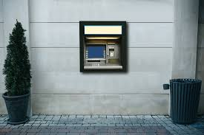
Here are some modern ATM’s from today.

Slide 8
I Hope you enjoyed our project! Thanks for watching.
People participating in the project:
Olga, Kostas, Sabina, Christos

