Slide 1
Countries and nationalities
GREECE

Slide 2
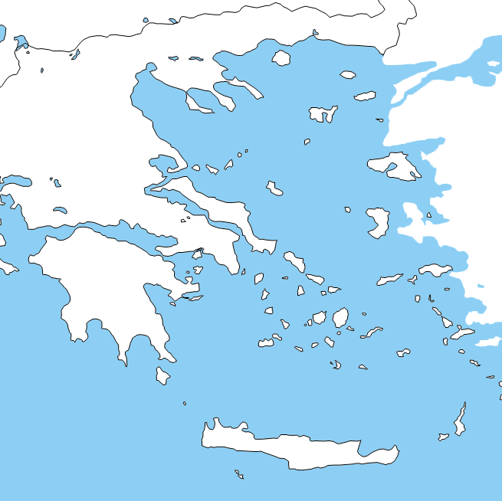
I am from greece

Slide 3
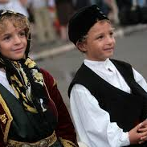
Iam greek

Slide 4
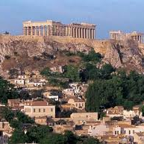
I live in athens

Slide 5

My flag is blue and white

Slide 6
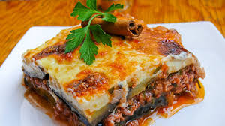
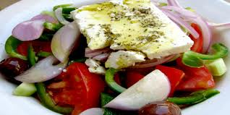
Greek food
My favourite food is mousaka
I like greek salad

Slide 7
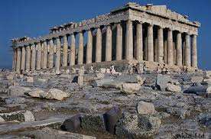
Acropolis is a great monument

Slide 8
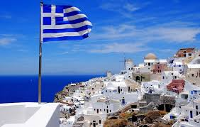
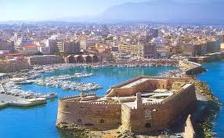
Greek islands
santorini
crete

Slide 9
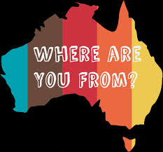
I am from…..now you choose a coyntry

