Slide 1
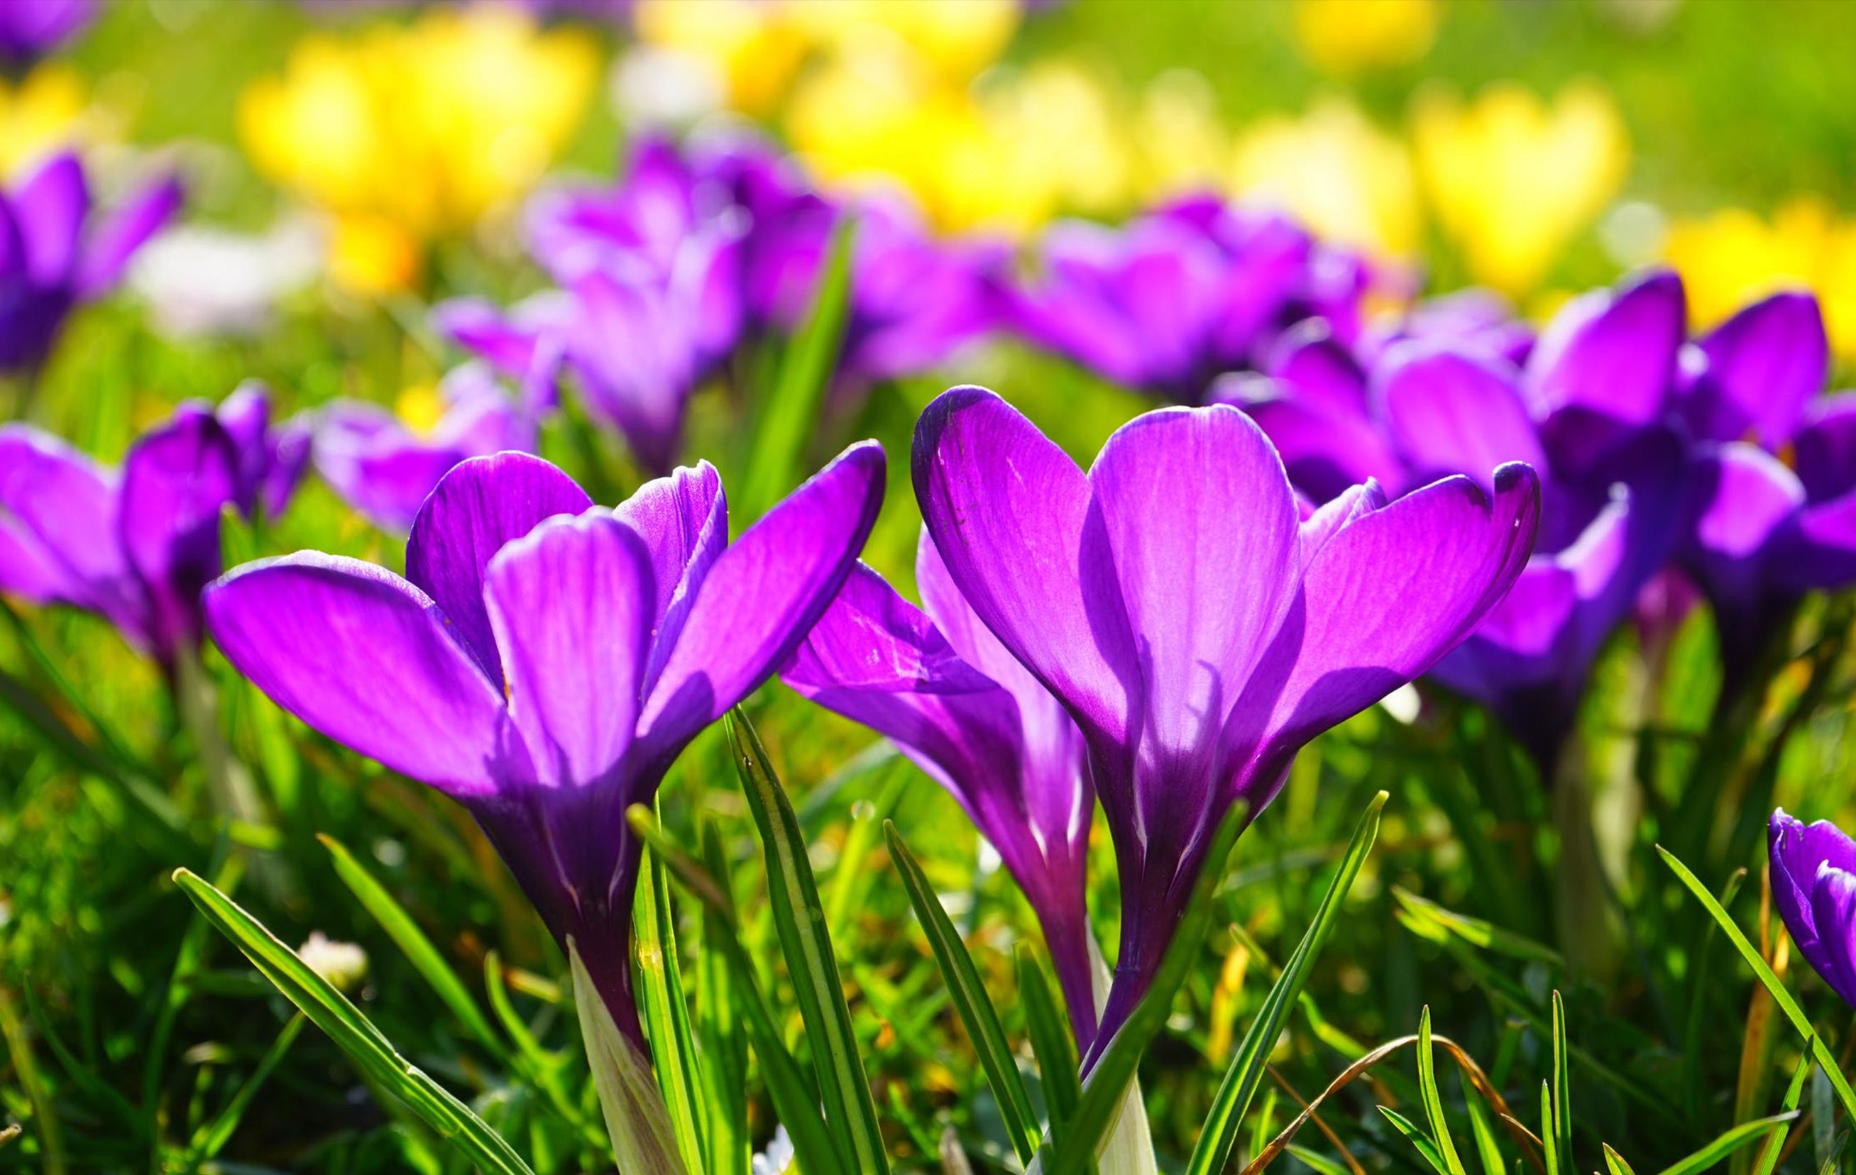
Ο Μάιος μέσα από την τέχνη

Slide 2
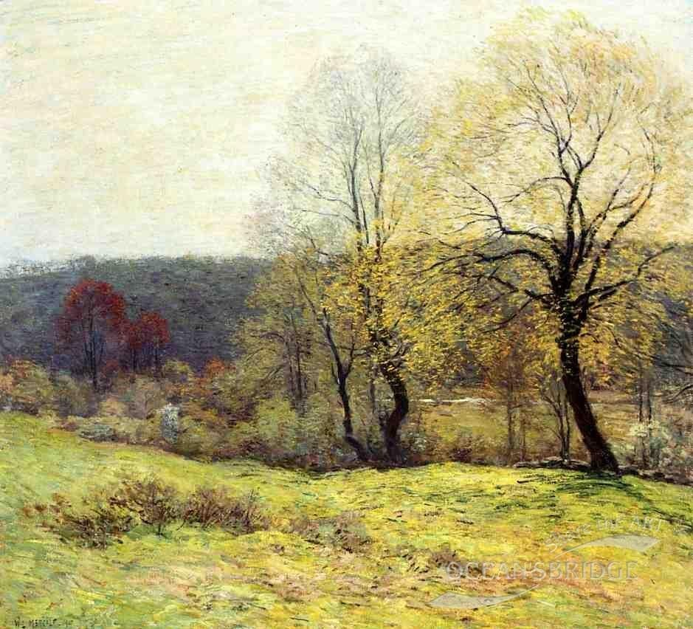
Willard Leroy Metcalf
May Pastoral 1907

Slide 3
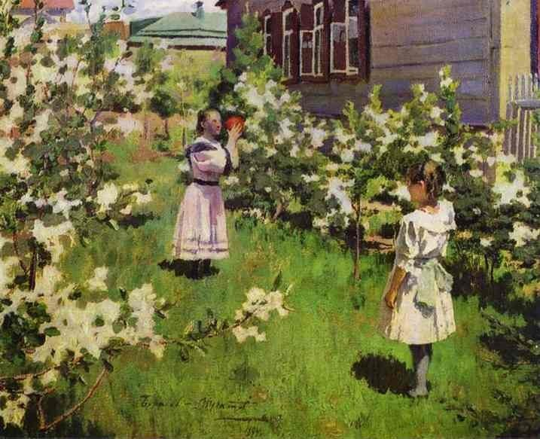
Wictor Borisov-Musatov
May Flowers

Slide 4
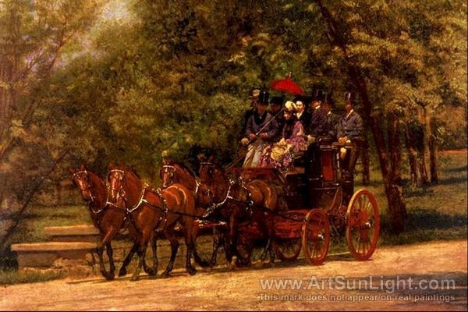
Thomas Eakins A May Morning in the Park

Slide 5
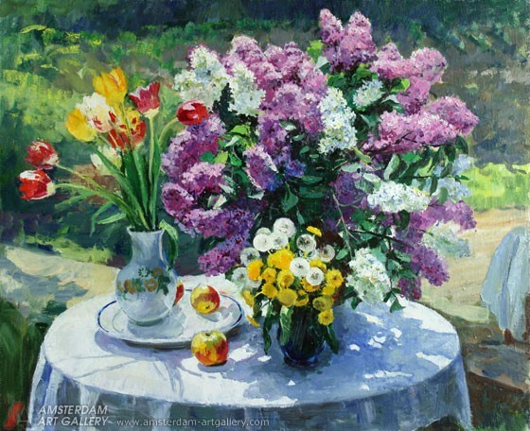
Bespruzhnaya Ludmila May flowers

Slide 6
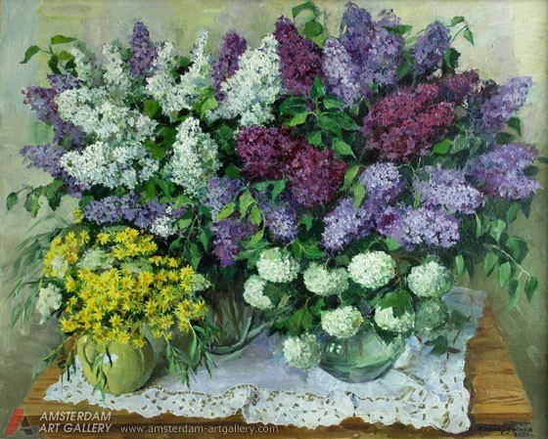
Bespruzhnaya Ludmila May lilac

Slide 7
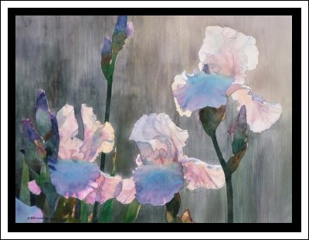
David Drummond May Morning

Slide 8
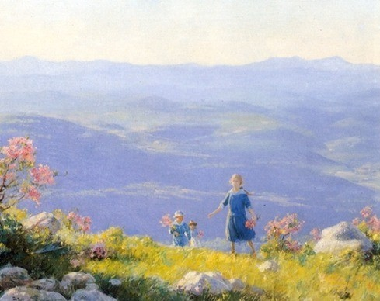
Charles Courtney Curran May Afternoon 1916

Slide 9
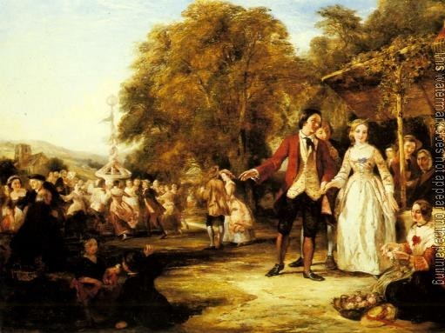
A May Day Celebration by William Powell Frith

Slide 10
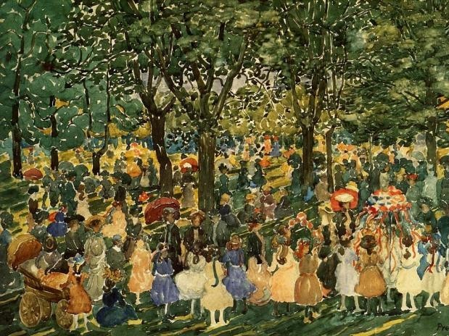
May Day Central Park Maurice Brazil Prendergast

Slide 11
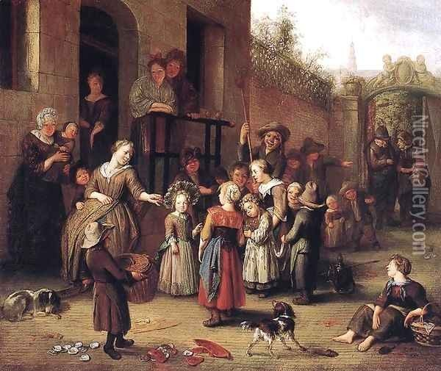
Richard Brakenburg May Queen Festival 1700

