Slide 1
Τριαντάφυλλα και τέχνη

Slide 2
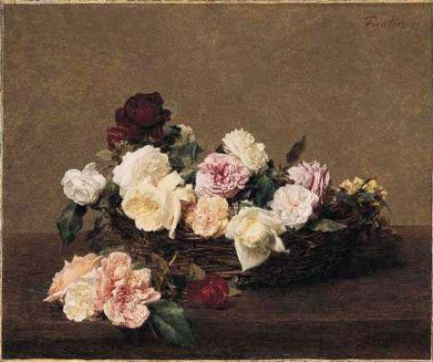
Henri Fantin Latour , A basket of roses

Slide 3
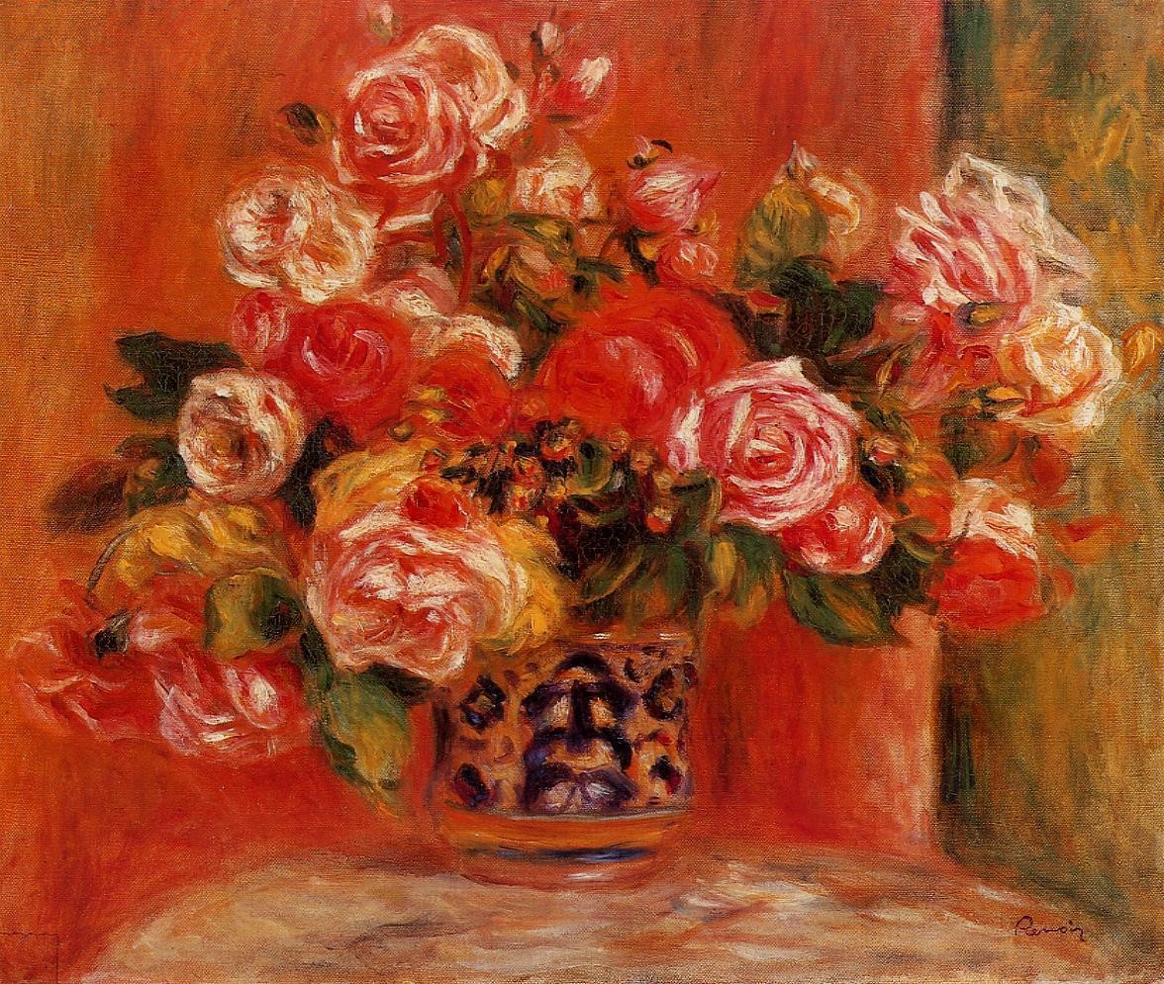
Pierre August Renoir, Roses in a Vase

Slide 4
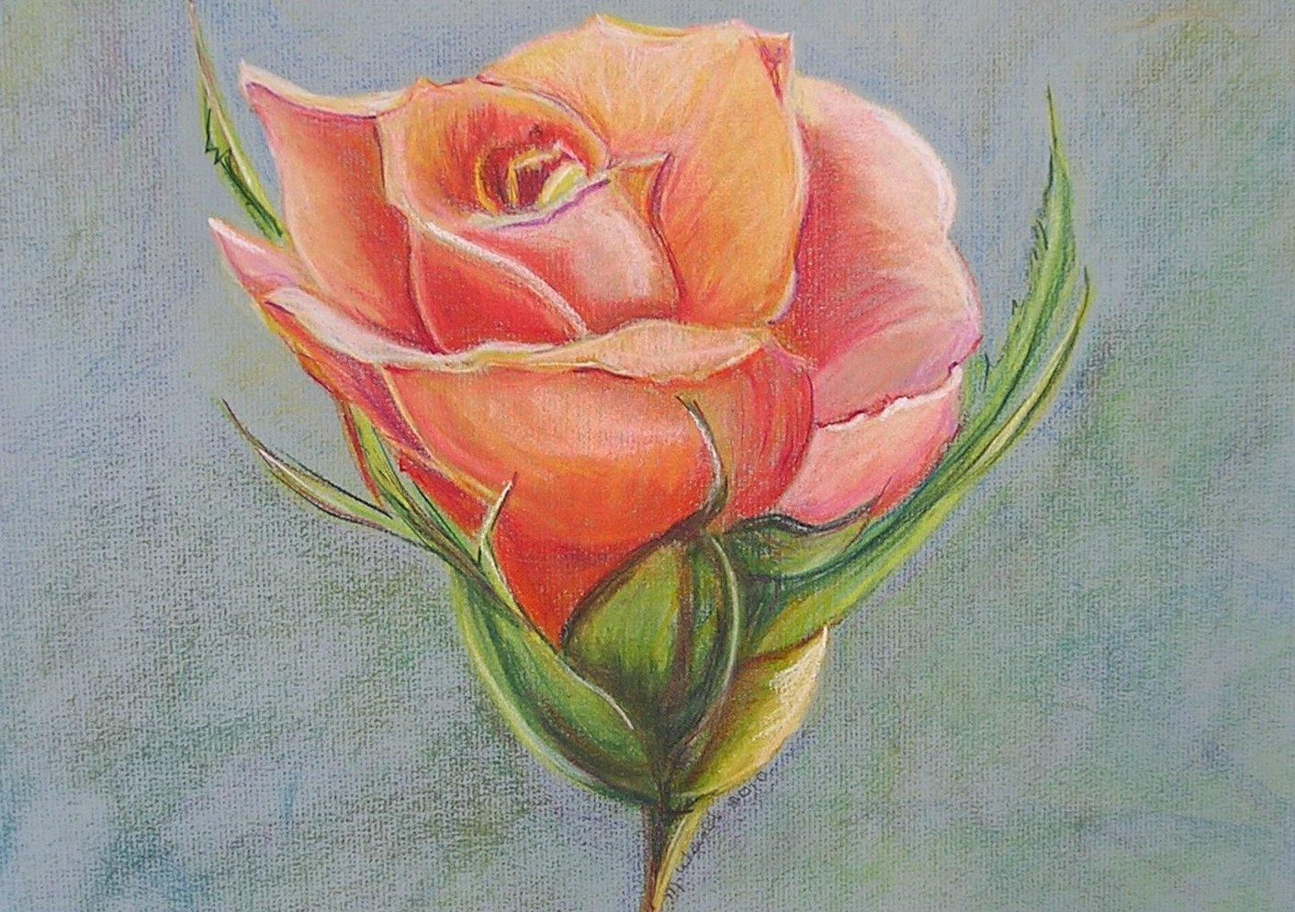
Marilyn Kay Weimer , Peach Rose

Slide 5
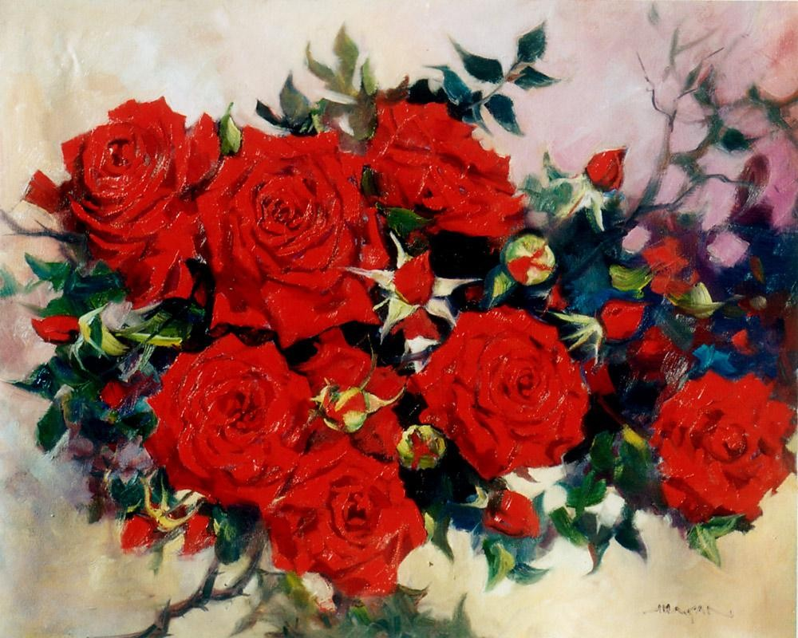
John Hagan’s , National Trust

Slide 6
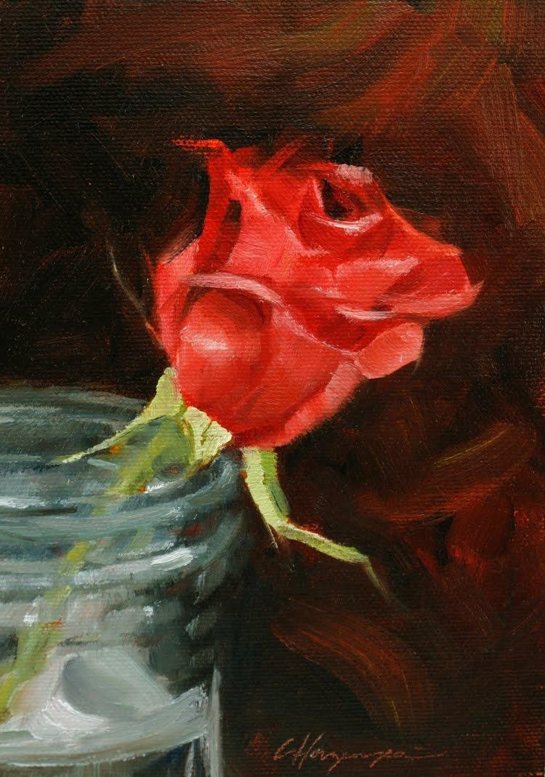
Carol Horzempa, Rose Study 2011

Slide 7
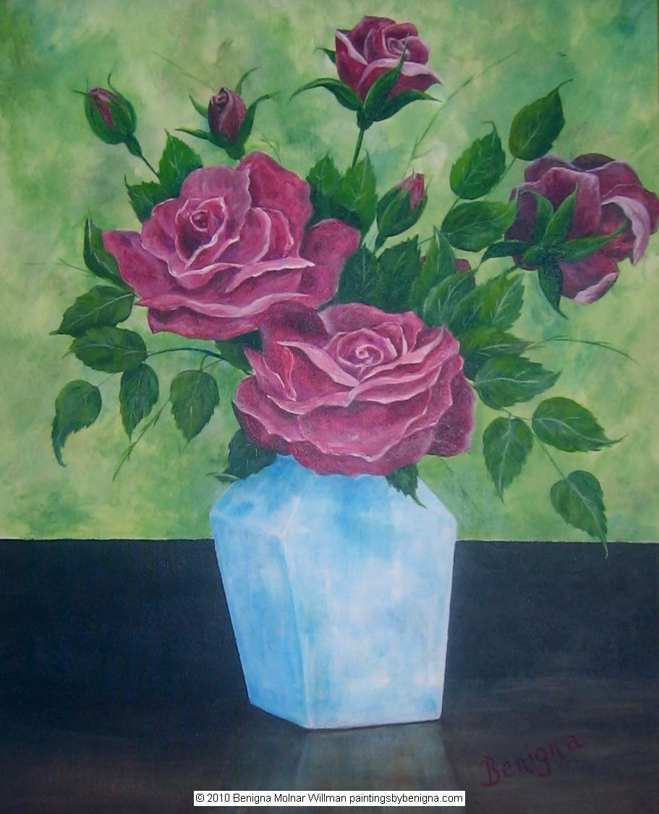
Benigna Molnar Willman , Red Roses for a Blue Lady

Slide 8
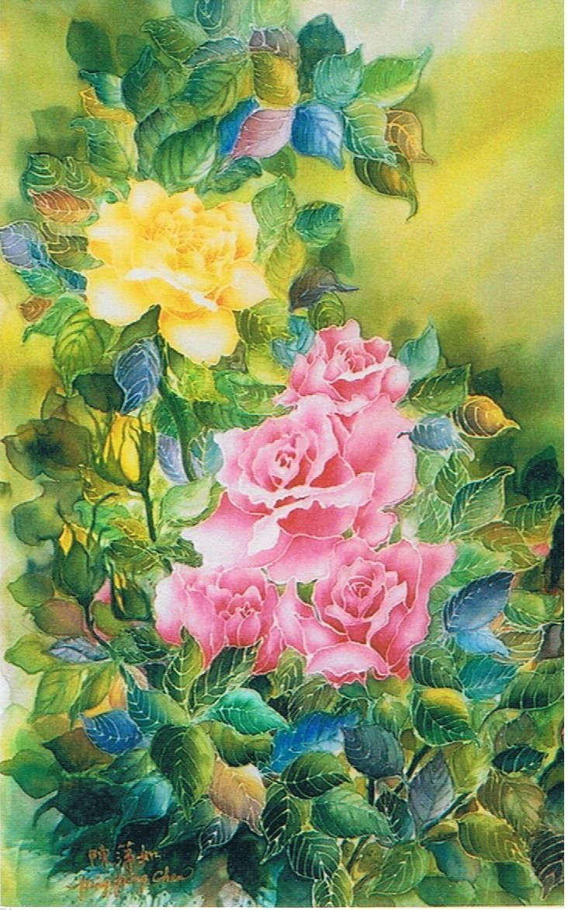
Ping Ping Chen , Dream of roses

Slide 9
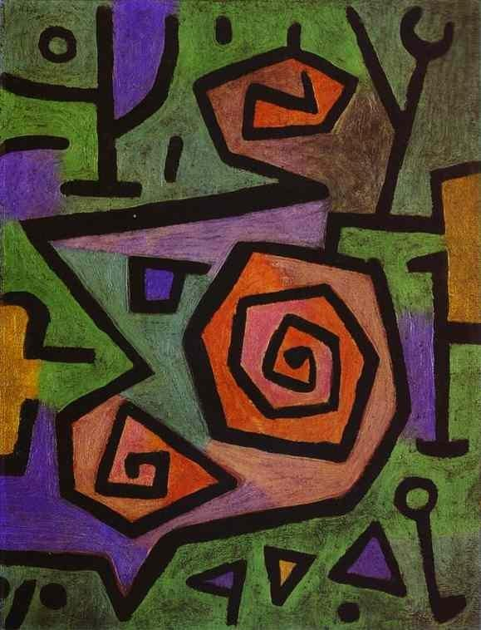
Paul Klee, Heroic Roses , 1938

Slide 10
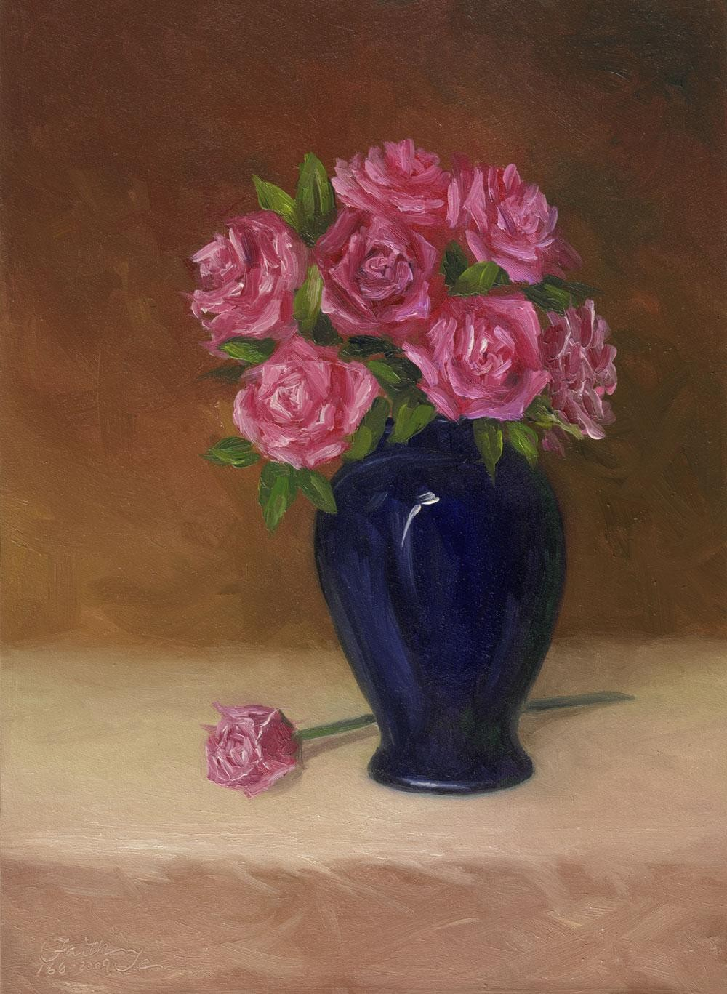
Faith Te , Roses in a blue Vase

Slide 11
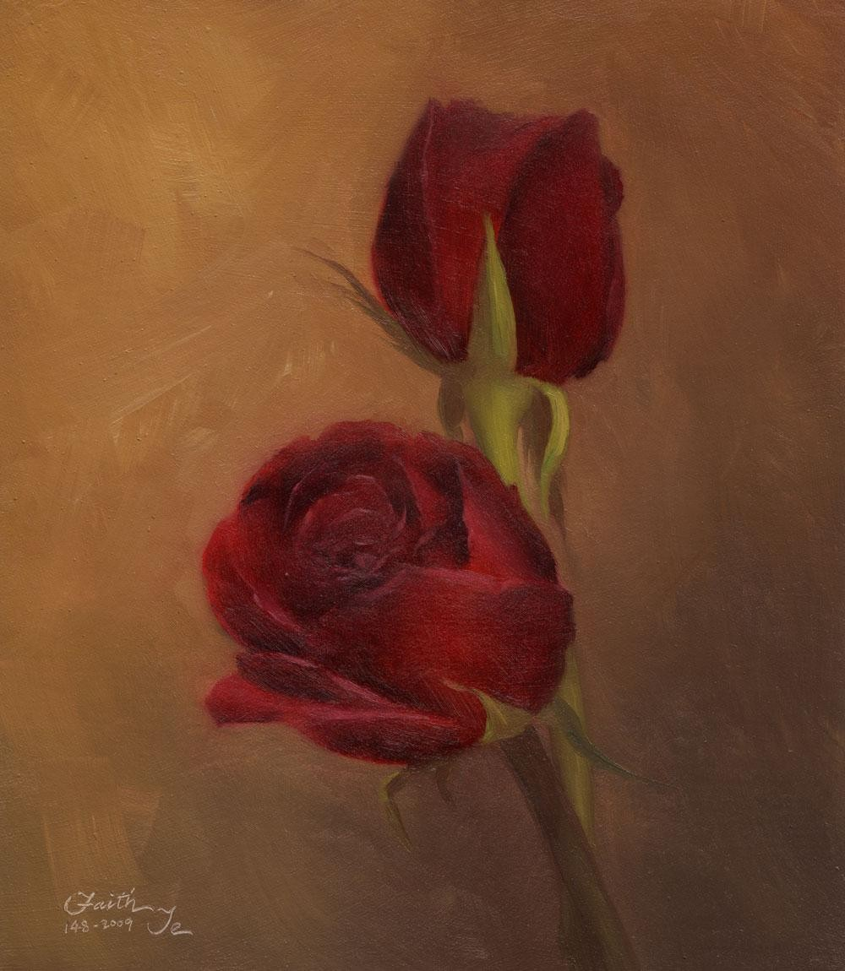
Faith Te , Red Roses

Slide 12
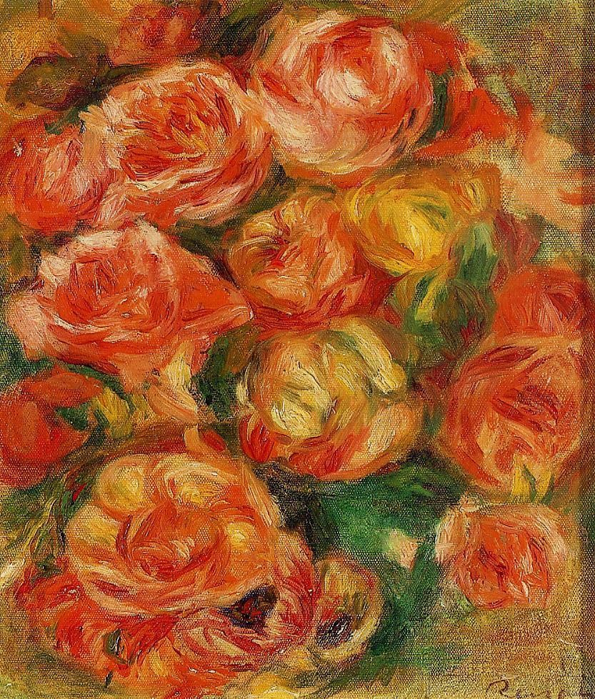
Pierre August Renoir, A Bowlful of Roses

Slide 13
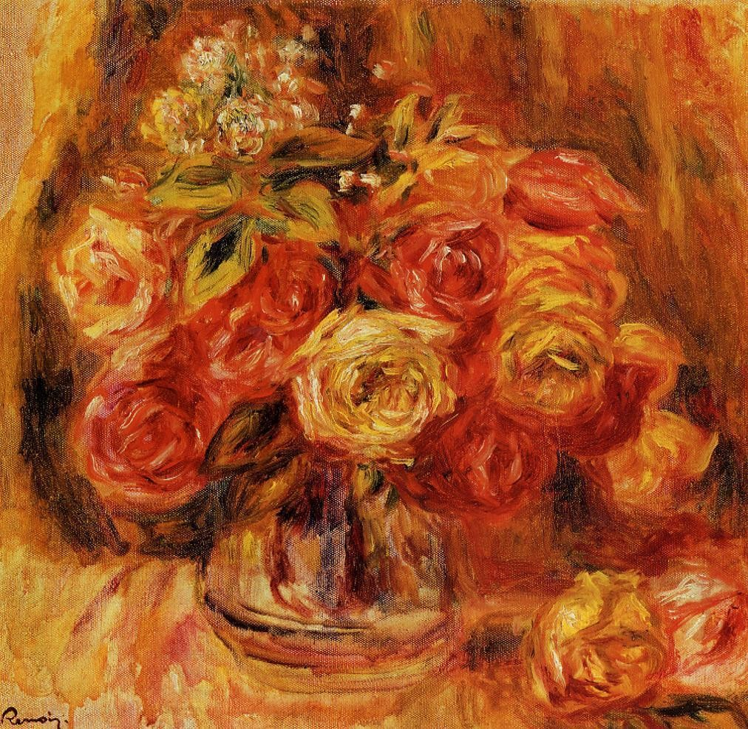
Pierre August Renoir, Roses in a Vase , 1910

Slide 14
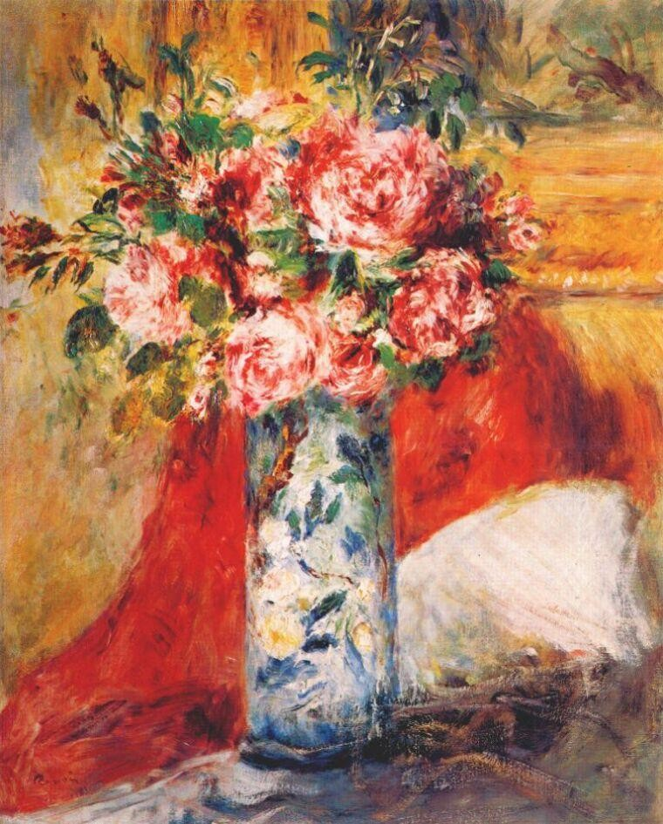
Pierre August Renoir, Roses in a Vase , 1876

Slide 15
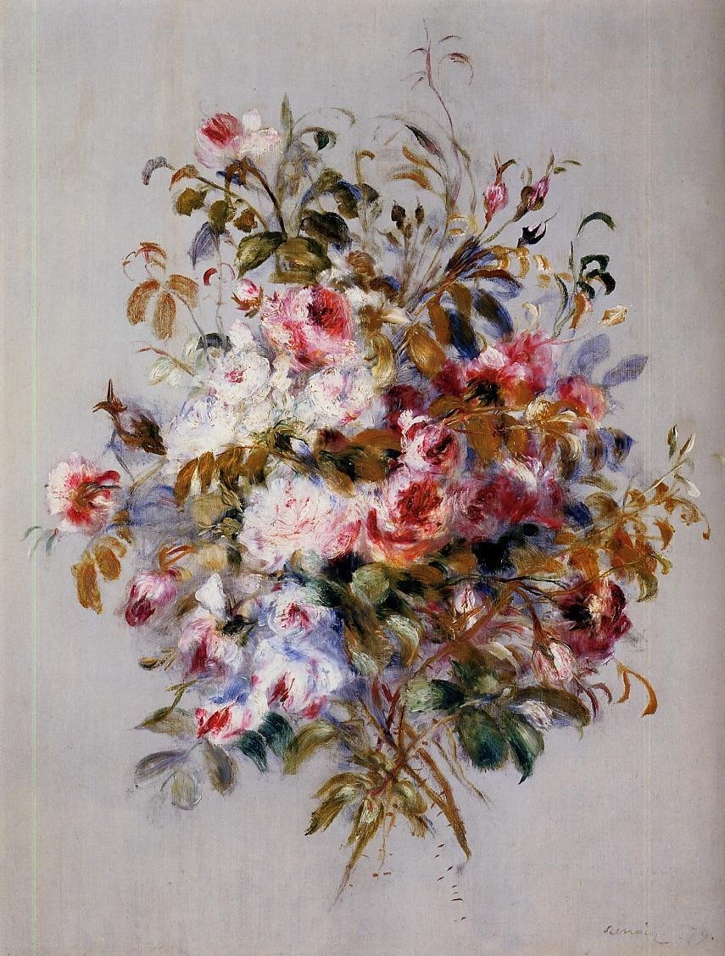
Pierre August Renoir, A Bouquet of Roses

Slide 16
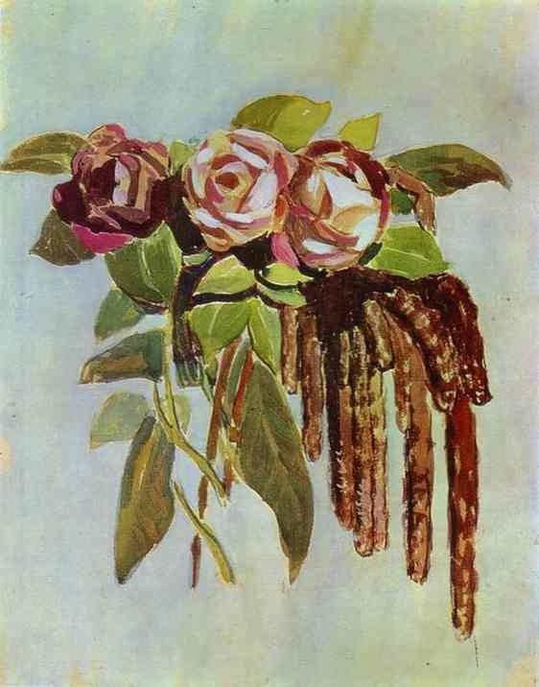
Victor Borisov-Musatov. Roses and Catkins. 1901-1903.
Watercolor and tempera. The A. N. Radishchev Museum of Arts, Saratov, Russia.

