Slide 1




Christmas in Greece
Misiria-Kindergarten
Rethimno-Greece

Slide 2
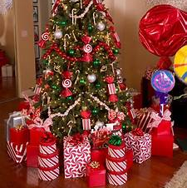
In Greece we decorate a Christmas Tree in our house. Under the tree Santa Claus leaves us our presents..

Slide 3
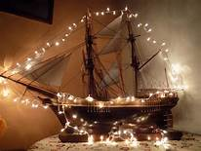

In previous years, people decorated a little ship, instead of a tree. This happened, because many men worked as mariners, and their families missed them.. Nowadays, usually in islands of Greece, people still decorate little ships!

Slide 4
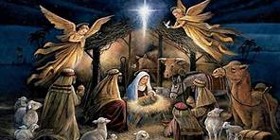
We celebrate the Birth of baby Jesus. Under the Chrismas Tree, we also put a nativity scene

Slide 5
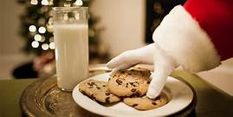
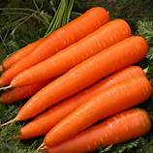
Under the Christmas Tree, we also put milk and cookies for Santa Claus and fresh carrots for Rudolf

Slide 6
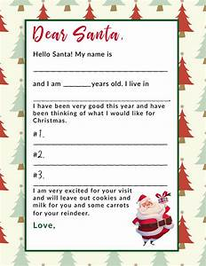
Santa Claus knows what present we want, because we have sent him a letter

Slide 7
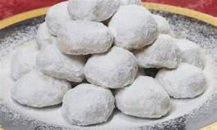
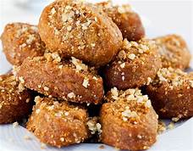
In Christmas we also bake some of our traditional delights! They are called: Kourabiedes and Melomakarona!

Slide 8
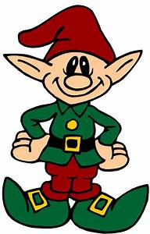
We are also searching for “Christmas Magic!” Christmas elves have a little Christmas magic.. They help Santa Claus!

Slide 9
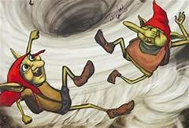
There are also some little dark-skinned creatures that have some Christmas magic! We call them: Kalikantzari!

Slide 10
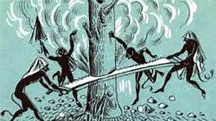
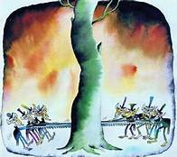
Kalikantzaroi are supposed to live under the earth, and for a whole year, they try to cut the tree that holds the earth. But every Christmas they go up and get into mischiefs! After the end of holidays, they go again underneath the earth and….Oh! The earth tree, has gone big again…

Slide 11
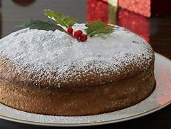
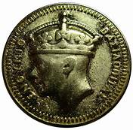
We also celebrate New Year! We eat a cake called: Vasilopita! We cut it in pieces, and someone is lucky enough to win the lucky coin hidden in one piece!

Slide 12
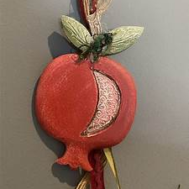
We also make lucky charms for new year and exchange them as a gift! Traditionally a fake pomegranate is hanged in charms for a Happy New Year!

Slide 13
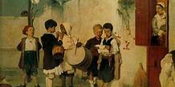
In Christmas Eve, and in New Year’s Eve, little children go out and sing carrols! People treat them with delights or give them money!

Slide 14
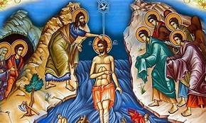
At 6th of January, we celebrate the Baptism of Jesus. It’s an important celebration for Orthodox. We go to church and take some Holy Water. In Greece we call it: Agiasmos

Slide 15
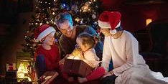
Christmas is the best time of the year! Schools are closed, and we spend time with friends and family!

Slide 16
Thank you! Warm wishes to all of you, from all of us!

