Slide 1



APPLICATION OF FEEDBACK IN PRESCHOOL INSTITUTIONS FOR TEACHERS-ANALYZE
Erasmus+Project:
"High quality feedback – the key to successful
cooperation between teachers and parents in
preschools"
(No:2020-1-LT01-KA229-077868)

Slide 2

"High quality feedback – the key to successful cooperation between teachers and parents in preschools"
Participating schools:
Vilniaus lopselis-darzelis "Justinukas" ,Lithuania-coordinator
Priekulu pirmsskolas izglitibas iestade"Mezmalina" Latvia-partner
Detska gradina Arabella, Bulgaria-partner
Scoala Profesionala Tiberiu Morariu Salva ,Romania-partener
2/thesio oloimero nipiagogeio Elateias, Greece-partener

Slide 3
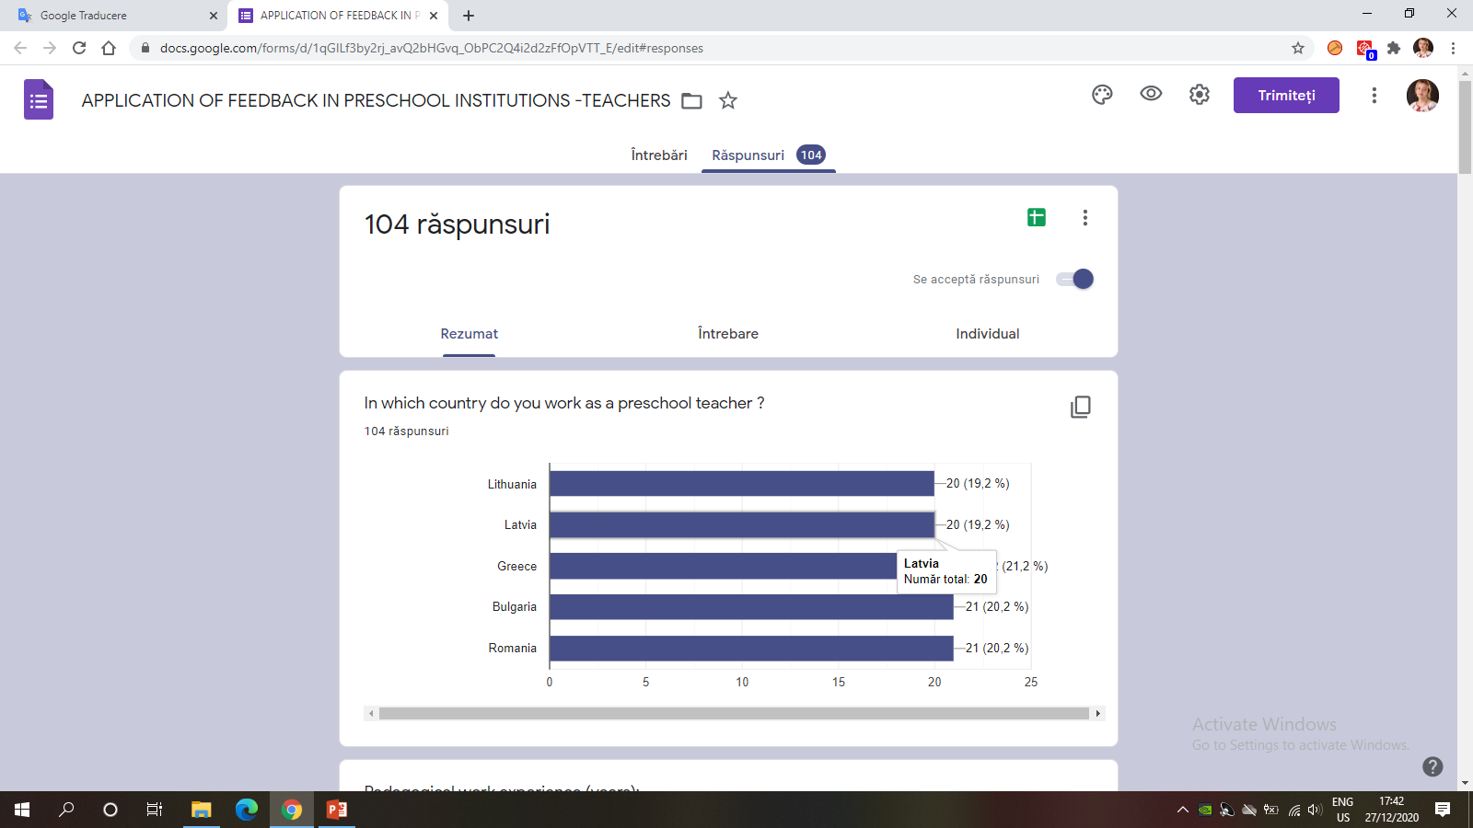
"High quality feedback – the key to successful cooperation between teachers and parents in preschools"

Slide 4
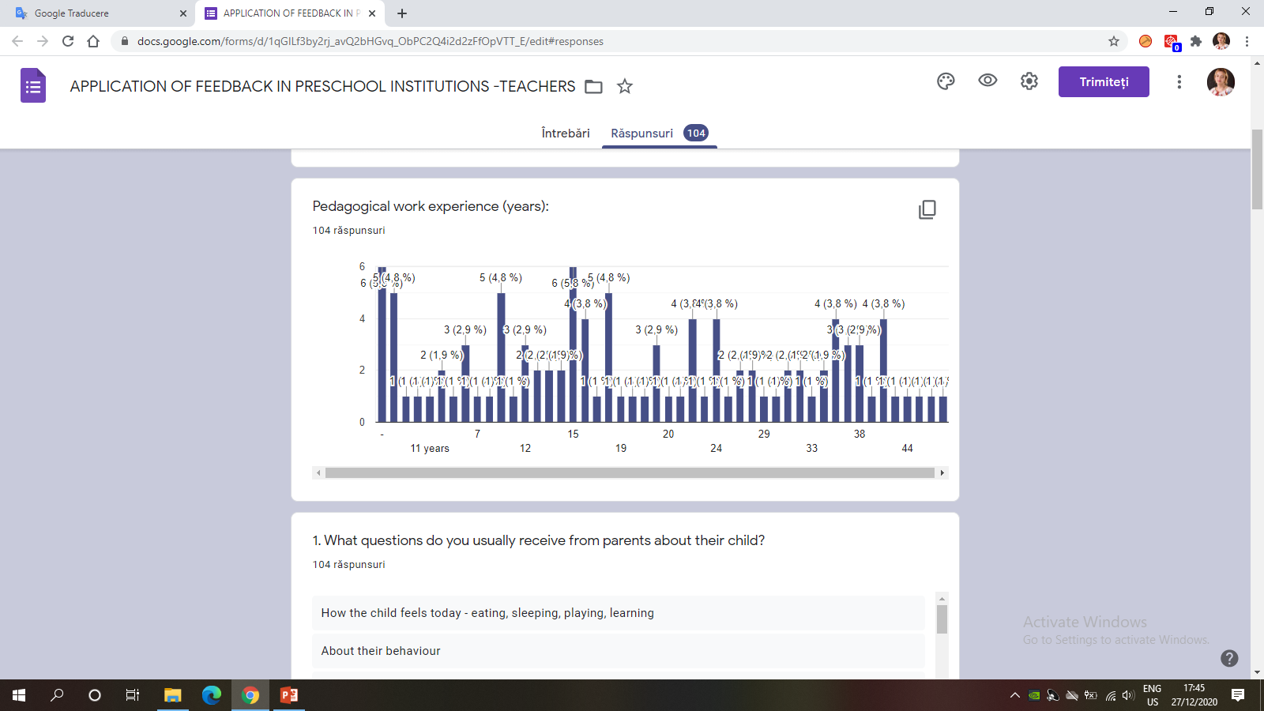

"High quality feedback – the key to successful cooperation between teachers and parents in preschools"

Slide 5
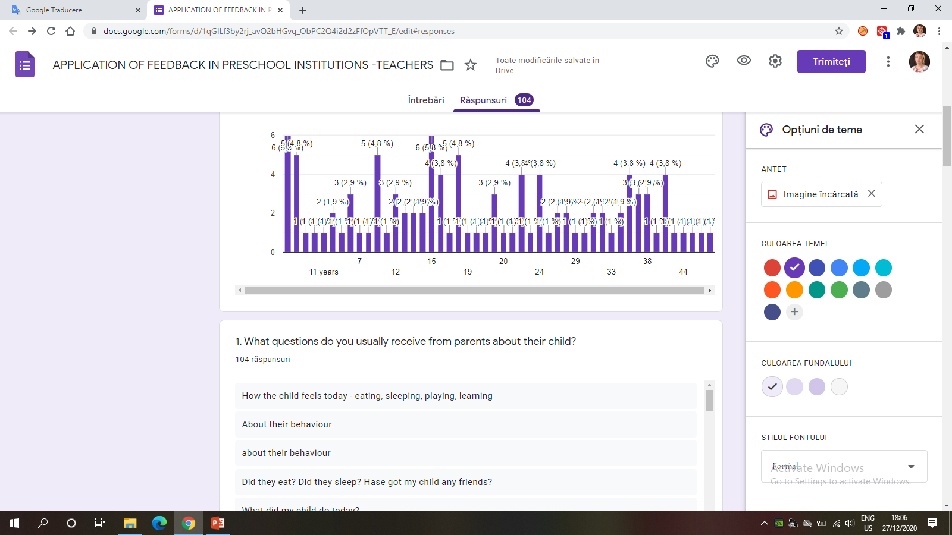
"High quality feedback – the key to successful cooperation between teachers and parents in preschools"
43-How the child feels today - eating, sleeping, playing,
35-Daily learning activities in kindergarten(be active, draw, sing..)
20-Behaviours( bad or good)
6-Cried.

Slide 6
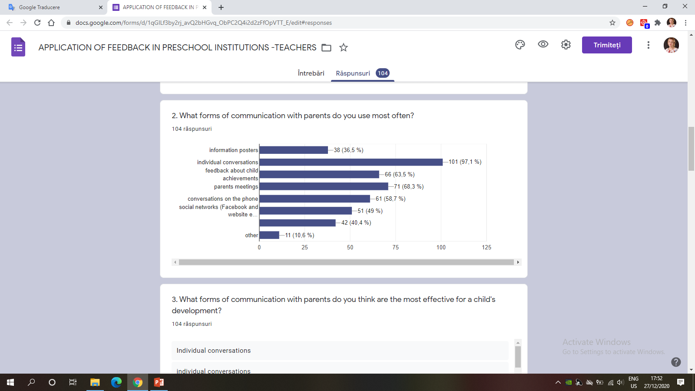
"High quality feedback – the key to successful cooperation between teachers and parents in preschools"

Slide 7
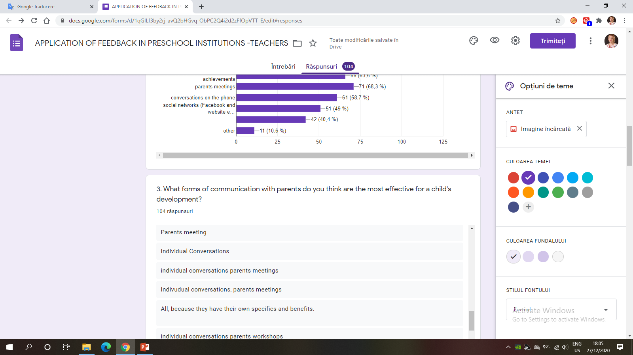
"High quality feedback – the key to successful cooperation between teachers and parents in preschools"
76- individual conversations
33-on-line,telephone
7-parents meetings.

Slide 8
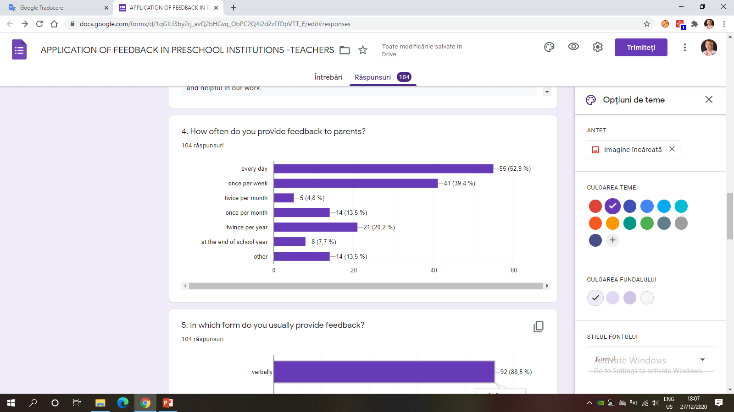
"High quality feedback – the key to successful cooperation between teachers and parents in preschools"

Slide 9
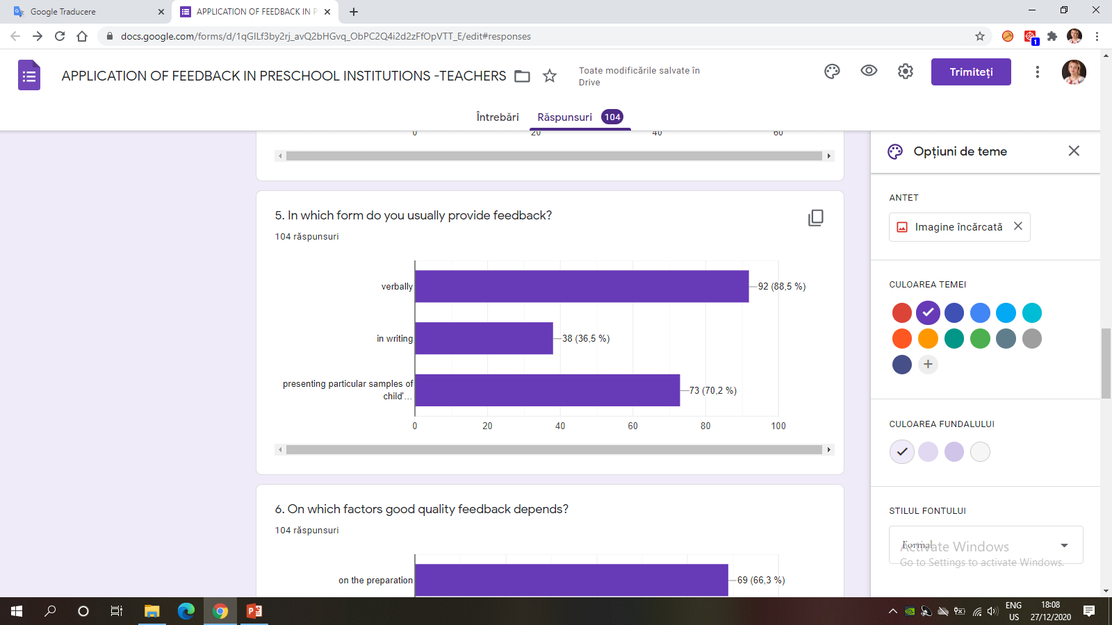
"High quality feedback – the key to successful cooperation between teachers and parents in preschools"

Slide 10
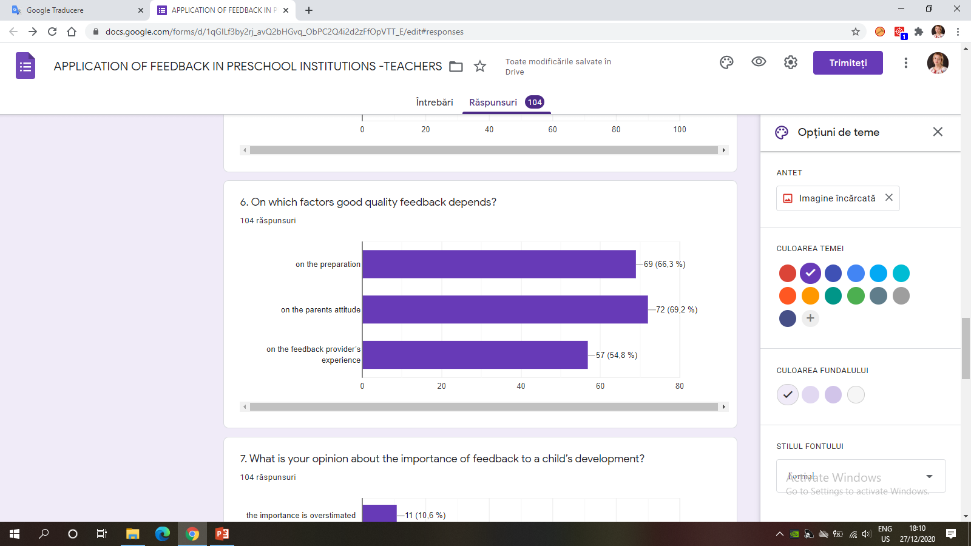
"High quality feedback – the key to successful cooperation between teachers and parents in preschools"

Slide 11
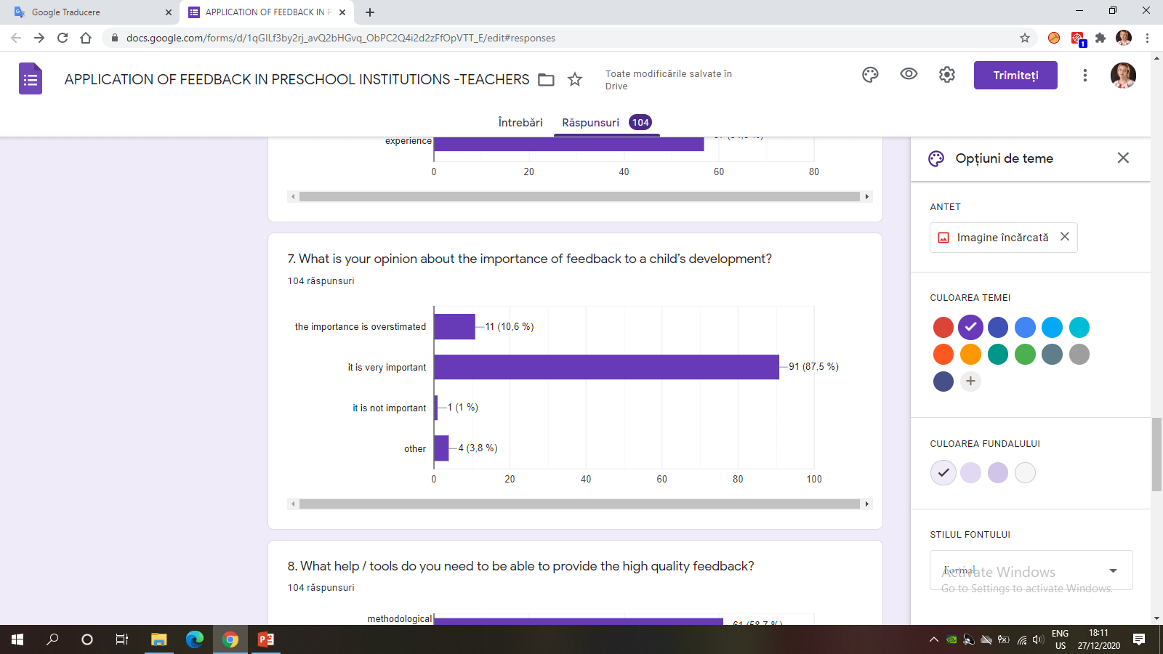
"High quality feedback – the key to successful cooperation between teachers and parents in preschools"

Slide 12
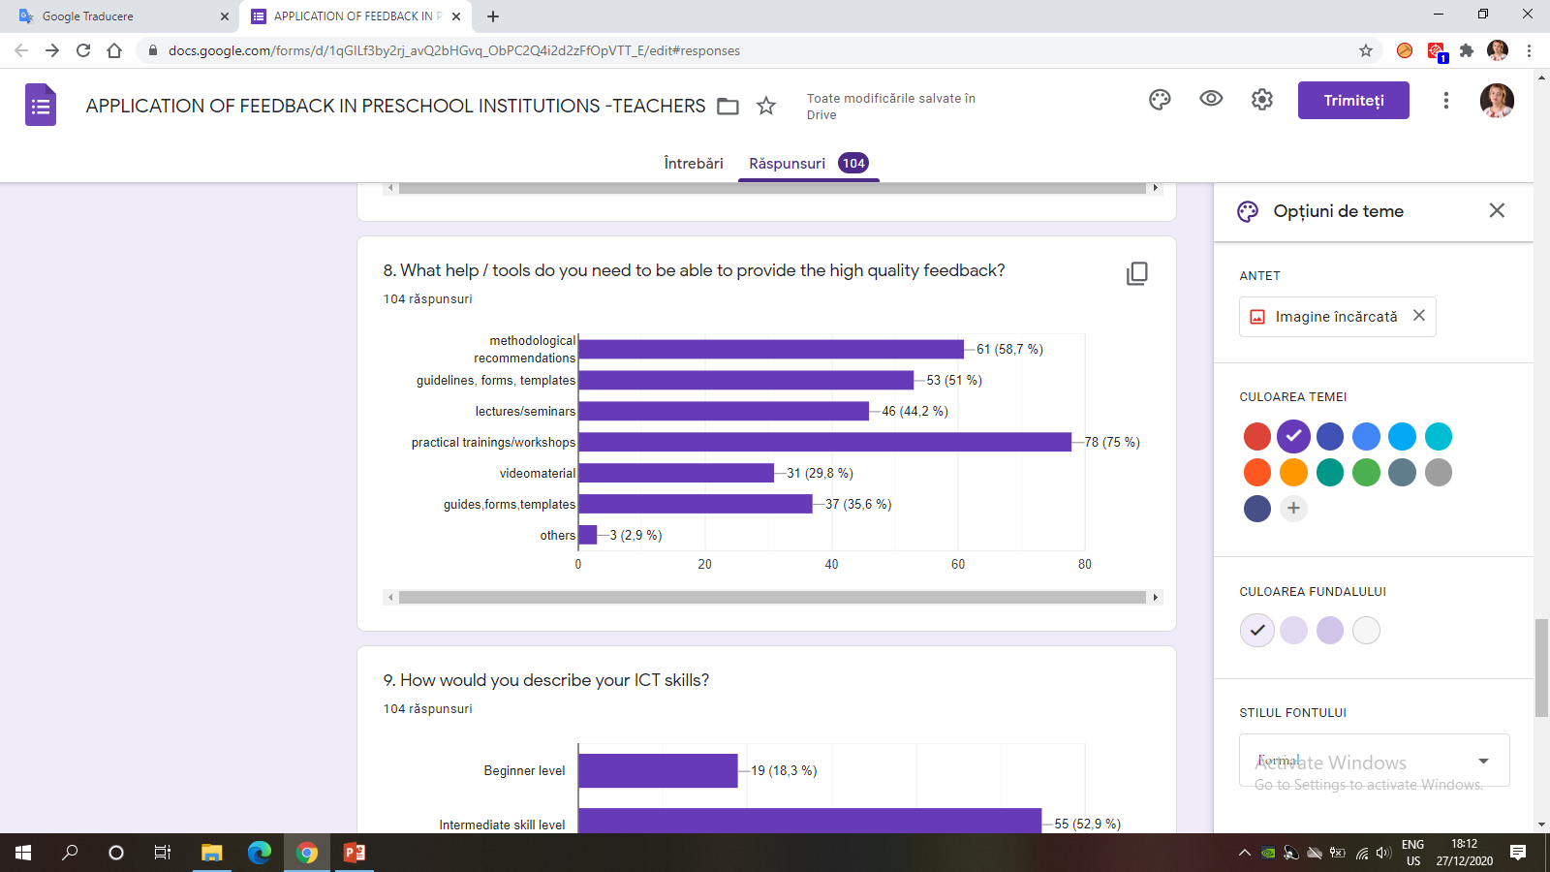
"High quality feedback – the key to successful cooperation between teachers and parents in preschools"

Slide 13
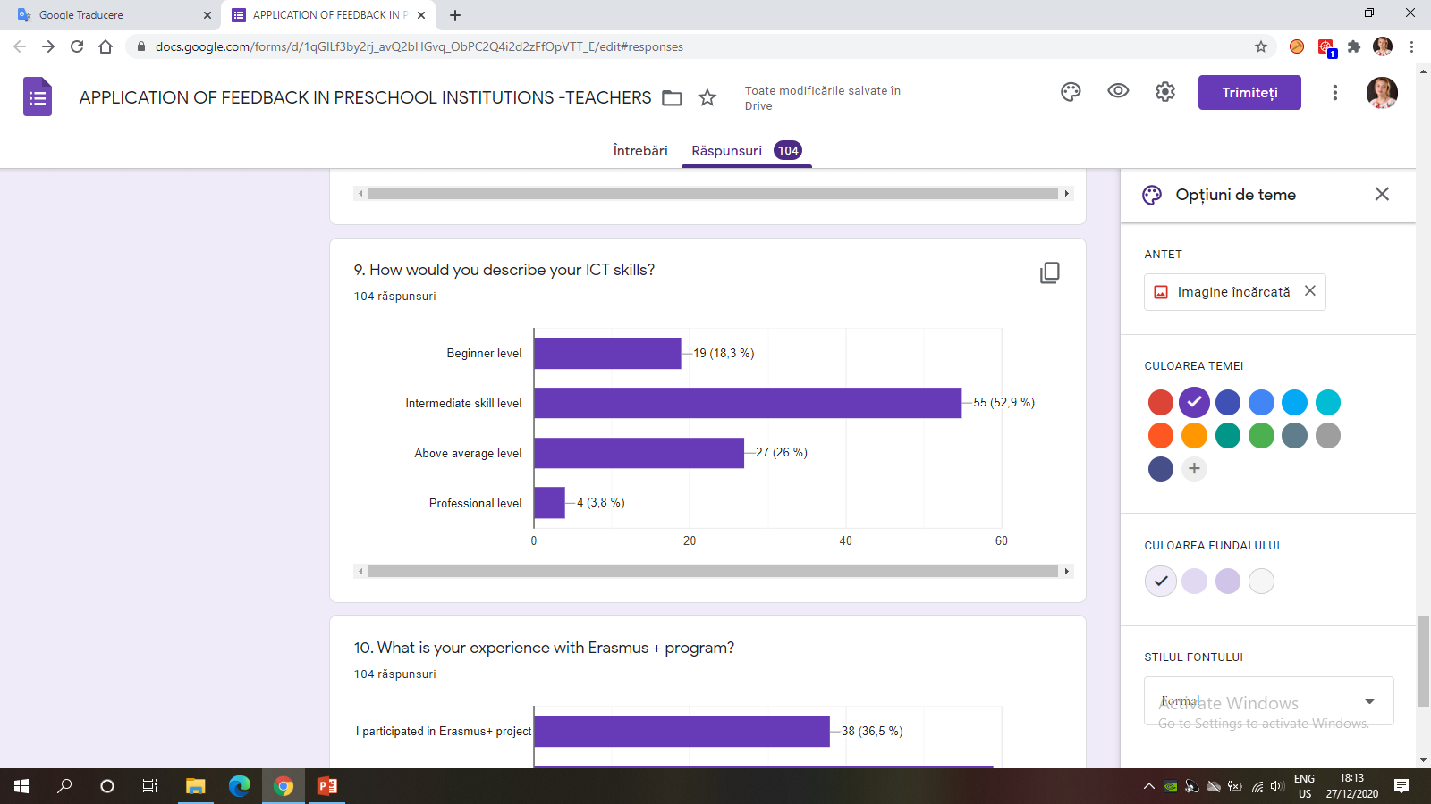
"High quality feedback – the key to successful cooperation between teachers and parents in preschools"

Slide 14
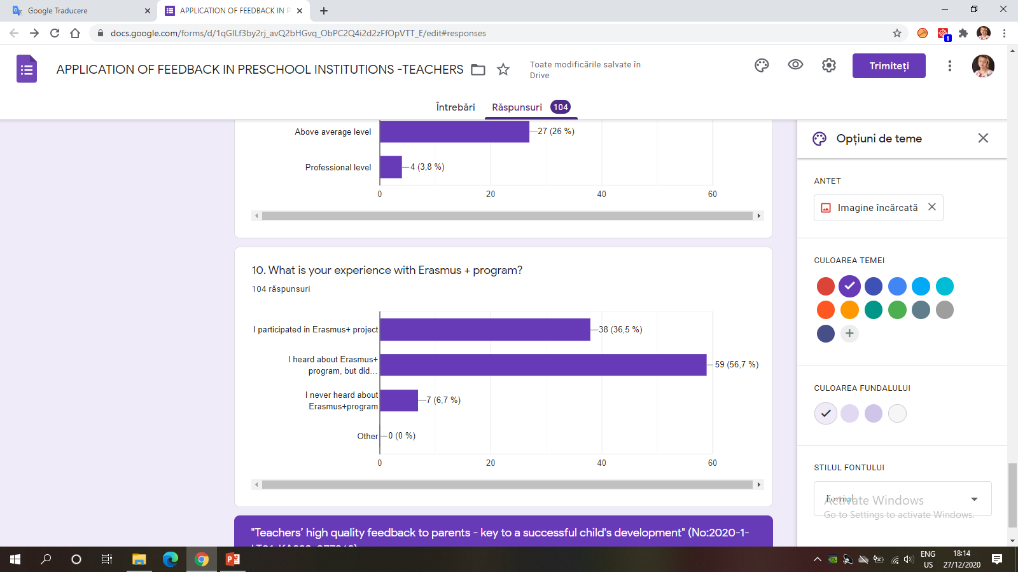
"High quality feedback – the key to successful cooperation between teachers and parents in preschools"

Slide 15

"High quality feedback – the key to successful cooperation between teachers and parents in preschools"
https://twinspace.etwinning.net/108485/home

Slide 16

"High quality feedback – the key to successful cooperation between teachers and parents in preschools"
No:2020-1-LT01-KA229-077868
“The European Commission support for the production of
this publication does not constitute an endorsement of the
contents which reflects the views only of the authors,
and the National Agency and Commission cannot be held responsible
for any use which may be made of the information contained therein”.
Made by Romania Team ( Vasilica Gazdac)
Thank you for your attention!

