Slide 1
ROBOTS IN GREEK SCHOOL
ERASMUS+ KA229

Slide 2
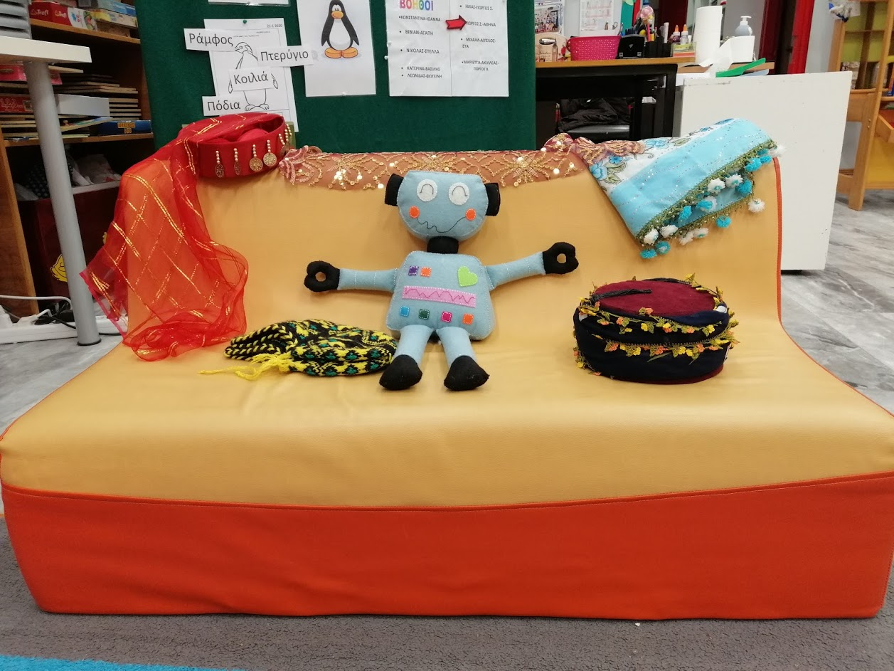
Robot came in our school
The 1st robot came from Turkey and student named him Turkey Proposals was: Blue, robot,
Happy
Smiley
Heart
Turkey
The winn winner was Turkey !
Aims: to think ,talk, choose and vote
(DEMOCRACY)!

Slide 3
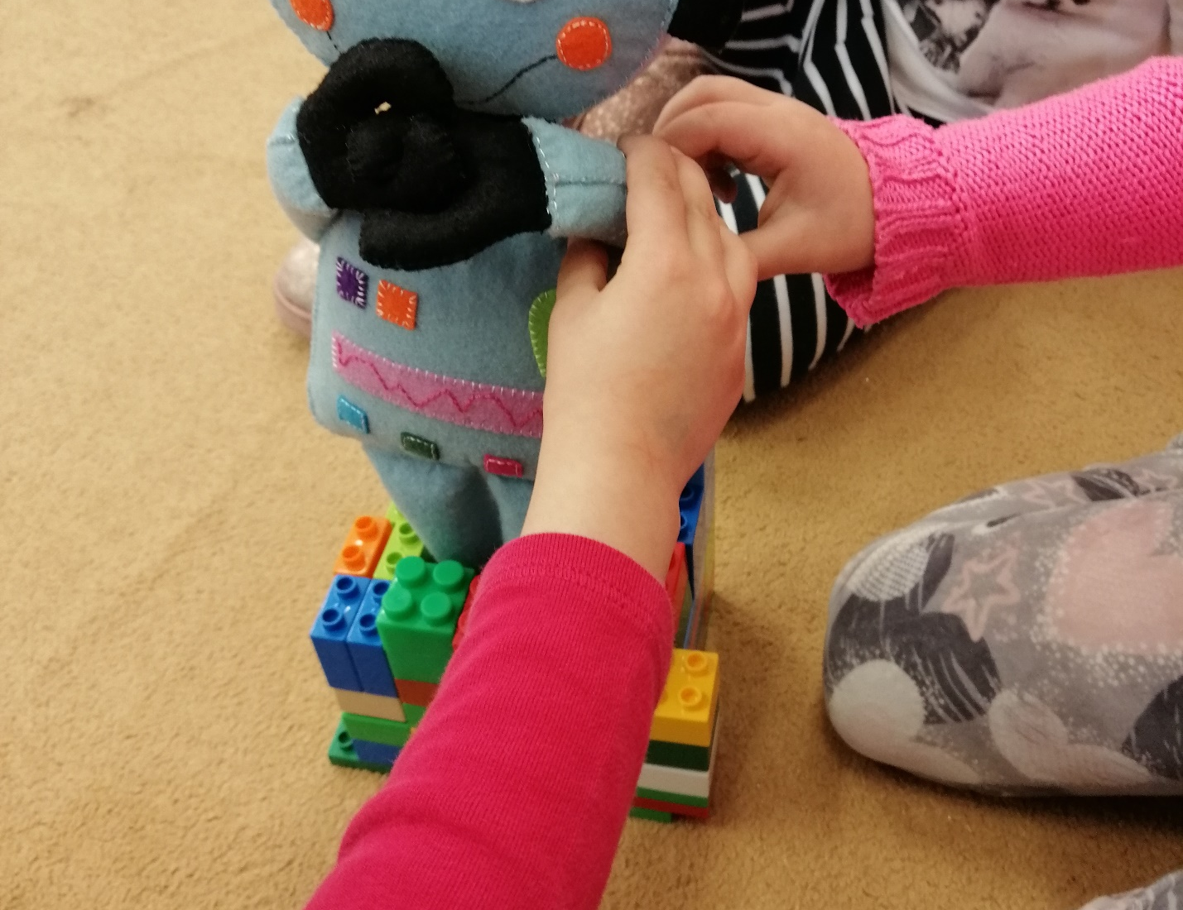
Students baptized him

Slide 4
WELCOME TO OUR SCHOOL

Slide 5
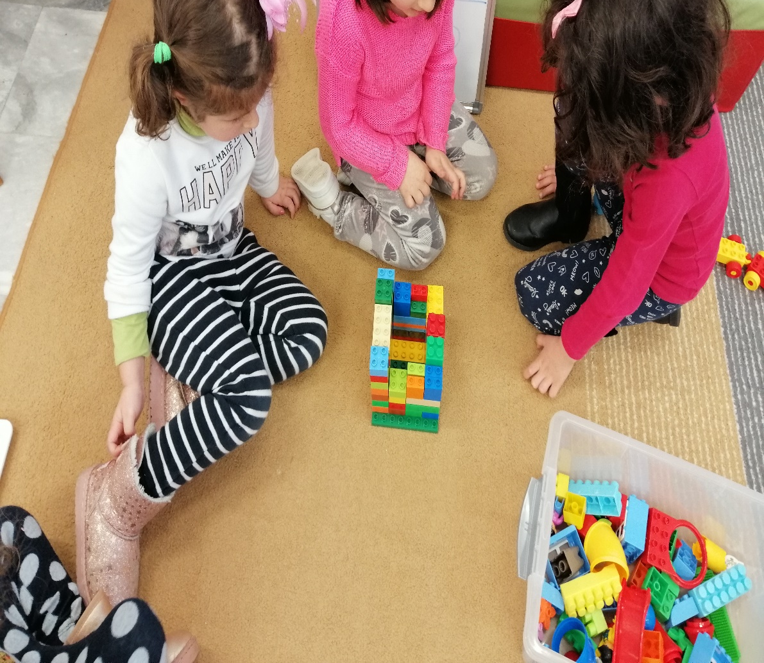
Students build with Lego blocs a place for him
Lego blocs and robot

Slide 6

1.Does Turkey fits?
2. How many Lego bricks have we used?
QUESTIONS AND ANSWERS
MATHS

Slide 7
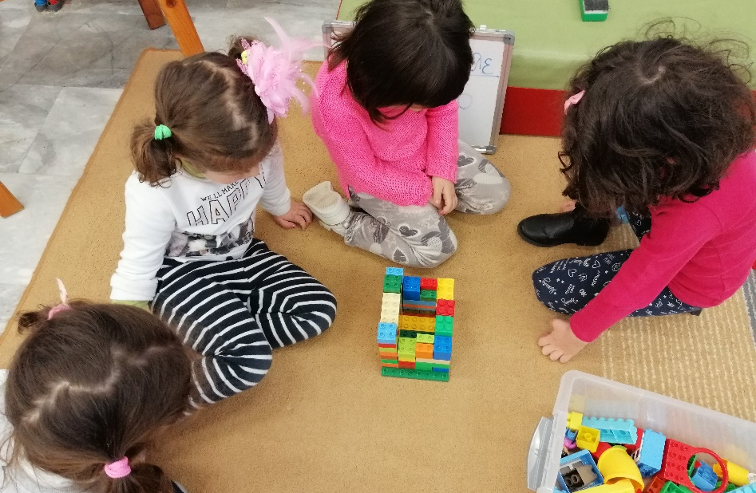

Turkey in the circus !
We count the Lego blocs
Ready!

Slide 8
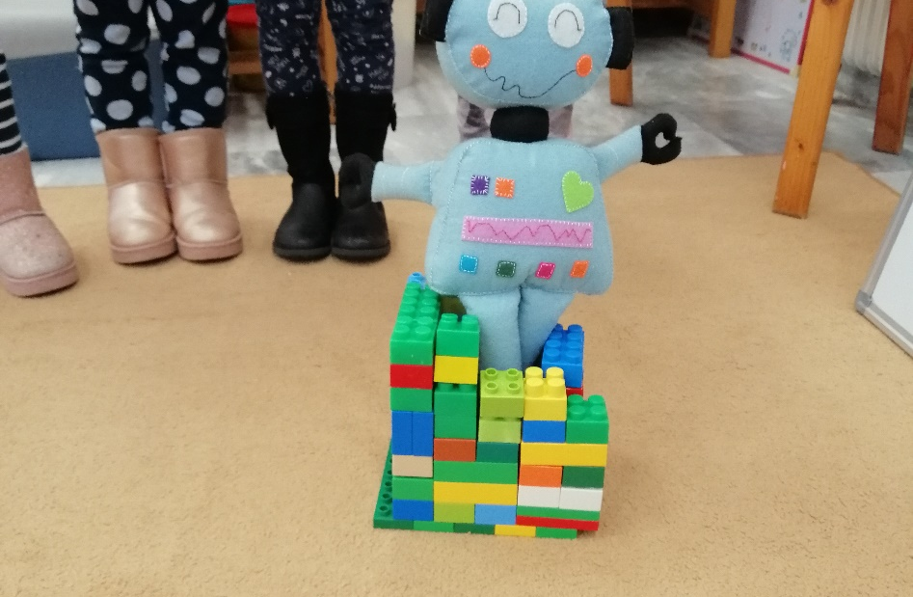
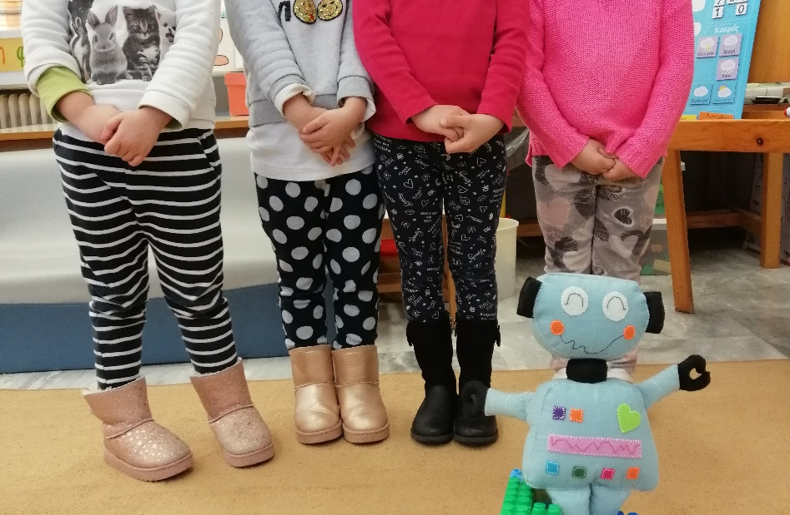
Ready!!

Slide 9
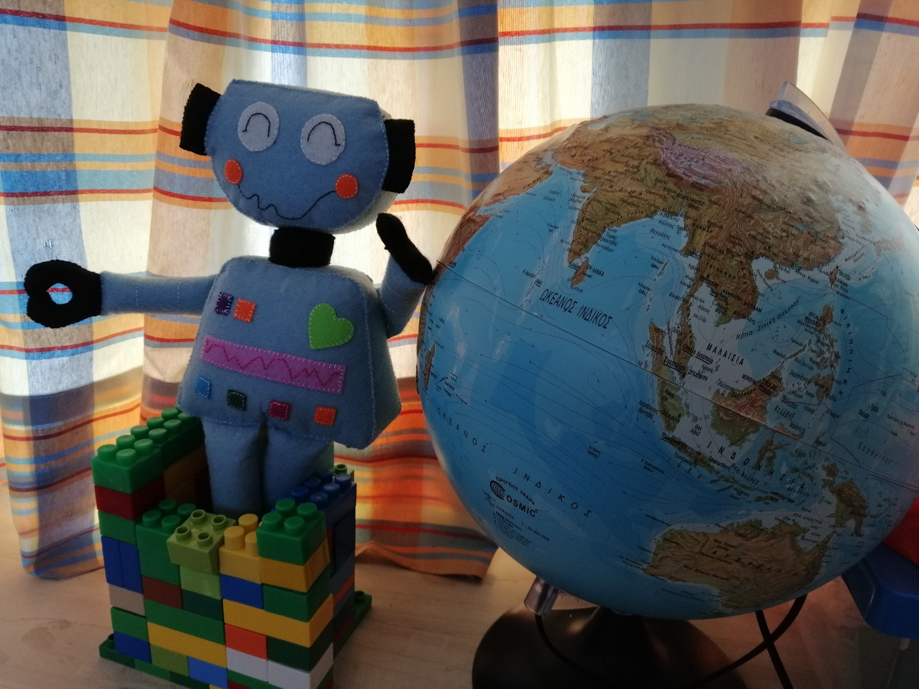
Turkey travels with our help around the world

Slide 10
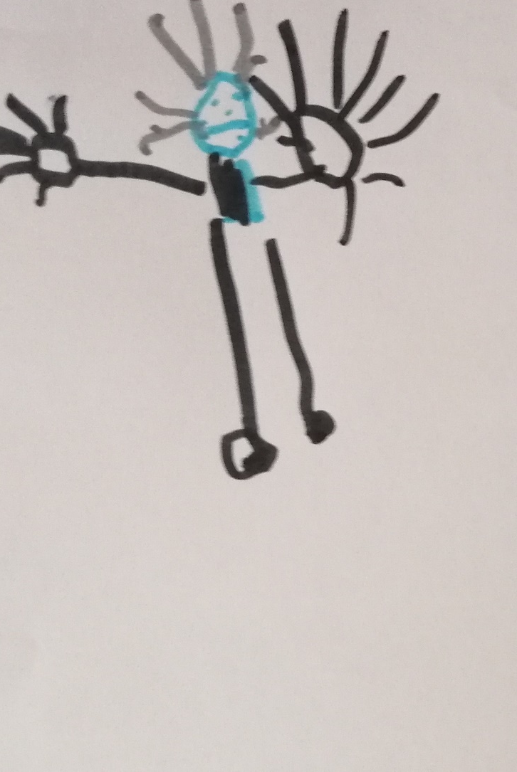
Turkey picture
How students imagine the Turkey robot

Slide 11
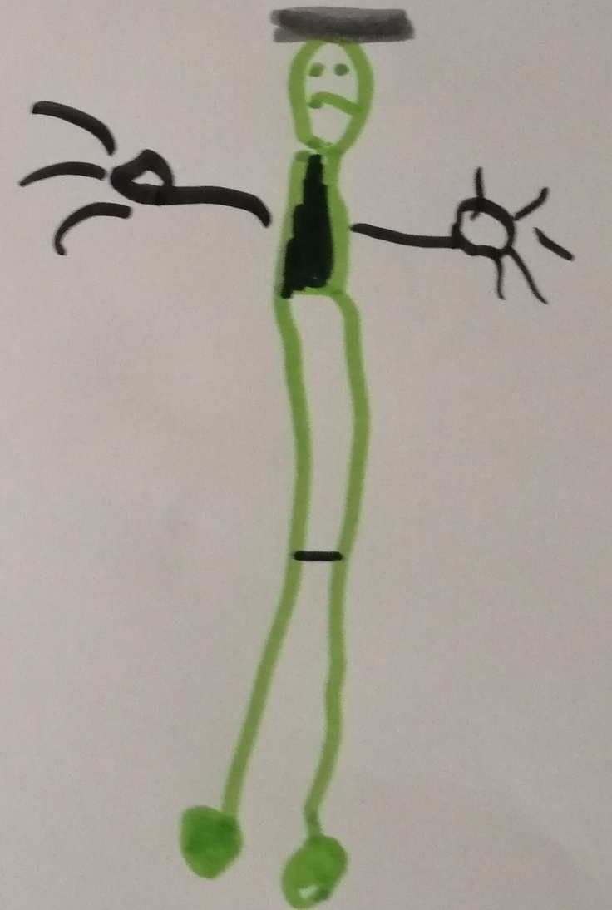
A story about Turkey
Students imagine a story about him:
How he came to our country(by plane).It was a long trip

Slide 12
THANK YOU !

