Slide 1
COLABORATIVE
LEGO MOVIE
NIPIAGOGEIO DREPANOU
Greece

Slide 2

Educational Activity ,as pupils are engaged in a collaborative learning
Reinforce social skills
Strengthen teamwork
Strengthen organization
Strengthen critical thinking and communication

Slide 3
Build up pupils confidence interacting with the other pupils
Increase pupils imagination
Create successful relationships
Conversation skills

Slide 4
HOW WE DID IT
Filming Technique with Lego brics as models
Brainstorm ideas
Create a story with beginning ,middle, end
Reinforce story telling skills, design characters ,create a background
Photograph in a series of slightly different positions so that the objects seem to move. ( move a prop take a photo, move a prop take a photo and so on )
Record their voice

Slide 5
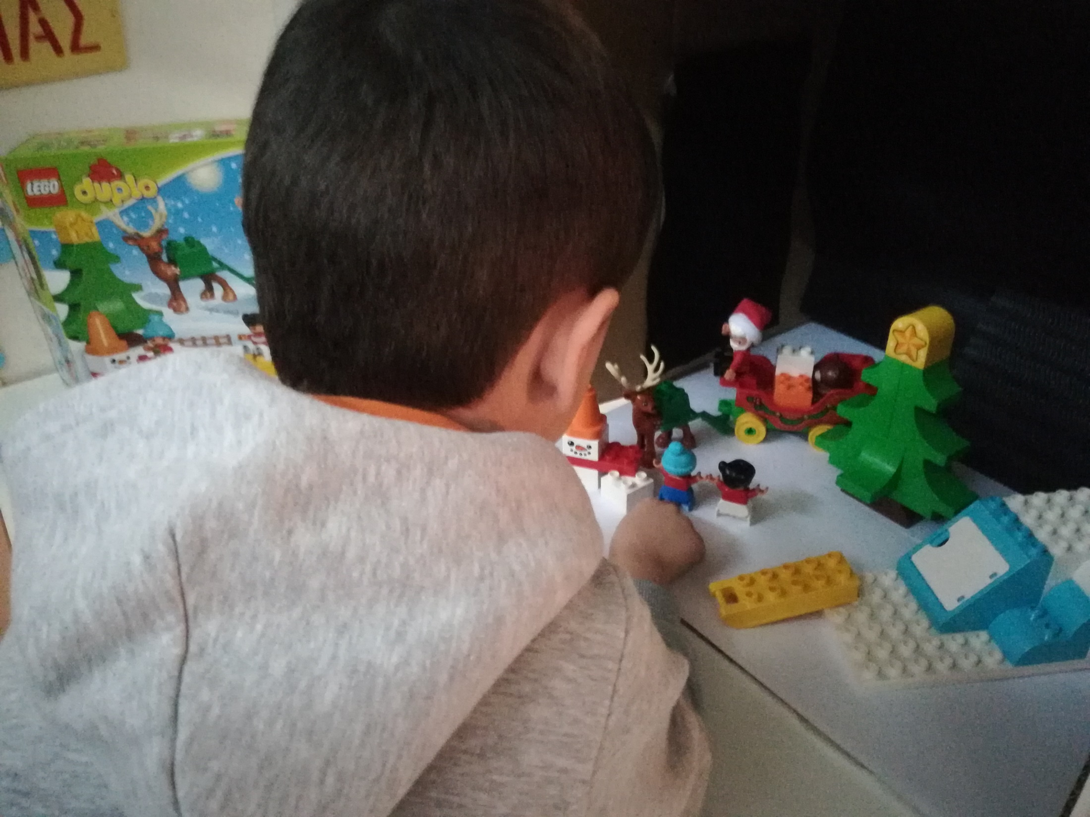

Slide 6
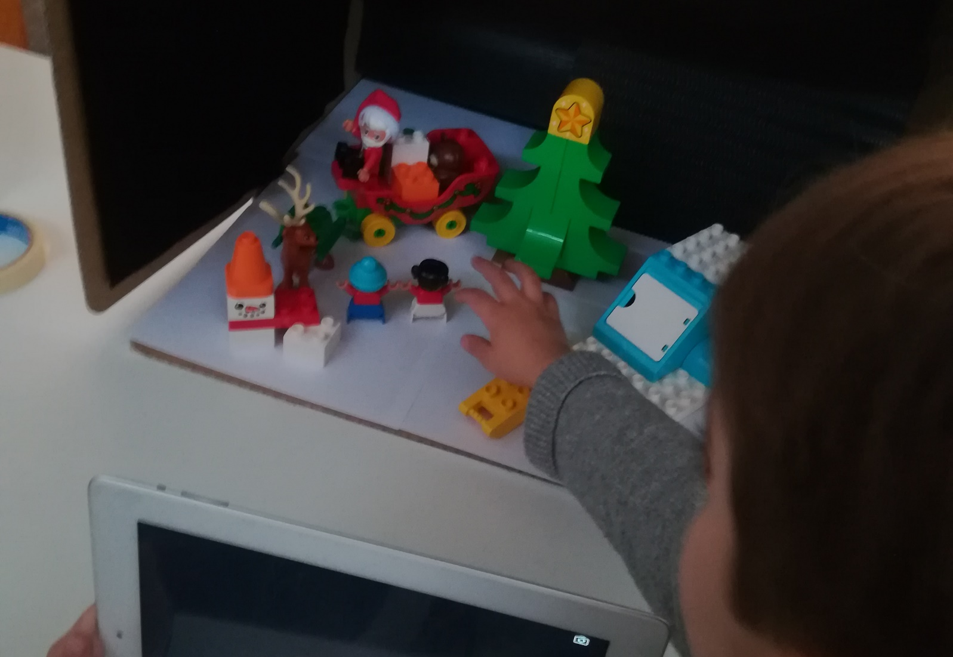
Create a Story
Λεζάντα

Slide 7
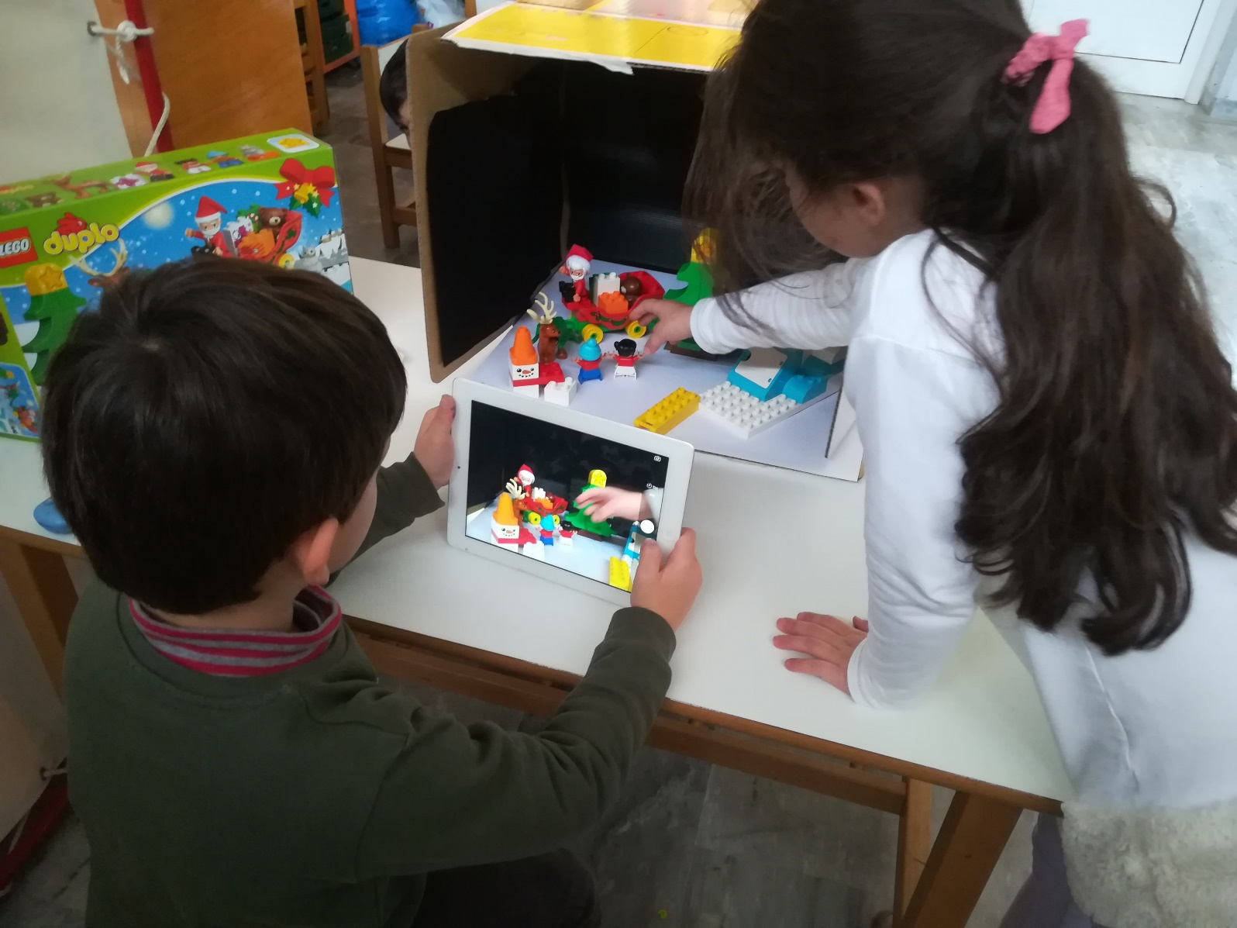
Strengthen team work

Slide 8
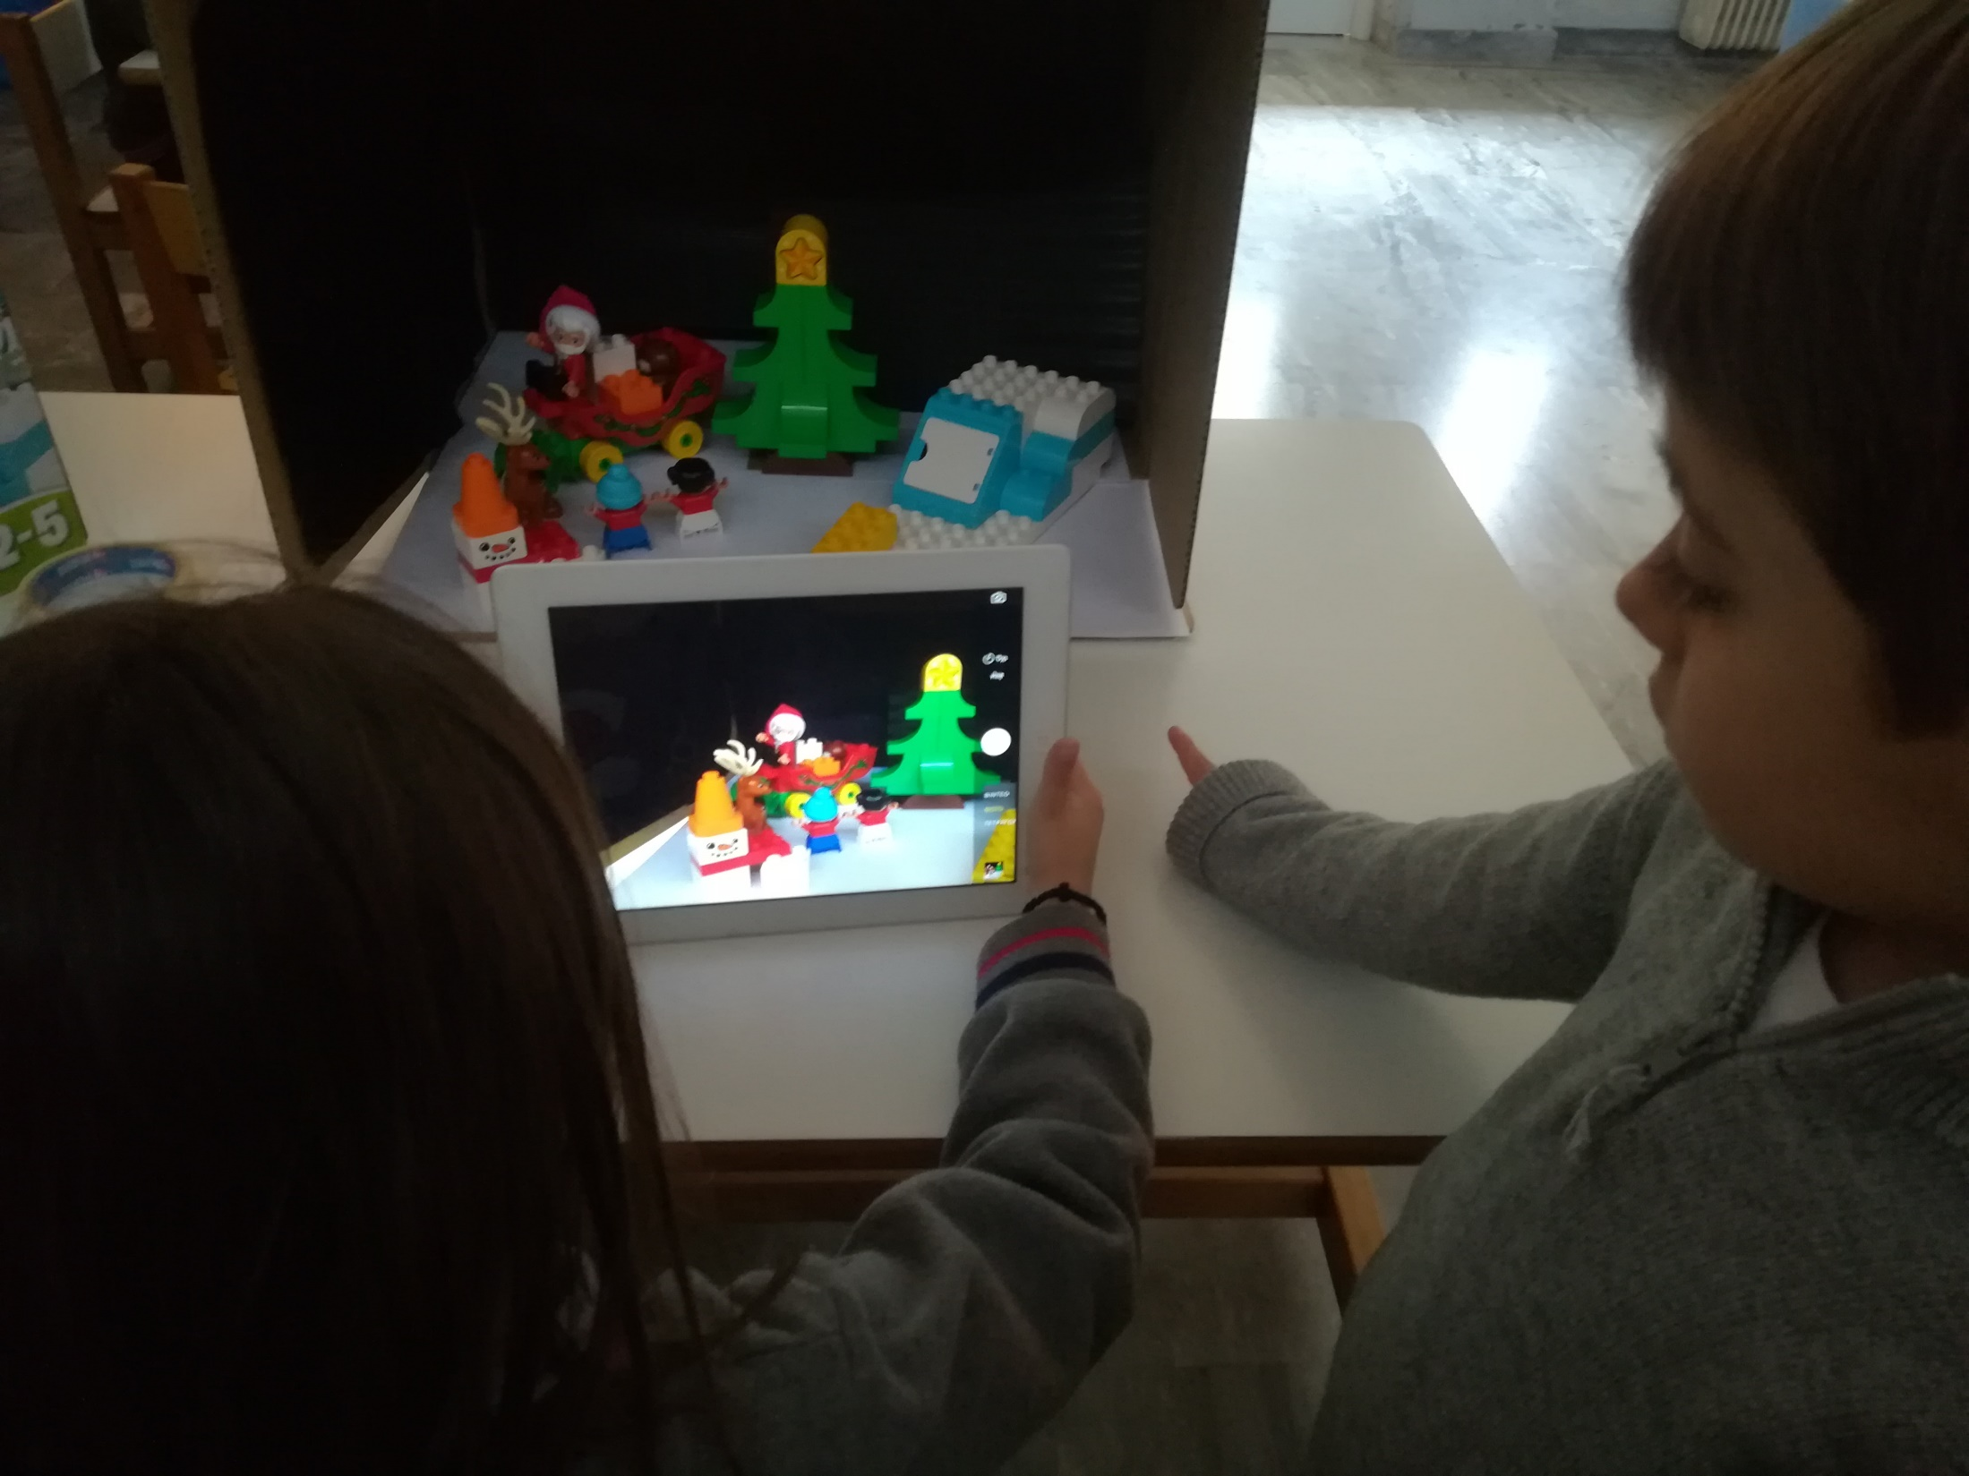
Collaboration

Slide 9
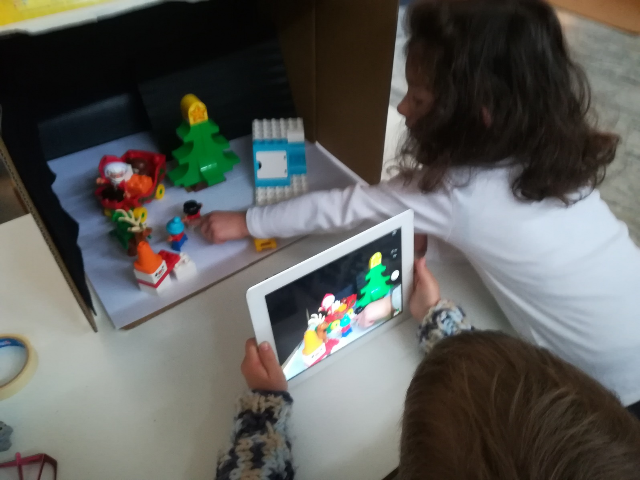
Move a prop take a photo

Slide 10
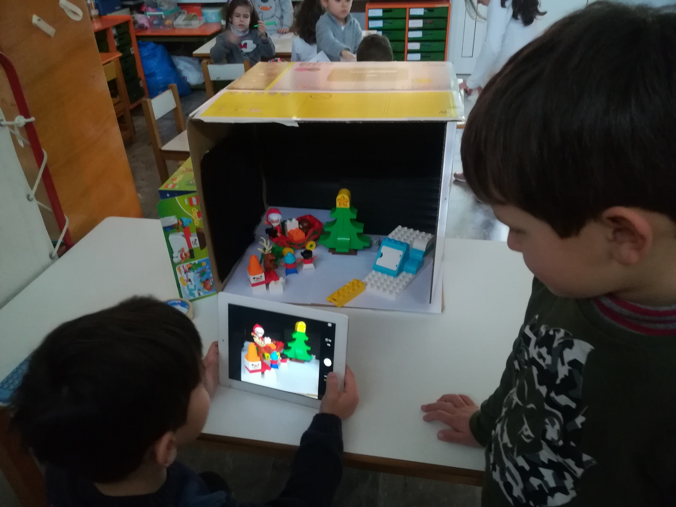
A story with beginning middle end

Slide 11
https://youtu.be/mVUJpD1Sh7A
OUR MOVIE

Slide 12
THANK YOU !

