Slide 1
Cook book for little hands
E-twinning project
A small miracle the kindergarten

Slide 2
recipes
Mytinys (cold fresh bread soup)……………. Jurbarko r. Skirsnemunės Jurgio Baltrušaičio pagrindinė mokykla
Baked pasta with feta cheese and cherry tomatoes……………Kindergarten of Charaka, Hraklio, Creece.
Lithuanian Saltibarsiai (cold beet soup)………………….. Vilniaus Žaliakalnio darželis - mokykla, Lietuva
Pancakes sugar free with banana & oats………………..24 Kindergarten Alexandroupolis, Greece
Greek salad recipe………………..15 Kindergarten of Agia Paraskevi, Athens, Greece.
Banana cake……………………. Kindergarten for Special Education , Ierapetra, Greece.

Slide 3
MYTINYS (COLD FRESH BREAD SOUP)
Jurbarko r. Skirsnemunės Jurgio Baltrušaičio pagrindinė mokykla

Slide 4
Baked pasta with feta cheese and cherry tomatoes

Slide 5
LITHUANIAN SALTIBARSCIAI (COLD BEET SOUP)
Vilniaus Žaliakalnio darželis
mokykla, Lietuva

Slide 6
PANCAKES SUGAR FREE WITH BANANA & OATS

Slide 7
GREEK SALAD RECIPE

Slide 8
BANANA CAKE

Slide 9
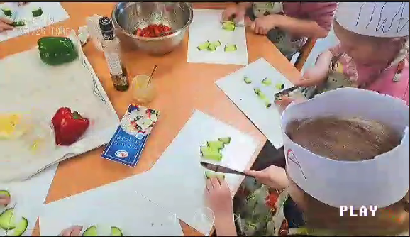
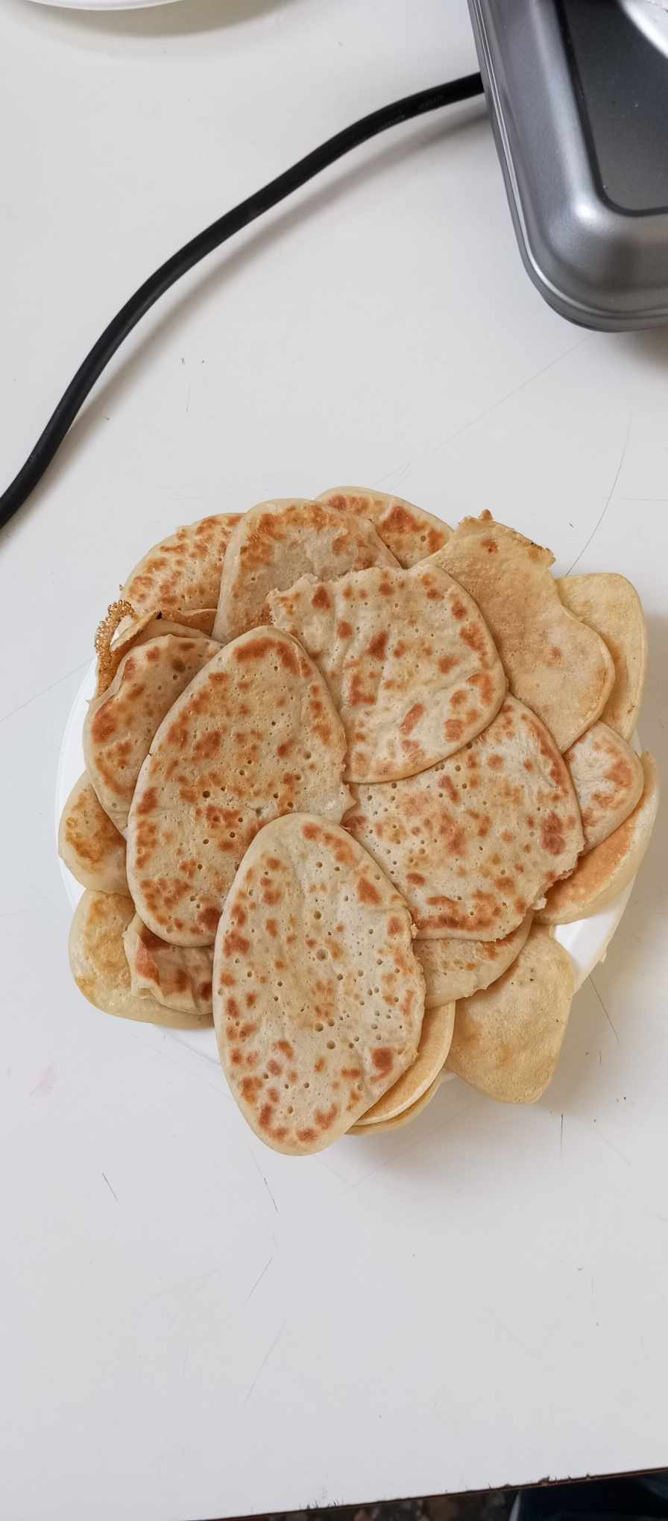
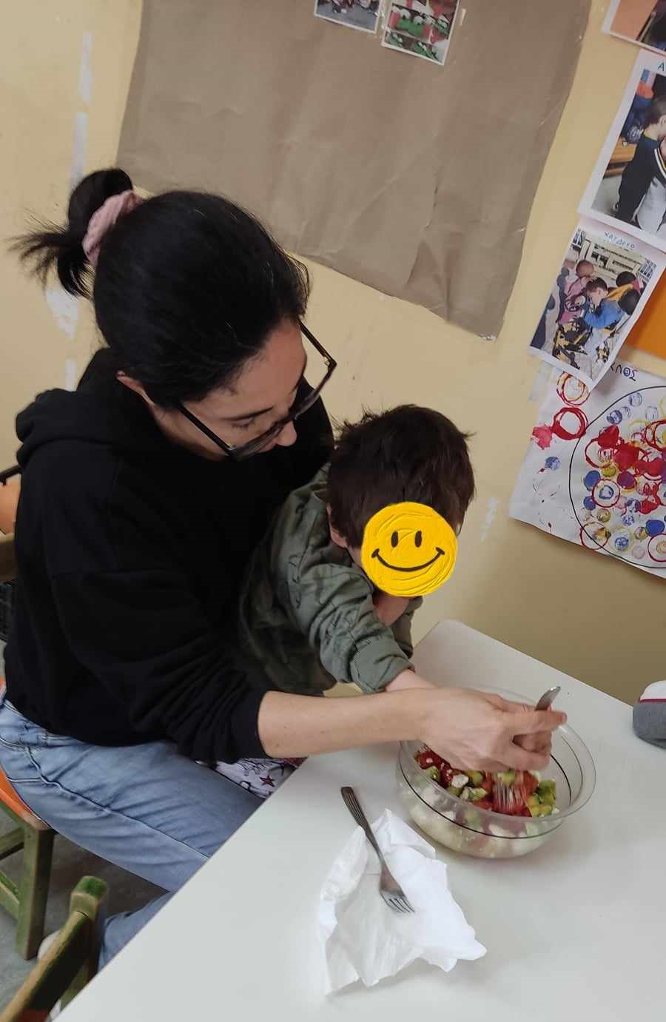
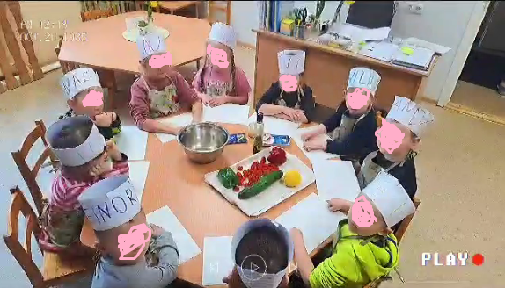

Slide 10
