Slide 1
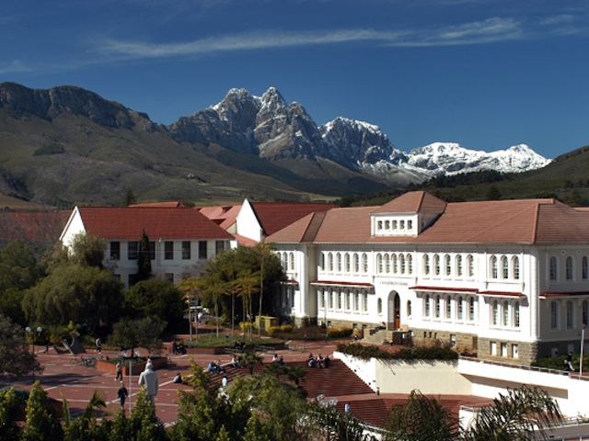
AN IDEAL SCHOOL

Slide 2
Outward Appearance of this school
To begin with, it should have special courts for outdoor activities. Cameras will prevent robbers or/and any other problems. Furthermore, there should be infrastructures for children with special needs and laboratories with special equipment. In front of the building there should be a big yard with benches and grass.

Slide 3
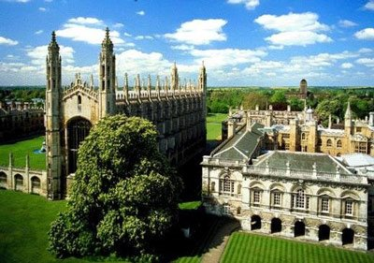
The Dream of every child

Slide 4
The management of this school
First of all, the headmaster and in general the stuff should not be very strict. Extracurricular activities should also take place in order to educate and entertain students. Moreover, school trips play an important role in school life. It is a life-time chance for children to learn more about things that are not taught at school.

Slide 5
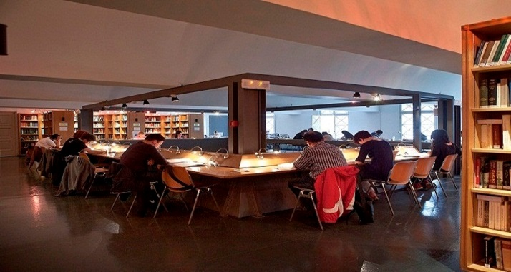
Edit ed by: Agapakis George, Vourexaki Joanna, Arvanitis Dimitris, Eleftheria Kladi

