Slide 1
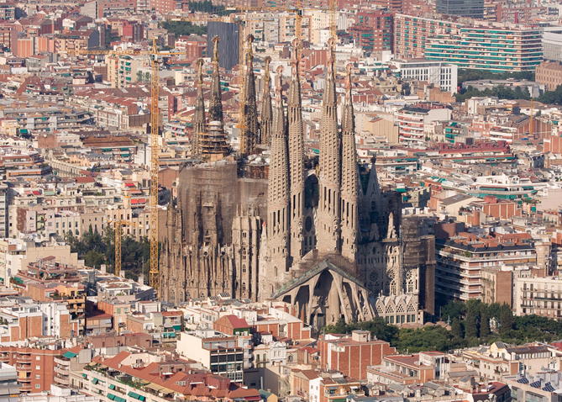
SAGRADA FAMILIA
BY:
Loukas Papaloukas
John Protopappas

Slide 2
Sagrada familia
The Sagrada Família is the largest unfinished Roman Catholic church in the world located in Barcelona, designed by Catalan architect Antonio Gaudí (1852–1926). The highest place of the church will be a little bit sorter that the hill of the city to show that humans cannot surpass god.

Slide 3
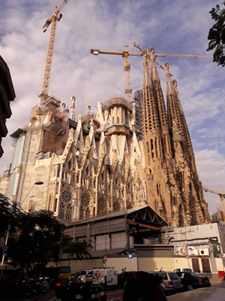
Construction
In 1882, construction of Sagrada Família started under architect Francisco Paula de Villar. In 1883, Gaudí took over transforming the project with his architectural and engineering style. The project could be completed by 2026.

Slide 4
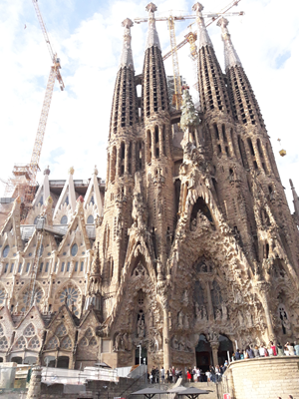
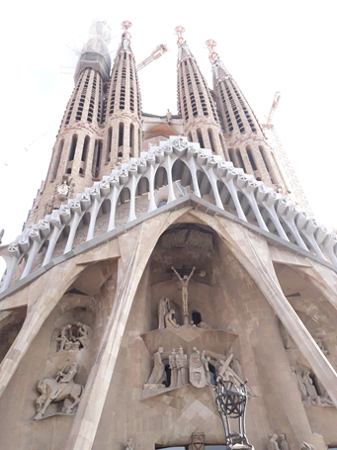
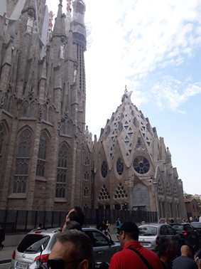
Art style
It has a combination of Gothic and curvilinear Art Nouveau forms. Gaudi's plan was mainly followed but because of the change of the main architect it has a lot of styles on it.

Slide 5
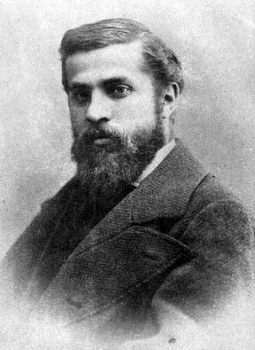
Gaudi’s long story
Gaudi created his own building style but the craziest thing is his death. On 7 June 1926, Gaudí was taking his daily walk outside Sagrada Familia but suddenly he was struck by a passing tram. He died on 10 June 1926 at the age of 73.

Slide 6
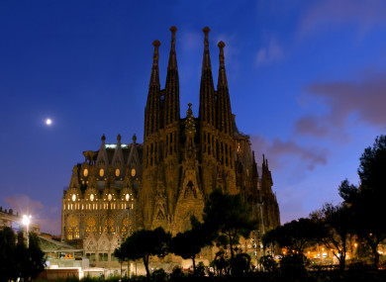
Public acceptance
This statistic shows the ranking of the 15 most visited places of interest in Barcelona in 2016. The Sagrada Familia was the most visited tourist attraction in Barcelona that year, with over 4.56 million visitors.

Slide 7
Information from
Wikipaidia
Sagrada Familia official blog
Statista.com
Loukas Papaloukas ☺

Slide 8
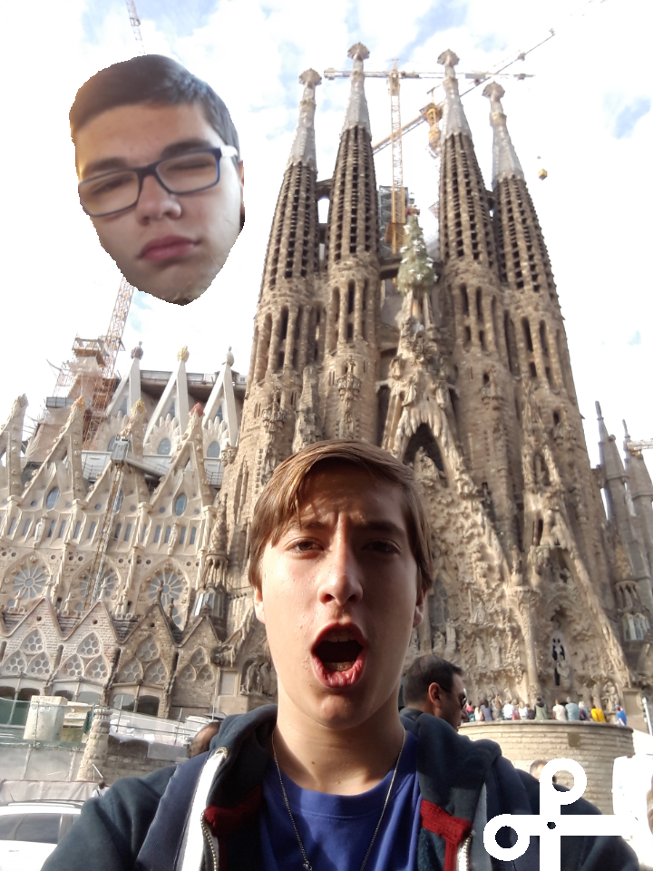
The end!!!☺

