Slide 1
Past Simple Αόριστος Απλός Irregular Verbs Ανώμαλα Ρήματα Τα ανώμαλα ρήματα σχηματίζουν τον Αόριστο με τον δικό τους τρόπο.

Slide 2
Yesterday he ate ice cream.
He did not / didn’t
eat a doughnut.

Slide 3
She made a cake.
She did not / didn’t make pizza.

Slide 4
They drank water.
They didn’t drink orange juice.

Slide 5
Did he forget his keys?
Yes, he did.
Did he forget his wallet?
No, he didn’t.

Slide 6
Did they ride their bikes?
Yes, they did.
Did they ride a horse?
No, they didn’t.

Slide 9
Affirmative-
Kατάφαση
Ρήμα ( 2^{η} στήλη)
I came
You came
He came
She came
It came
We came
You came
They came
Negative- Άρνηση
did not / didn’t + Ρήμα
(1^{η} στήλη)
I did not / didn’t come
You did not / didn’t come
He did not / didn’t come
She did not / didn’t come
It did not / didn’t come
We did not/ didn’t come
You did not / didn’t come
They did not / didn’t come
Question- Ερώτηση
did + Υποκείμενο + Ρήμα
(1^{η} στήλη)
Did I come ?
Did you come?
Did he come?
Did she come?
Did it come?
Did we come?
Did you come?
Did they come?

Slide 10
Το ρήμα To Be κλίνεται με τον δικό του τρόπο.

Slide 11
He was at the library.
Was he at the sports centre?
He was not / wasn’t at the sports cetnre.

Slide 12
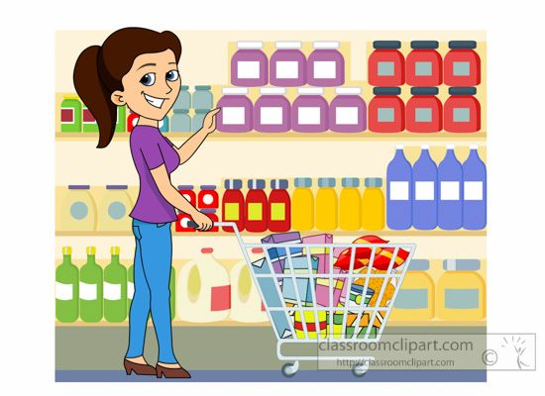
She was at the supermarket.
Was she at the bank?
She was not / wasn’t at the bank.

Slide 13
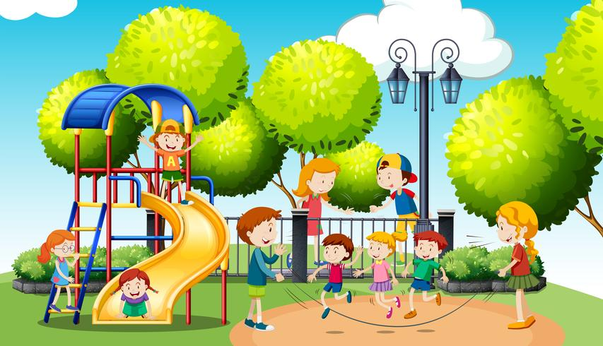
They were at the park.
They were not / weren’t at school.

Slide 14
Affirmative-
Υποκείμενο +
Was / Were
I was
You were
He was
She was
It was
We were
You were
They were
Negative- Άρνηση
Υποκείμενο +
wasn’t / weren’t
I wasn’t
You weren't
He wasn't
She wasn't
It wasn't
We weren’t
You weren't
They weren't
Question- Ερώτηση
Was / Were + Υποκείμενο
Was I ?
were you ?
was he ?
was she ?
was it ?
were we ?
were you ?
were they ?

Slide 15
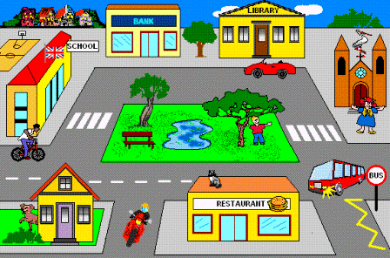
There was =
Υπήρχε
Τhere was a bank next to the library.
There wasn’t a post office next to the library.
Was there a school in town ? Yes, there was.
Was there a museum in town ? No, there wasn’t.

Slide 16
There were =
Υπήρχαν
Τhere were trees at the park.
There weren’t two benches at the park.
Were there trees in town ? Yes, there were.
Were there many cars in town ? No, there weren’t.

Slide 17
Use - Χρήση:
1.Για πραξεις που άρχισαν και τελείωσαν στο παρελθόν
He bought his car last year.
2.Για πραξεις που έγιναν διαδοχικά, η μια μετά την άλλη στο παρελθόν.
She washed her face and brushed her teeth .
Time expressions – Χρονικές Εκφράσεις :
yesterday = χθες / the day before yesterday = προχθές
last week = προηγούμενη, περασμένη εβδομάδα/ last month / last year.. /
a year ago = ένα χρόνο πριν / a week ago / a month ago…
In 2004/ in 1998…

