Slide 1
Past Simple Αόριστος Απλός Regular Verbs Ομαλά Ρήματα

Slide 2
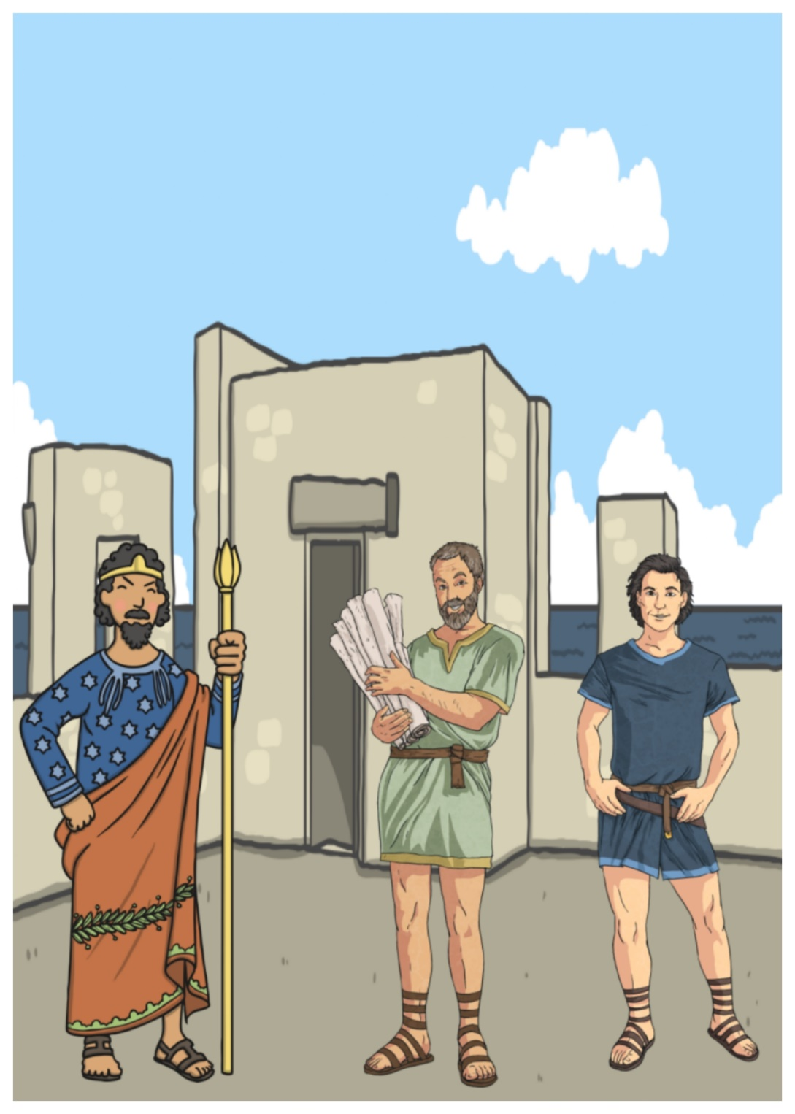
Minos, The King of Crete asked Daedalus and Icarus to build a labyrinth.
But when they finished it, Minos jailed them.

Slide 3
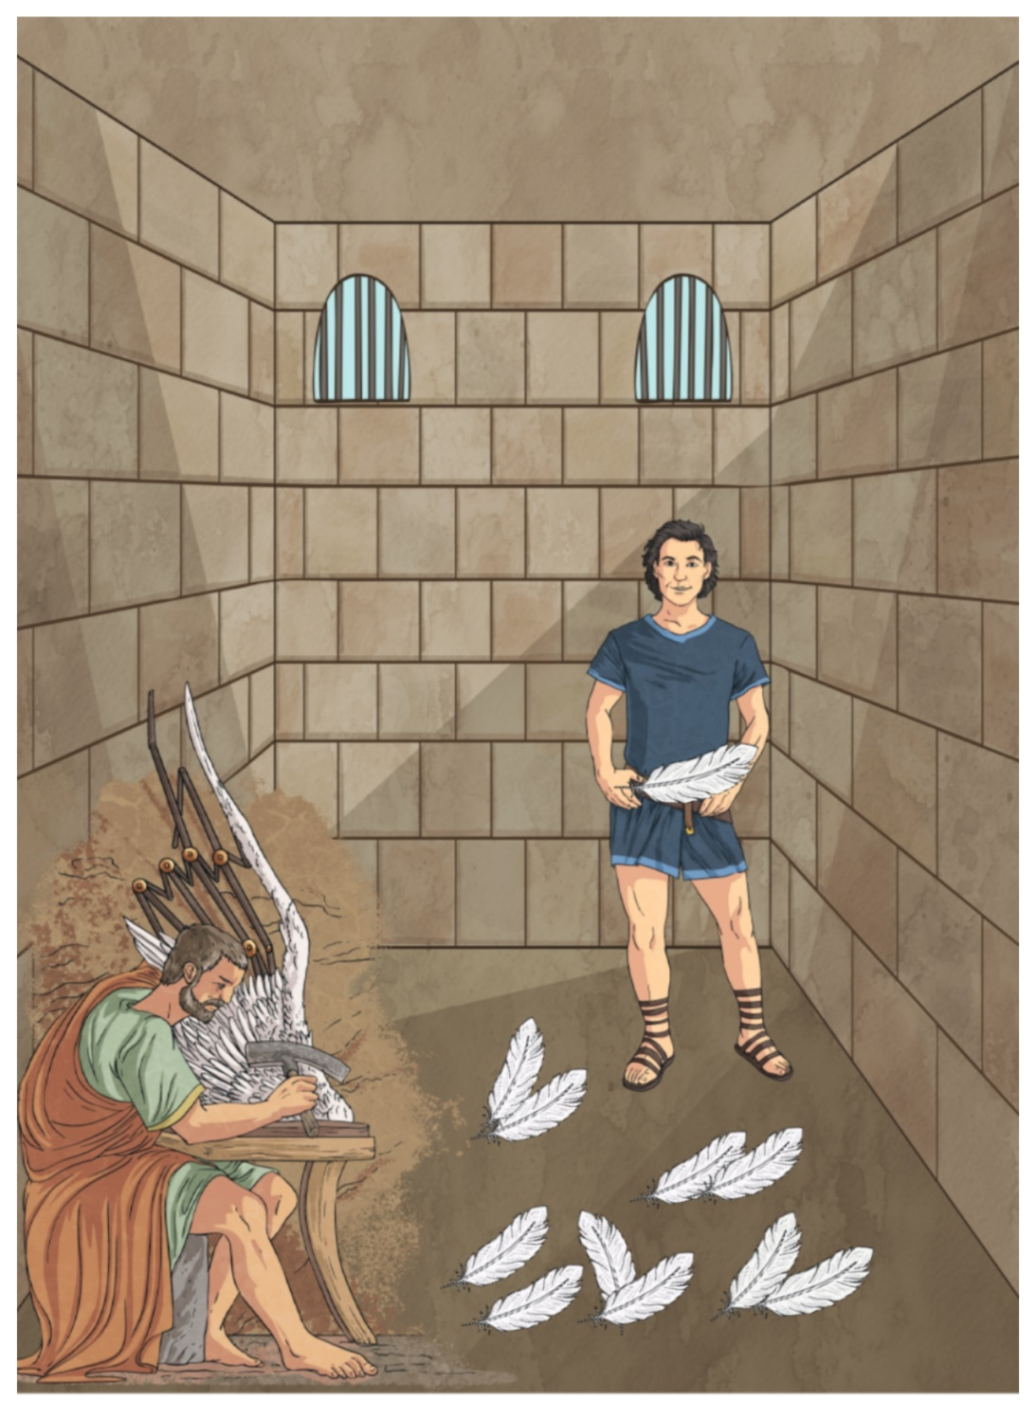
Daedalus and Icarus tried
to create two sets of wings. They used feathers and wax.

Slide 4
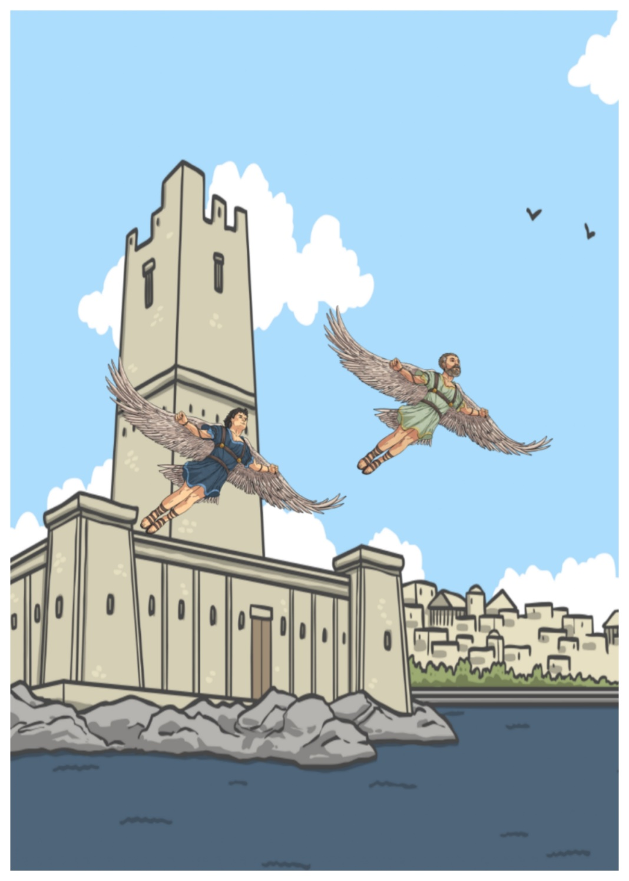
Daedalus and Icarus used the wings to escape from prison .

Slide 5
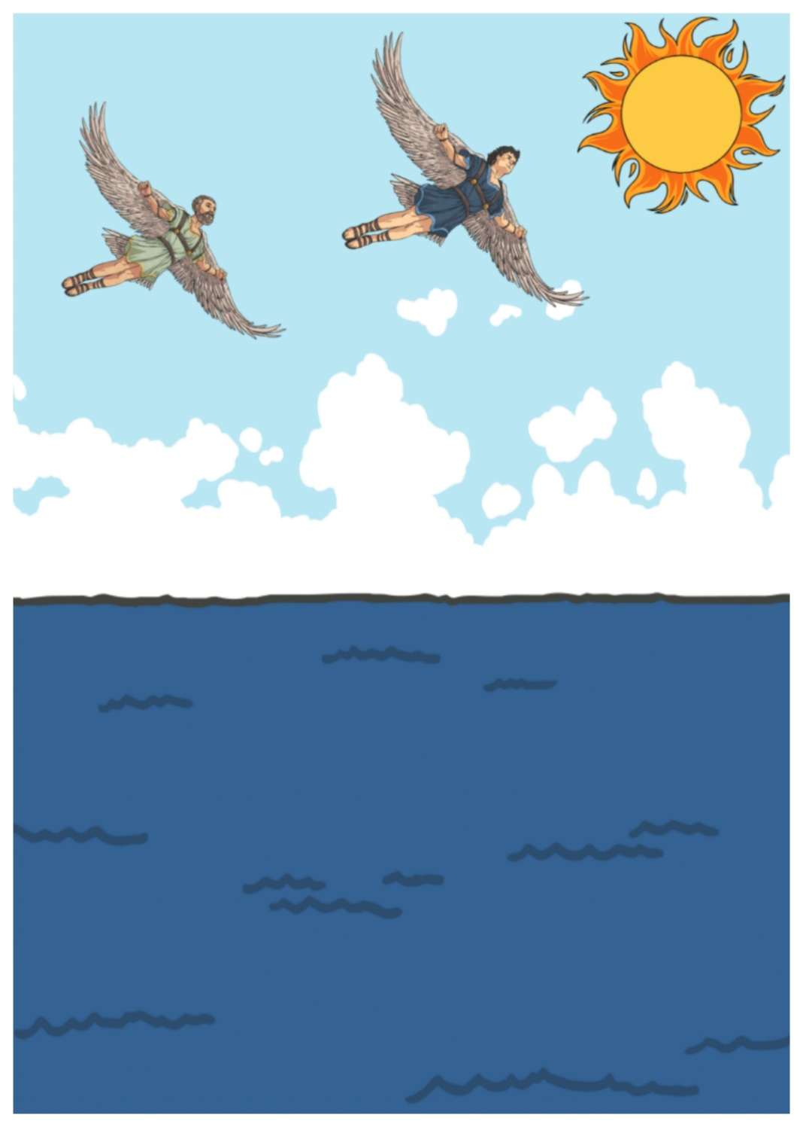
Icarus did not / didn’t stop flying higher and higher.

Slide 6
Did he listen to his father’s advice?
No, he didn’t.

Slide 7
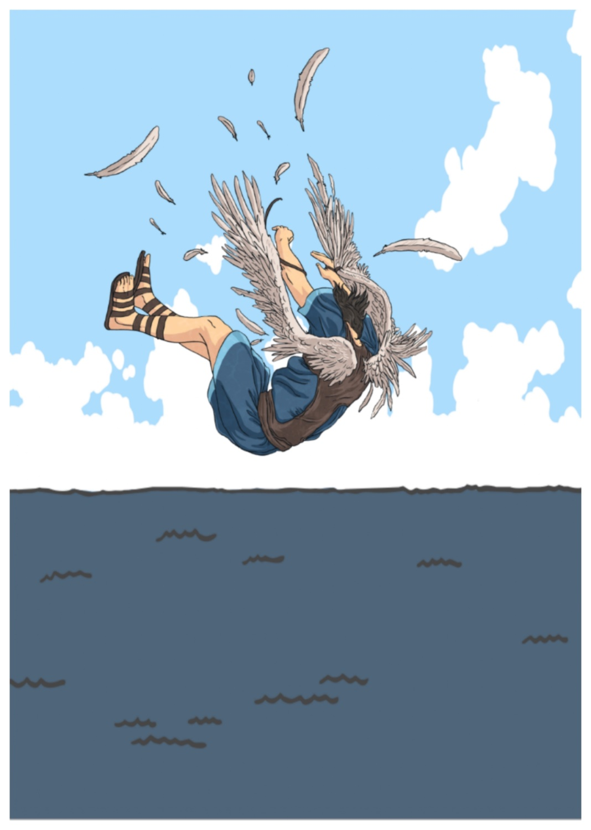
Did the wings start to melt?
Yes, they did.

Slide 8
Affirmative-
Kατάφαση
Ρήμα + ed
I painted
You painted
He painted
She painted
It painted
We painted
You painted
They painted
Question- Ερώτηση
did + Υποκείμενο + Ρήμα
Did I paint ?
Did you paint?
Did he paint?
Did she paint?
Did it paint?
Did we paint?
Did you paint?
Did they paint?
Negative- Άρνηση
did not / didn’t + Ρήμα
I did not / didn’t paint
You did not / didn’t paint
He did not / didn’t paint
She did not / didn’t paint
It did not / didn’t paint
We did not/ didn’t paint
You did not / didn’t paint
They did not / didn’t paint

Slide 9
Κανόνες Ορθογραφίας | Παραδείγματα
Ρήμα + ed | paint → painted play → played
Ρήμα που τελειώνει σε - e + d | move → moved dance → danced
Ρήμα που τελειώνει σε σύμφωνο + y → διώχνει το y + ied | cry → cried carry → carried
Ρήμα που τελειώνει σε σύμφωνο -φωνήεν- σύμφωνο, διπλασιάζει το τελευταίο γράμμα + ed Εξαιρούνται : x / w | stop → stopped plan → planned fix → fixed

Slide 10
Use - Χρήση:
1.Για πραξεις που άρχισαν και τελείωσαν στο παρελθόν
He bought his car last year.
2.Για πραξεις που έγιναν διαδοχικά, η μια μετά την άλλη στο παρελθόν.
She washed her face and brushed her teeth .
Time expressions – Χρονικές Εκφράσεις :
yesterday = χθες / the day before yesterday = προχθές
last week = προηγούμενη, περασμένη εβδομάδα/ last month / last year.. /
a year ago = ένα χρόνο πριν / a week ago / a month ago…
In 2004/ in 1998…

