Slide 1
CIVIL RIGHTS MOVEMENT
IOANNA DIMOKOLIOY – MARIA GIANNOULI
3rd Grade of Neochori High School
School Year 2025-26

Slide 2
Background
The legal institution of human chattel slavery, comprising the enslavement primarily of Africans and African Americans, was prevalent in the United States of America from its founding in 1776 until 1865, predominantly in the South.
Slavery was found throughout European colonization in the Americas. From 1526, during the early colonial period, it was practiced in what became Britain's colonies, including the Thirteen Colonies that formed the United States.

Slide 3
Background (II)
Under the law, children were born into slavery
An enslaved person was treated as property that could be bought, sold, or given away
8 serving presidents had owned slaves
Almost 4,000,000 black people remained enslaved in the South
Only white men with property could vote
Only whites had U.S. citizenship

Slide 4
Following the American Civil War (1861–1865)
the three Reconstruction Amendments to the U.S. Constitution
abolished slavery and
granted citizenship to all African Americans, the majority of whom had recently been enslaved in the southern states.
African-American men in the South voted and
held political office

Slide 5
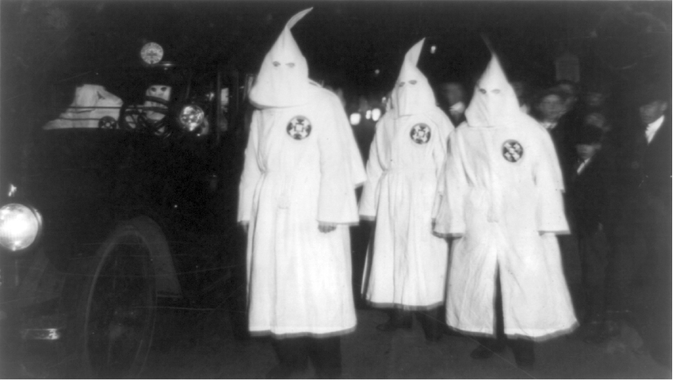
However,
Many whites resisted the social changes, leading to the formation of insurgent paramilitary movements such as the Ku Klux Klan (KKK), whose members
attacked black and white republicans,
violently opposed African-American legal equality and suffrage,
intimidated and suppressed black voters,
assassinated republican officeholders,
in order to maintain white supremacy.

Slide 6
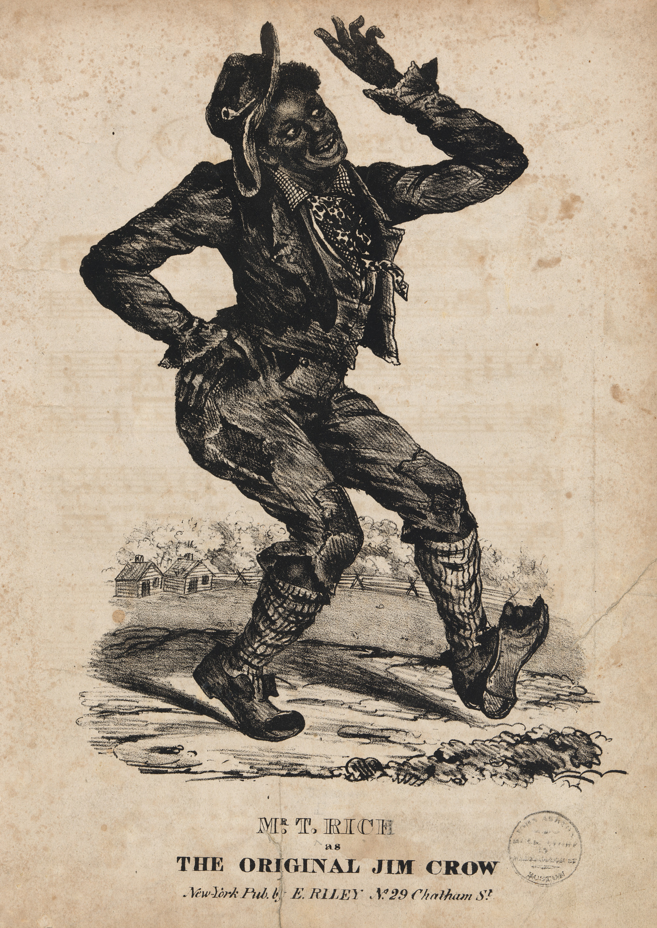
‘Jim Crow Laws’
After 1877, racist Jim Crow laws
banned interracial marriage,
introduced literacy tests for voters,
segregated schools and all public places …
‘Jim Crow Laws’ signs used to show blacks where they could legally
walk,
talk,
drink,
rest, or
eat.
For those places that were racially mixed, non-whites had to wait until all white customers were served first.

Slide 7
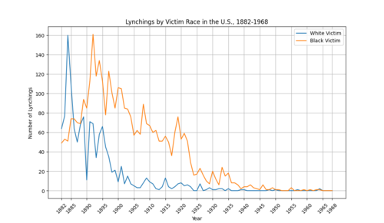
Lynching
Began in the United States’ pre-Civil War South in the 1830s
African Americans who were accused of violating Jim Crow’s laws became the primary victims of lynchings by white Southerners
A major motive for lynchings, particularly in the South, was white society's efforts to maintain white supremacy after the emancipation of enslaved people following the American Civil War
Mostly ended by time of the civil rights movement in the 1950s and 1960s

Slide 8
Paving the way
Hence, African-Americans were
racially segregated,
increasingly deprived of civil rights
treated as having second-class status, and
were subjected to violence from white supremacists
leading to the civil rights movement

Slide 9
Civil Rights Movement
The civil rights movement was a social movement in the United States from 1954 to 1968 which aimed to abolish legalized racial segregation, discrimination, and disenfranchisement in the country, which most commonly affected African Americans.

Slide 10
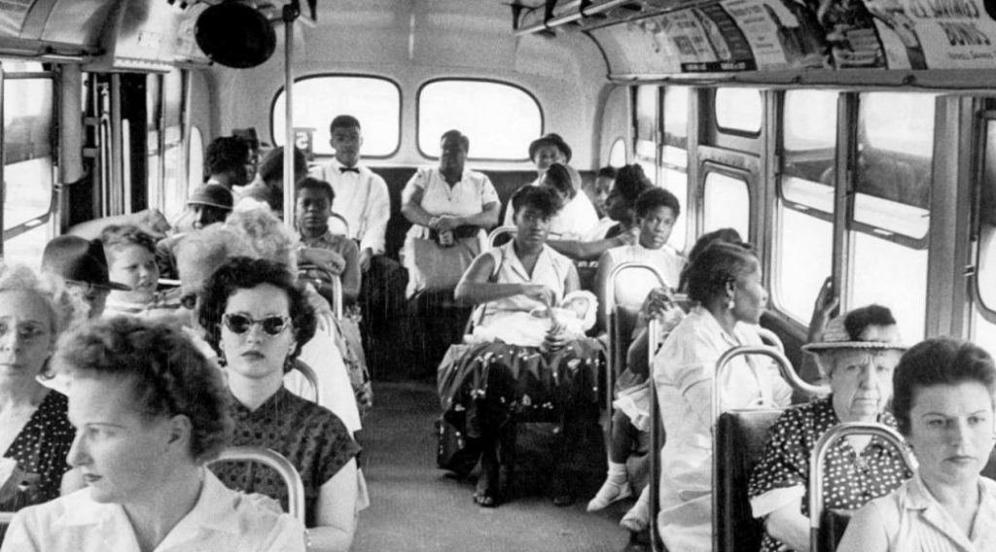
Nonviolent protests and civil disobedience
the Montgomery bus boycott in 1955-1956,
“sit-ins” in Greensboro and Nashville in 1960,
the Birmingham campaign in 1963, and
a march from Selma to Montgomery in 1965.
Press coverage of events such as the lynching of Emmett till in 1955
and the use of fire hoses and dogs against protesters in Birmingham
increased public support for the civil rights movement.

Slide 11
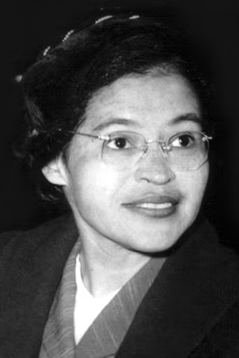
ROSA PARKS
The ‘mother of the civil rights movement’
On December 1, 1955, nine months after a 15-year-old high school student, Claudette Colvin, refused to give up her seat to a white passenger on a public bus in Montgomery, Alabama, and was arrested, Rosa Parks did the same thing.
Parks soon became the symbol of the resulting Montgomery bus boycott and received national publicity.

Slide 12
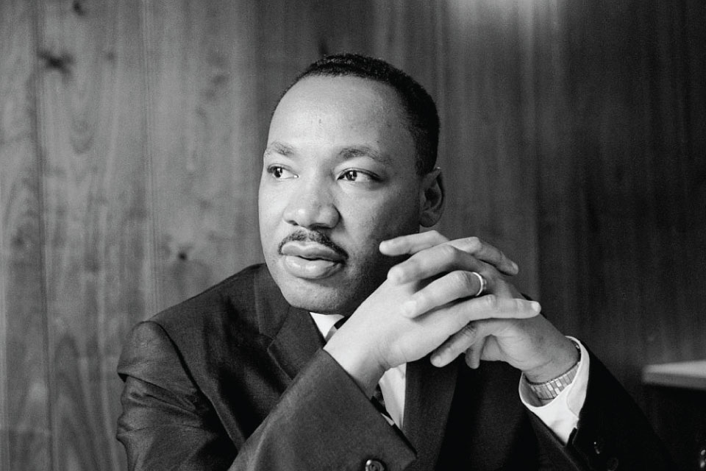
MARTIN LUTHER KING
The most visible spokesperson and leader in the civil rights movement from 1954 until his death in 1968 was Martin Luther King.
King (1929-1968) was an American Baptist minister and activist.
He is best known for advancing civil rights through non-violence.

Slide 13
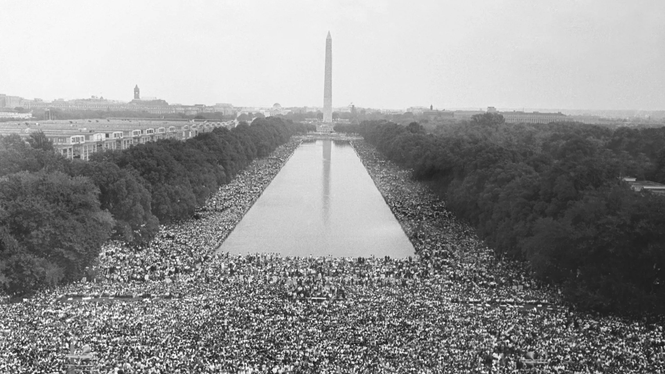
March on Washington, 1963
250,000 people participated in the march on Washington, after which president John F. Kennedy asked congress to pass civil rights legislation
The march had six official goals:
meaningful civil rights laws
a massive federal works program
full and fair employment
decent housing
the right to vote
adequate integrated education.
Of these, the march's major focus was on passage of the civil rights law that the Kennedy administration had proposed after the upheavals in Birmingham.

Slide 14
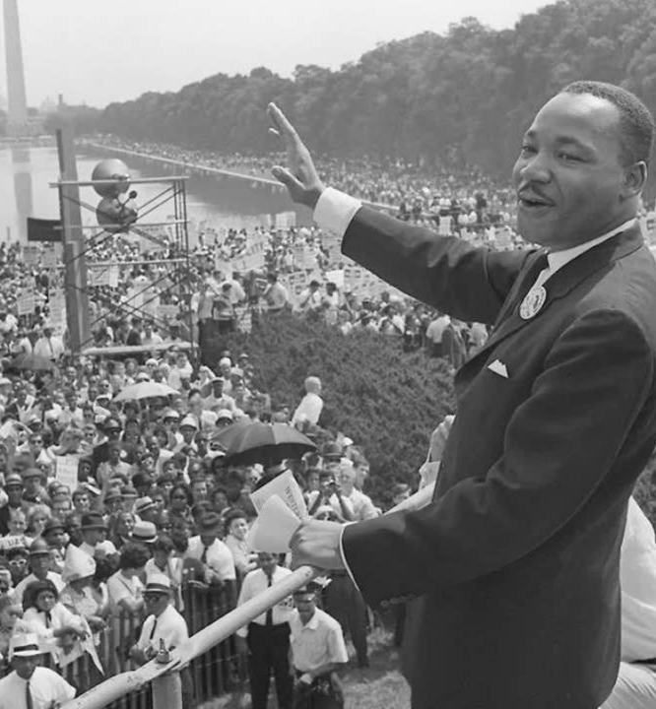
"I Have A Dream"
In front of the Lincoln Memorial, King delivered his famous "I Have A Dream" speech.

Slide 15
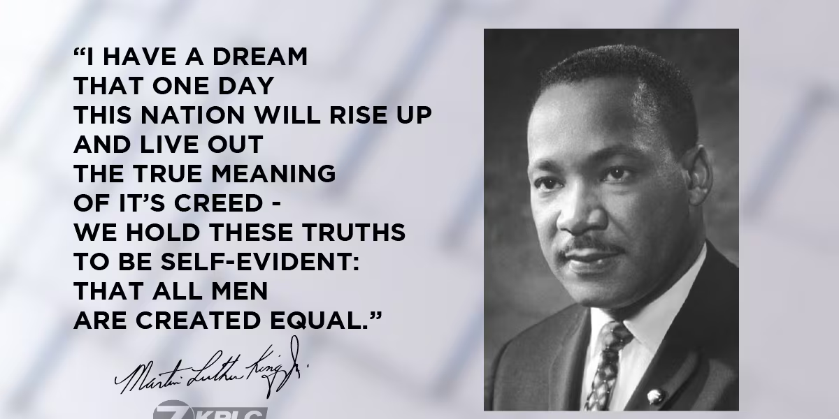

Slide 16
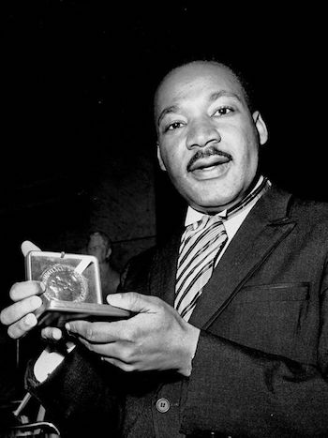
On October 14, 1964, King won the Nobel Peace Prize for combating racial inequality through nonviolent resistance.
In his final years, he expanded his focus to include opposition towards poverty.
In 1968 he was assassinated by James Earl Ray on April 4 in Memphis, Tennessee; riots followed in many U.S. cities.

Slide 17
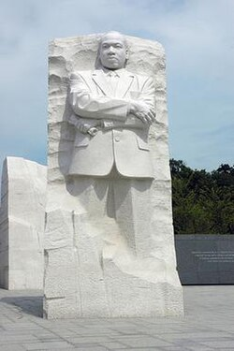
Posthumously
King was awarded the Presidential Medal of Freedom and the Congressional Gold Medal.
Martin Luther King Jr. Day was established as a holiday in numerous cities and states.
Hundreds of streets in the U.S. have been renamed in his honor
A county in Washington State was also rededicated for him.
The Martin Luther King Jr. Memorial on the National Mall in Washington, D.C. was dedicated in 2011.

Slide 18
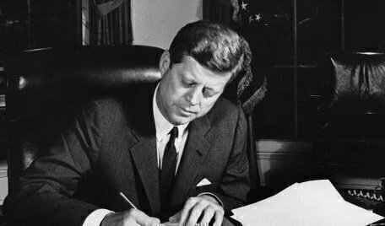
Civil Rights Act of 1964
Although President Kennedy had proposed civil rights legislation and it had support from Northern Congressmen and Senators of both parties, Southern Senators blocked the bill by threatening filibusters. After considerable parliamentary maneuvering and 54 days of filibuster on the floor of the United States Senate, President Johnson got a bill through the Congress.

Slide 19
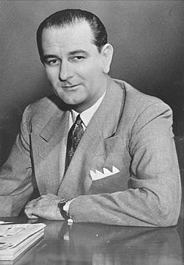
When president Kennedy was assassinated (22/11/1963), the new president Lyndon Johnson decided to use his influence in congress to bring about much of Kennedy's legislative agenda.
Johnson overcame the opposition of Southern politicians to pass three major laws:
The Civil Rights Act Of 1964, which prohibited discrimination based on race, color, religion, sex, or national origin in public accommodations, employment, and federally assisted programs;
The Voting Rights Act Of 1965, which outlawed discriminatory voting laws and authorized federal oversight of election law in areas with a history of Voter Suppression; and
the Fair Housing Act Of 1968, which banned Housing Discrimination.

Slide 20
Thank you !!!!

Slide 21
SOURCES
https://en.Wikipedia.org/wiki/Civil rights movement
https://www.uncsa.edu/chancellor/communications/20220117-martin-luther-king-jr.aspx
https://www.biography.com/activists/rosa-parks
https://en.wikipedia.org/wiki/Slavery_in_the_United_States
https://edition.cnn.com/2015/08/12/us/north-carolina-mlk-jr-i-have-a-dream-recording
https://www.kplctv.com/2019/08/28/th-anniversary-i-have-dream-speech/
https://constitutioncenter.org/blog/10-fascinating-facts-about-president-john-f-kennedy
https://www.google.com/url?sa=i&url=https%3A%2F%2Fen.wikipedia.org%2Fwiki%2FLyndon_B._Johnson&psig=AOvVaw2HQentvaM3eMg0KX3W7ipY&ust=1771502089093000&source=images&cd=vfe&opi=89978449&ved=0CBUQjRxqFwoTCIjq0Nv94pIDFQAAAAAdAAAAABAE
https://www.google.com/url?sa=i&url=https%3A%2F%2Fbillofrightsinstitute.org%2Fessays%2Fthe-ku-klux-klan-in-the-1920s%2F&psig=AOvVaw18_6_zc585GgJWu_DN5gxy&ust=1771502497921000&source=images&cd=vfe&opi=89978449&ved=0CBUQjRxqFwoTCIjT1p7_4pIDFQAAAAAdAAAAABAE
https://www.google.com/url?sa=i&url=https%3A%2F%2Fnpg.si.edu%2Fobject%2Fnpg_NPG.2022.102&psig=AOvVaw24xUMnczmeOg_hqLPWaaQR&ust=1772105161656000&source=images&cd=vfe&opi=89978449&ved=0CBUQjRxqFwoTCPi4hrTE9JIDFQAAAAAdAAAAABAE
https://www.google.com/url?sa=i&url=https%3A%2F%2Fsocialism.com%2Ffs-article%2Ffs-book-review-montgomery-bus-boycott-women-started%2F&psig=AOvVaw35JU_StPnC0CZv5AjNG-Dh&ust=1772105720518000&source=images&cd=vfe&opi=89978449&ved=0CBUQjRxqFwoTCJic8LvG9JIDFQAAAAAdAAAAABAE

Slide 22
SOURCES
https://www.google.com/url?sa=i&url=https%3A%2F%2Fwww.kplctv.com%2F2019%2F08%2F28%2Fth-anniversary-i-have-dream-speech%2F&psig=AOvVaw21rFqcbCXup7Xxq17Xy6zB&ust=1772105967926000&source=images&cd=vfe&opi=89978449&ved=0CBUQjRxqFwoTCIC37anH9JIDFQAAAAAdAAAAABAE
https://www.google.com/url?sa=i&url=https%3A%2F%2Fwww.axios.com%2F2023%2F08%2F25%2Fmarch-on-washington-60th-anniversary-george-floyd&psig=AOvVaw3JEIFD0yAOnID6VqE-mlT8&ust=1772106299977000&source=images&cd=vfe&opi=89978449&ved=0CBUQjRxqFwoTCKCXh8_I9JIDFQAAAAAdAAAAABAE
https://www.google.com/url?sa=i&url=https%3A%2F%2Faaregistry.org%2Fstory%2Frev-dr-martin-luther-king-jr-awarded-nobel-peace-prize%2F&psig=AOvVaw2MbzSk3SZD96XzHhW7kywH&ust=1772106431526000&source=images&cd=vfe&opi=89978449&ved=0CBUQjRxqFwoTCPjB2ojJ9JIDFQAAAAAdAAAAABAE
https://en.wikipedia.org/wiki/Martin_Luther_King_Jr._Memorial
https://en.wikipedia.org/wiki/Lynching_in_the_United_States

