Slide 1


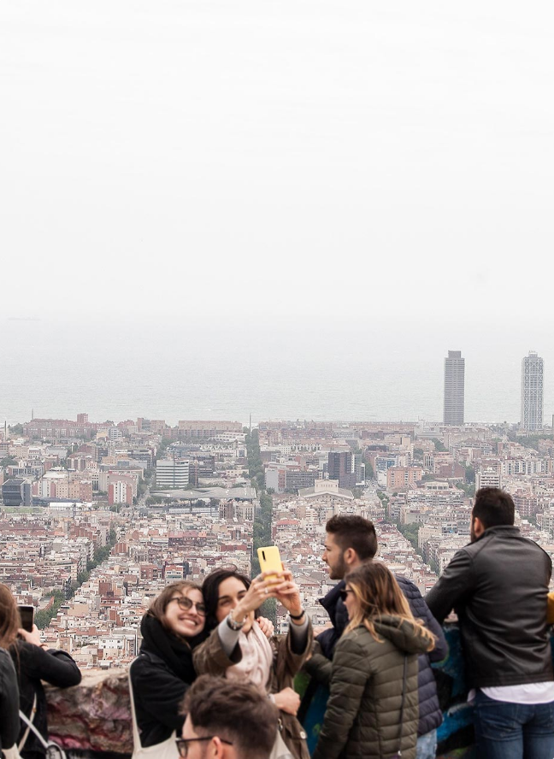

Erasmus+ Programme: Empowering Collaboration and Learning
A dynamic week of workshops, cultural exchanges, and immersive educational activities fostering student mobility and intercultural understanding.
Katerina Sarantinou

Slide 2







Monday 20th October: Aligning, Exploring, and Connecting
Kick off with a formal meeting among project participants, school authorities, and Erasmus+ coordinator to align objectives
Explore the learning environment through a detailed school presentation and guided tour
Engage in collaborative meetings, immersive tours, and cultural storytelling to inspire teamwork and intercultural insight.
Build connections with engaging ice-breaking activities that foster teamwork and engagement
Discover local heritage with an interactive tour of Madamados and connecting spots, blending myths with experiential learning
Share insights and experiences through presentations and exchanges to deepen intercultural dialogue and reflection

Slide 3









Discovering Democracy’s Roots in Mililene City
Explore how historic sites reveal the evolution of democratic values and civic governance
Visit the ancient town to understand early governance and community organization
Explore the medieval castle, highlighting feudal power structures and emerging democratic ideas
Tour the Ottoman baths to connect cultural influences with civic life and social governance
Experience how each site links historical governance to modern democratic values
Enhance understanding of political development through tangible heritage and civic education

Slide 4

Explore Lesvos' Nature Through Action and Inquiry
Engage in immersive talks, hands-on planting, and scientific field research to deepen your environmental connection.
In-depth talks on Lesvos’ unique ecosystems and natural heritage
Hands-on planting activities fostering practical ecological stewardship
Field research exposure introducing scientific methods and data collection
Activities designed to promote inquiry-based learning and environmental responsibility
Supports sustainability education by raising awareness of local biodiversity

Slide 5





Explore Lesvos: Petrified Forest, Paleontology, and Sustainable Textiles
A dynamic day blending natural history, hands-on learning, cultural breaks, and eco-conscious fashion innovation
Visit the Petrified Forest of Lesvos to explore ancient geological formations and fossil records
Engage in paleontological workshops to deepen understanding of geological time and fossilization
Enjoy lunch and cultural pause at Vathilimno, connecting with local traditions
Participate in a knit machine workshop emphasizing sustainability in texture and clothing design
Experience interdisciplinary learning by linking environmental science with practical fashion applications

Slide 6










Empowering Reflection and Cultural Unity on October 24th
Explore history, celebrate heritage, and strengthen community through workshops, dance, and shared festivities
Engage In A Powerful Workshop On The Nazi Occupation Of Greece That Deepens Historical Understanding And Critical Reflection
Share And Exchange Traditional Dances To Promote Cultural Heritage Appreciation And Foster Social Cohesion
Prepare And Celebrate OXI Day, Honoring Greek Resistance And National Pride Through Meaningful Cultural Activities
Present Insights From The Week’s Workshops During Erasmus Days, Showcasing Shared Learning And Collaboration
Conclude The Day With A Lively Farewell Party That Reinforces Community Bonds And Celebrates Collective Achievements

