Slide 1
Alessandro Botticelli
Artist of renaissance
Ζωή Αγγελοπούλου
Εργασία στο μάθημα των Αγγλικών
Σχολικό έτος: 2022-2023

Slide 2
A litle bit about him
Alessandro di Mariano di Vanni Filipepi was born in 1445 and died in May 17 1510, known as Sandro Botticelli, was an Italian painter of the Early Renaissance. Botticelli's posthumous reputation suffered until the late 19th century, when he was rediscovered by the Pre-Raphaelites who stimulated a reappraisal of his work. Since then, his paintings have been seen to represent the linear grace of late Italian Gothic and some Early Renaissance painting, even though they date from the latter half of the Italian Renaissance period.

Slide 3
Early life
Botticelli was born in the city of Florence in a house in the street still called Borgo Ognissanti. He lived in the same area all his life and was buried in his neighbourhood church called Ognissanti ("All Saints"). Sandro was one of several children to the tanner Mariano di Vanni d'Amedeo Filipepi and mother Smeralda Filipepi, and the youngest of his four to survive into adulthood. In 1464, his father bought a house in the nearby Via Nuova in which Sandro lived from 1470 until his death in 1510. Botticelli both lived and worked in the house, despite his brothers Giovanni and Simone also being resident there. The family's most notable neighbours were the Vespucci, including Amerigo Vespucci. The Vespucci were Medici allies and eventually regular patrons of Botticelli. The nickname Botticelli, meaning "little barrel", derives from the nickname of Sandro's brother, Giovanni, who was called Botticello apparently because of his round stature. A document of 1470 refers to Sandro as "Sandro Mariano Botticelli", meaning that he had fully adopted the name.

Slide 4
His carrer before Rome
From around 1461 or 1462 Botticelli was apprenticed to Fra Filippo Lippi, one of the leading Florentine painters and a favorite of the Medici. It was from Lippi that Botticelli learned how to create intimate compositions with beautiful, melancholic figures drawn with clear contours and only slight contrasts of light and shadow. In the late 1450s, Botticelli entered into Filippo Lippi’s workshop, and Lippi’s style is seen in many of Botticelli’s paintings, especially his earliest works. For much of this period Lippi was based in Prato, a few miles west of Florence, frescoing the apse of what is now Prato Cathedral. Botticelli probably left Lippi's workshop by April 1467, when the latter went to work in Spoleto. There has been much speculation as to whether Botticelli spent a shorter period of time in another workshop, such as that of the Pollaiuolo brothers or Andrea del Verrocchio. However, although both artists had a strong impact on the young Botticelli's development, the young artist's presence in their workshops cannot be definitively proven.

Slide 5
Lippi died in 1469. Botticelli must have had his own workshop by then, and in June of that year he was commissioned a panel of Fortitude to accompany a set of all Seven Virtues commissioned one year earlier from Piero del Pollaiuolo. Botticelli's panel adopts the format and composition of Piero's but features a more elegant and naturally posed figure and includes an array of fanciful enrichments so as to show up Piero's poverty of ornamental invention.
In 1472 Botticelli took on his first apprentice, the young Filippino Lippi, son of his master. Botticelli and Filippino's works from these years, including many Madonna and Child paintings, are often difficult to distinguish from one another. The two also routinely collaborated, as in the panels from a dismantled pair of cassoni, now divided between the Louvre, the National Gallery of Canada, the Musée Condé in Chantilly and the Galleria Pallavicini in Rome.

Slide 6
Some early paintings
Botticelli's earliest surviving altarpiece is a large sacra conversazione of about 1470–72, now in the Uffizi. The painting shows Botticelli's early mastery of composition, with eight figures arranged with an "easy naturalness in a closed architectural setting". Another work from this period is the Saint Sebastian in Berlin, painted in 1474 for a pier in Santa Maria Maggiore, Florence. This work was painted soon after the Pollaiuolo brothers' much larger altarpiece of the same saint. Though Botticelli's saint is very similar in pose to that by the Pollaiuolo, he is also calmer and more poised. The almost nude body is very carefully drawn and anatomically precise, reflecting the young artist's close study of the human body. The delicate winter landscape, referring to the saint's feast-day in January, is inspired by contemporary Early Netherlandish painting, widely-appreciated in Florentine circles.

Slide 7
The Adoration of the Magi for Santa Maria Novella was singled out for praise by Vasari, and was in a much-visited church, so spreading his reputation. It can be thought of as marking the climax of Botticelli's early style. Despite being commissioned by a money-changer, or perhaps money-lender, not otherwise known as an ally of the Medici, it contains the portraits of Cosimo de Medici, his sons Piero and Giovanni, and his grandsons Lorenzo and Giuliano. There are also portraits of the donor and, in the view of most, Botticelli himself, standing at the front on the right. The painting was celebrated for the variety of the angles from which the faces are painted, and of their expressions. A large fresco for the customs house of Florence, that is now lost, depicted the execution by hanging of the leaders of the Pazzi conspiracy of 1478 against the Medici. It was a Florentine custom to humiliate traitors in this way, by the so-called "pittura infamante". This was Botticelli's first major fresco commission, and may have led to his summons to Rome. The figure of Francesco Salviati, Archbishop of Pisa was removed in 1479, after protests from the Pope, and the rest were destroyed after the expulsion of the Medici and return of the Pazzi family in 1494.

Slide 8
Another lost work was a tondo of the Madonna ordered by a Florentine banker in Rome to present to Cardinal Francesco Gonzaga. A fresco in the Palazzo Vecchio, headquarters of the Florentine state, was lost in the next century when Vasari remodelled the building. In 1480 the Vespucci family commissioned a fresco figure of Saint Augustine for the Ognissanti, their parish church, and Botticelli's. Someone else, probably the order running the church, commissioned Domenico Ghirlandaio to do a facing Saint Jerome; both saints were shown writing in their studies, which are crowded with objects. As in other cases, such direct competition "was always an inducement to Botticelli to put out all his powers", and the fresco, now his earliest to survive, is regarded as his finest by Ronald Lightbown.

Slide 9
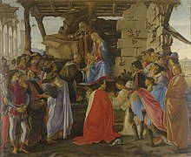

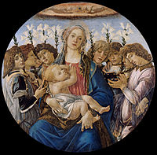
Some of his paintings

Slide 10
Sistine Chapel
In 1481, Pope Sixtus IV summoned Botticelli and other prominent Florentine and Umbrian artists to fresco the walls of the newly completed Sistine Chapel. This large project was to be the main decoration of the chapel. Botticelli painted a series of portraits of popes. These works were called Temptation of Moses, Temptation of Christ, and Conturbation of the Laws of Moses. Most of the frescos remain but are greatly overshadowed and disrupted by Michelangelo's work of the next century, as some of the earlier frescos were destroyed to make room for his paintings. The Florentine contribution is thought to be part of a peace deal between Lorenzo Medici and the papacy. After Sixtus was implicated in the Pazzi conspiracy hostilities had escalated into excommunication for Lorenzo and other Florentine officials and a small "Pazzi War".

Slide 11
The iconographic scheme was a pair of cycles, facing each other on the sides of the chapel, of the Life of Christ and the Life of Moses, together suggesting the supremacy of the Papacy. Botticelli's contribution included three of the original fourteen large scenes: the Temptations of Christ, Youth of Moses and Punishment of the Sons of Corah, as well as several of the imagined portraits of popes in the level above, and paintings of unknown subjects in the lunettes above, where Michelangelo's Sistine Chapel ceiling now is. He may have also done a fourth scene on the end wall opposite the altar, now destroyed. Each painter brought a team of assistants from his workshop, as the space to be covered was considerable; each of the main panels is some 3.5 by 5.7 metres, and the work was done in a few months. Botticelli differs from his colleagues in imposing a more insistent triptych-like composition, dividing each of his scenes into a main central group with two flanking groups at the sides, showing different incidents. In each the principal figure of Christ or Moses appears several times, seven in the case of the Youth of Moses. The thirty invented portraits of the earliest popes seem to have been mainly Botticelli's responsibility, at least as far as producing the cartoons went. Of those surviving, most scholars agree that ten were designed by Botticelli, and five probably at least partly by him, although all have been damaged and restored.

Slide 12
The Punishment of the Sons of Corah contains what was for Botticelli an unusually close, if not exact, copy of a classical work. This is the rendering in the centre of the north side of the Arch of Constantine in Rome, which he repeated in about 1500 in The Story of Lucretia. If he was apparently not spending his spare time in Rome drawing antiquities, as many artists of his day were very keen to do, he does seem to have painted there an Adoration of the Magi. In 1482 he returned to Florence, and apart from his lost frescos for the Medici villa at Spedaletto a year or so later, no further trips away from home are recorded. He had perhaps been away from July 1481 to, at the latest, May 1482.

Slide 13
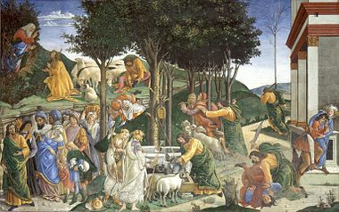
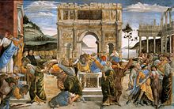
Youth of Moses, Sistine Chapel
Punishment of the Sons of Corah, Sistine Chapel

Slide 14
Mythological subjects of the 1480s
The masterpieces Primavera (c. 1482) and The Birth of Venus (c. 1485) are not a pair, but are inevitably discussed together; both are in the Uffizi. They are among the most famous paintings in the world, and icons of the Italian Renaissance. As depictions of subjects from classical mythology on a very large scale they were virtually unprecedented in Western art since classical antiquity. Together with the smaller and less celebrated Venus and Mars and Pallas and the Centaur, they have been endlessly analysed by art historians, with the main themes being: the emulation of ancient painters and the context of wedding celebrations, the influence of Renaissance Neo-Platonism, and the identity of the commissioners and possible models for the figures.

Slide 15
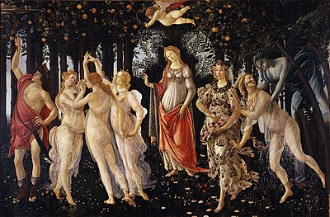
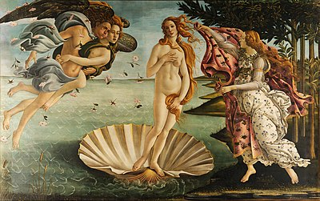
Primavera
The Birth of Venus

Slide 16
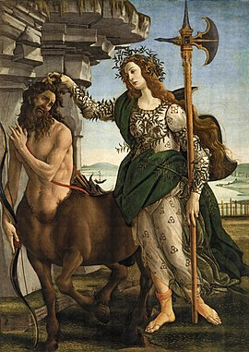
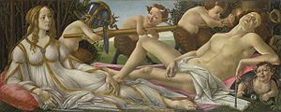
Pallas and the Centaur
Venus and Mars

Slide 17
Though all carry differing degrees of complexity in their meanings, they also have an immediate visual appeal that accounts for their enormous popularity. All show dominant and beautiful female figures in an idyllic world of feeling, with a sexual element. Continuing scholarly attention mainly focuses on the poetry and philosophy of contemporary Renaissance humanists. The works do not illustrate particular texts; rather, each relies upon several texts for its significance. Their beauty was characterized by Vasari as exemplifying "grace" and by John Ruskin as possessing linear rhythm. The pictures feature Botticelli's linear style at its most effective, emphasized by the soft continual contours and pastel colours.

Slide 18
Religious paintings after Rome
Botticelli returned from Rome in 1482 with a reputation considerably enhanced by his work there. As with his secular paintings, many religious commissions are larger and no doubt more expensive than before. Altogether more datable works by Botticelli come from the 1480s than any other decade, and most of these are religious. By the mid-1480s, many leading Florentine artists had left the city, some never to return. The rising star Leonardo da Vinci, who scoffed at Botticelli's landscapes, left in 1481 for Milan, the Pollaiolo brothers in 1484 for Rome, and Andrea Verrochio in 1485 for Venice. The remaining leaders of Florentine painting, Botticelli, Domenico Ghirlandaio and Filippino Lippi, worked on a major fresco cycle with Perugino, for Lorenzo the Magnificent's villa at Spedalletto near Volterra. Botticelli painted many Madonnas, covered in a section below, and altarpieces and frescos in Florentine churches. In 1491 he served on a committee to decide upon a façade for the Cathedral of Florence, receiving the next year three payments for a design for a scheme, eventually abortive, to put mosaics on some interior roof vaults in the cathedral.

Slide 19
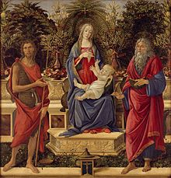
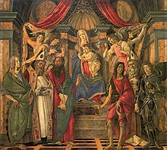
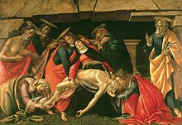
The Bardi Altarpiece San Barnaba Altarpiece Lamentation of Christ

Slide 20
Portraits
Botticelli painted a number of portraits, although not nearly as many as have been attributed to him. There are a number of idealized portrait-like paintings of women which probably do not represent a specific person. With one or two exceptions his small independent panel portraits show the sitter no further down the torso than about the bottom of the rib-cage. Women are normally in profile, full or just a little turned, whereas men are normally a "three-quarters" pose, but never quite seen completely frontally. Even when the head is facing more or less straight ahead, the lighting is used to create a difference between the sides of the face. Backgrounds may be plain, or show an open window, usually with nothing but sky visible through it. A few have developed landscape backgrounds. These characteristics were typical of Florentine portraits at the beginning of his career, but old-fashioned by his last years.

Slide 21
Botticelli often slightly exaggerates aspects of the features to increase the likeness. He also painted portraits in other works, as when he inserted a self-portrait and the Medici into his early Adoration of the Magi. Several figures in the Sistine Chapel frescos appear to be portraits, but the subjects are unknown, although fanciful guesses have been made. Large allegorical frescos from a villa show members of the Tornabuoni family together with gods and personifications.

Slide 22
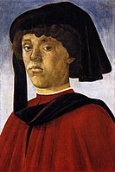
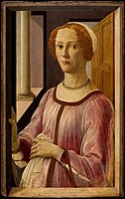
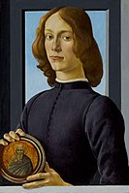
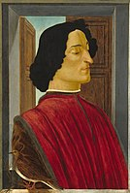
Young Man Portrait of a Lady Known Giuliano de' Medici A young man as Smeralda Brandini holding a roundel

Slide 23
Later reputation
After his death, Botticelli's reputation was eclipsed longer and more thoroughly than that of any other major European artist. His paintings remained in the churches and villas for which they had been created, and his frescos in the Sistine Chapel were upstaged by those of Michelangelo. Botticelli appears as a character, sometimes a main one, in numerous fictional depictions of 15th-century Florence in various media. He was portrayed by Sebastian de Souza in the second season of the TV series Medici: Masters of Florence.

Slide 24
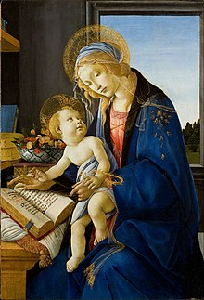
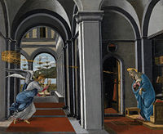
Madonna of the Book
Annunciation

Slide 25
Bibliography
https://en.wikipedia.org/wiki/Sandro_Botticelli

Slide 26
.
The end

