Slide 1
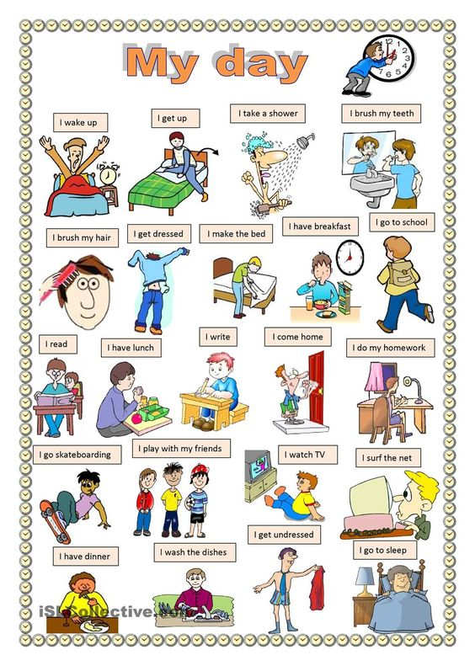
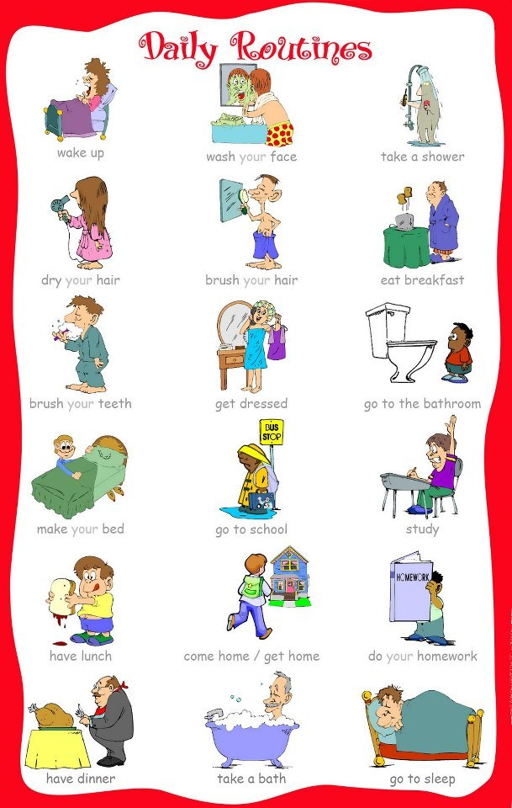
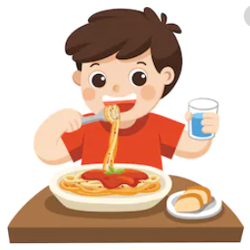
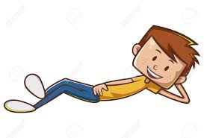
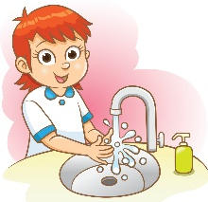
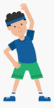
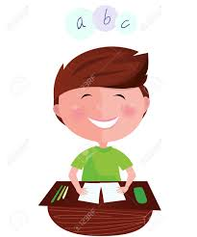
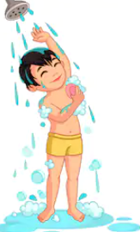
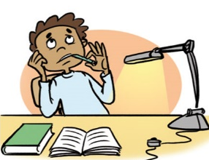
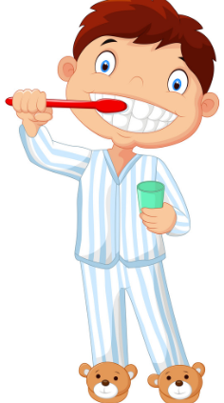
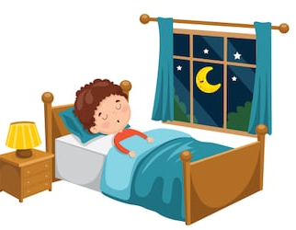
My daily routine
I wake up at 07:00
I get up
I eat breakfast
I brush my teeth
I comb my hair
I get dressed
I go to school
I take classes
at school
I play with my friends
at the breaks
I wash my hands and
change my clothes
I eat lunch
I relax for an hour
I have a snack
I return home
I do my homework
I exercise
I have an English class
I eat dinner
I take a shower
I brush my teeth
I go to bed at 21:30

