Slide 1

SPAIN
Alex F.
Apostolis G.
Maria A.
Kostas F.

Slide 2
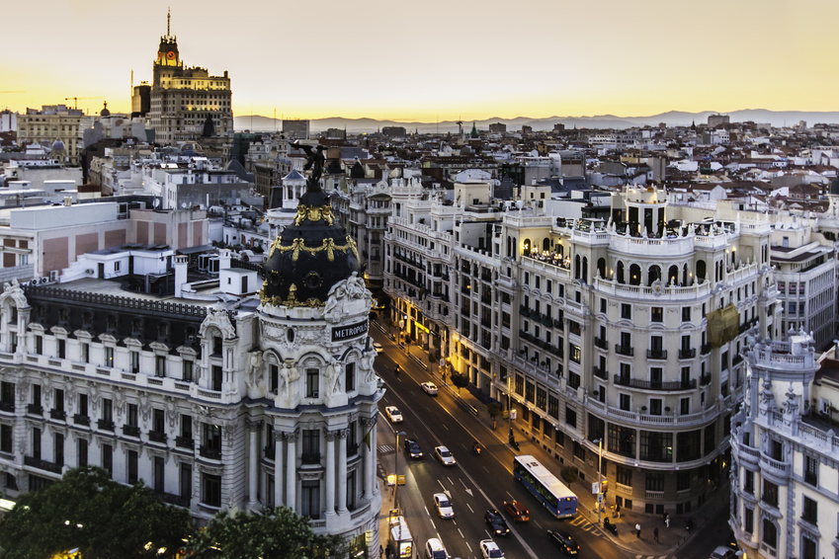
Capital
The capital of Spain is Madrid

Slide 3
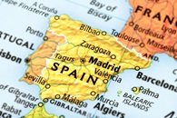
Map
Spain is a country in southern Europe
Spain shares borders with France, Portugal, Andorra, Marocco and Gibraltar

Slide 4
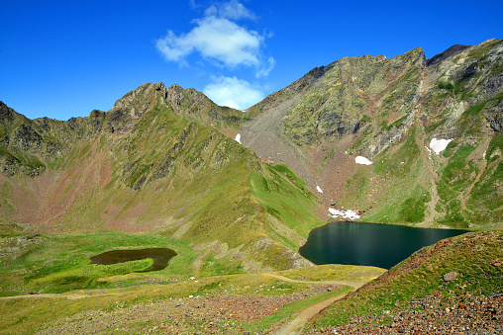
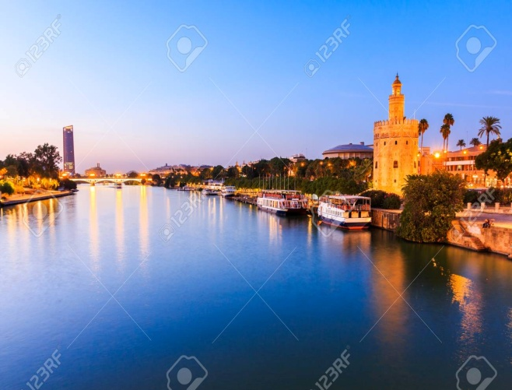
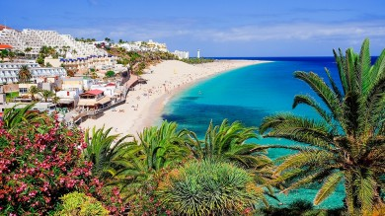
Landform
Spain is mostly mountainous and there are lots of mountain ranges like the Pyrenees
Also there are many rivers like the river Guadalquivir
There are not any islands just the Canary islands

Slide 5
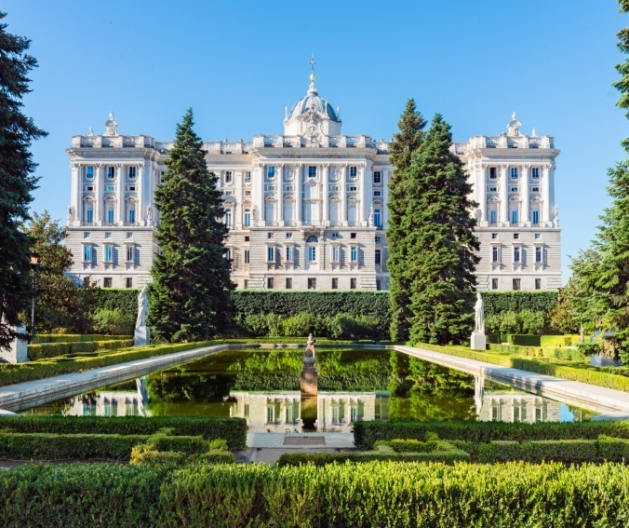
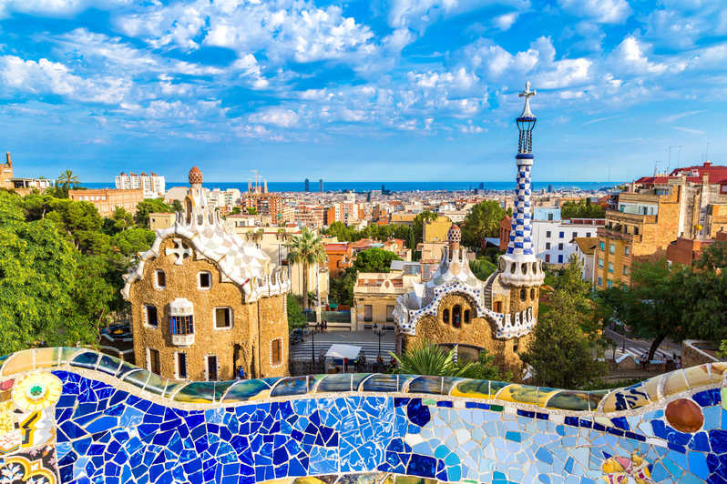
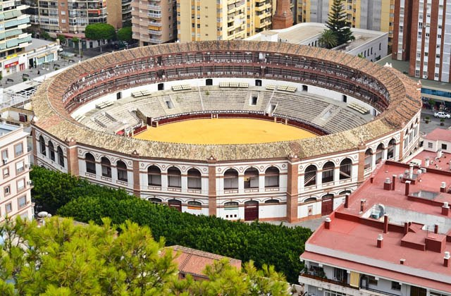
Sights
One of the sights in Spain is Palacio Real in Madrid
Also there’s Park Guell in Barcelona
The most popular sights are bullrings, where there are bullfights

Slide 6
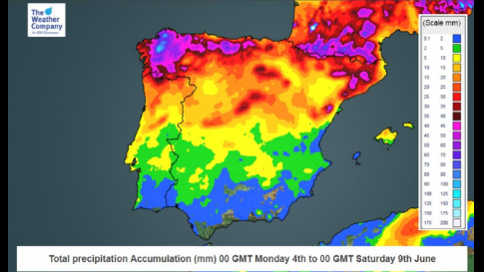
Weather
The weather in Southern Spain is usually mild, but in northern Spain it’s often wet and warm in summers

Slide 7


