Slide 1
How do you get
ready for Christmas?
Simple Present: a habit, a custom or an action we often do e.g. I play football every Sunday.
I / you / we / they + ρήμα
he / she / it + ρήμα με -s

Slide 2
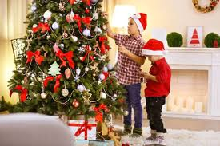
They / decorate the Christmas tree

Slide 3
They decorate the Christmas tree.

Slide 4
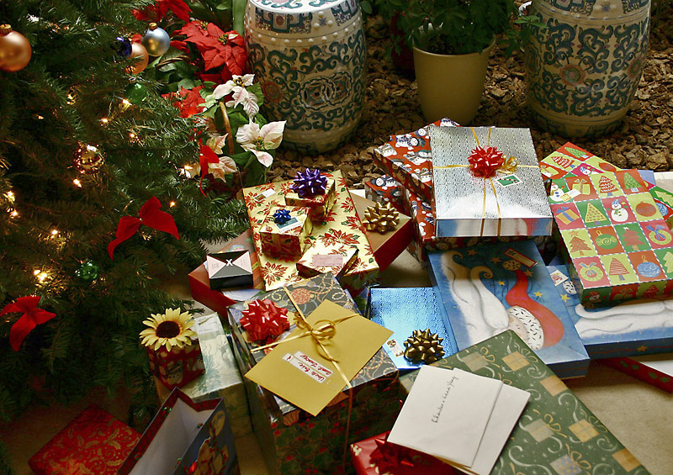
My father / buy Christmas presents

Slide 5
My father buys Christmas presents.

Slide 6
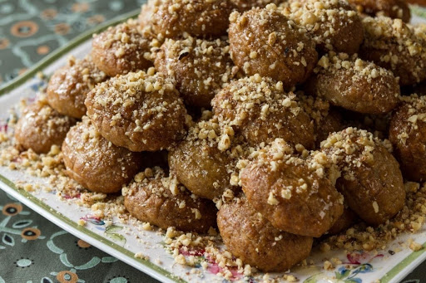
My grandma / make melomakarona

Slide 7
My grandma makes melomakarona.

Slide 8
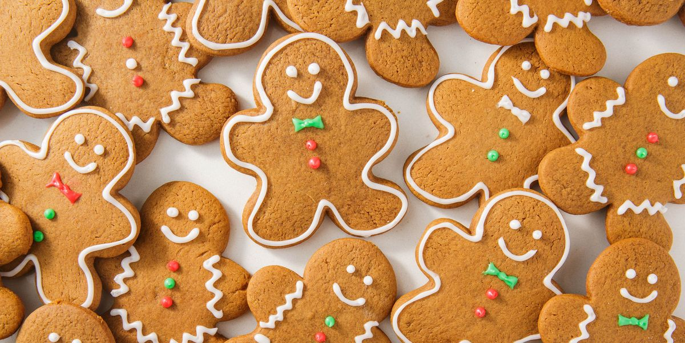
We / eat Christmas cookies

Slide 9
We eat Christmas cookies.

Slide 10
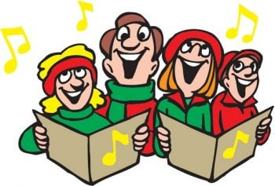
My brother / sing carols

Slide 11
My brother sings Christmas carols.

Slide 12
We / watch Christmas films

Slide 13
We watch Christmas films.

Slide 14
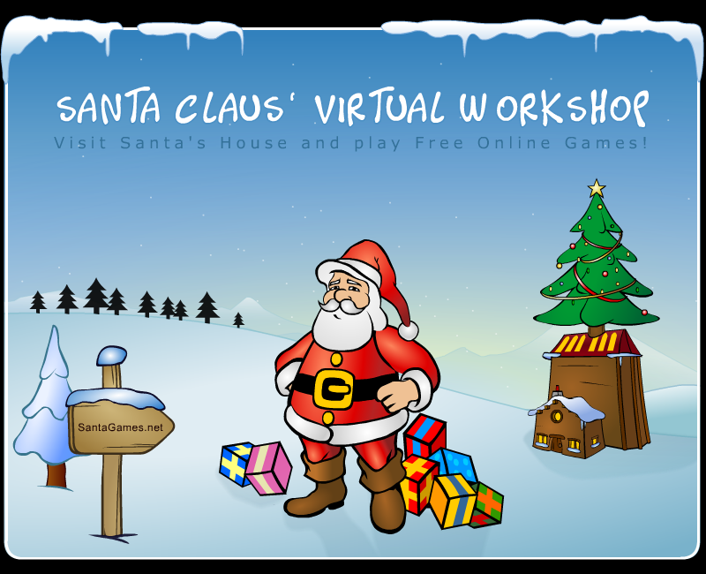
I / play Christmas computer games

Slide 15
I play Christmas computer games.

Slide 16
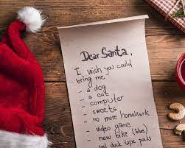
Mary / write a letter to Santa

Slide 17
Mary writes a letter to Santa

Slide 18
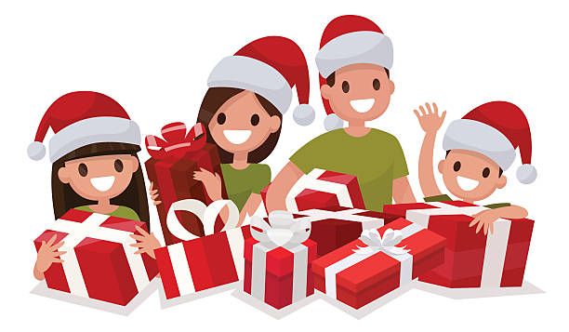
We / open our presents

Slide 19
We open our presents.

Slide 20
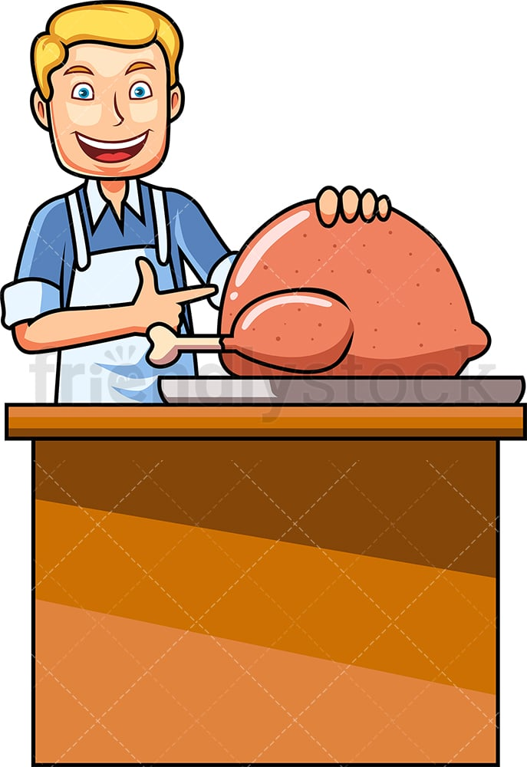
John / cook the turkey

Slide 21
John cooks the turkey.

Slide 22
Whatever you do have FUN

