Slide 1
Traditional Greek
Christmas recipes
19th primary School of Thessaloniki, Greece

Slide 2
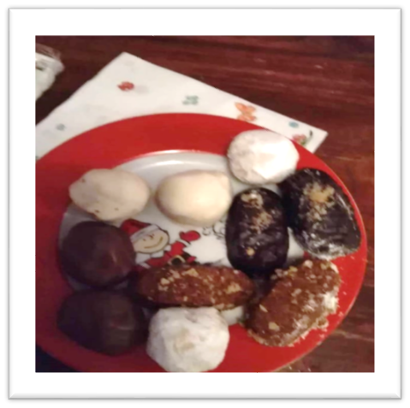
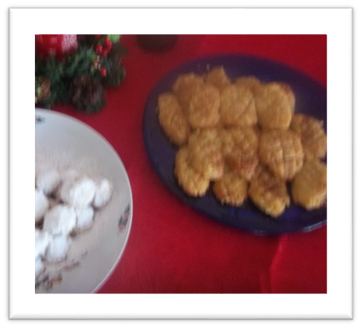
Melomakarona ( a traditional Christmas sweet)
2nd mixture
1 kilo flour
200 gr fine semolina
For serving
honey
Walnuts
Procedure
For the syrup
Boil the ingredients for the syrup , except honey.
Do the syrup 3-4 hours before make melomakarona.
For the melomakarona
Preheat the oven to 190o C.
Mix the ingredients for mixture 1 in a bowl with a whisk.
In another bowl mix the ingredients for mixture 2.
Add the 2 mixtures and stir them by hand for 10sec.
Make the melomakarona in the beautiful shape (3-4 centimeters diameter, 30 gr each) and bake them about 20-25 minutes.
Soak them in the syrup for 10-16sec.
Serve with honey and walnuts.
Ingredients
For the syrup
500 gr water
800 gr sugar
150 gr honey
3 sticks of cinnamon
3 carnation
1 orange cut in half
1st mixture
400 gr juice orange
400 gr seed oil
180 gr olive oil
50 gr caster sugar
½ teaspoon carnation
2-3 teaspoon cinnamon
¼ teaspoon nutmeg
1 teaspoon soda
2 orange zest
Natalia – 5th grade
19th Primary School of Thessaloniki

Slide 3
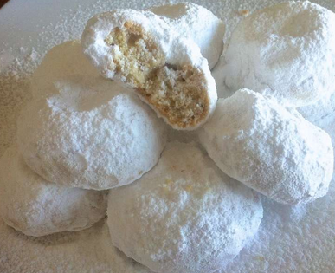
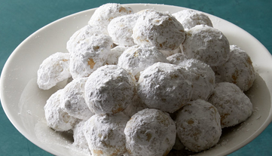
Kourabiedes
Ingredients
2 cups of butter
1 cup of caster sugar
4 cups of soft flour
1 teaspoon baking powder
¼ cup of cognac
1-2 cups of almonds
2 cups of caster sugar to sprinkle
Procedure
Put the butter in a bowl and whisk. Add sugar and cognac and mix well.
Add flour, baking powder, almonds and mix all the ingredients with your hands.
Use your favourite cupcake cases to cut the dough.
Put the kourabiedes on a baking tray.
Bake them at 180◦C for 30’ until golden.
Take out of the oven, sprinkle with caster sugar and let them cool.
Enjoy kourabiedes for Christmas!!!
Argiro Ioanna – 5th grade
19th Primary School of Thessaloniki

Slide 4
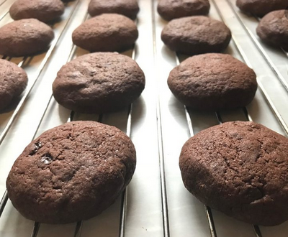
Christmas Cookies
Ingredients
1 cup of sunflower oil
1 cup of sugar
1 cup of orange juice
1 teaspoon of soda
1 teaspoon of baking powder
1 packet of hard chocolate
800 gr of flour
Procedure
Mix the oil with the sugar in a bowl.
Dissolve the soda in the orange juice and add it to the bowl.
Continue to beat and slowly add the flour with the baking powder.
Knead lightly with a fork and by hand.
Melt the chocolate and add it to the mixture.
Make the mixture into small balls and press lightly.
Bake at 180◦C until brown for about 20’.
Vaggelis – 5th grade
19th Primary School of Thessaloniki

Slide 5
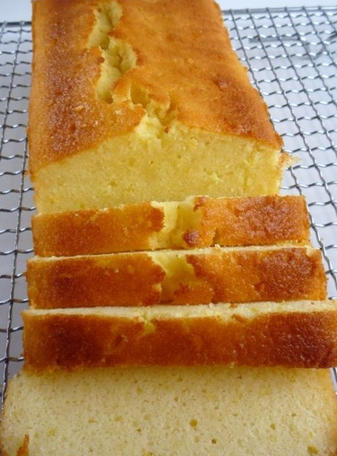
Cake
Ingredients
1 packet of butter
1 cup of sugar
4 eggs
1 yoghurt
250 gr flour
1 baking powder
Procedure
First beat together the butter and the sugar.
Then beat the yoghurt and the eggs.
Add the flour and the baking powder. Beat them for 10 minutes.
Put the mixture in a baking case for cakes.
Bake for 45’ .
Decorate with caster suger.
Jim – 5th grade
19th Primary School of Thessaloniki

Slide 6
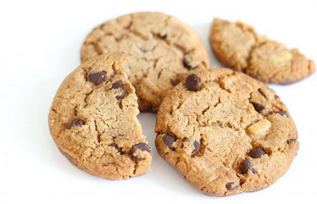
Biscuits
Ingredients
325 gr soft butter (at room temperature)
1 egg yolk
1 vanilla
½ cup of sugar
Some salt
500 gr flour
Drops of chocolate or chocolate chips
Procedure
Put all the ingredients except for the flour and chocolate in the mixer bin. Beat them and then add the flour. The dough must be soft.
Take a piece of the dough, shape it into a ball and make a hole in the middle with your finger. Put a piece of chocolate in it.
When you make all the biscuits, put them on a baking tray.
Preheat the oven at 170◦C and bake the biscuits for about 20’ until they get golden.
When they are ready, put them in a box to keep them fresh.
Vasiliki – 5th grade
19th Primary School of Thessaloniki

Slide 7
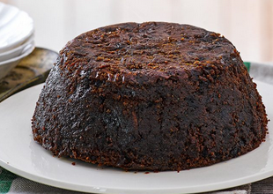
Christmas Pudding
Ingredients
450 gr mixed dried fruit
25 gr candies (finely chopped)
1 small apple
1 tablespoon orange zest
½ tablespoon lemon zest
2 tablespoons orange juice
1 tablespoon lemon juice
4 tablespoons brandy
55 gr flour
1 teaspoon mixed spice
1 ½ teaspoon cinnamon
110 gr sugar
110 gr bread crumbs
25 gr almonds
2 large eggs
Procedure
Gather the ingredients.
Put the dried fruit, candies, apple, orange and lemon juice into a large mixing bowl.
Add the brandy and mix well.
Cover the bowl with a towel and leave it for 2 hours.
Stir the rest of the ingredients together. Add the mixture with the dried fruit and stir again.
Beat the eggs and then mix with the other ingredients.
Place the pudding in the steamer for 7 hours. The pudding will be dark brown.
Remove from the steamer and let it cool.
Enjoy it!!!
Orfeas– 5th grade
19th Primary School of Thessaloniki

Slide 8
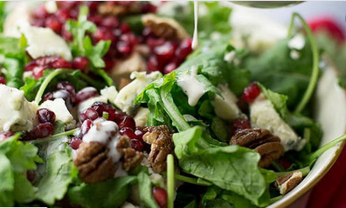
Christmas salad with pomegranate and feta cheese
Ingredients
½ head of lettuce, chopped
1 pear washed, peeled and chopped
2 slices of red onion, chopped
1 tablespoon feta cheese
some nuts, broken
1 pomegranate, peeled
Balsamic vinegar dressing
Procedure
Wash and dry the lettuce.
In a bowl mix the lettuce, pear and onion.
Add pomegranate, nuts and feta cheese.
Add some oil and sprinkle some salt.
Then pour the balsamic vinegar dressing and serve!
Vasiliki S.– 5th grade
19th Primary School of Thessaloniki

Slide 9
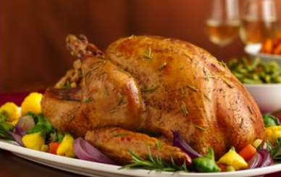
Classic Stuffed turkey
Procedure
In a large frying pan fry the onions, celery and mushrooms in butter until soft. Add the broth and spices and mix well.
Stuff the turkey with the mixture and tie the openings with kitchen string. Spread melted butter on it and place it on a big baking tray.
Bake at 325◦C for about 4 - 4 ½ hours or until the thermometer in the turkey reads 180◦.
Cover the turkey with aluminium foil and let it stand for 20’ before you remove the stuffing and carve it. If you want, add gravy sauce.
Ingredients
2 large onions, chopped
2 celery ribs, chopped
½ kilo mushrooms, sliced
½ cup of butter
1 cup chicken broth
½ cup of parsley
2 teaspoons sage
1 teaspoon spices
1 teaspoon salt
½ teaspoon pepper
Warm water
1 turkey (14 -16 pounds)
Melted butter
Enjoy it!!!
Leonidas & Thomas– 5th grade
19th Primary School of Thessaloniki

Slide 10
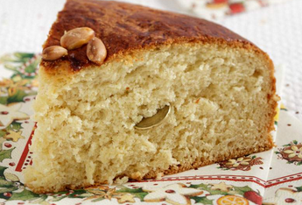
Vasilopita A Greek New Year Eve’s Cake
Procedure
Separate the egg yolks and beat only the white part of the eggs until the mixture is thick.
Beat the butter and sugar for 20’.
Add the egg yolks. Then pour in the orange juice, vanilla , orange zest and the yoghurt.
Add 1/3 of the flour and mix. Repeat with the rest of the flour.
Preheat the oven at 200◦C.
Put butter on a non-sticking cake tray and pour in the mixture.
Bake for 50 – 60’.
Let vasilopita cool and put it upside down on a plate.
Wrap a coin in aluminium foil and stick it in the cake.
At midnight on New Year ‘s Eve cut the cake into pieces. The person whose piece has the coin is lucky all year and gets a present!
Ingredients
375 gr butter
3 cups of sugar
6 eggs (separate yolks)
Some salt
2 orange zest
½ cup orange juice
200 gr yoghurt
1 teaspoon vanilla
750 gr self-rising flour
Lazaros– 5th grade
19th Primary School of Thessaloniki

Slide 11
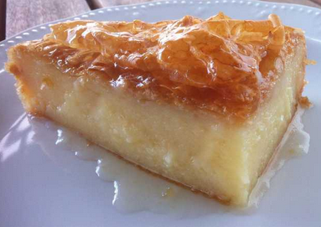
Galaktoboureko
Ingredients
For the base
400-450 gr pastry
210 gr butter
For the custard
160 gr thin semolina
220 gr sugar
500gr milk
4 eggs
2 tablespoons vanilla extract
500 gr cream
For the syrup
360 gr water
640 gr sugar
2 tablespoons of lemon zest
A cinnamon stick
Instructions
Start by preparing the syrup. In a small pan add the sugar, the water and the lemon zest. Boil until the sugar melts. Remove from the stove and add the cinnamon stick. Then let it cool.
For the custard, divide the eggs into yolks and whites. Put the eggs’ whites and 50 gr of sugar in a bowl. Whisk them to make the meringues and then set aside.
In another bowl whisk the yolks and 50 gr sugar for 5’.
Mix ¼ of the meringues with the egg yolk and sugar mixture.
Put into a saucepan the milk, the cream and the rest of the sugar and boil. Add the semolina and vanilla extract. Whisk until the mixture is creamy. Remove from the stove, add butter and blend.
Put the mixtures from step 4 and 5 together.
In a baking tray melt 230 gr butter. Put 5 sheets of the pastry. Then put the custard on top and smooth the surface. Add 4 sheets of pastry on top.
Bake at 160◦ C for 60-75’ until golden.
When it’s ready, pour the cold syrup on top and enjoy it!!!
Andriana & Georgia– 5th grade
19th Primary School of Thessaloniki

Slide 12
