Slide 1
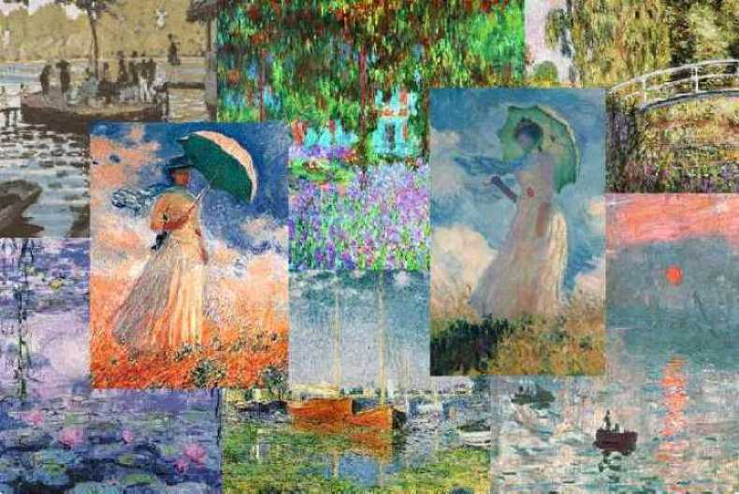
PAINTINGS
CAN TALK

Slide 2
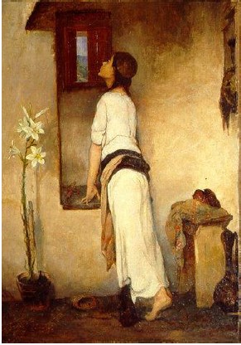
The waiting
Nikolaos Lytras
Why did the painter give this title to the painting?
Why is the girl looking out of the window?
What does she look like?
What is she like?
Who is she? Where does she live? What does she do? How does she feel?
You are this girl. Write a self-poem.
Her mum is coming into her room telling her off. What does she say? What does the girl say?

Slide 3
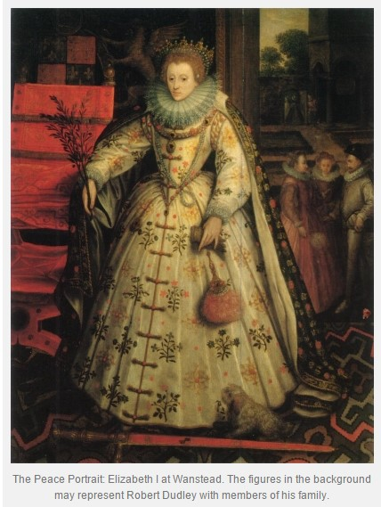
Elizabeth I at Wantstead Robert Dudley
What does she look like? What is she wearing?
Where is she? What is she doing?
How does she feel? Why?
Who are the people in the background? Write what they are saying.
You are this woman. Write a self-poem.
Compare this woman with the girl from the previous painting.
You find yourself in the painting. Ask her 2 questions. Write her answers.

Slide 4
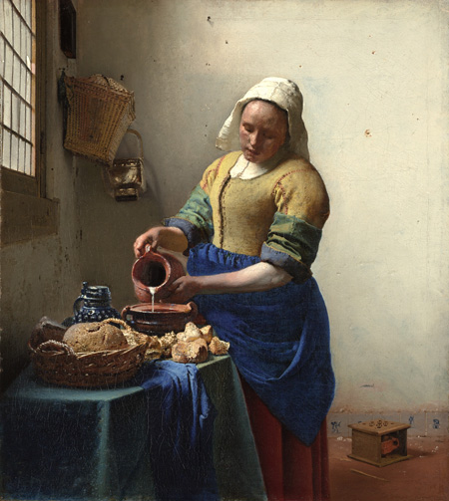
The Milkmaid
Johannes Vermeer
What does she look like?
Where is she? What’s the place like?
Compare this woman with the woman/ women from the previous paintings.
How does she feel?
You are this woman. Write a self-poem.
You are this woman. What are you thinking?
You are the cook of the queen in the previous painting. The milkmaid is your assistant but she does everything wrong. What do you tell her? Write the dialogue.

Slide 5
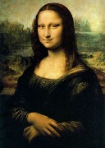
Mona Lisa
Leonardo Da Vinci
What does she look like?
How does she feel? Why?
Who is she? Where does she live? What does she do?
You are this woman. Write a self-poem.
Mona Lisa meets the woman from the previous painting. Write their conversation.

Slide 6
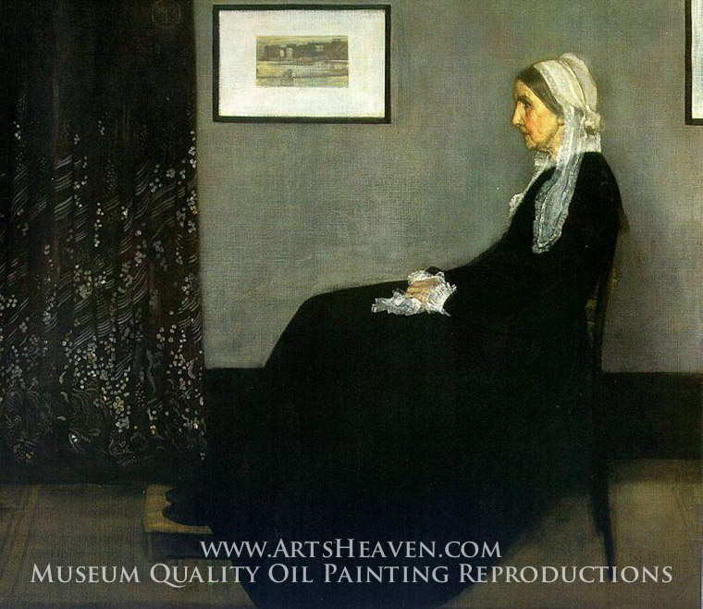
Whistler’s mother
James Whistler
What does she look like?
Where is she? What is she doing?
What is she looking at?
Why did the painter paint his mother?
You are this woman. Write a self-poem.
Compare the women of the four paintings.
You are the daughter/ son of this woman sitting opposite her. What does she say to you? Write the dialogue.

Slide 7
Woman with Goldfish
K. Parthenis
Where is the woman?
How does she feel? Why? What is she thinking?
You are this woman. Write a self-poem.
Compare this woman with the women in the previous paintings.
You are the fish in the fishbowl. Write a short scene with the title “The woman looking at us”.

Slide 8
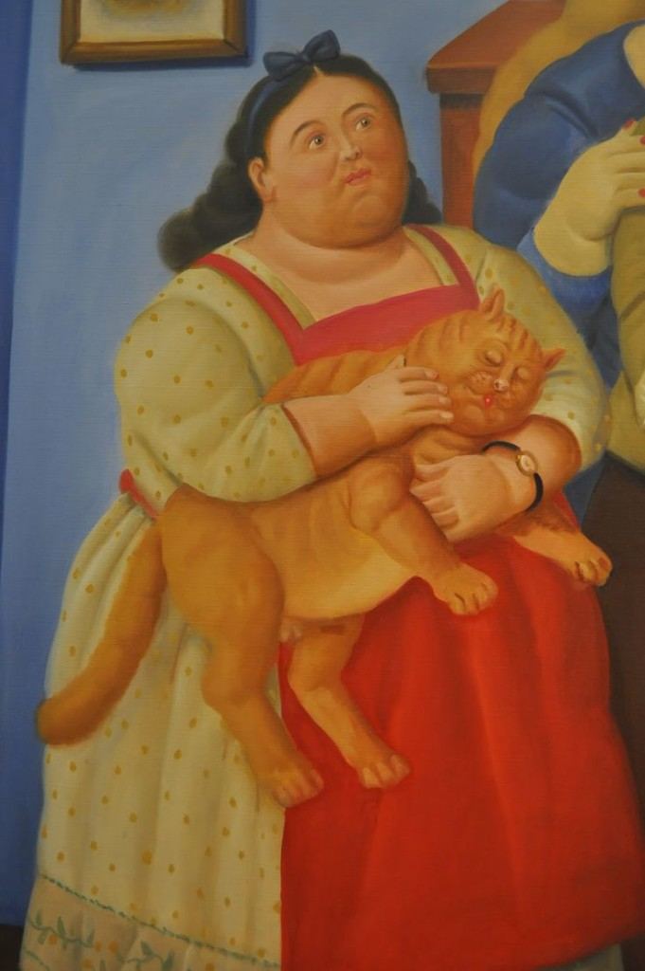
Girl with cat
Fernando Botero
What does the woman look like? What does the cat look like?
Compare the woman with the woman in the previous painting.
You are this woman. Write a self-poem.
You are the cat. What are you thinking about? Write a short story about this cat.

Slide 9
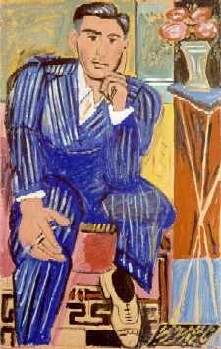
The Thinking Man
Giannis Tsarouhis
What does he look like? What is he like?
Why did the painter give the painting this title?
Who is he? Where does he live? What does he do?
You are this man. Write a self – poem.
You are this man. What are you thinking about?
This man is the son of the woman from the previous painting. What does she say to him? Write the dialogue.

Slide 10
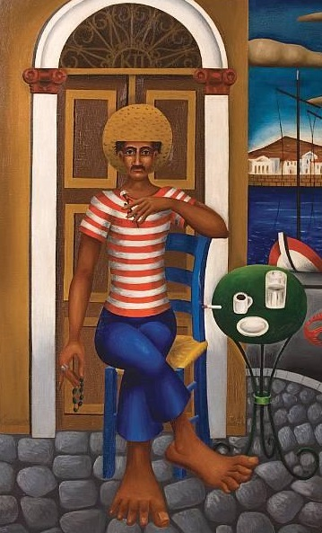
Man at the cafeneion
Nikos Eggonopoulos
Compare this man with the one from the previous painting.
Where is he? What is he doing? How does he feel?
You are this man. Write a self-poem.
You are this man. What are you thinking?
This man and Mona Lisa are ………….
Write their conversation.
https://pteroen.wordpress.com/category/%CE%BD%CE%B9%CE%BA%CE%BF%CE%BB%CE%B1%CE%BA%CE%B7%CF%83-%CE%BA%CF%89%CF%83%CF%84%CE%B7%CF%83/

Slide 11
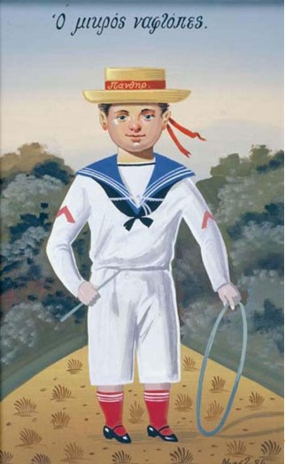
The young sailor
Giannis Bostantzoglou
(Bost)
What does the boy look like? What is he wearing?
Where is he? What is he doing?
Compare the boy with the men from the two previous paintings.
You are this boy. Write a self-poem.
The girl from the first painting is your sister. She’s shouting at you from the window. What is she saying?
You are in the park with this boy. Write your dialogue.

Slide 12
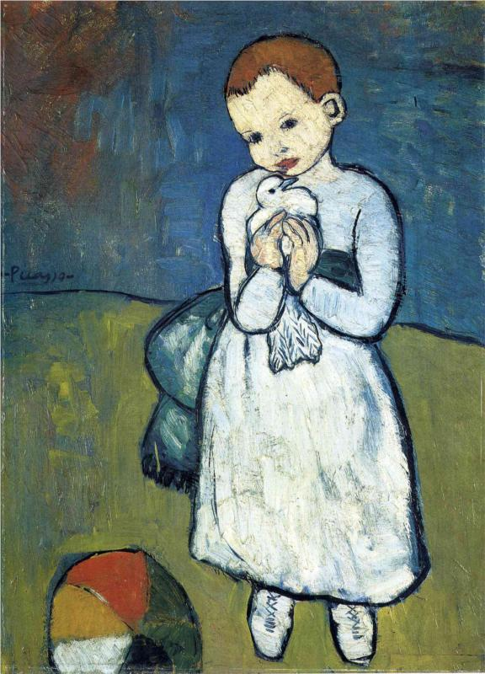
Child with Dove
Pablo Picasso
Who is this child? Where does it live?
What does he look like? What is he like?
How does it feel?
What is he thinking?
You are this child. Write a self-poem.
Compare this child with The young sailor (Bost).
The two children want to play together. Write their dialogue.

Slide 13
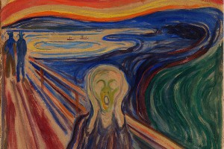
The scream
Edvard Munch
What do you think is strange about this painting?
Why did the painter give this title?
Who are the men in the background? What are they saying?
Compare this person with the man from the previous painting.
You are this man. Write a self-poem.
You are this man. What are you thinking?
You are talking with the man behind you. Write the conversation.

Slide 14
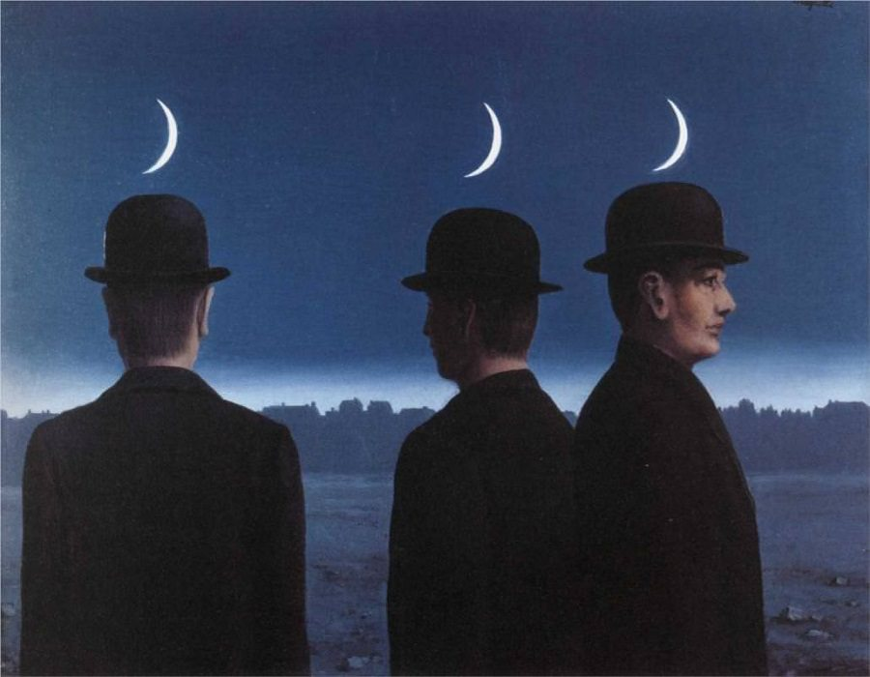
The Mysteries of the Horizon
René Magritte
Who are these men? What are they looking at?
Why are they looking at different places?
Imagine they are talking to one another. What are they saying?

Slide 15
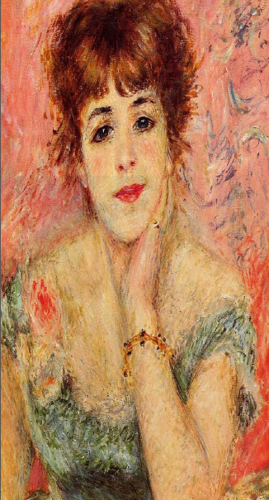
Self- poem
I Katerina
Playful and naughty
Daughter of Brad Pitt and Angelina Jolie
Sister of the magician Houdini
I love picking flowers in the spring
I like dancing when the moon is up
I feel happy when the flowers bloom
I’m sad when people cry
I’ m afraid of the dark
I want to travel all over the world
I the cute Katerina
11 lines
name
characteristics
Parents
Brother/sister
I love
I like / I hate
I fell happy (when)
I’m sad
I’m afraid of
I want
name / last name

Slide 16
Which painting do you like the most? Why?
Which painting do you like the least? Why?
Which painting is the most frightening? Why?
Choose some paintings to create a photostory.

Slide 17
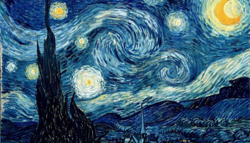
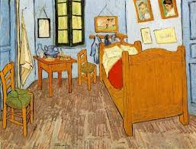
Starry Night
Vincent Van Gogh
Who lives in this bedroom? What does he do? What is he like?
Bedroom in Arles
Vincent Van Gogh

Slide 18
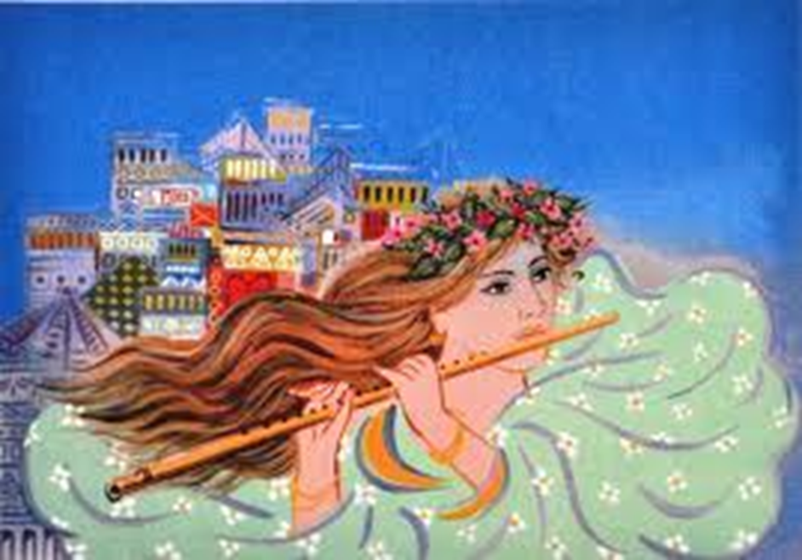
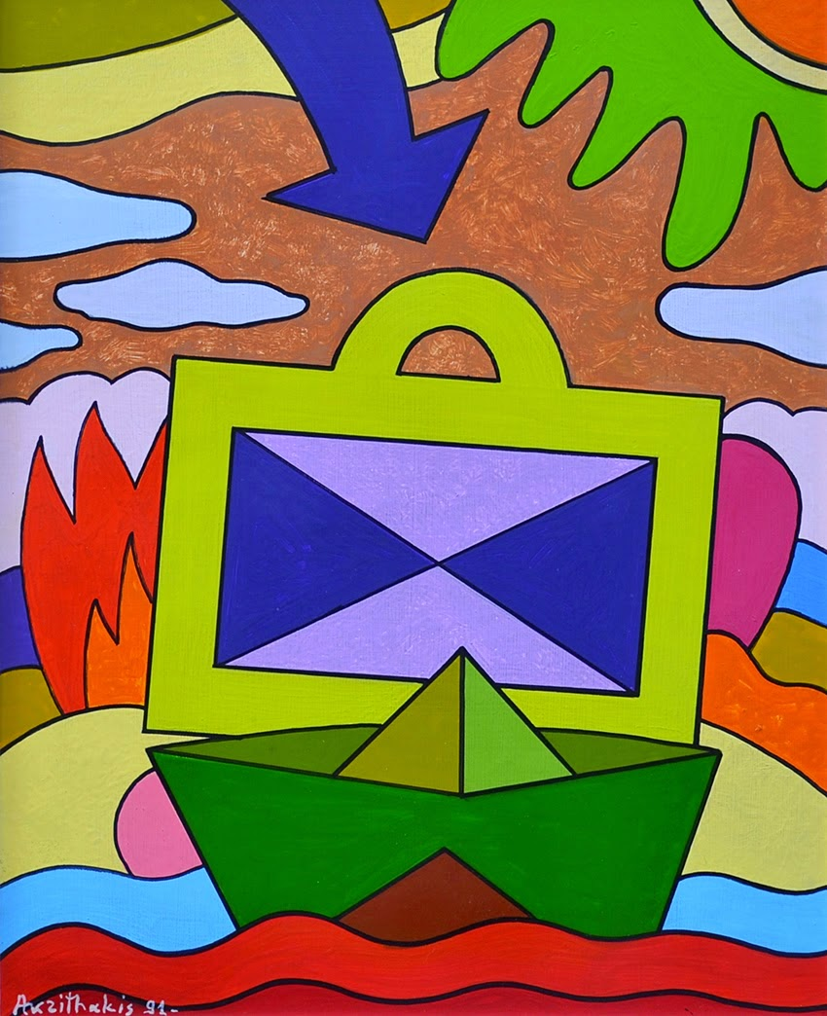
Girl with Flute
Giorgos Stathopoulos
Who is the girl? Where does she live?
She’s playing music on her magic flute. What can it do? What magic properties does it have?
Suitcase
Alexis Akrithakis
Where is this suitcase going?
Who does it belong to?

Slide 19
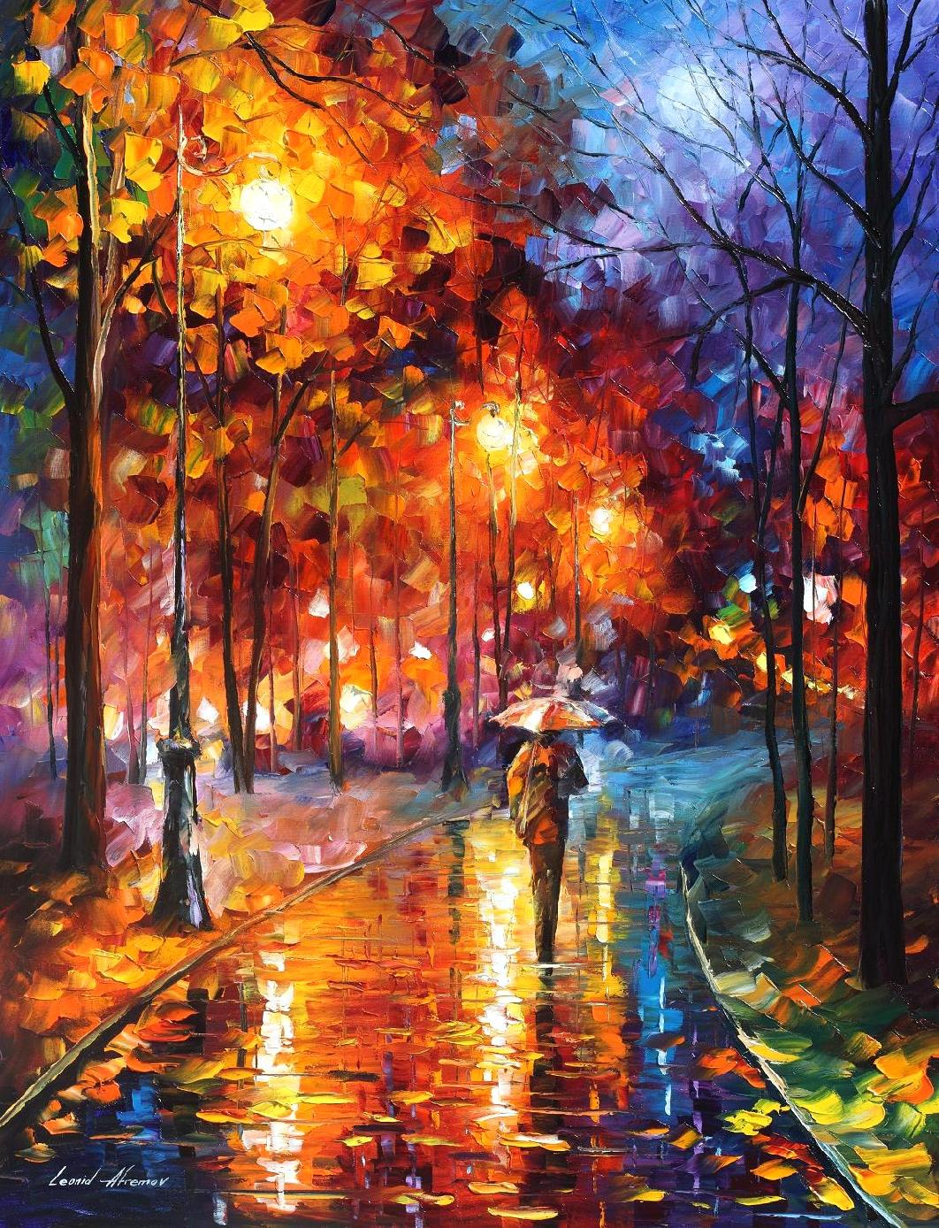
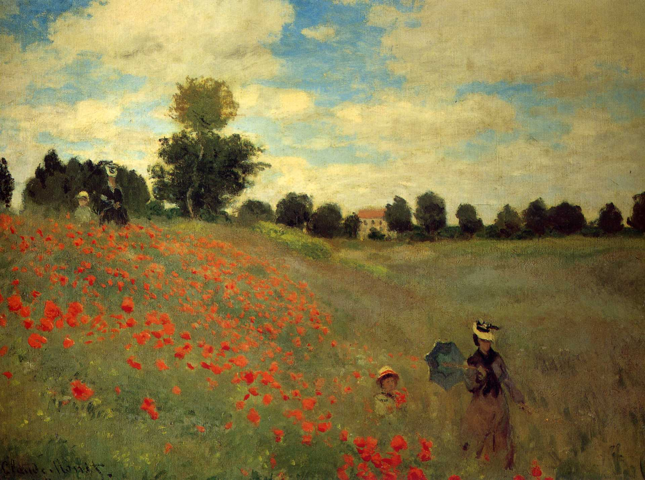
Who is the person in the painting? Where is he /she?
Why is he /she walking in the rain? Where is he / she going?
Who are the people in the painting? Where are they?
Where are they going?
Poppies near Argentuil
Claude Monet
Night park
Leonid Afremov

Slide 20
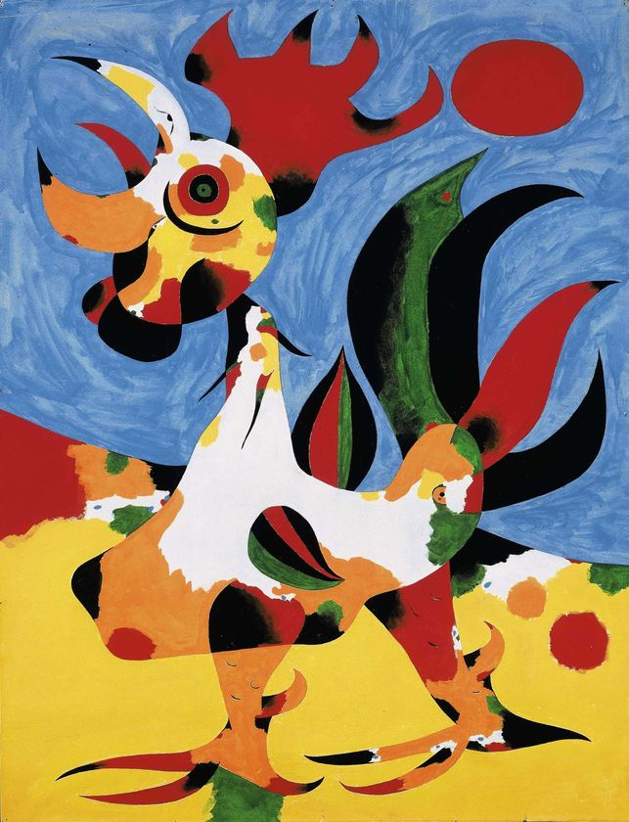
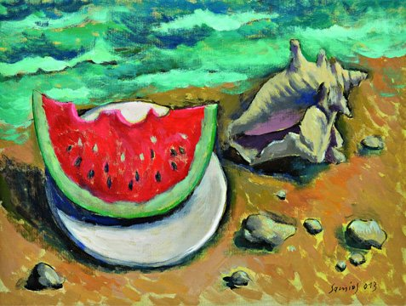
At the Island
Pavlos Samios
The Rooster
Joan Miro
Who is the rooster waking up?
This rooster can talk. What is it saying?

