Slide 1
Cans
A green planet

Slide 2
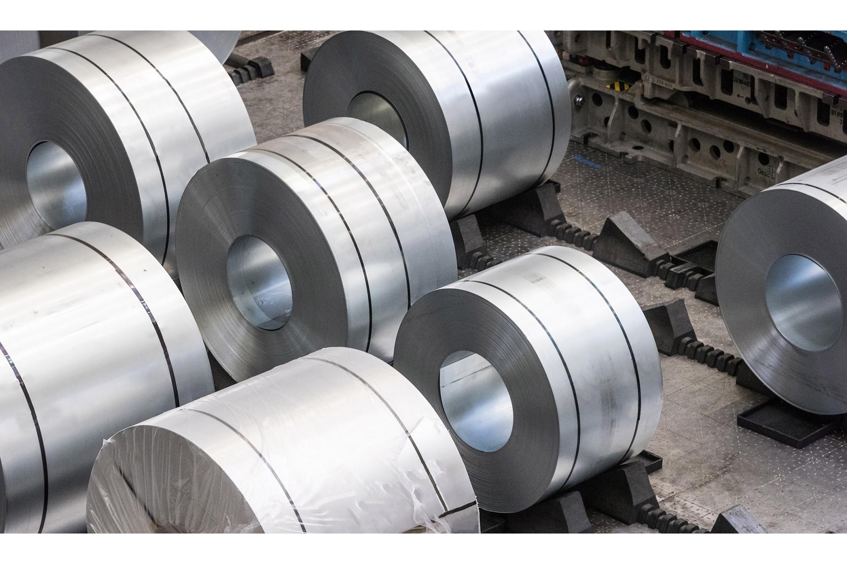
Aluminum recycling has significant benefits for the environment, society, country and consumers. Aluminum is an ideal material for recycling because it is easily separated from other materials and thus its sorting does not require high costs, while its recycling is a process that can be repeated without degrading its properties.

Slide 3
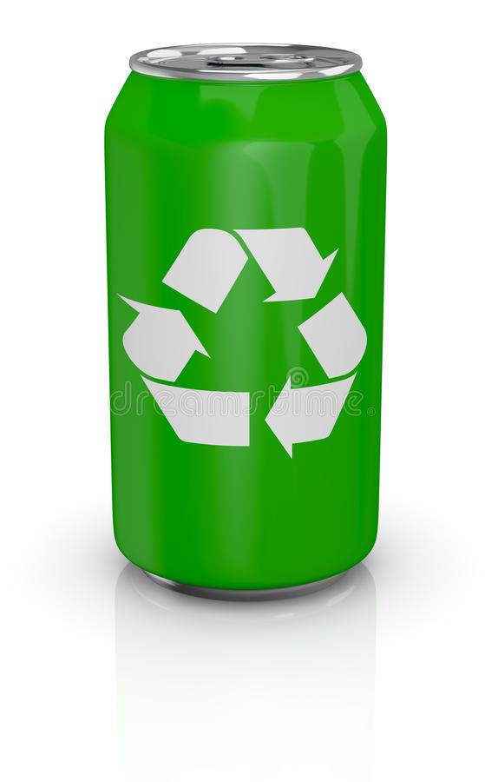
Can recycling
Can recycling is the process by which aluminum scrap can be reused in products, after its initial production. The processit simply
involves re-smelting the metal, which is much less expensive and energy-intensive than creating new aluminum, through the electrolysis of aluminum oxide (Al2O3), which must first be mined from bauxite ore and then refined into oxide of aluminum, using the Bayer process, and then refined back into aluminum metal, using the Hall–Héroult process.

Slide 4
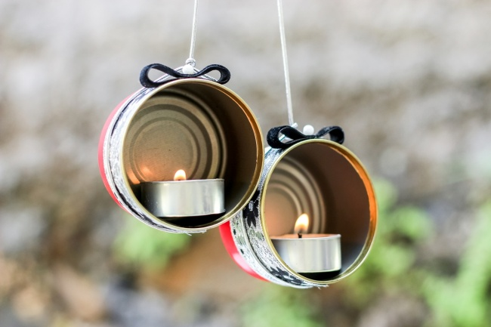
We can use the jars as a kind of pot to plant or even to water the plants as a watering can. We can use them as pencil holders if we decorate them with paper or even a candle holder by decorating it and putting a candle.

Slide 5
participated: Lambros Psarogiannis, Vasilis FL udas and Mitsos Zervas

