Slide 1
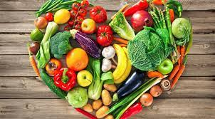
Unity in Diversity (multicultural fair)
By George Katsamiras

Slide 2
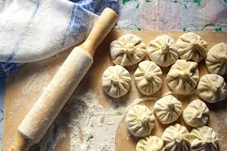
Khinkali
Khinkali is a georgian dumpling that is made from minced meat (lamb or beef and pork mixed), onions, chili pepper, salt, and cumin. It is often served with much black pepper on top and hot. If it cools, you are able to fry it.

Slide 3
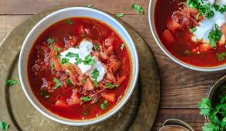
Borscht
Borscht is a russian soup with vegetable and beef. When it is served, you are able to put smetana( a russian yogurt) on top of it.

Slide 4
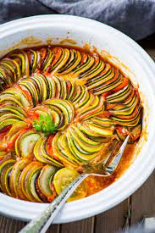
Ratatouille
Ratatouille is a french dish with stewed vegetables. It is made from tomato, garlic, onion, zucchini, eggplant, bell pepper, and a combination of leafy green herbs.

Slide 5
Sources
Wikipedia

