Slide 1
The strangest foods in the world
In some countries there are traditional foods that are unusual for us

Slide 2
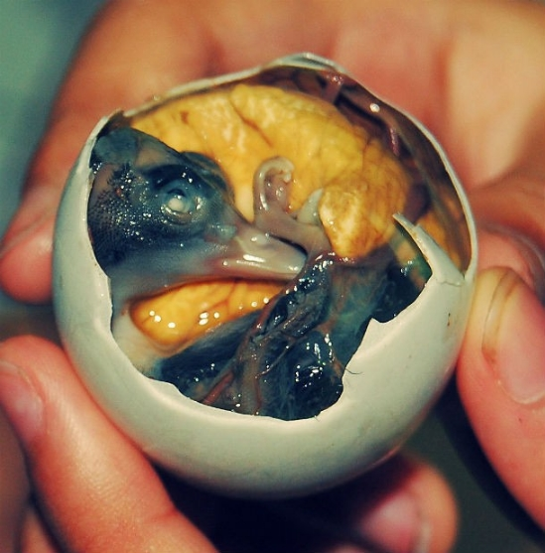
1.BALUT
A well-known food in the Philippines is Balut. It comes from the developed duck embryo, which is boiled alive and eaten through its egg.

Slide 3
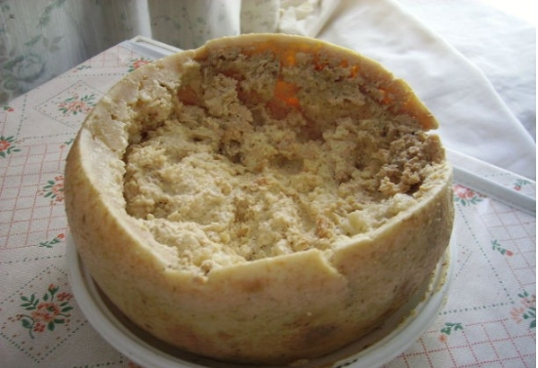
2. The cazu marzu
Cazu marzu is essentially a goat cheese made in Sardinia, Italy. After the cheese is made, the makers leave it exposed and the flies have the opportunity to lay their eggs in it. The larvae break down the fats of the cheese and help in its fermentation. Of course the larvae do not come out of the cheese since it is born from them.

Slide 4
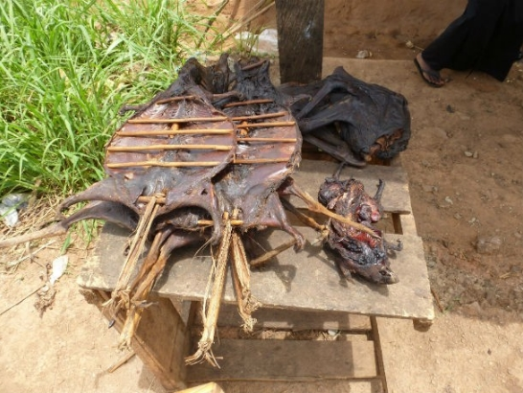
3. The meat from wild animals
This food is found in West Africa and it is the meat that comes from the wild animals of the area. Meat from various animals is used, such as rats, bats and monkeys which the inhabitants dry, put in salt or make smoked.

Slide 5
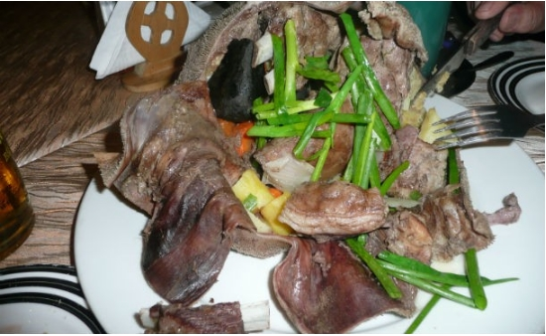
4. Boodog
This food comes from Mongolia and is a dish that includes goat or marmot. The animal is cooked with its skin by placing hot stones on its stomach.

Slide 6
Sources of information
https://wikipedia.org
Τhe students Dimitra Dimitriou,Anastasia Boulgari,Nefeli Giagkoula and Eleni Iatrou

