Slide 1
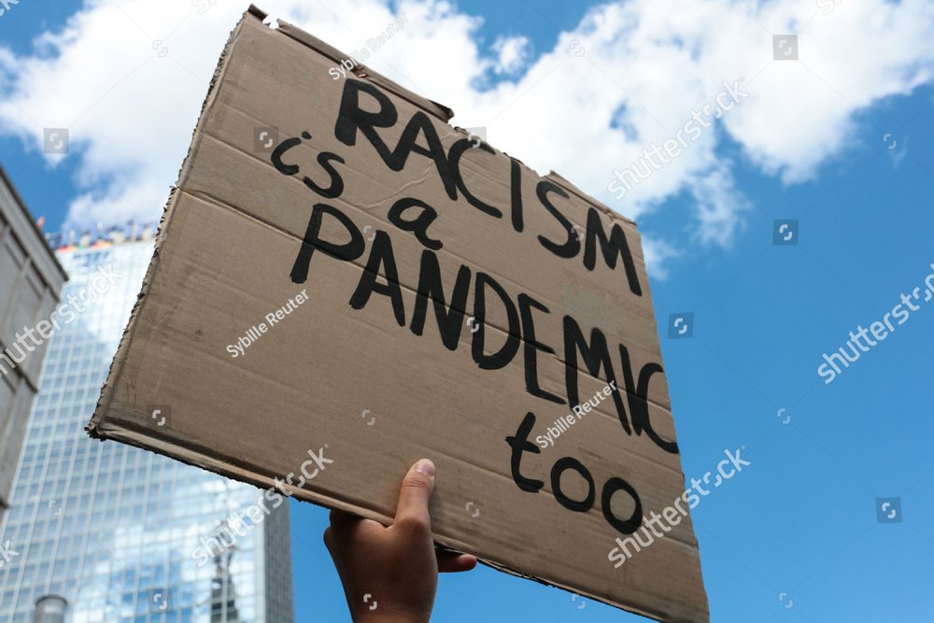
Social Racism
Societal racism is the formalization of a set of institutional, historical, cultural, and interpersonal practices within a society that places one or more social or ethnic groups in a better position to succeed and disadvantages other groups so that disparities develop between the groups over a period of time. Societal racism has also been called structural racism, because, according to Carl E. James, society is structured in a way that excludes substantial numbers of people from minority backgrounds from taking part in social institutions.[ Societal racism is sometimes referred to as systemic racism as well.

Slide 2
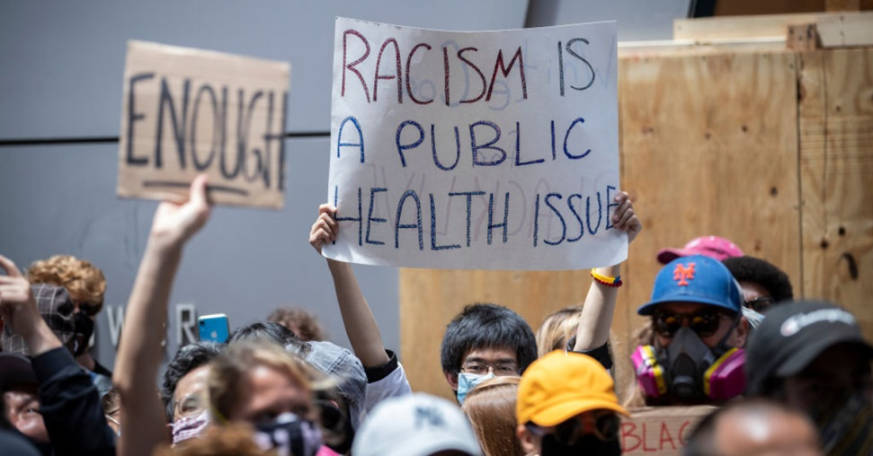
What exactly is Social Racism?
First and foremost, social racism is the
racism that exists between two people, who
belong to different social classes, who have
a financial gap in terms of their finances, in
the area where they live, in the luxuries that
they own. The general idea of this global issue is that, because
someone habitats a degraded area in contrast to someone else, is
inferior to someone who has an upgraded area, defines social
racism. It is surely a pity that this current phenomenon has not
withdrawn from modern society, despite the technological
achievements and the best in terms of quality education that we
receive to date.

Slide 3
Types of Social Racism
It is well known that Social Racism is perhaps one of the most insignificant categories of racism. However, social racism is divided into some smaller groups.
Racism for personal preferences and lifestyle
( for example being a good student or choosing a different type of hobbie)
Racism of
Appearance
(It’s about clothing preferences or haircuts)
Religious
racism
Socio-economic
racism

Slide 4
Socio-economic
Religious Racism
Socio-economic is Racism which is based on
the social and economic situation of individuals (rich-poor), their
educational level (educated-uneducated), gender (woman-
man), his profession, his mental ability, his health and his
habits. There are examples of socio-economic racism in
history, such as genocide, which can also lead to social
exclusion and war.
Religious racism is the perception that one religion is the only
true one and must prevail among others but also the rivalries
between religious dogmas that take the form of racist prejudice.

Slide 5
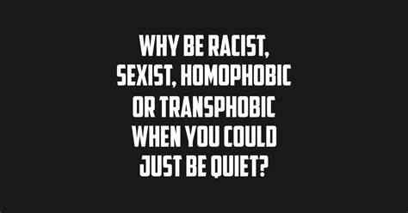
The causes of social racism
To start with, the causes of human misconduct and tactics
against vulnerable groups have many roots. One reason is the
security and intimacy of the person in the familiar and familiar
environment they have created, and for this reason his different
causes fear and insecurity, as a result of which they treat it as a
threat, as a dangerous invasion that must be exterminated. In this
case, the prejudices and stereotypes with which people are
usually educated from an early age play a decisive role.

Slide 6
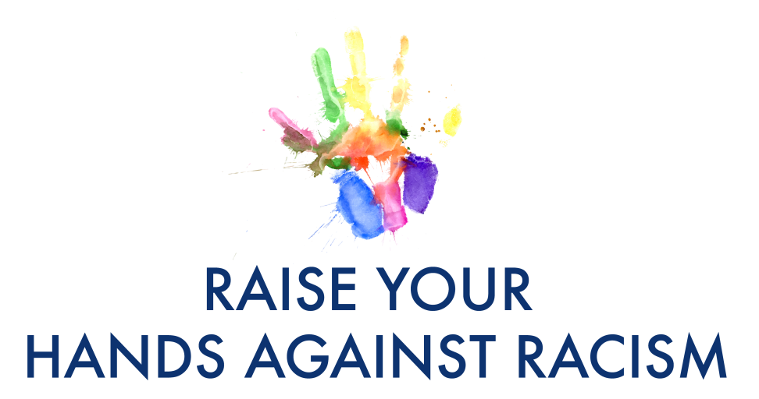
How we can play a significant role in decreasing social racism
In the first place, knowledge, education are compulsory for the
young and can help to contribute to the development of critical
capacity, in order to reduce social racism. In addition to this, the
study of history and sociology, are able to further prove that
racism in any way, shape or form is scientifically unfounded and
that equality between people is indisputable. Last but not least,
equality and respect for the divergent people can create a world
that has equal rights, fair policies and established democratic
Values. Also, International intervention
organizations, with the aim of raising awareness of the global public
Opinion would help. Mobilizing the spiritual leadership of the peoples for
combating intolerance and prejudice. Its development
humanitarian education and the introduction of special courses for
tolerance of the diversity of all individuals and peoples.

Slide 7
English project for social racism by :
Chrysoula Tsanga
Apostolis Georgantas
Manolis Metsikas
Pantelis Koudounas
Vaia Bamou
(thanks for watching<3)

