Slide 1
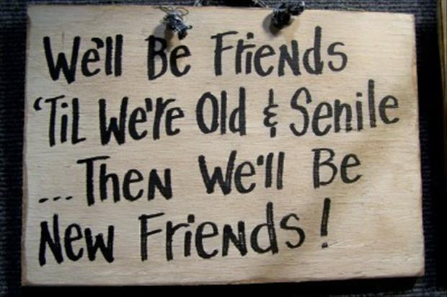
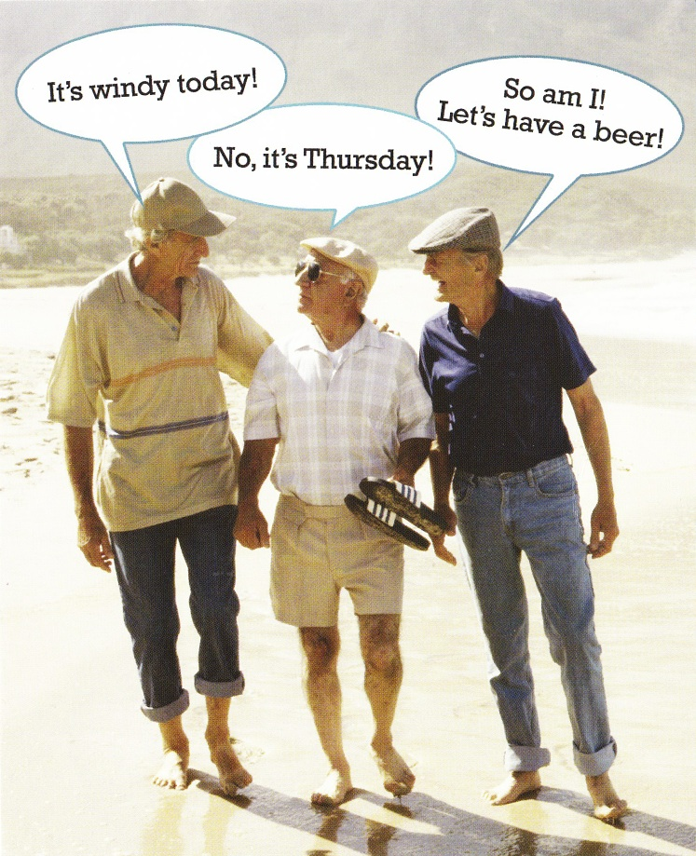
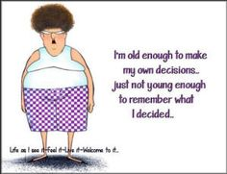
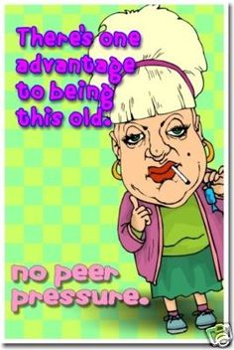
I’m not ageing… I’m marinating!!!

Slide 2
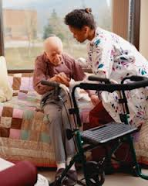
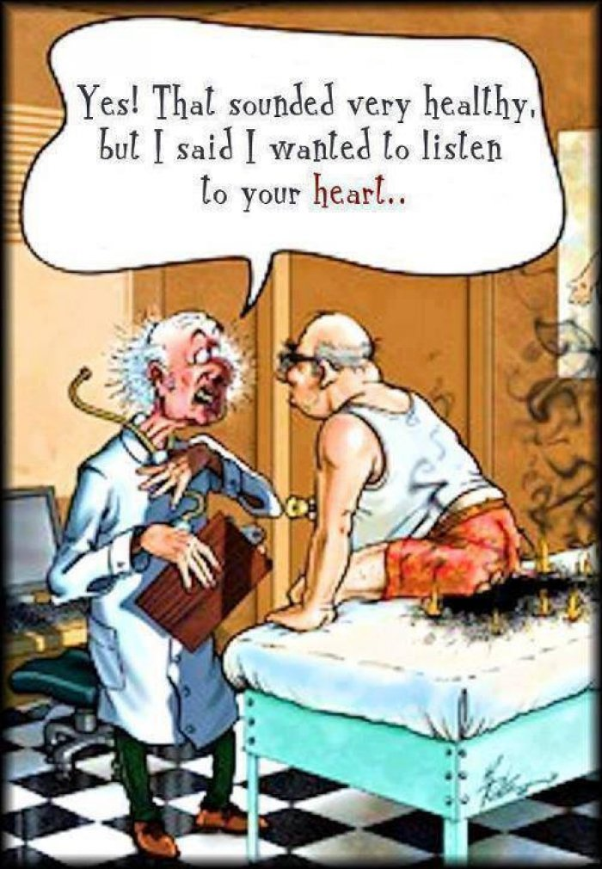
“we start dying the day we are born”
The aging process is synonymous with failing health.
It is of prime importance that good quality health care be made available and accessible to the elderly in an age-sensitive manner. Rehabilitation, community or home based disability support and end-of-life care should also be provided where needed.

Slide 3
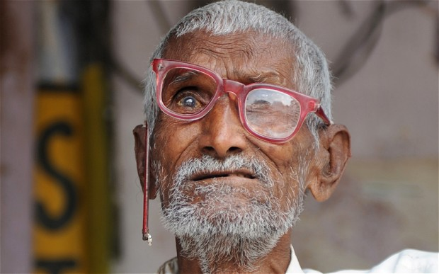
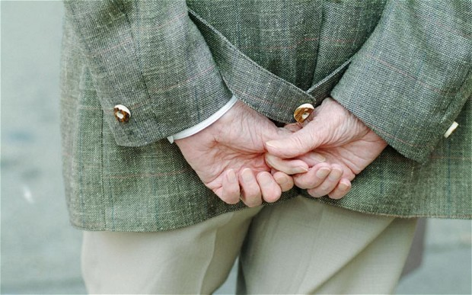
Economic Insecurity

Slide 4
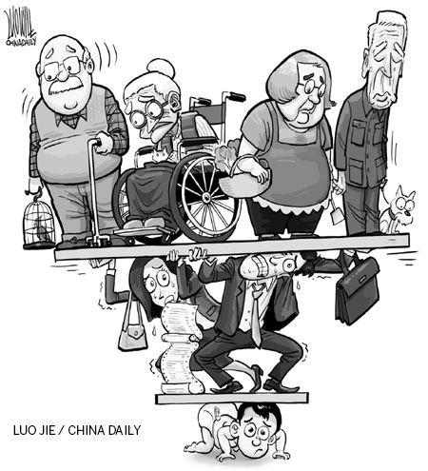
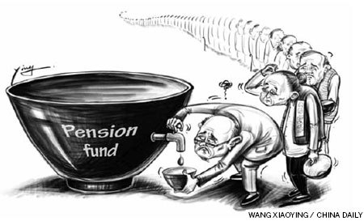
The problem of economic insecurity is faced by the elderly when they are unable to sustain themselves financially. Many older persons either lack the opportunity or the capacity to be as productive as they were. Increasing competition from younger people, chronic malnutrition and slowing physical and mental faculties, limited access to resources and lack of awareness of their rights and entitlements play significant roles in reducing the ability of the elderly to remain financially productive and independent.

Slide 5
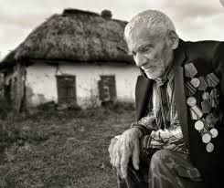
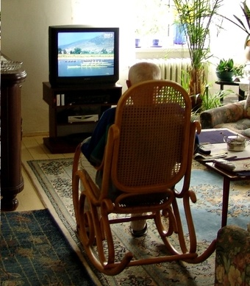
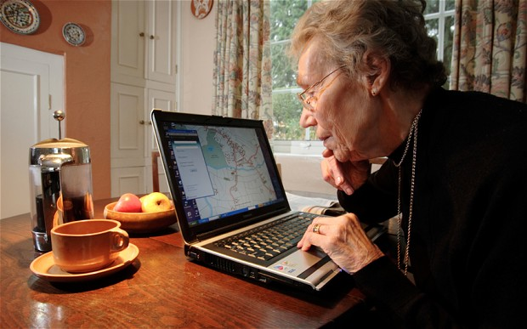
ISOLATION
isolation is most often imposed purposefully or inadvertently by the families and/or communities where the elderly live. Isolation is a terrible feeling that, if not addressed, leads to tragic deterioration of the quality of life.

Slide 6
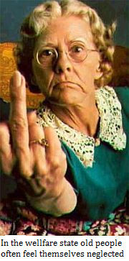
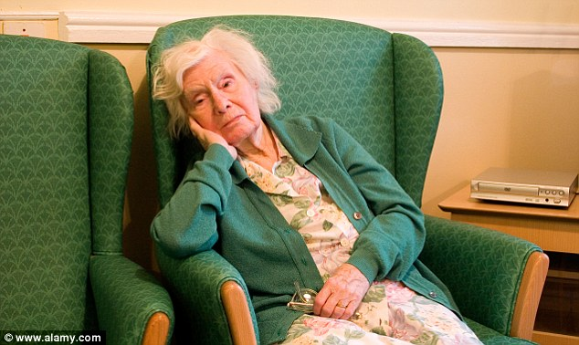
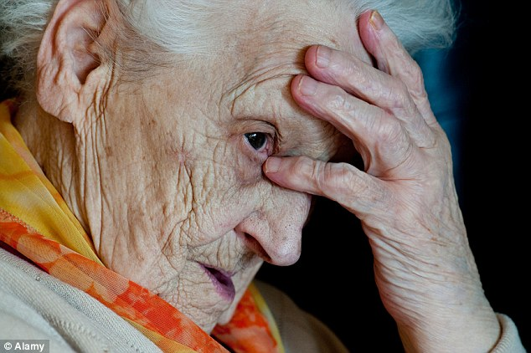
neglect
Changing lifestyles and values, demanding jobs, distractions such as television, a shift to nuclear family structures and redefined priorities have led to increased neglect of the elderly by families and communities.

Slide 7
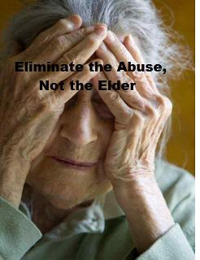
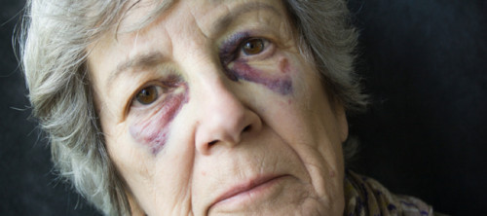
abuse
Being relatively weak, elderly are vulnerable to physical abuse. Their resources, including finances ones are also often misused. In addition, the elderly may suffer from emotional and mental abuse for various reasons and in different ways.

Slide 8
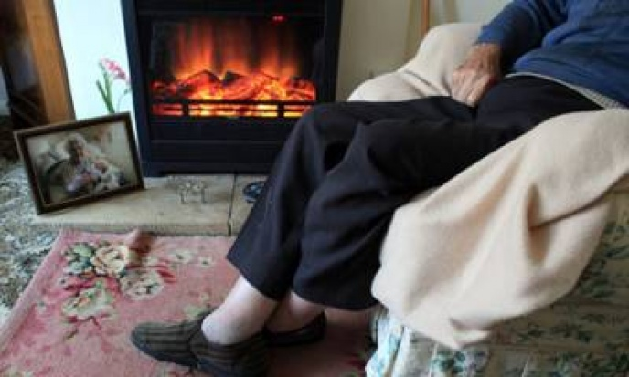
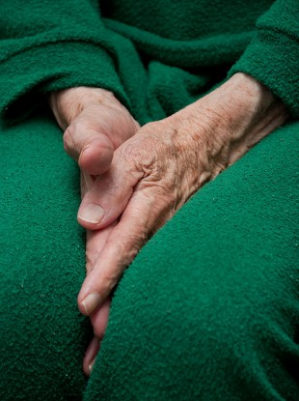
Fear
Elderly who suffer from fear need to be reassured. Whether rational or irrational, this is a relevant problem face by the elderly that needs to be carefully and effectively addressed.

Slide 9
boredom
The problem occurs due to forced inactivity, withdrawal from responsibilities and lack of personal goals. A person who is not usefully occupied tends to physically and mentally decline and this in turn has a negative emotional impact.

Slide 10
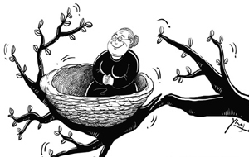
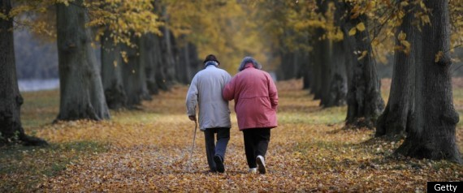
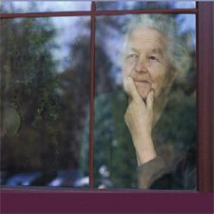
Lack of Preparedness for Old Age
A large number of people enter ‘old age’ with little, or no, awareness of what this entails. The majority of them are unaware of the rights and entitlements of old people. Awareness generation through the work place is a good beginning with HR departments taking an active role in preparing employees to face retirement and facing old age issues. For the majority who have unregulated occupations and for those who are self-employed, including farmers, awareness can be generated through the media and also through government offices.

Slide 11
Old man

