Slide 1
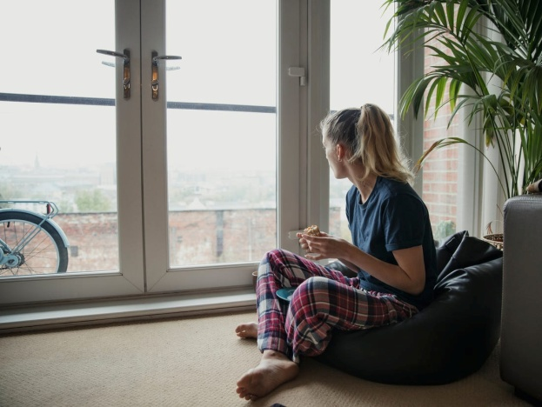
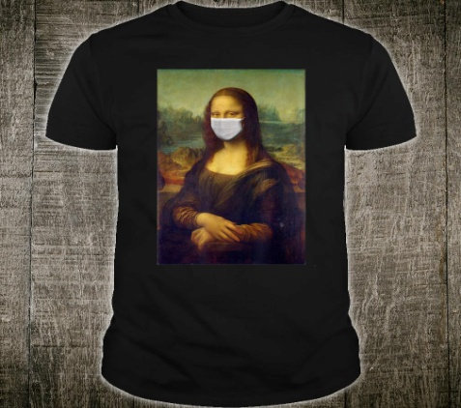
Social distancing and teens
For a generation of teenagers and tweens used to socializing through their iPhones and iPads and apps, staying connected through social distancing may prove easier than for the rest of us.

Slide 2
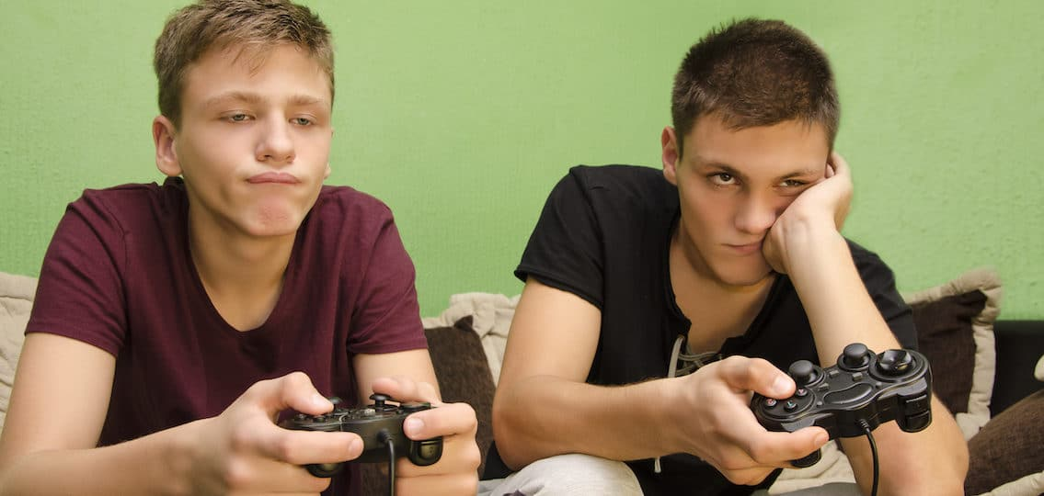
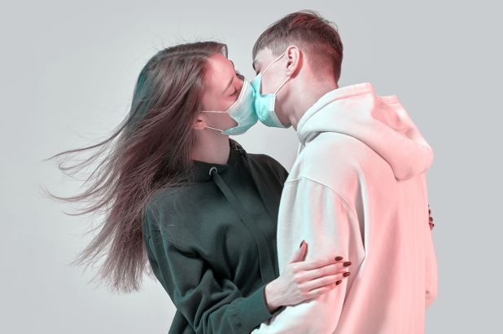
Quaranteenagers
Being a teenager is difficult no matter what, and the coronavirus disease (COVID-19) is making it even harder. With school closures and cancelled events, many teens are missing out on some of the biggest moments of their young lives — as well as everyday moments like chatting with friends and participating in class.

Slide 3
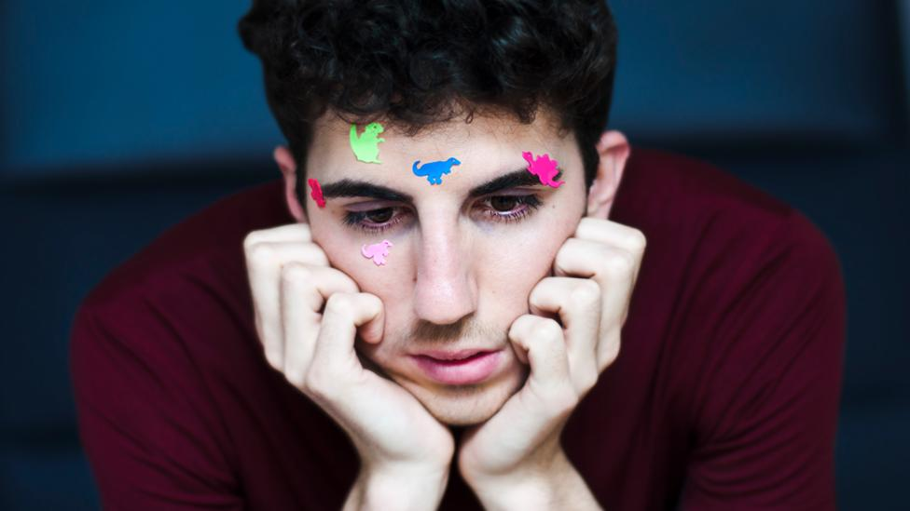
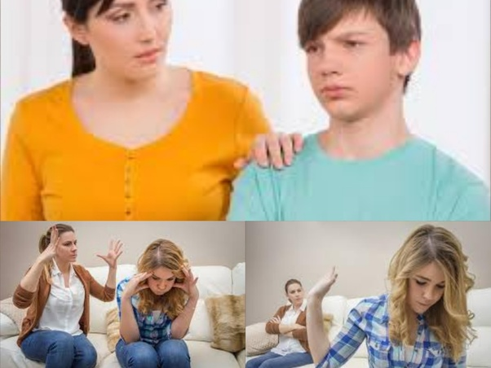
Moulding our identity
Feeling socially connected and supported and able to express yourself is so important for teenagers. Part of adolescence is defining your own identity, and for children that happens more in your peer group and social conversations.

Slide 4
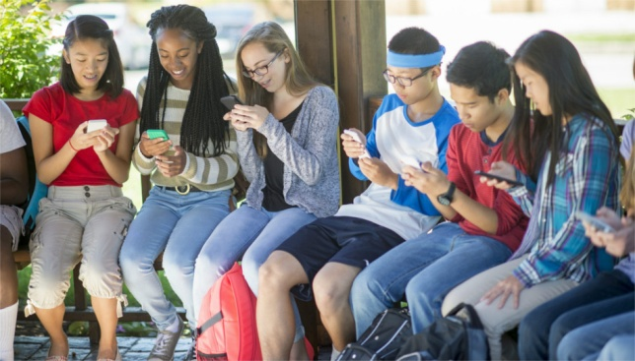
Social media : a blessing in disguise?
One good thing about the ubiquity of social media for teens is that there is already a mechanism in place that teens can use to stay connected with peers while social distancing. Online contact can be helpful, especially if teens can videochat with their friends or co-play mobile games with them.
This situation may make parents feel differently about social media than we did in the past, when we cast a jaundiced eye on it

Slide 5
Surviving the social closure
Create distractions
What psychologists know is that when we are under chronically difficult conditions, it’s very helpful to divide the problem into two categories: things I can do something about, and then things I can do nothing about.
There is a lot that falls under that second category right now, and that’s okay, but one thing that helps us to deal with that is creating distractions for ourselves. A good idea might be doing homework, watching a favourite movie or getting in bed with a novel as ways to seek relief and find balance in the day-to-day life.

Slide 6
Find new ways to connect with your friends
If you want to spend time with friends while you’re practicing social distancing, social media is a great way to connect.
However, it’s not going to be a good idea to have unfettered access to screens or social media. That’s not healthy, that’s not smart, it may amplify your anxiety.

Slide 7
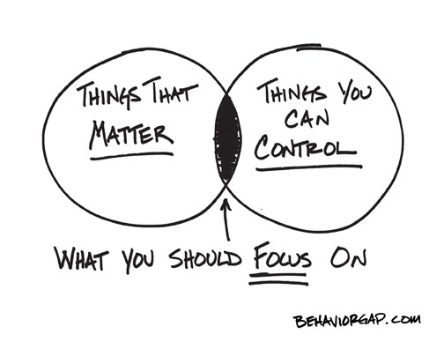
Focus on you
Have you been wanting to learn how to do something new, start a new book or spend time practicing a musical instrument? Now is the time to do that. Focusing on yourself and finding ways to use your new-found time is a productive way to look after your mental health.

Slide 8
Feel your feelings
Missing out on events with friends, hobbies, or sports matches is incredibly disappointing. These are large-scale losses. They’re really upsetting and rightly so to teenagers. The best way to deal with this disappointment? Let yourself feel it. When it comes to having a painful feeling, the only way out is through. Go ahead and be sad, and if you can let yourself be sad, you’ll start to feel better faster.

