Slide 1
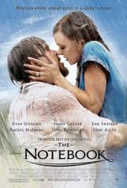
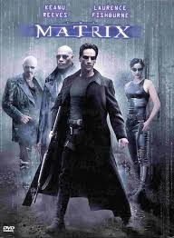
How to Write a Film Review

Slide 2
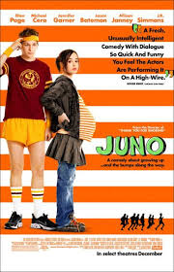
Gather basic facts about the movie
The title of the film, and the year it came out.
The director's name.
The names of the lead actors.
The genre

Slide 3
Analyze the mechanics of the movie
Analyze the different components that came together in the movie as you watch:
Direction-Cinematography(What techniques were used to film the movie? What setting and background elements helped to create a certain tone?)
Writing. Evaluate the script, including dialogue and characterization. Did you feel like the plot was inventive and unpredictable or boring and weak? Did the characters' words seem credible to you?

Slide 4
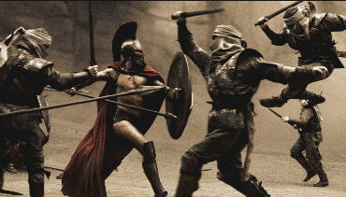
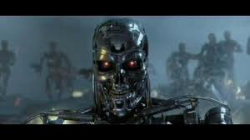
Editing
Was the movie choppy or did it flow smoothly from scene to scene? What about the use of lighting and other ambient effects? If the movie has computer-generated graphics, think about whether or not they looked realistic or fit in with the rest of the film.

Slide 5
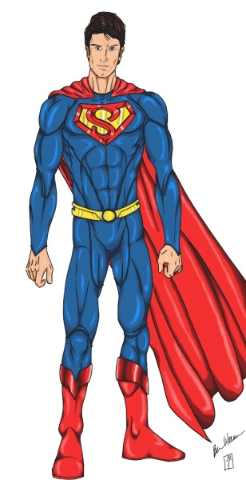
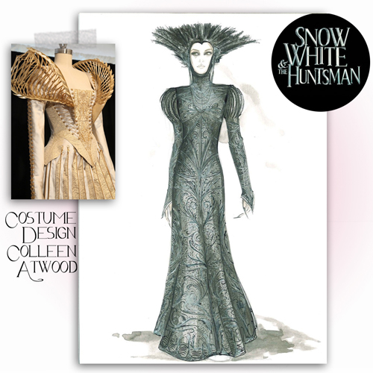
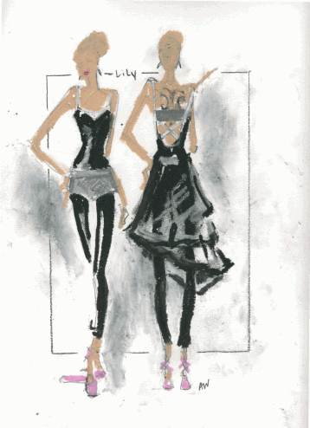
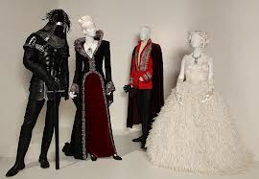
Costume design
Did the clothing choices fit the style of the movie? Did they contribute to the overall tone, rather than digress from it?

Slide 6
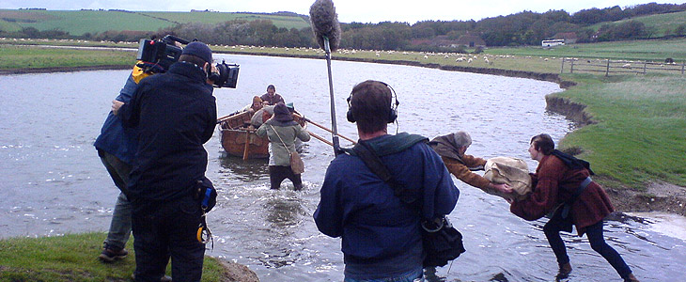
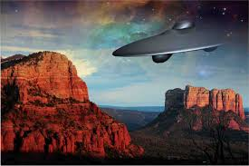
Set design
Consider how the setting of the film influenced its other elements. Did it add or subtract from the experience for you? If the movie was filmed in a real place, was this location well-chosen?

Slide 7
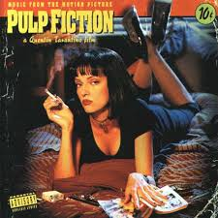
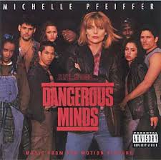
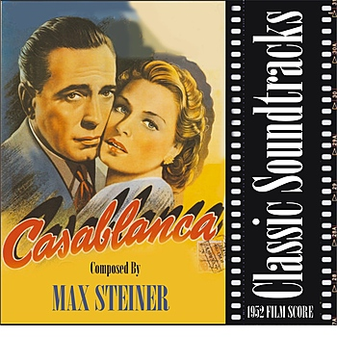
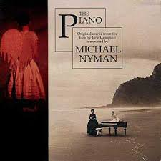
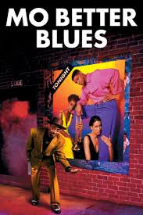
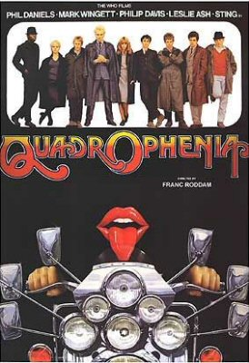
Score or soundtrack
Did it work with the scenes? Was it over/under-used? Was it suspenseful? Amusing? Irritating? A soundtrack can make or break a movie, especially if the songs have a particular message or meaning to them.

Slide 8
Does the film reflect on a current event or contemporary issue?
Does the film seem to have a message, or does it attempt to elicit a specific response or emotion from the audience?
Does the film connect with you on a personal level?

Slide 9
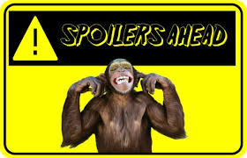
Don’t Be A Spoiler!
Allude to the climax of the movie within the middle paragraphs. You will not want to give away what it is, of course, but giving hints builds interest. Many readers become angry at a "spoiler," or a critique that gives away the best moment of the movie, so do not forget to cleverly conceal this with your writing.

Slide 10
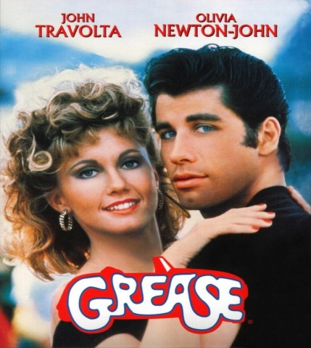
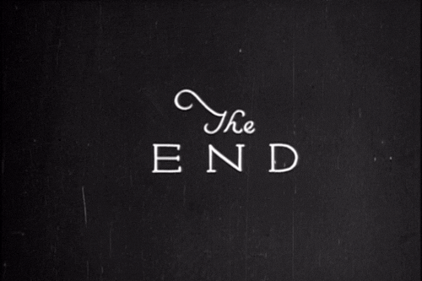
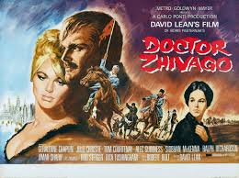
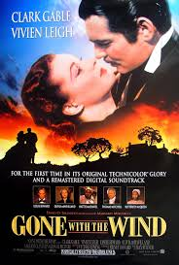
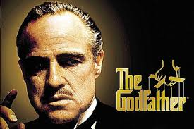
Finally……
Close up your review by giving your opinion. Readers want to hear not only what you think, but why, so remember to give reasons why you think the movie is great/terrible. Leave the reader either loving or loathing the movie with a key line. Your closing is just as important as your beginning, so make sure it's interesting!

