Slide 1
THE BIG QUESTION
WHAT SORT OF ADVICE WOULD YOU OFFER TO A YOUNG PERSON JUST ENTERING THE WORK FORCE? WHAT’S THE MOST IMPORTANT THING TO LOOK FOR IN A JOB? IS MONEY THE TOP PRIORITY? JOB SATISFACTION? IS IT BETTER TO BE IN A JOB YOU LOVE THAT BARELY PAYS THE RENT, OR TO BE MAKING A FORTUNE IN A JOB THAT SUCKS YOUR SOUL OUT AND SPITS IT ON THE FLOOR? HOW CAN YOU TELL WHAT YOU LOVE WHEN YOU’RE JUST STARTING OUT?

Slide 2
Found in a world without a real strong grasp on what our true values and goals are
Most people nowadays follow a traditional route of going through primary school, then secondary school, then college, and suddenly they’re dumped out into the work force without being able to figure out who they are and what they want out of life. For a few very lucky ones, the answer becomes clear in high school; for a few more, it becomes clear in college.

Slide 3
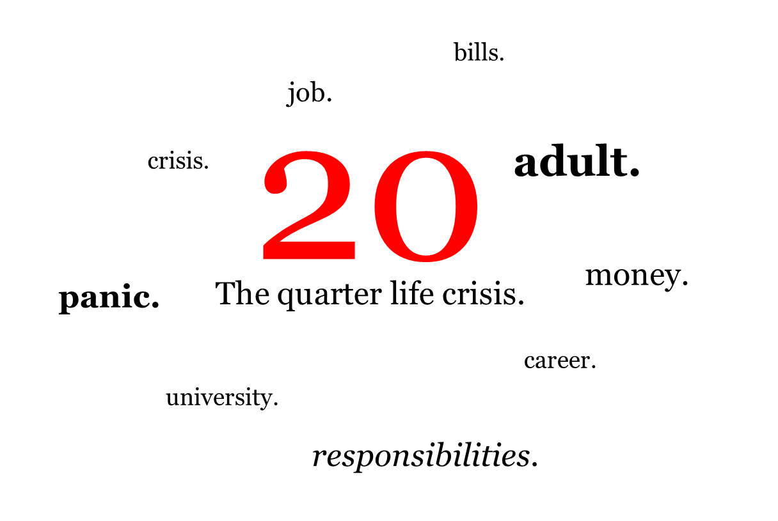
We believe that we are supposed to work and make money and have certain things in life, but we’ve never been able to really sit down and figure out what that means for us. This is quite often referred to as a quarter life crisis, when people reach the workforce and realize that they don’t know why they’re there.

Slide 4
Salary is something you negotiate once and take home once every thirty days. Job satisfaction keeps you happy every minute of every day. So ideally a good balance of both is required. But there is no doubt that of the two, JOB SATISFACTION IS DEFINITELY MORE IMPORTANT.
It is the one thing that keeps you motivated. If you are motivated, you perform better and you grow. If you grow, you become even more satisfied.

Slide 5
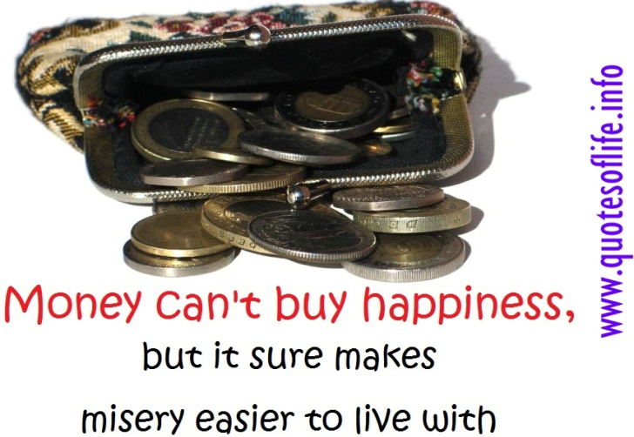
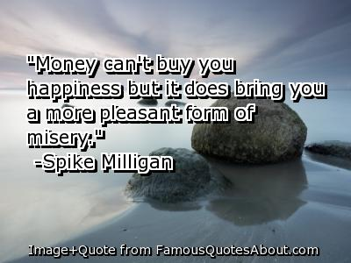
money buys you happiness but lack of money buys you misery.
There is always a certain basic level of salary needed to keep a person comfortable in a job, anything less than that will cause dissatisfaction with the job. Beyond that level of salary, job satisfaction, freedom to do the job in the way best suited to you and recognition is the prime motivator.

Slide 6
A matter of priorities
It all depends on priorities. Some people are willing to make lifestyle changes because the intrinsic rewards of following a passion or making a difference are more important than a high salary in an unenjoyable career.

Slide 7
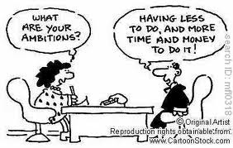

Slide 8
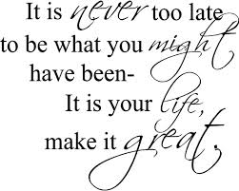
It’s never too late
we should be asking ourselves lots and lots of “what if” questions to really open up the context and create new possibilities.”What if I had chosen THE ROAD NOT TAKEN, when standing at the fork carrying my backpack towards the true destination on this journey of life”.

Slide 9
What makes people maximize their performance

