Slide 1
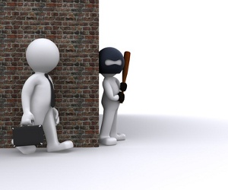
How do some people decide to commit a crime? Do they think about the benefits and the risks? Why do some people commit crimes regardless of the consequences? Why do others never commit a crime, no matter how desperate their circumstances?

Slide 2
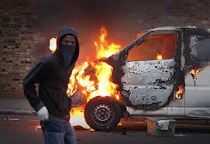
But why do they do so….???
Reasons for committing a crime include greed, anger, jealously, revenge, or pride. Some people decide to commit a crime and carefully plan everything in advance to increase gain and decrease risk. some even consider a life of crime better than a regular job—believing crime brings in greater rewards, admiration, and excitement—at least until they are caught. Others get an adrenaline rush when successfully carrying out a dangerous crime. Others commit crimes on impulse, out of rage or fear.

Slide 3
a problem ….or a symptom?
Crime is a problem, but more importantly, crime is a symptom of a much deeper social problem …… a societal dysfunction in which every one of us, by omission or commission plays a part.
So the answer to the question of why people commit crime lies within each of us.

Slide 4
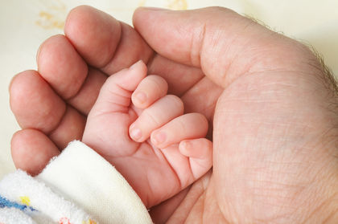
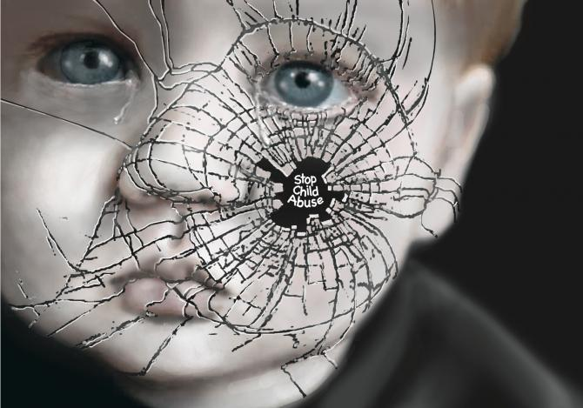
Parental relations
Children who are neglected or abused are more likely to commit crimes later in life than others. Similarly, sexual abuse in childhood often leads these victims to become sexual predators as adults.

Slide 5
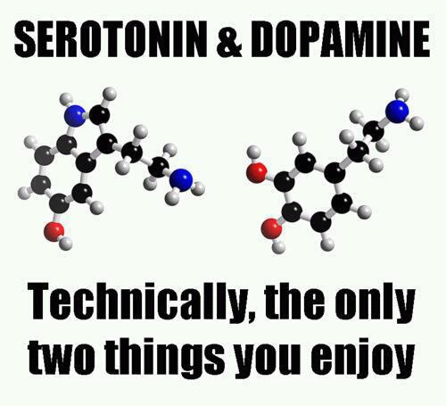
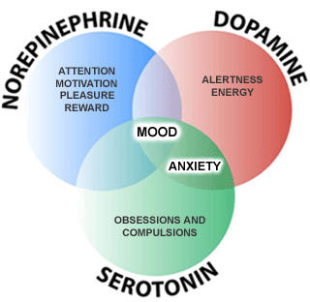
Heredity and brain activity
Studies indicated that increased levels of some neurochemicals, such as serotonin, decreases aggression. Serotonin is a substance produced by the central nervous system that has broad sweeping effects on the emotional state of the individual. In contrast higher levels of others, such as dopamine, increased aggression. Researchers expected to find that persons who committed violent crimes have reduced levels of serotonin and higher levels of dopamine.

Slide 6
Hormones Testosterone Cortisol
Testosterone is a sex hormone produced by male sexual organs that cause development of masculine body traits. Research suggested that when the cortisol level is high a person's attention is sharp and he or she is physically active. In contrast, researchers found low levels of cortisol were associated with short attention spans, lower activity levels, and often linked to antisocial behavior including crime. Studies of violent adults have shown lower levels of cortisol; some believe this low level serves to numb an offender to the usual fear associated with committing a crime and possibly getting caught.

Slide 7
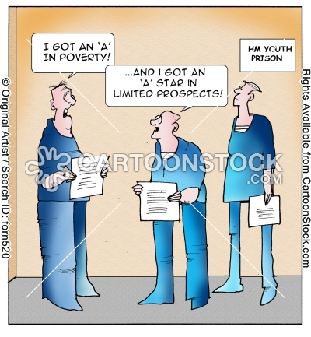
Education
poor educational backgrounds entail employment histories consisting of mostly low wage jobs with frequent periods of unemployment

Slide 8
Peer influence
young boys and girls who do not fit into expected standards of academic achievement or participate in sports or social programs can become lost in the competition.
youth may abandon schoolmates in favor of criminal gangs, since membership in a gang earns respect and status in a different manner. In gangs, antisocial behavior and criminal activity earns respect and street credibility.
Like society in general, criminal gangs are usually focused on material gain. Gangs, however, resort to extortion, fraud, and theft as a means of achieving it.

Slide 9
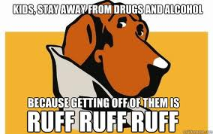
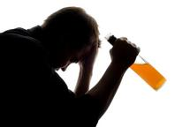
Drugs and alcohol
The urge to commit crime to support a drug habit definitely influences the decision process. Both drugs and alcohol impair judgment and reduce inhibitions (socially defined rules of behavior), giving a person greater courage to commit a crime. Deterrents such as long prison sentences have little meaning when a person is high or drunk.

Slide 10
What’s the cause of crime?

Slide 11
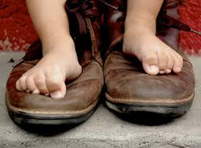
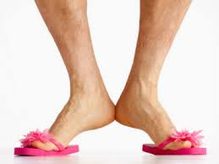
An effective change…
Walk in your brother’s shoes so you can feel how his feet hurt or you won’t be motivated to buy him a new pair or fix the ones he has. If you’ve already waiked in his shoes and know how they feel but you don’t have the resources to fix them by yourself, then you have to recruit others to also take a short hike in his shoes so they can help you get a new pair.

