Slide 1
A Very Merry Un-Birthday?
Contrary to popular belief, the Bible doesn't actually mention a specific date for Jesus' birth. In fact, most historians believe he was probably born in the spring, hence the Bible's description of shepherds herding animals. But in the 4th century, when the Catholic Church decided to recognize Jesus' birth as an official holiday, Pope Julius I chose December 25 for the Feast of the Nativity. That the date happened to coincide with the pagan festival known as Saturnalia must have been pure coincidence.

Slide 3
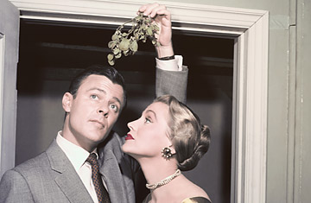
Kiss Me; I'm Celtic
According to Celtic and Teutonic legend, mistletoe is magical — it can heal wounds, increase fertility, bring good luck and ward off evil spirits. The tradition of kissing under the mistletoe didn't begin until the Victorian era, a surprising origin given the stuffy and sexually repressive behavior of the time. Actually, it's not very surprising at all.

Slide 4
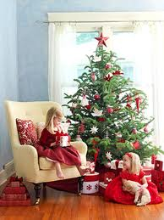
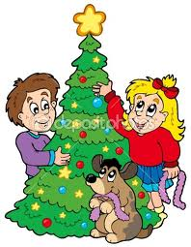
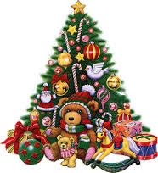
O Tannenbaum!
Even before the arrival of Christianity, Germans decorated evergreen trees to brighten the dark, gloomy days of the winter solstice. The first "Christmas trees" appeared in Strasbourg in the 17th century and spread to Pennsylvania in the 1820s with the arrival of German immigrants. When Queen Victoria married Germany's Prince Albert in 1840, he brought the tradition to England. Eight years later, the first American newspaper ran a picture of the royal Christmas tree, and Americans outside Pennsylvania quickly followed suit.

Slide 5
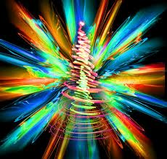
THE COLORS OF CHRISTMAS
The traditional three colors of Christmas are green, red, and gold. Green has long been a symbol of life and rebirth; red symbolizes the blood of Christ, and gold represents light as well as wealth and royalty.

Slide 6
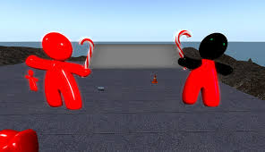
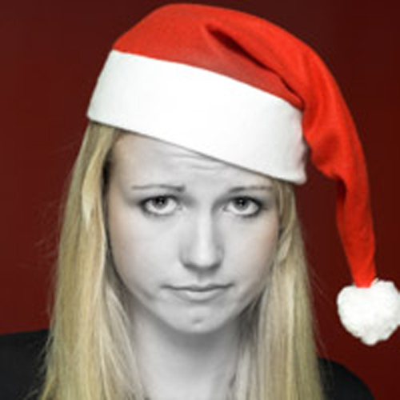
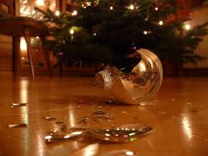
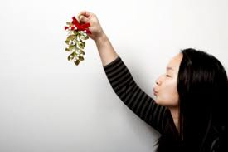
Last Year I Gave You My Heart
According to data analyzed from Facebook posts, two weeks before Christmas is one of the two most popular times for couples to break up. However, Christmas Day is the least favorite day for breakups.

Slide 7
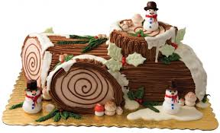
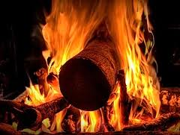
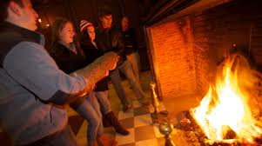
Burns away all evil spirits
A Yule log is an enormous log that is typically burned during the Twelve Days of Christmas (December 25-January 6). Some scholars suggest that the word yule means “revolution” or “wheel,” which symbolizes the cyclical return of the sun. A burning log or its charred remains is said to offer health, fertility, and luck as well as the ability to ward off evil spirits.

Slide 8
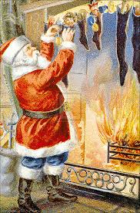
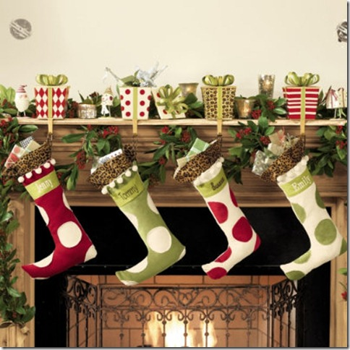
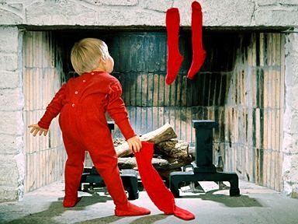
The stockings were hung by the chimney with care…..
Christmas stockings allegedly evolved from three sisters who were too poor to afford a marriage dowry and were, therefore, doomed to a life of prostitution. They were saved, however, when the wealthy Bishop Saint Nicholas of Smyrna (the precursor to Santa Claus) crept down their chimney and generously filled their stockings with gold coins.

Slide 9
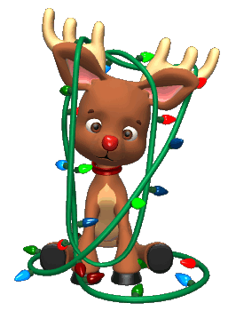
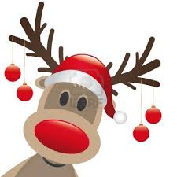
"Now, Dasher! Now, Dancer! Now, Prancer, and Vixen! "On, Comet! On, Cupid! On, Donder and Blitzen! "To the top of the porch! to the top of the wall! "Now dash away! dash away! dash away all!"
Most of Santa’s reindeer have male-sounding names, such as Blitzer, Comet, and Cupid. However, male reindeers shed their antlers around Christmas, so the reindeer pulling Santa’s sleigh are likely not male, but female or castrati.

Slide 10
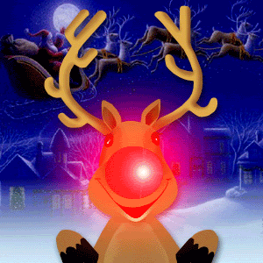
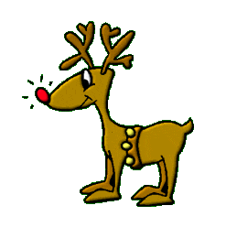
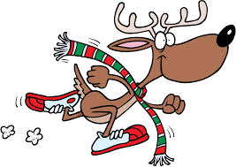
Rudolph's story was originally written in verse by Robert L. May for the Montgomery Ward chain of department stores in 1939, and published as a book to be given to children in the store at Christmas time. According to this story, Rudolph's glowing red nose made him a social outcast among the other reindeer. However, one Christmas Eve Santa Claus was having a lot of difficulty making his flight around the world because it was too foggy. When Santa went to Rudolph's house to deliver his presents he noticed the glowing red nose in the darkened bedroom and decided it could be a makeshift lamp to guide his sleigh. He asked Rudolph to lead the sleigh for the rest of the night, Rudolph accepted and returned home a hero for having helped Santa Claus.

Slide 11
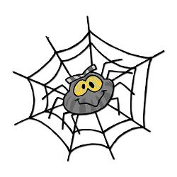
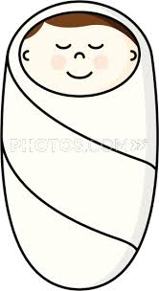
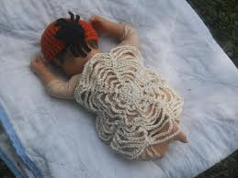
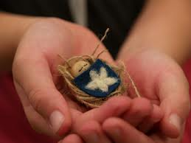
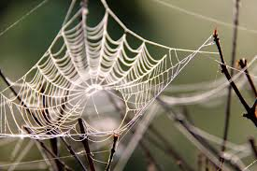
Jesus “tucked” in a web?
In Poland, spiders or spider webs are common Christmas trees decorations because according to legend, a spider wove a blanket for Baby Jesus. In fact, Polish people consider spiders to be symbols of goodness and prosperity at Christmas.

Slide 12
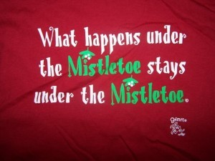
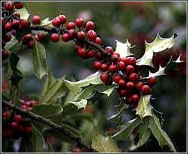
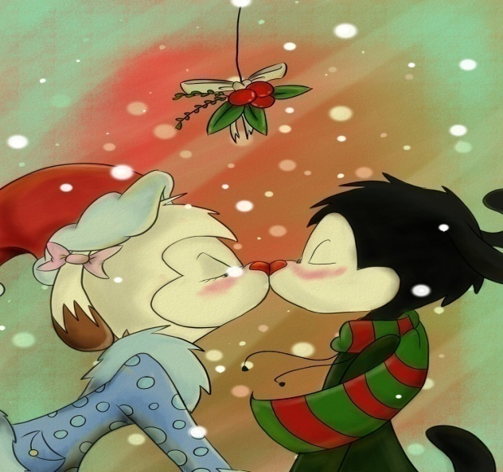
Kiss me below the mistletoe
Ancient peoples, such as the Druids, considered mistletoe sacred because it remains green and bears fruit during the winter when all other plants appear to die. Druids would cut the plant with golden sickles and never let it touch the ground. They thought it had the power to cure infertility and nervous diseases and to ward off evil

Slide 13
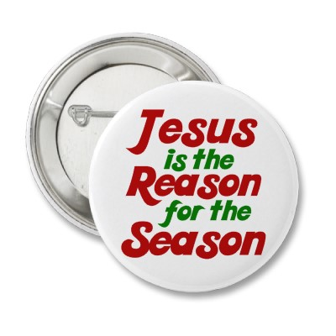
A Tale of Two Christmases
by Jim Smith
It is the worst of times. It is the best of times. The Christmas you have depends upon you. May you be blessed to follow the Light and choose the right.A Christmas Poem
C is for Credit Cards that make buying a breeze. H is for your Headache when your cards are seized. R is for Remembering everyone on your list. I is for feeling Insulted when your gifts are dissed. S is for feeling Stressed when you're on the fly. T is for the Truckloads of presents that you buy. M is for your Massive debt that soars into the sky. A is for the Awful feeling that you've gone astray. S is for your Sorrow and the tears you'll shed today.The True Christmas Poem
C is for the Christ child lying in a manager. H is for the Holy One who saved us all from danger. R is to Remember Him who died that we may live. I is to Inspire us that we may always give. S is for joyful Songs and sacred hymns that praise. T is to Thank the Lord for showing us the way. M is for the Miracles that bless us each day. A is for the Almighty who always puts us first. S is for the Shepherd who guides us on earth.

Slide 14
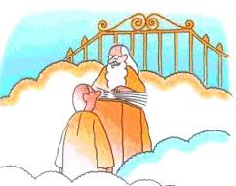
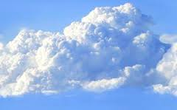
Entering Heaven
Three men died on Christmas Eve and were met by Saint Peter at the pearly gates.
«In honor of this holy season,» Saint Peter said, «You must each possess something that symbolizes Christmas to get into heaven.»
The first man fumbled through his pockets and pulled out a lighter. He flicked it on. «It represents a candle,» he said. «You may pass through the pearly gates,» Saint Peter said.
The second man reached into his pocket and pulled out a set of keys. He shook them and said, «They’re bells.» Saint Peter said, «You may pass through the pearly gates.»
The third man started searching desperately through his pockets and finally pulled out a pair of women’s glasses.
St. Peter looked at the man with a raised eyebrow and asked, «And just what do those symbolize?»
The man replied, «They’re Carol’s.»

Slide 15
Clement Clarke Moore’s poem

Slide 17
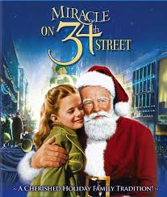
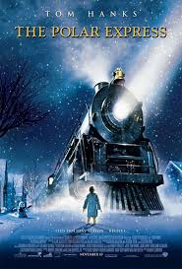
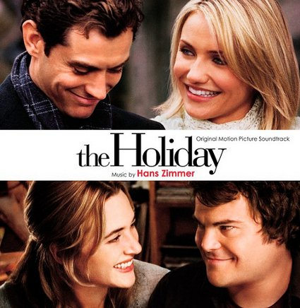
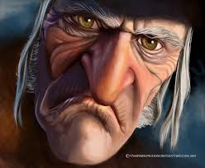
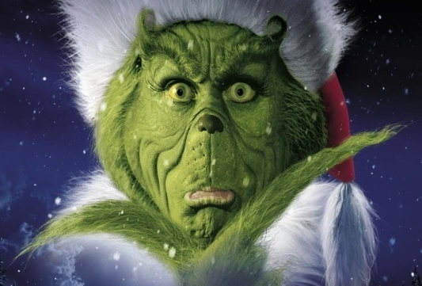
Christmas movies

