Slide 1
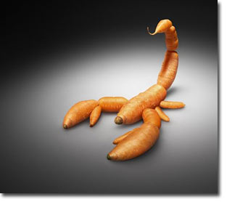
Rewards and Praise: The Poisoned Carrot
We give our children ice-cream if they're "good", chocolate if they're quiet, little gold stars if they eat their greens, maybe even money if they get good marks at school. We praise them with a "good boy!" or "good girl!" if they do something that pleases us. For the modern and discerning parent, the hitting-and-shaming method of "discipline" is passι. Punishment is out, and rewards are in. Why use the stick, when we can better teach a child by using a carrot?

Slide 2
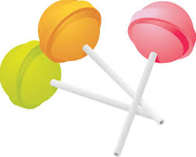
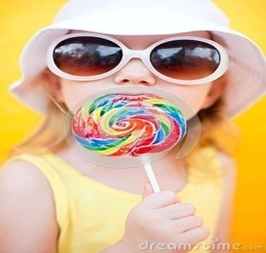
The lollipop effect
I recently took Big A to the hairdresser, and, as usual, she didn’t want to get her hair washed. The hairdresser kept pushing it until I finally said, “Maybe there’s something we could entice you with a sweet.” While I was quickly brainstorming a reward, like a book, the hairdresser quickly chimed in with, “A lollipop — you can’t have a lollipop unless you get your hair washed.”
Before I could say anything Big A moved (more like sprinted) straight into the hair washing seat. As she was getting situated she got scared and told me she didn’t want to do it. The hairdresser said in a sing-songy voice, “Well, then you won’t get a lollipop.” And then Big A checked in with me: “Mom, can I still get a lollipop?”
“Yes, sweet” I replied. The hairdresser glared at me, with a look of disbelief, and I told her that as a dietitian I can’t use food as a reward and then apologized.

Slide 3
What’s the big deal?
a lot of parents know that using food as a reward isn’t the best strategy – they do it because it works in the short term. When we are short-term focused with feeding, we are more tempted to employ feeding strategies that are counter-productive for kids’ eating down the line.-term.

Slide 4
Palatable food
We know from research that using palatable foods as a reward makes them even more appealing to kids. And on the opposite end, using healthy food as punishment, to get the reward, makes kids less interested in the healthy food.

Slide 5
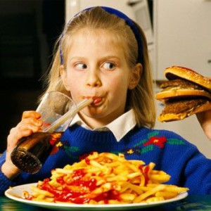
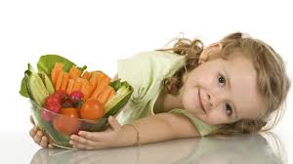
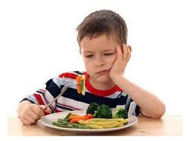
kids’ relationship with food in the super long run?
Kids who see food as a reward may turn into adults who seek food rewards.
The more frequently parents use food as a reward or punishment, the more likely it is their kids will grow into adults who eat in the absence of hunger.

Slide 6
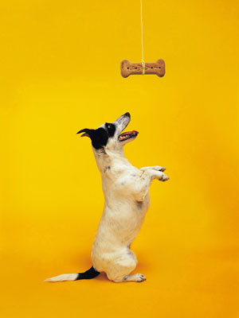
Rewards
As teachers know, classroom rewards can be an effective way to encourage positive behavior. Children, like everyone, alter their actions based on short-term anticipated consequences. When trying to foster a new behavior, it is important to reward a child consistently each time he or she does the desired behavior. Once the behavior has become an established habit, rewards can be given every now and then to encourage the child to maintain the preferred behavior.

Slide 7
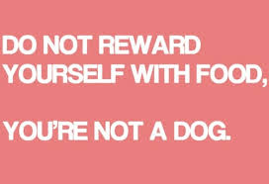
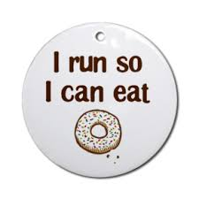
Food ….a reward?
Food is commonly used to reward students for good behavior and academic performance. It’s an easy, inexpensive and powerful tool to bring about immediate short-term behavior change. Yet, using food as reward has many negative consequences that go far beyond the short-term benefits of good behavior or performance.

Slide 8
Consequences of Using Food Rewards
Contributes to Poor Health
Foods commonly used as rewards, like candy and cookies, can contribute to health problems for children, such as obesity, diabetes, hypertension and cavities. Food rewards provide unneeded calories and displace healthier food choices.

Slide 9
Encourages Overconsumption of Unhealthy Foods
Foods used as rewards are typically high in fat,
added sugars and sodium with little nutritional value.
Decreasing the availability of these foods is one strategy schools can use to address the current childhood obesity epidemic.

Slide 10
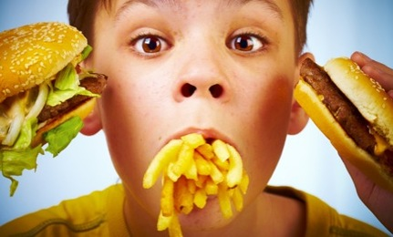
Contributes to Poor Eating Habits
Rewarding with food can interfere with children learning to eat in response to hunger and satiety cues. This teaches kids to eat when they are not hungry as a reward to themselves, and may contribute to the development of disordered eating.

Slide 11
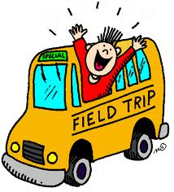
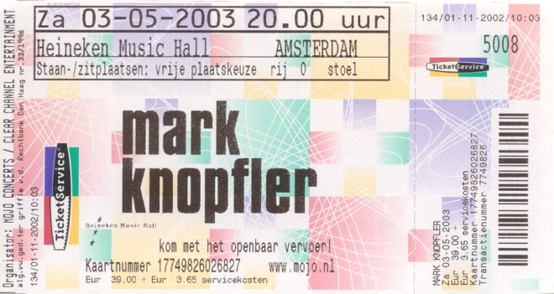
IDEAS FOR ALTERNATIVES TO FOOD REWARDS
 Sit with friends
 Choose partners for activities
 Listen to music while working at desk
 Reduced homework or “no homework” pass
 Extra credit
 Fun movie
 Brainteaser puzzles, group activities and games
 Earn points or play money for privileges or nonfood
items
 Computer time
 Free choice time or chat break at end of class
 Assemblies
 Field trips
 Eat lunch outside or have class outside

Slide 12
“momversations”

