Slide 1
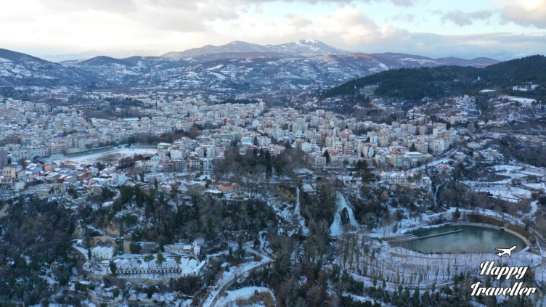
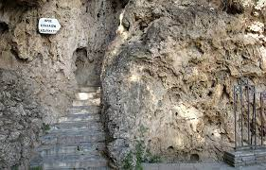
EDESSA
http://www.edessacity.gr/tourism/edessa/edessa-waterfalls-cave/
https://happytraveller.gr/edessa/
Edessa I s a beautiful country. It has a population of 18229 people, it is a tourists place and
many cherries are produced there. If you visit her, go to the attractions describe below.

Slide 2
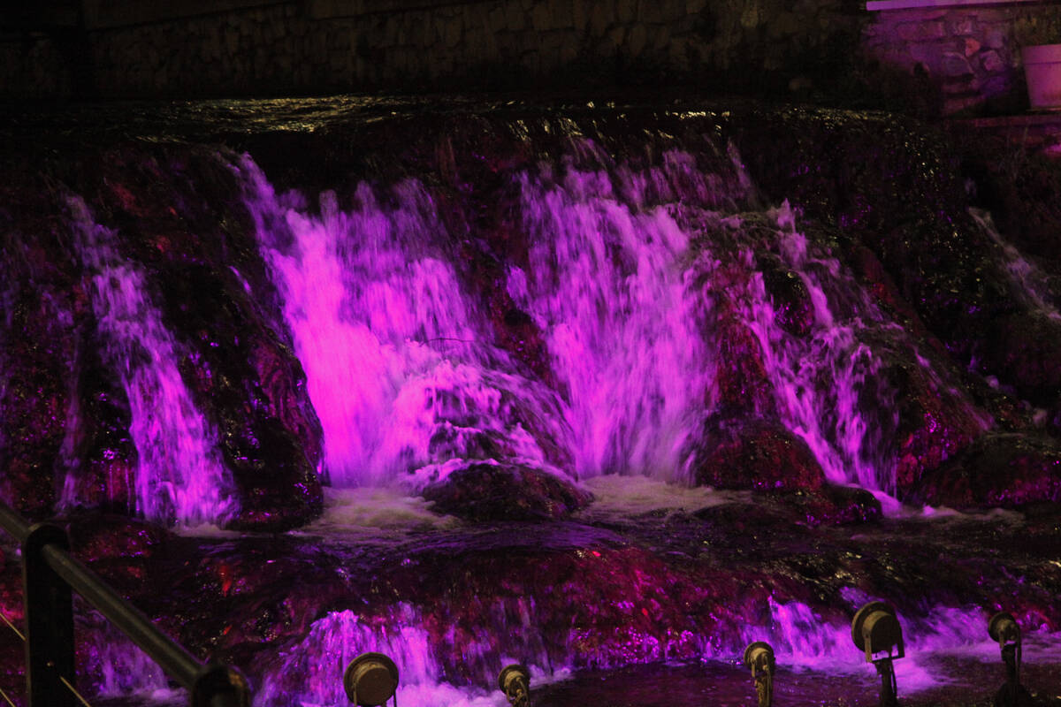
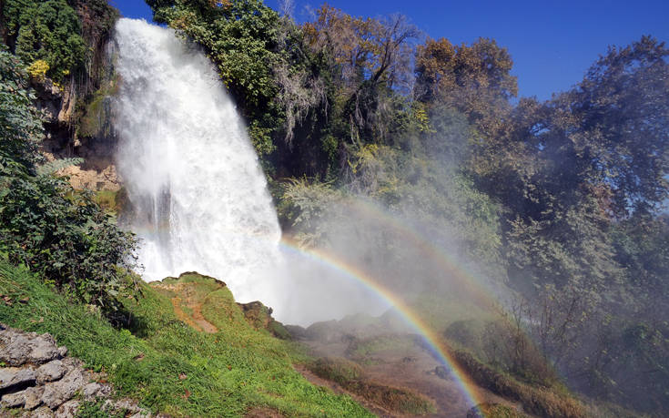
The waterfalls of Edessa
https://www.cnn.gr/taksidi/ellada/story/28946/eikones-apo-toys-katarraktes-tis-edessas
The waterfalls of Edessa were created after a strong earthquake in the 14th century. The waterfall is 70 meters high ,at the bottom there is a cave ,and then there is the forked Lambda waterfall with the two lakes.
The waterfalls at night are illuminated in rainbow colors. The waterfalls are a great sight because it is a great place to enjoy it and has a nice view from above. Really worth a visit!!!
https://www.citypatras.gr/epikairotita/ellada/katarraktes-edessas-oi-megalyteroi-sta-valkania/ 2
2

Slide 3
CIUPRI PARK
Edessα is beautiful city. An attraction is the Ciupri park. Ciupri park is the largest park in Edessa. As It is full of greenery and trees. Also from this point was the ancient Egnatia road that connected constantinople with the shores of the Adriatic sea. There you will find a fountain but also the Byzantine bridge of Ciupri. Finally there are cafes and sports facilities.
https://nicelocal.gr/central-macedonia/cultural_places/byzantine_gephyra_kioupri/

Slide 4
Byzantine bridge of Edessa
https://www.tripadvisor.com.gr/Attractions-g776951-Activities-Edessa_Pella_Region_Central_Macedonia.html
It to the store accherd of the Ottoman evy That dominates
the park landscape .Many resoorchers argue that the same bridye was existing since the Roma erg and through this was passing .The famous Egnatia screet.

Slide 5
The reptile museum is a museum in Edessa. Inside you can see many reptiles from
salamandres to snakes. There are all kinds of snakes and other reptiles. The reptiles are kept
in small glass boxes. There are also many hotels nearby such as restaurants. I hope you visit
it and like it!
https://golden-greece.gr/museums/makedonia/pela/mouseio-erpeton

