Slide 1
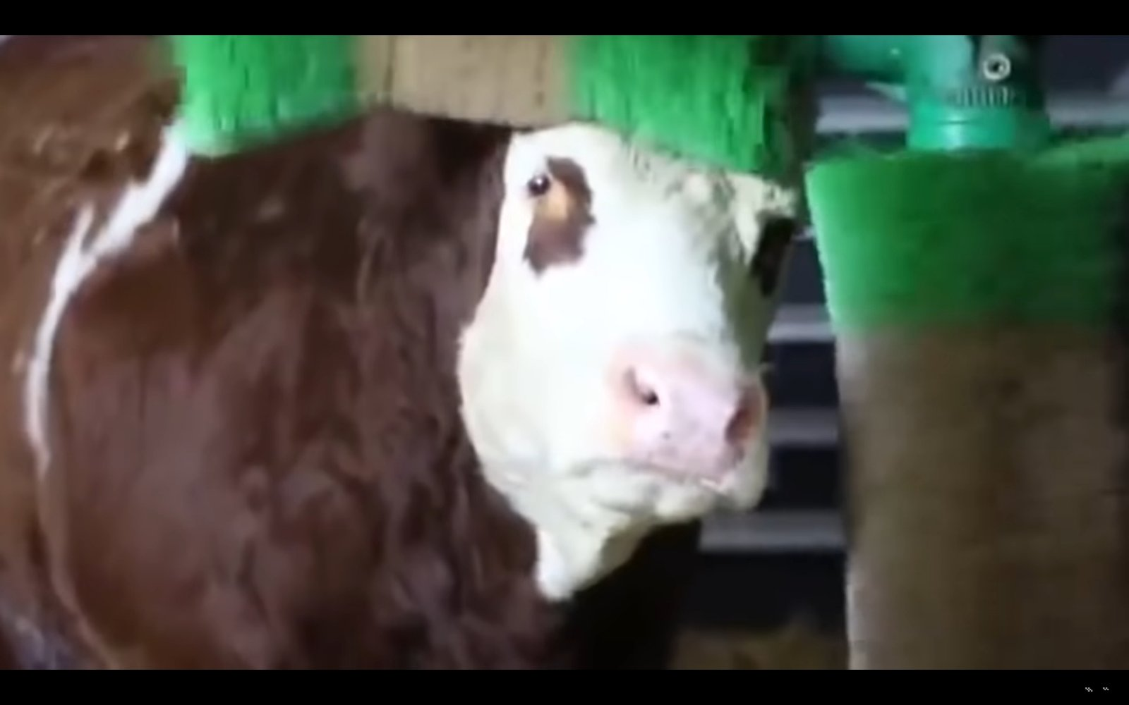
My country Greece
Ioaninna

Slide 2
Intro
Greece is a beaubeautiful country with lot of beautiful island's.Greece is in South Europe in Balkan peninsula. It proves with Italy on the west,Turkey on the cast ,on the north with Albanian, north Macedonia and Bulgarian on the south across the Mediterranean sea in Africa
But today we will focus on Ioaninna,one of the most beautiful and popular town in Greece.Ioanenna mentioned in a decree of 2010 by the Byzantine

Slide 3
Ioaninna’s castle🏰🏯
Story
Picture

Slide 4
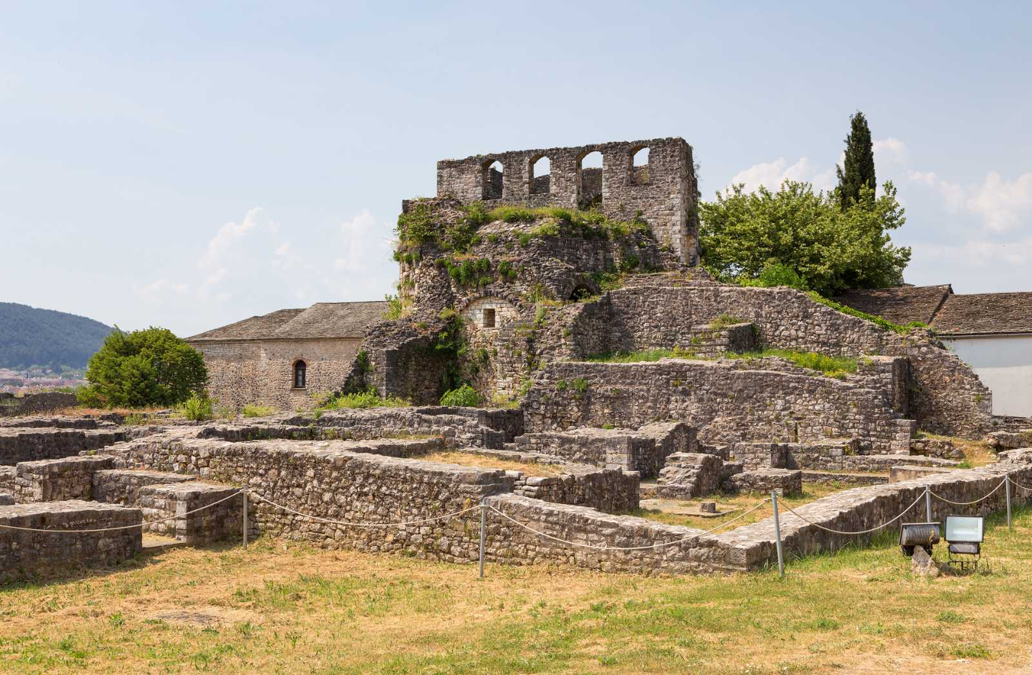

Slide 11
Sources
•Kastra.eu
•OffLine Post
•Travel Ioannina
•blogs.sch.gr
Wikipedi

