Slide 1
PAST CONTINUOUS
Use
We use the Past Continuous to talk about:
Things that were happening at a specific time in the past
Two or more things that were happening at the same time in the past
The background of a story
An action that was happening in the past and was interrupted by another action
Examples:
We were having lunch at two o’clock yesterday.
My brother was playing football and I was playing handball.
It was raining and the wind was blowing.
Amanda was cooking dinner when the phone rang.

Slide 2
Formation
Affirmative:
Subject + was/were + verb + -ing
I was working
You were working
He was working
She was working
It was working
We were working
You were working
They were working

Slide 3
Interrogative
Was/Were + Subject + verb + -ing
Was I working?
Were you working?
Was he working?
Was she working?
Was it working?
Were we working?
Were you working?
Were they working?

Slide 4
Negative
Subject + was/were + not (=wasn’t/weren’t) + verb + -ing
I wasn’t working
You weren’t working
He wasn’t working
She wasn’t working
It wasn’t working
We weren’t working
You weren’t working
They weren’t working

Slide 5
Time expressions used with Past Continuous
All day yesterday, all afternoon, at nine o’clock last night,
last Tuesday, last year, this morning
Examples:
She was talking on the phone all afternoon.
It was raining all day yesterday.
At eight o’clock on Saturday evening they were watching a film.

Slide 6
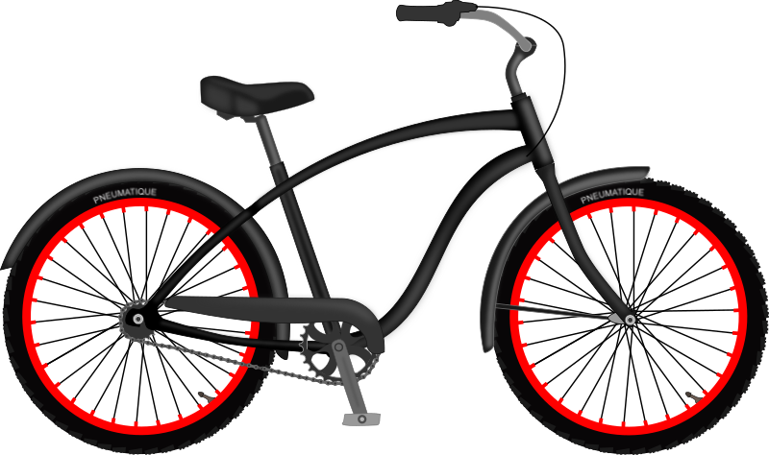
Χρησιμοποιούμε το while με τον Past Continuous
While I was reading, my sister was washing the dishes.
We met some friends while we were riding our bikes.

