Slide 1
OUR MUSEUM
Nuncio and Lucia
PHYSICS
BIIOLOGY

Slide 2
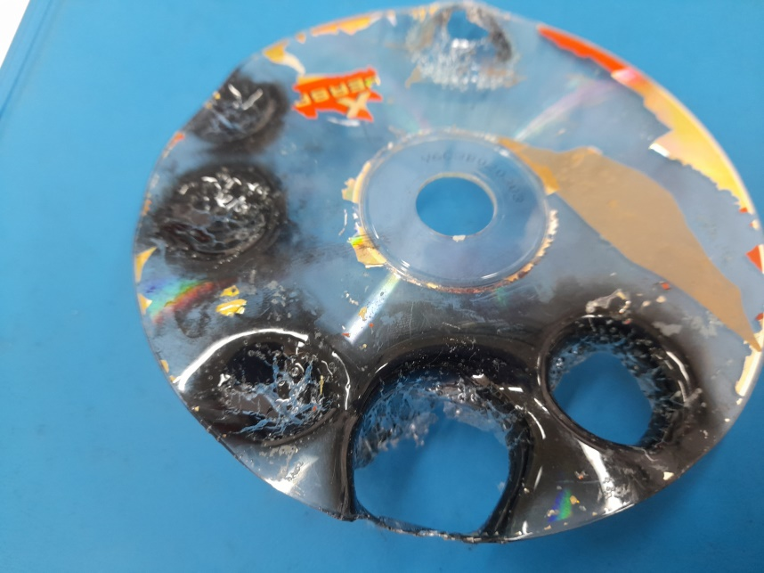
PHYSICS
BEGGINING
CHEMISTRY

Slide 3
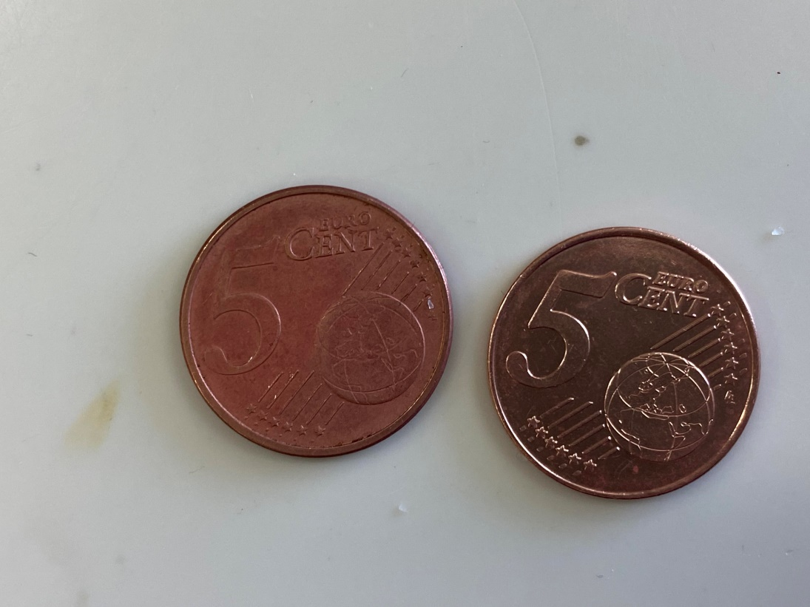
CHEMISTRY
PHYSICS
BIOLOGY

Slide 4
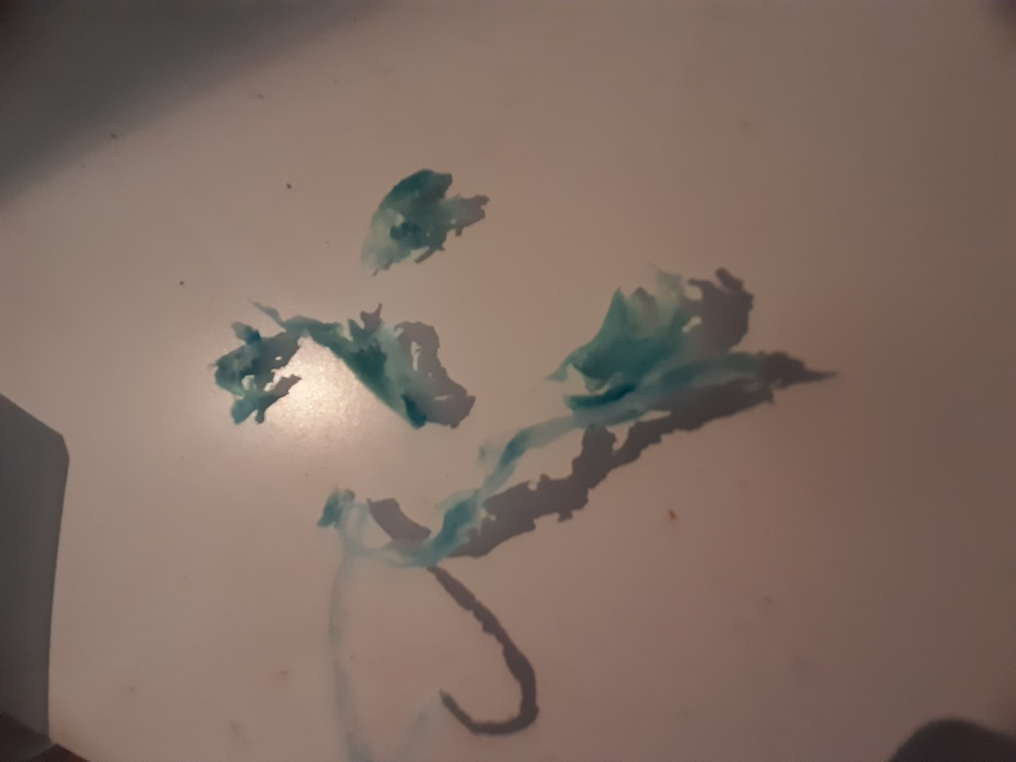
BIOLOGY
CHEMISTRY
BEGGINING

