Slide 1
IOANNIS RAPTOPOULOS Γ3
10 FAMOUS SCIENTISTS-INVENTORS

Slide 2
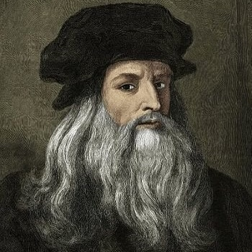
Leonardo da Vinci
Renaissance genius – Designed flying machines, studied anatomy, and painted the Mona Lisa.

Slide 3
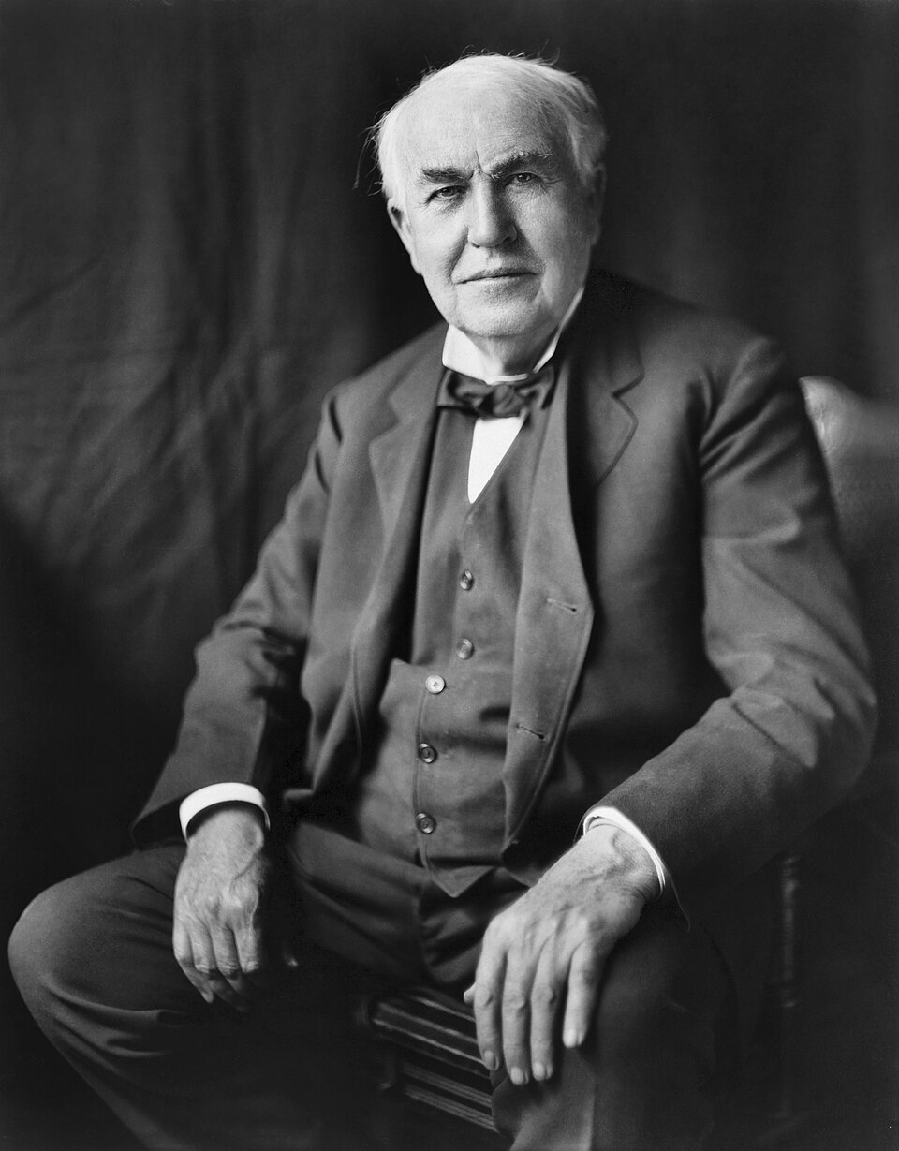
Thomas Edison
Lightbulb pioneer – Invented the phonograph and held 1,093 patents.

Slide 4
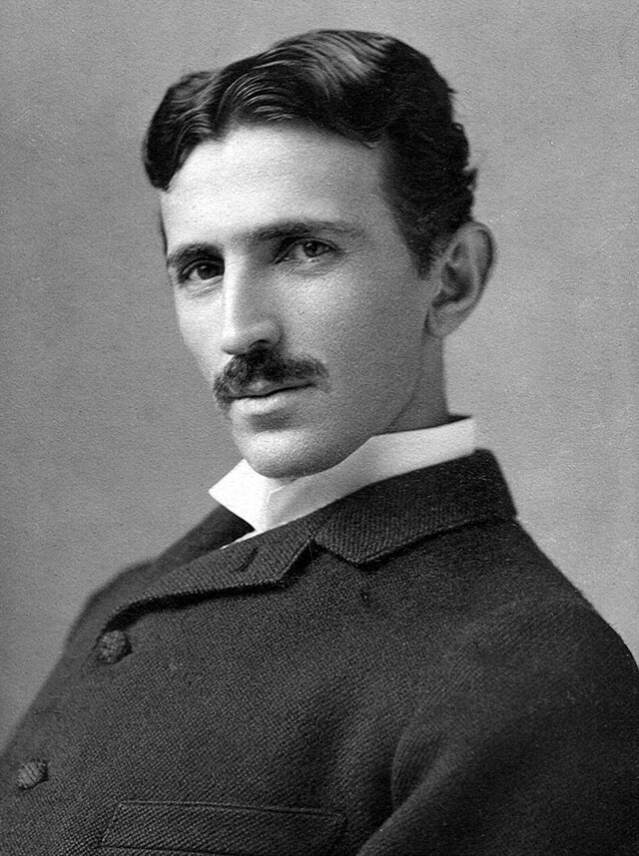
Nikola Tesla
Electricity visionary – Mastermind of AC current and wireless technology.

Slide 5
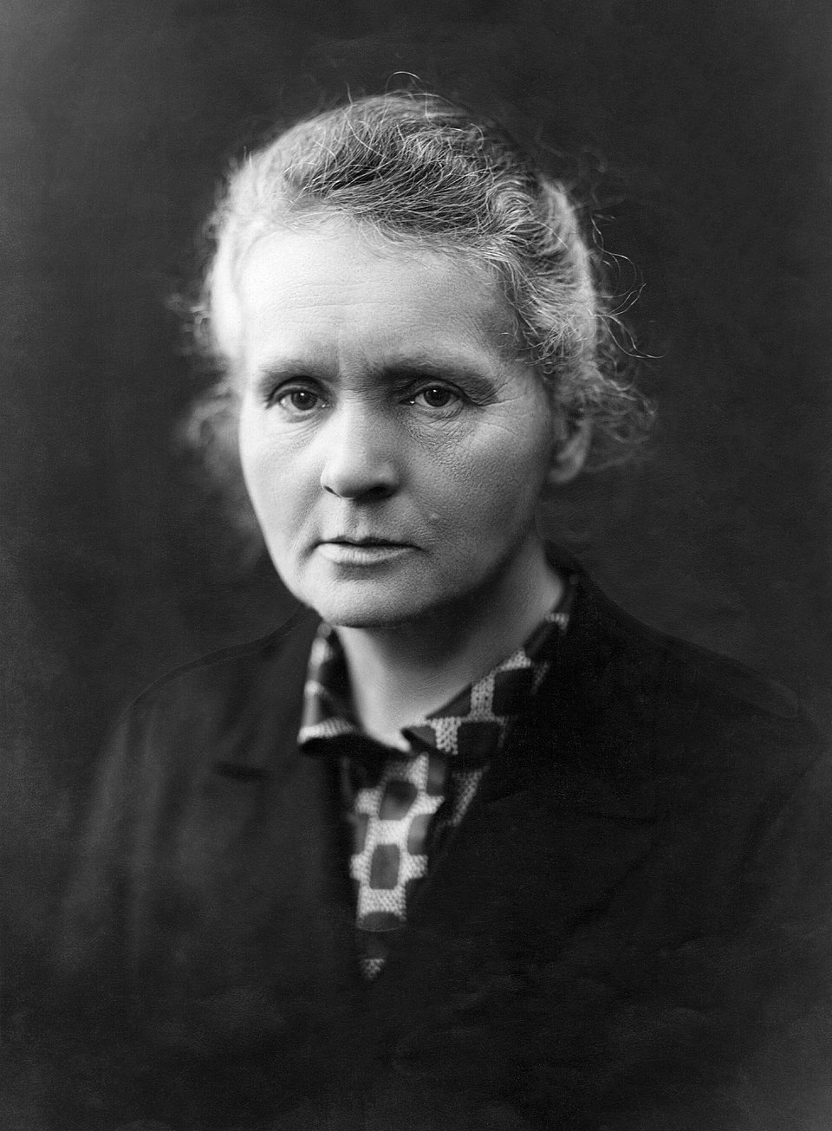
Marie Curie
Radioactivity trailblazer – Discovered radium; first double Nobel laureate.

Slide 6
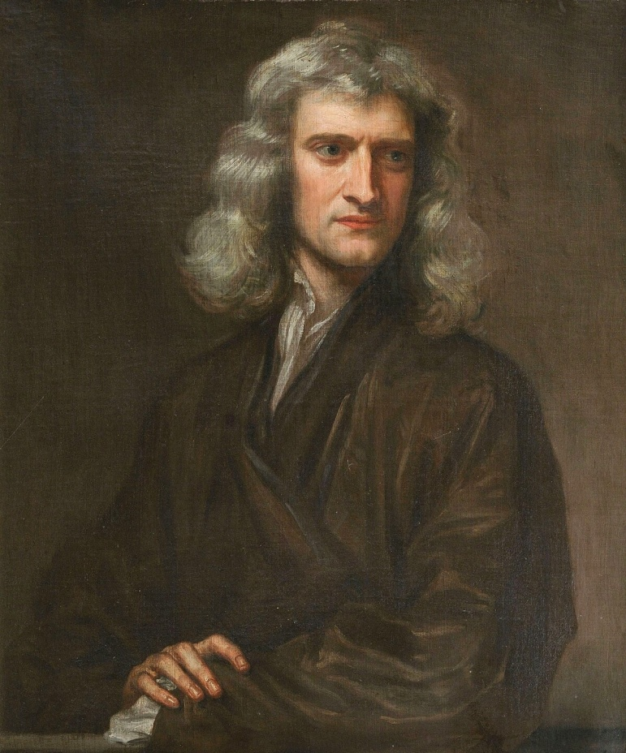
Isaac Newton
Gravity revolutionary – Defined laws of motion and invented calculus.

Slide 7
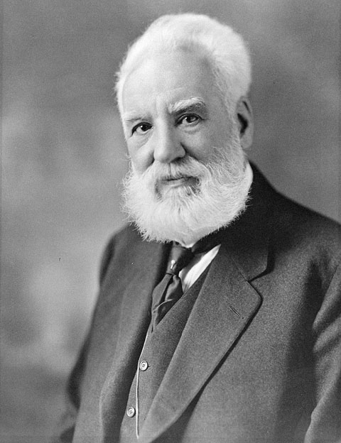
Alexander Graham Bell
Telecom innovator – Patented the telephone and worked with the deaf.

Slide 8
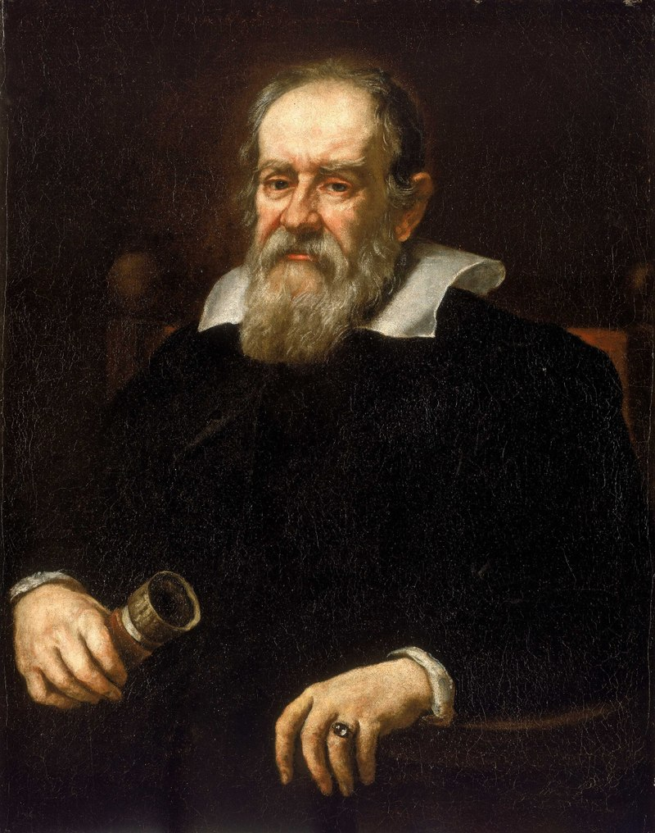
Galileo Galilei
Astronomy father – Improved the telescope, proved Earth orbits the Sun.

Slide 9
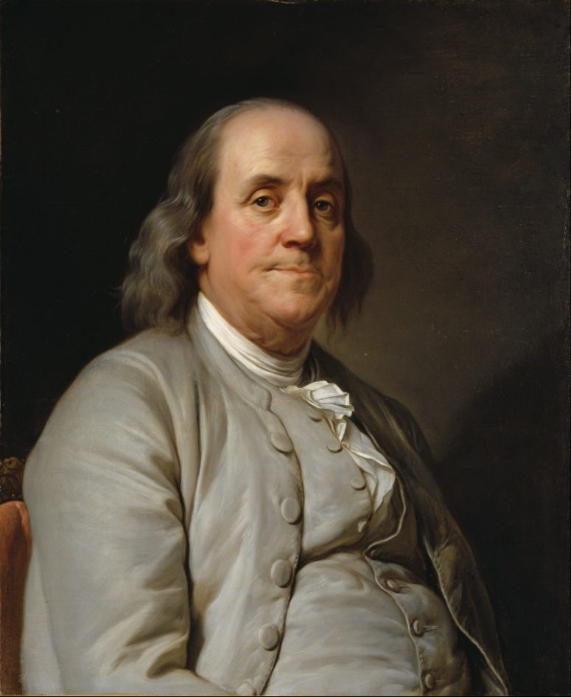
Benjamin Franklin
Polymath inventor – Harnessed electricity and designed bifocals.

Slide 10
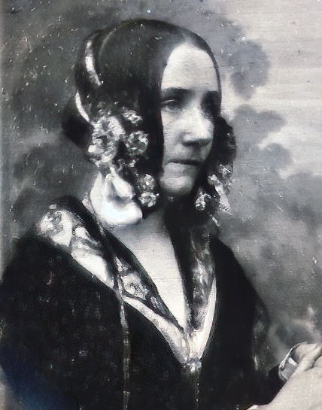
Ada Lovelace
First computer programmer – Wrote algorithms for Charles Babbage’s engine.

Slide 11
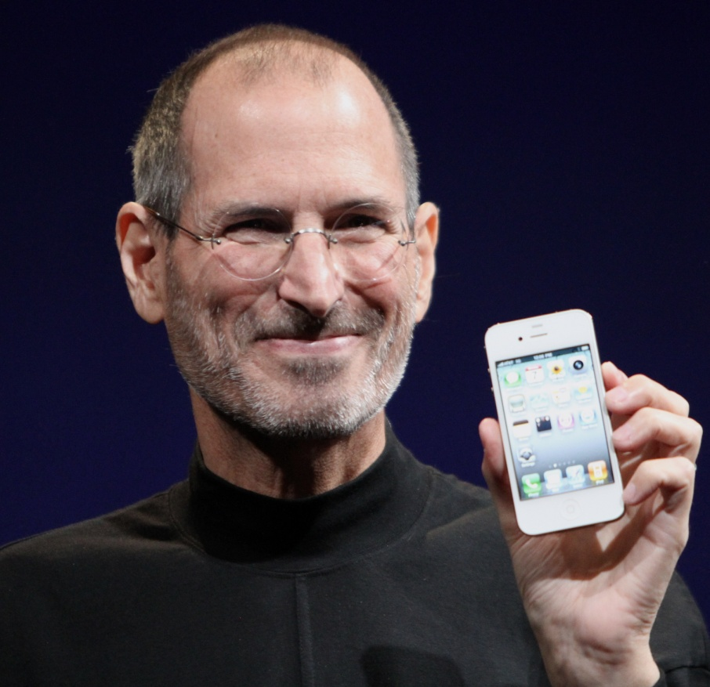
Steve Jobs
  Tech design icon – Co-created the iPhone and revolutionized personal computing.

Slide 12
Thank you for your time 👍

