Slide 1
The most modern transports in the world

Slide 2
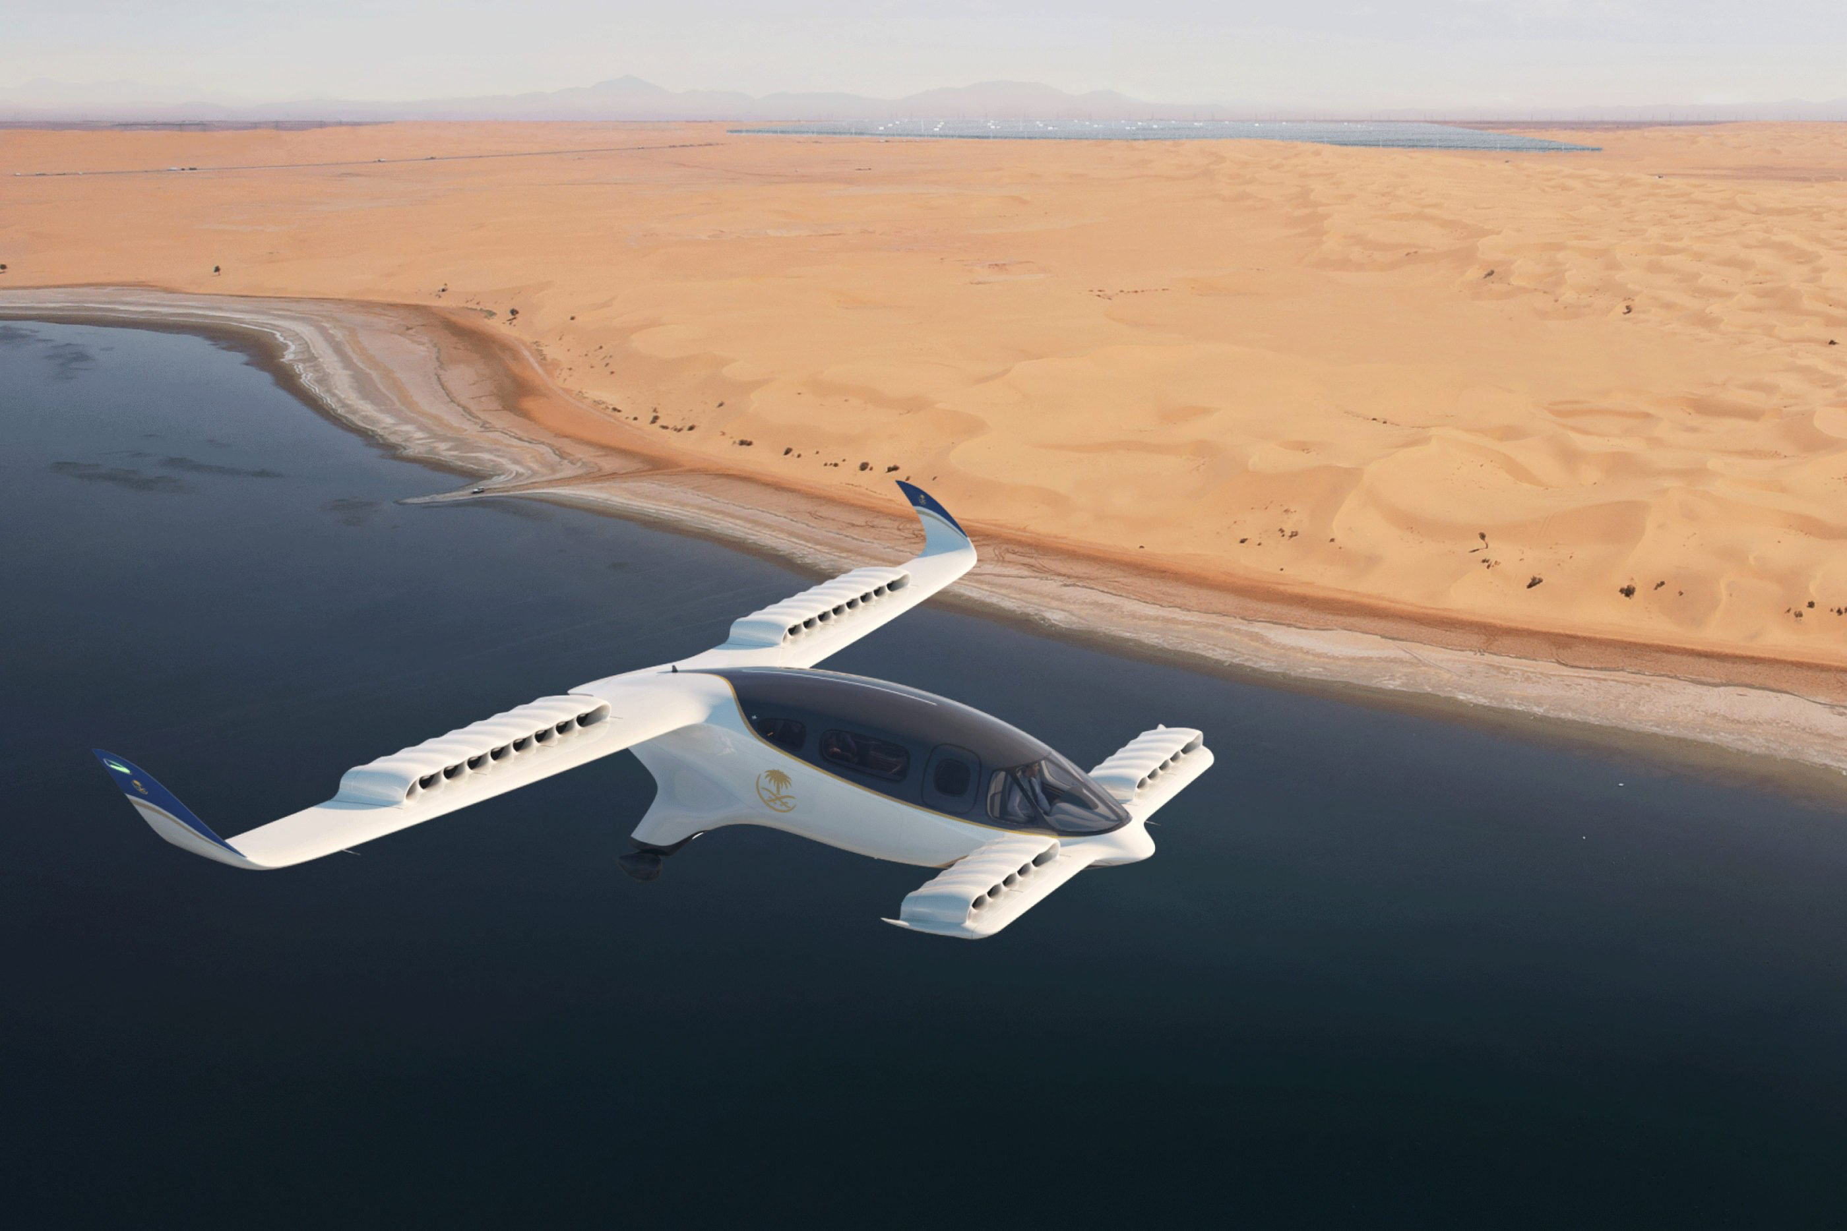
Electric Vertical Take-Off and Landing Jet. Lilium
Lilium Jet, by some referred as the flying car, is the world’s first all-electric vertical take-off and landing jet. It allows its passengers to travel 5 times faster than a car and fits up to 5 people. In fact, by definition it is not a flying car, since it doesn’t have a road-driving mode. Lilium makes some truly impressive claims for their vehicle, saying that they can achieve a top speed of about 186 miles per hour and a range of 186 miles per charge.

Slide 3
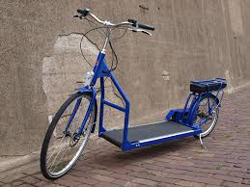
Electric Walking Bike. Lopifit
Lopifit developed the electric walking bike – the scooter-like contraption, which is the first of its kind in the world. It was inspired by the idea of having treadmills outdoors. As casual walking lacks the speed, adding the wheels to the treadmills, created a speedy option for daily walks. This Lopifit bike has six gears and an Quantum Motor that gives the bike a range of 34 miles on a single charge. The Lopifit bike is an innovative and a totally new way of moving and exercising. The bike is propelled by a 350W Samsung lithium-Ion battery which turns the treadmill while the user walks.

Slide 4
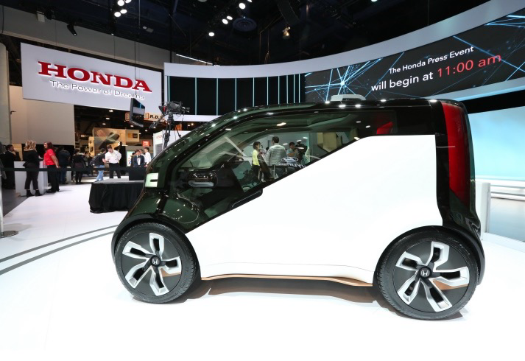
HANA at Honda Neuv. Honda
HANA stands for ‘Honda’s Automated Network Assistant’. HANA has been integrated in Honda NeuV, a mini electric concept car with emotional intelligence (a.k.a. HANA). Through HANA, the car becomes aware of a driver’s emotions and moods, and can support driving choices as well as suggest media do other infotainment options. “Honda concept envisions a future where vehicles will communicate with each other and infrastructure to mitigate traffic congestion and eliminate traffic fatalities, while increasing the productivity of road users and delivering new types of in-vehicle entertainment experiences.”

Slide 5
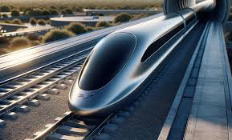
Hyperloop. Hyperloop One
Many people are aware of 5 modes of transportation plus the intermodal option. Today the world is getting ready for a new mode of transportation – the Hyperloop. In the world where time is more precious than ever before, Hyperloop One aims to move people and things at airline speeds for the price of a bus ticket (passengers could travel on magnetically levitating pods more than 700 miles per hour). Hyperloop One uses a custom electric motor to accelerate and decelerate a levitated pod through a low-pressure tube (a.k.a. Hyperloop). The vehicle will glide silently for miles with no turbulence. Hyperloop One started in 2014, and today there work over 200 people on three campuses in the US. This fast growth indicates the need for this kind of concept. Hyperloop One aims to connect 80% of the U.S. through these electromagnetic tubes.

Slide 6
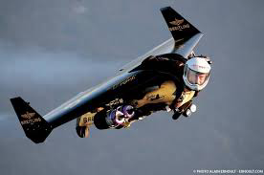
Jetpack Rocket Wing Suits. Jetman
Jetpack Rocket Wing Suits by Jetman, allow its users to fly 4,000 feet (around 1,2 km), which may seem low for a passenger airline, but heady heights for a man with a rocket strapped on his back. Throughout the development process, the formation was calculated to mitigate the dangers to the wing pilots. It is equipped with two jet engines and without mechanization wing. It weights 55 kg (including about 24 kg – tank with 30 liters of kerosene), its wingspan is 2 meters, which allows the fliers relatively easily maneuver the Jetpack at speeds as high as 300 km / h. Full tank of fuel consumed jetpacks for 10 minutes. The security system includes three Jet Man parachute.

Slide 7
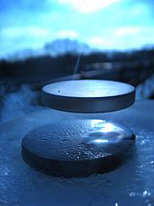
Magnetic Levitation Train. SCMaglev
Refered as the future of the ground transportation, Maglev trains, in fact, are not touching the ground. The train doesn’t have any wheels. Train is designed to float 10 millimeters above the track, so that the only resistance it has – is air resistance, which makes this train very fast. In fact, the SCMAGLEV (L0 Series) train is the fastest train in the world by reaching the 600 km/h mark and setting an astonishing speed record for rail vehicles at 603 km/h (375 mph). Unlike conventional railway systems, the SCMAGLEV accelerates and decelerates not by adhesion between wheel and rail, but through magnetic force generated between the onboard superconducting magnets and ground coils. By operating completely separated from any surface at high speeds, this transformational form of transportation will eliminate the traditional challenges and constraints of rail-based systems. It is revolutionary and technological advancement also in terms to extremely low environmental emission levels .

Slide 8

Ride Tap. Moovel Group
Moovel Group is an urban mobility company, making cities smarter. The Ride Tap, a product in the moovel Transit suite, is real-time ride options displaying app. Users are informed about real-time options in their area; from a bus to an uber, to a bike sharing option. The users can filter the options, based if they are looking for the fastest or the cheapest option. The app displays the most efficient route, that the user should go. It responds to a trend, that lately a lot of people are being resistant to use public transportation (the option, that is being displayed in the Google Maps) and do not own their own vehicle. Moovel Group aims to discover how new technologies will affect the way we move tomorrow and connect the ever-changing state of urban transportation.

Slide 9
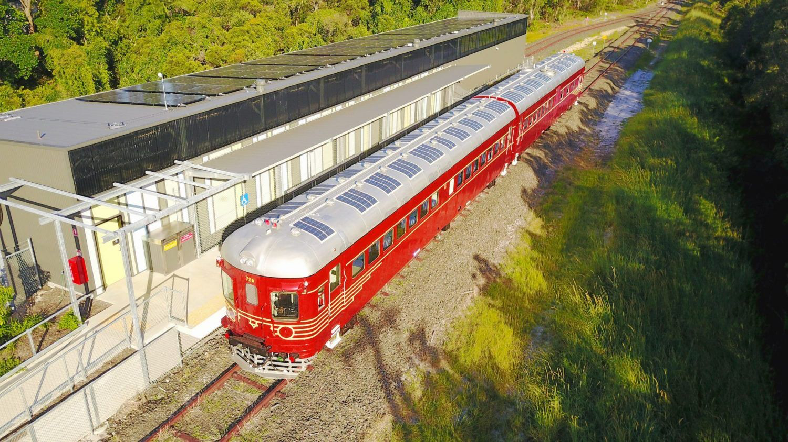
Solar-powered trains. Imperial College London
Solar powered trains will be for our use soon. A team led by the Imperial College London is connecting solar panels directly to the lines that power British trains. It is innovative and completely unique concept, to connect solar panels directly to the lines which provide electricity to trains. This will bypass the electricity grid so that the panels can provide power precisely when needed most. It the part of ‘Renewable Traction Power project’ – funded by Innovate UK’s Energy Game Changers programme. This offgrid solution could herald a revolution when it comes to public transport’s green credentials.

Slide 10
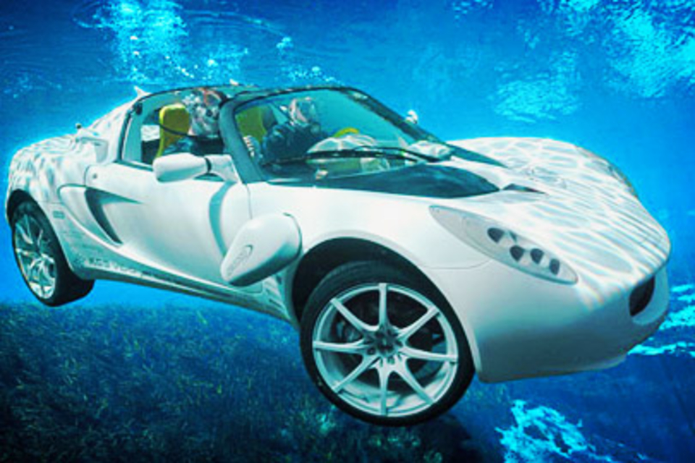
sQuba Diving Car. Rinspeed
The sQuba is the world’s first real submersible car. sQuba is a zero-emission, fully electric vehicle, powered by rechargeable lithium-ion batteries. It uses three electric motors, one for land travel, two for water. It can be submerged to a depth of 10 metres (33 ft), powered by twin electric-powered propellers supplemented by two Seabob water jets. Underwater it is designed to move as a submarin

Slide 11

Waze App. Waze
Waze is the world’s largest community-based traffic and navigation app. It is a free app that provides turn-by-turn driving directions and gas prices based on crowdsourcing: users can input information about accidents or other exceptions, but also automatically upload their actual driving times. The drivers get alerted before they approach police, accidents, road hazards or traffic jams; this information is shared by other drivers in real-time.

Slide 12
Majlinda Doka
Γ3

