Slide 1
WEIRD ART
In this research, you will see some weird art and some weird artist

Slide 2
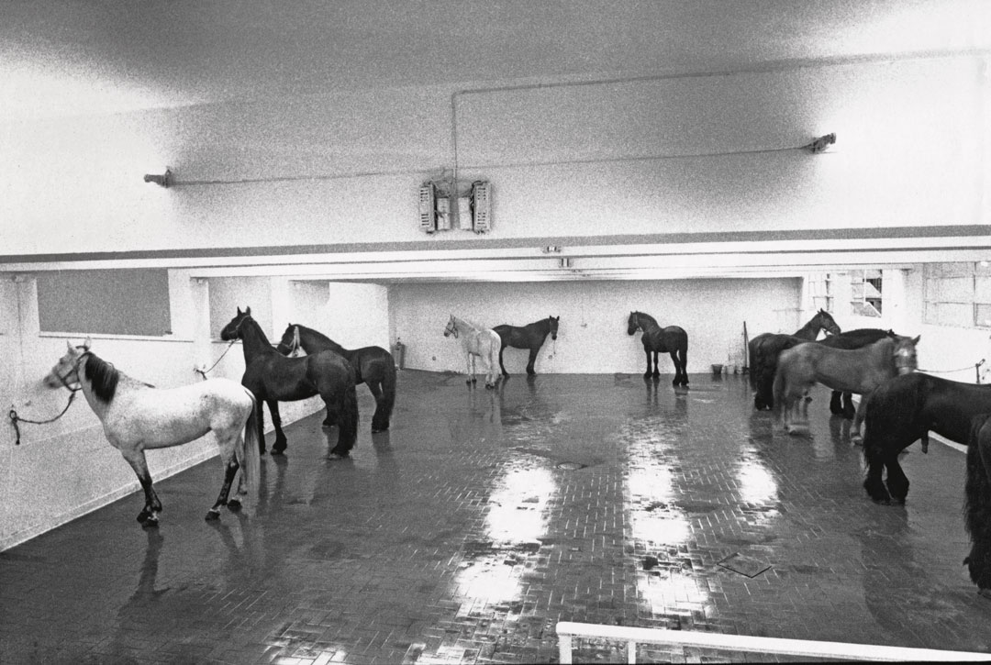
Jiannis Kounellis
Untitled 12 horses, 1969
There is no transformation of material or exhibition space instead, the sole artistic act is an act of displacement that is, the decision to position twelve horses in the gallery. Using horses, parrots, the human body itself, the artist removes the distinction between art and life.

Slide 3
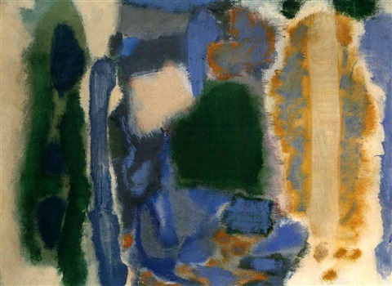
Mark Rothko
Number 26, 1947
The painter’s paintings are distinguished for their almost spiritual character while an element of depression is always present, they require from the viewer silence, concentration, absolute absorption.

Slide 4
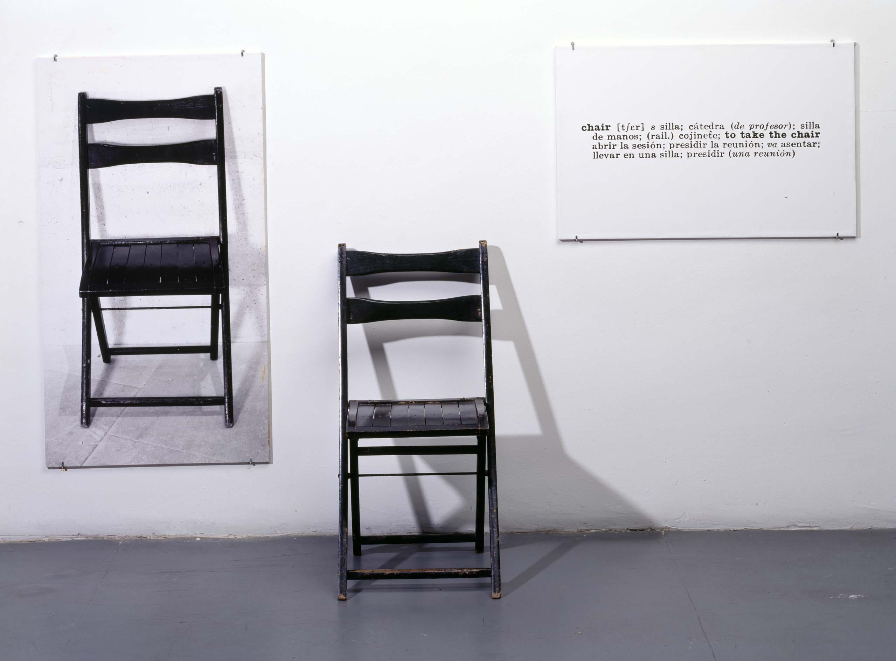
Joseph Kosuth
ONE AND THREE CHAIRS, 1965
The artist creates a semantic equivalent between a real chair, its photograph and the photographic magnification of the definition as defined in the dictionary. The public is asked to think in what form the identity of the object is found. In the object itself, in its representation or in its verbal description.

Slide 5
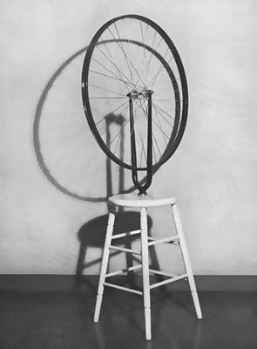
Marcel Duchamp
Bicycle Wheel, 1913
In 1913, he simply took a bicycle wheel, rested it upside down on a stool instead of a pedestal and signed this construction as a work of art, since then, such joints have become works of art, not because they were works in the traditional sense of the term, but because the objects, alienated from their common use, are there, to see them and to appreciate them as art.

Slide 6
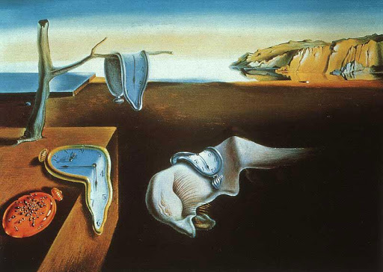
Salvador Dali
The Persistence of MemorY, 1931
Hard objects become inexplicably limp in this bleak and infinite dreamscape, while metal attracts ants like rotting flesh. Mastering what he called “the usual paralyzing tricks of eye-fooling,” Dalí painted with “the most imperialist fury of precision,” he said, but only “to systematize confusion and thus to help discredit completely the world of reality.” It is the classic Surrealist ambition, yet some literal reality is included, too: the distant golden cliffs are the coast of Catalonia, Dalí’s home.

Slide 7
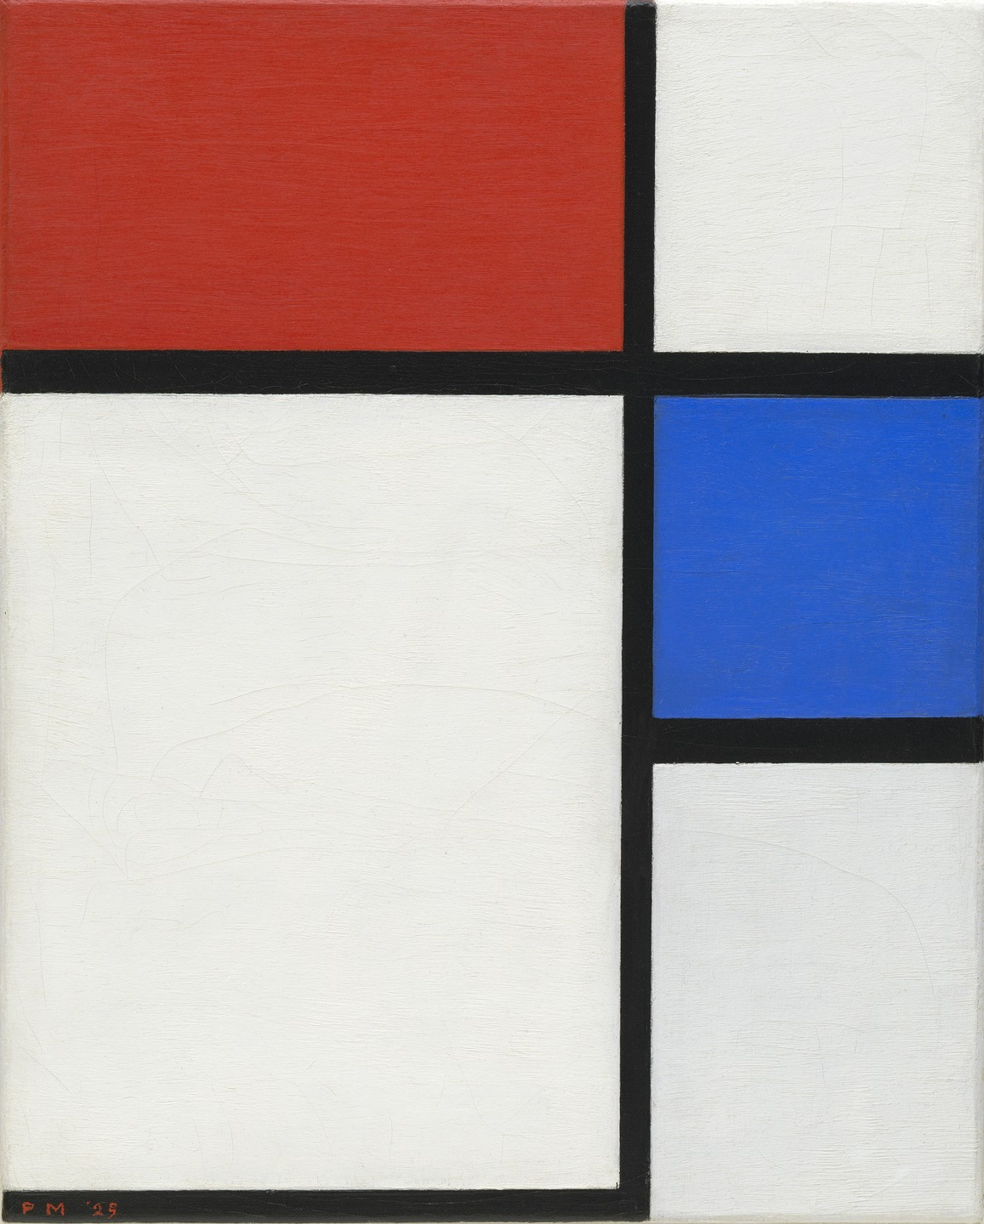
Piet Mondrian
Composition No. II, with Red and Blue, 1929
When Mondrian made his paintings, he would always mix his own colours, never using the paint directly out of a tube. He often used primary colours – red yellow and blue – as in this painting.

Slide 8
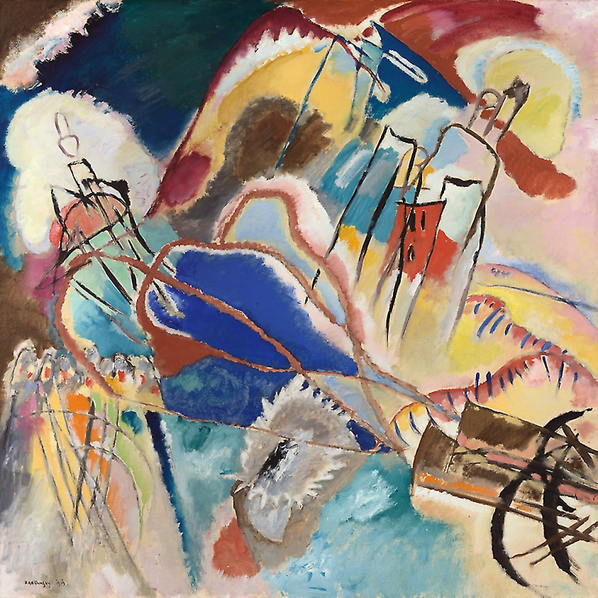
Wassily Kandinsky
Improvisation No. 30, 1913
Wassily Kandinsky advocated an art that could move beyond imitation of the physical world, inspiring, as he put it, “vibrations in the soul.” Pioneering abstraction as the richest, most musical form of artistic expression, Kandinsky believed that the physical properties of artworks could stir emotions, and he produced a revolutionary group of increasingly abstract canvases—with titles such as Fugue, Impression, and Improvisation—hoping to bring painting closer to music making.

Slide 9
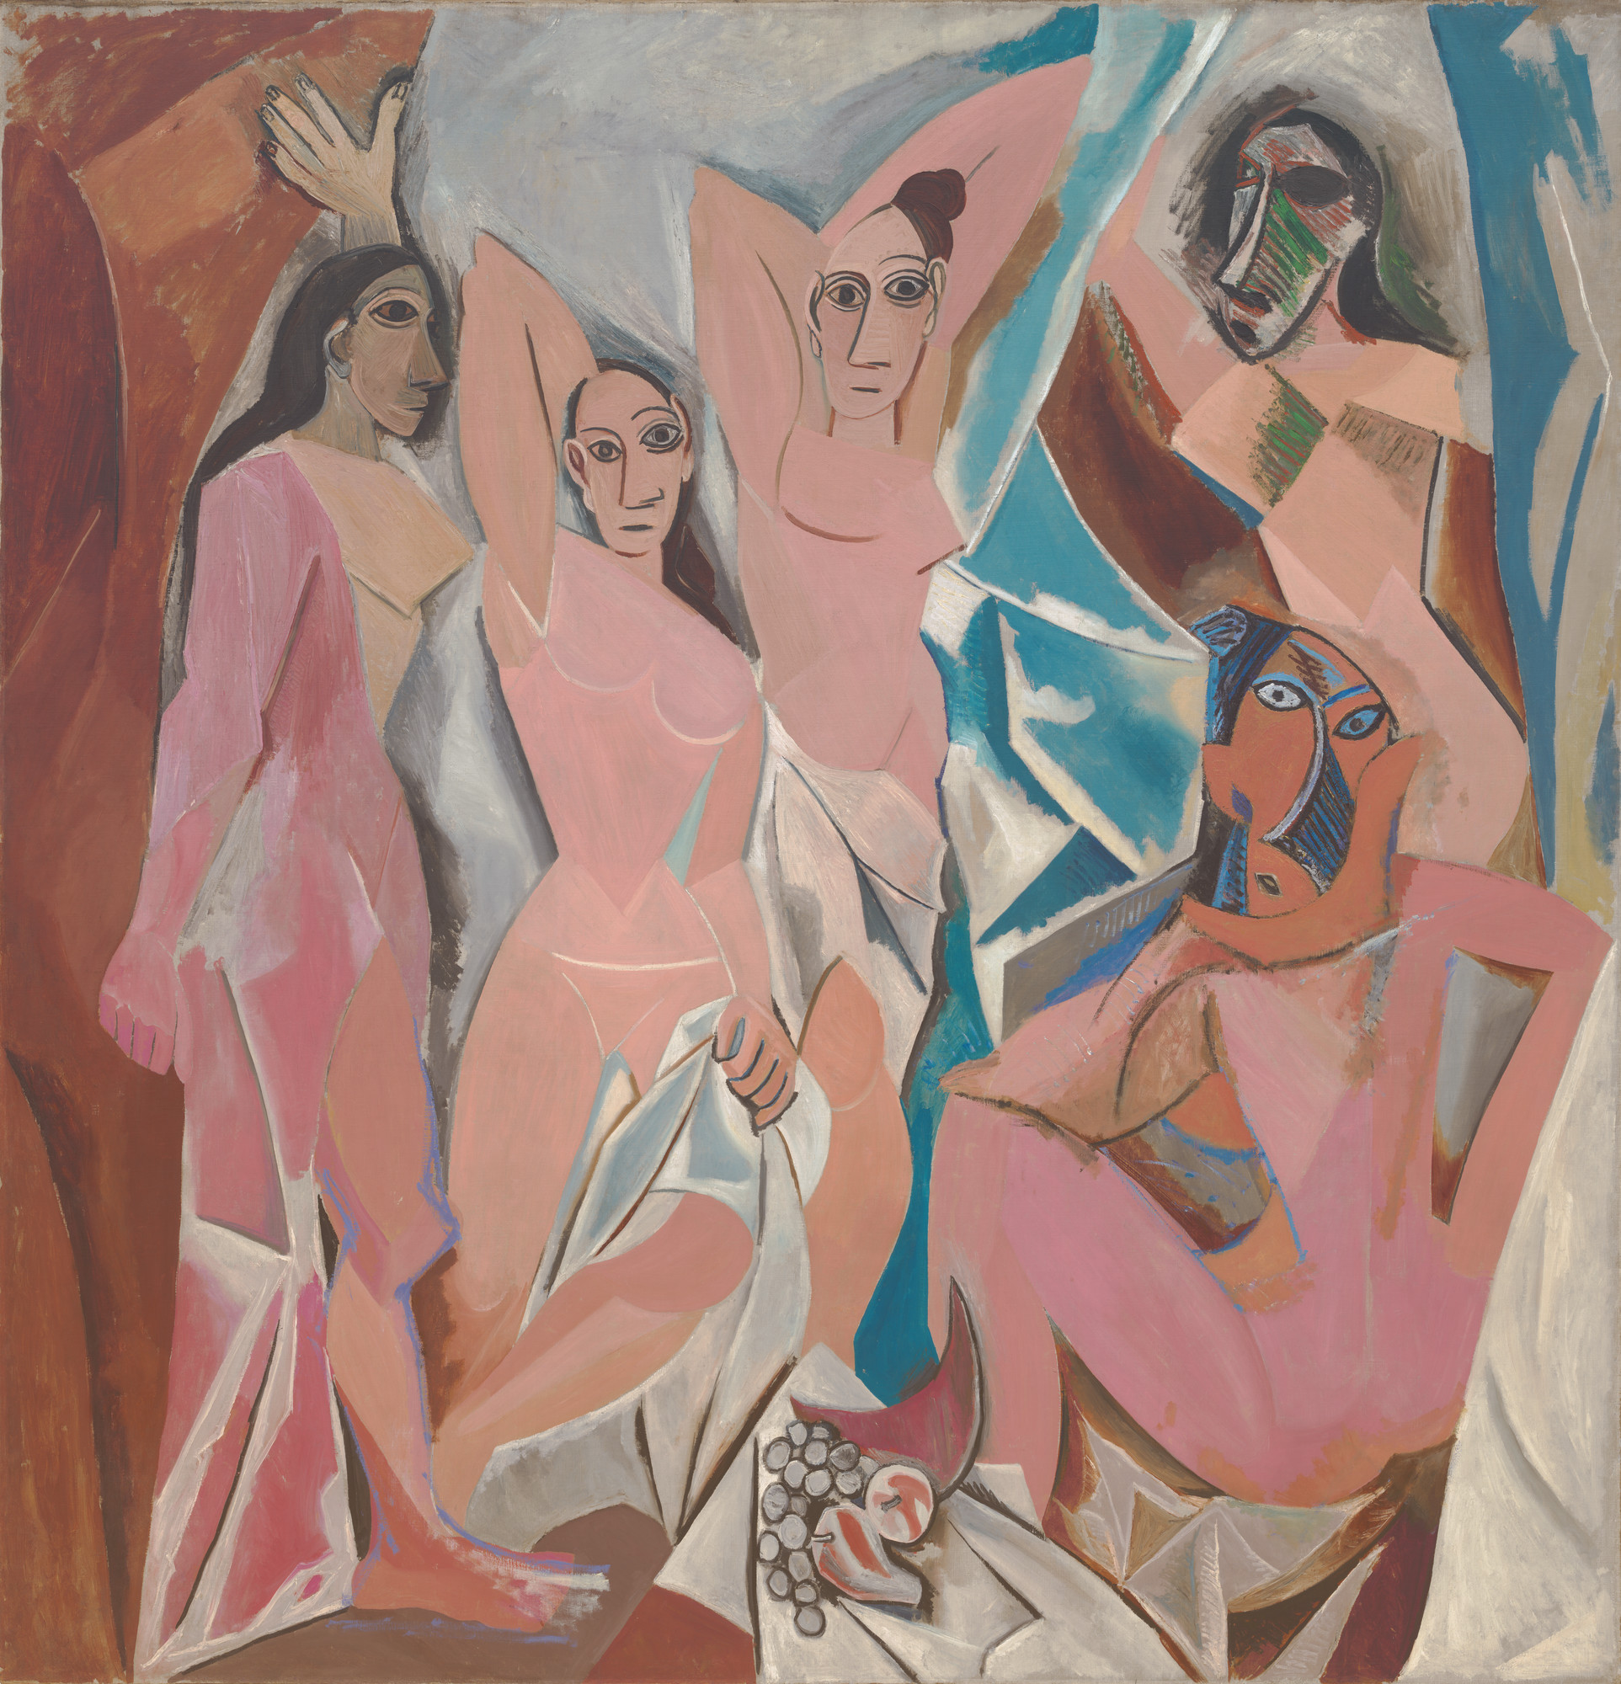
Pablo Picasso
Les Demoiselles d'Avignon, 1907
Les Demoiselles d’Avignon marks a radical break from traditional composition and perspective in painting. It depicts five naked women composed of flat, splintered planes whose faces were inspired by Iberian sculpture and African masks. The compressed space they inhabit appears to project forward in jagged shards, while a slice of melon in the still life at the bottom of the composition teeters on an upturned tabletop. Picasso unveiled the monumental painting in his Paris studio after months of revision.

Slide 10
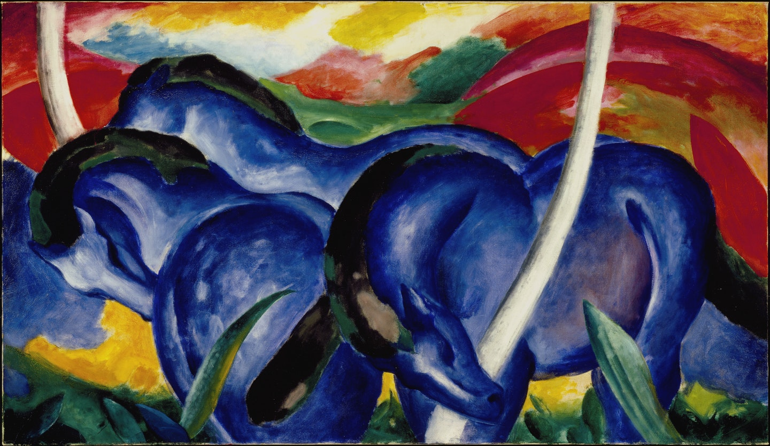
Franz Marc
BLUE HORSES, 1911
Marc gave an emotional or psychological meaning or purpose to the colors he used in his work: blue was used for masculinity and spirituality, yellow represented feminine joy, and red encased the sound of violence and of base matter. Marc used blue throughout his career to represent spirituality and his use of vivid color is thought to have been an attempt to eschew the material world to evoke a spiritual or transcendental essence.

Slide 11
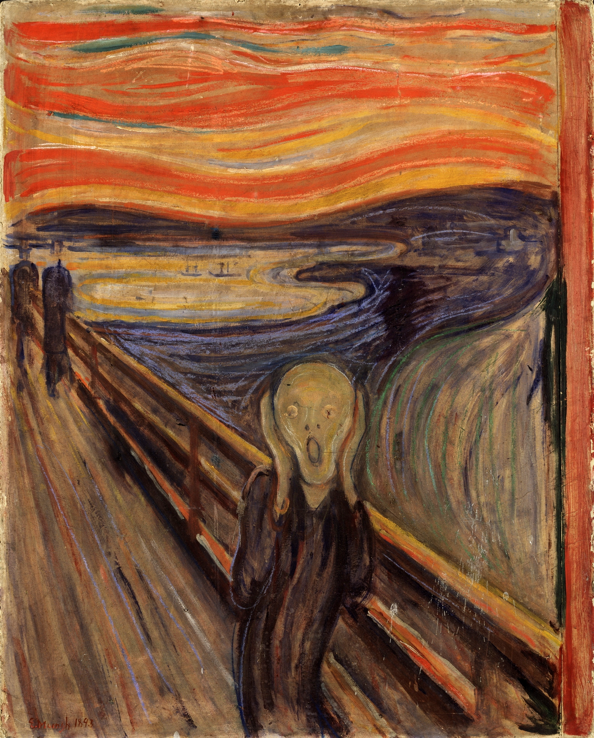
Edvard Munch
The scream, 1893
Here, however, in depicting his own morbid experience, he has let go, and allowed the foreground figure to become distorted by the subjectivized flow of nature; the scream could be interpreted as expressing the agony of the obliteration of human personality by this unifying force. Significantly, although it was Munch himself who underwent the experience depicted, the protagonist bears no resemblance to him or anyone else. The creature in the foreground has been depersonalized, if anything, stamped with a trace of the femininity of the world that has come close to assimilating it.

Slide 12


Maria Tsani

