Slide 1
PROJECT
WEIRD FOOD

Slide 2
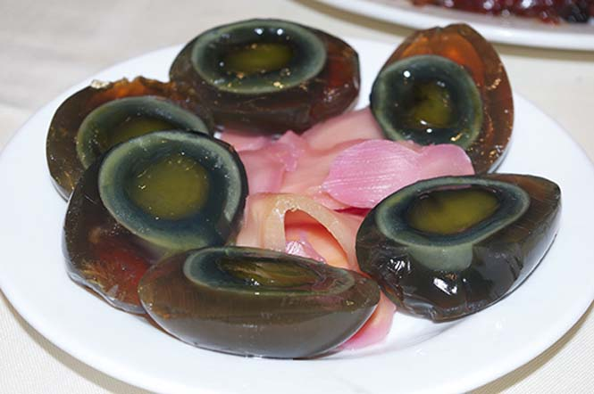
Egg of the Century - China
Eggs of the century is a Chinese delicacy made from duck, hen or quail eggs, which are kept in a special mix for several weeks of the century eggs are eaten either plain, as an accompaniment or as an appetizer, with some being added as basic material to various main dishes

Slide 3
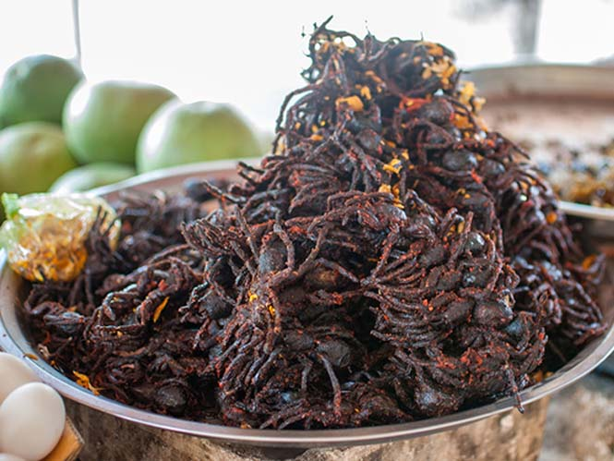
Fried Tarantula - Cambodia
In Cambodia large black tarantulas are served fried with garlic and salt, which they sell quite cheaply. According to those who have tried them, they are delicious, their taste reminiscent of crickets or weak chickens and are crunchy on the outside and sticky on the inside.

Slide 4
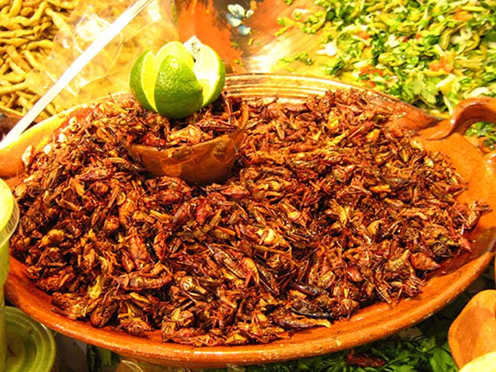
Locusts in various variations
Grasshoppers are even fried or roasted on the streets of various Asian countries, but another traditional version is the Mexican chapulines, in which grasshoppers are cooked with garlic, lime juice, salt and hot peppers.

Slide 5
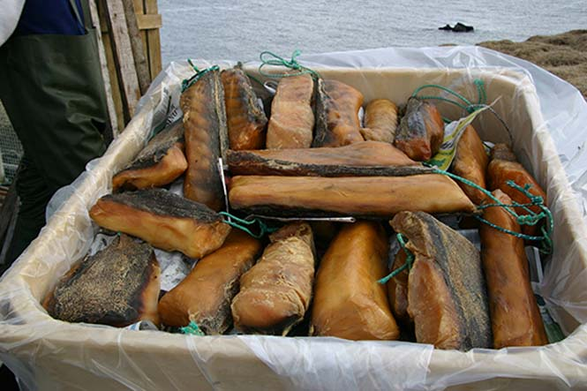
Ηákarl from prawn shark
One of Iceland's national dishes is the Hákarl made from shark. But not any shark, but a Greenland shark that stays for several months before eating. Hákarl has a naturally fishy taste, but the smell of ammonia that emerges makes it rather repulsive, though Icelanders do not seem to be sucked in.

Slide 6
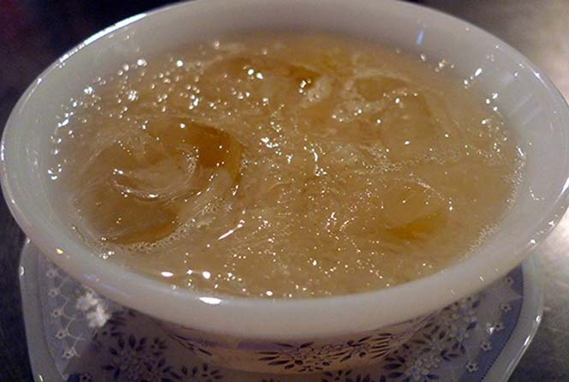
bird nest
Note that swallow's nests are mainly made of saliva, one of the most expensive animal products one can buy, and a bowl of such soup can cost from $ 30 to $ 100! Their value is due to their rarity as nests can be harvested only 3 times a year and are usually found in coastal caves, requiring particular climbing and agility skills from hunters. Bird nesting soup has been made for centuries, is rich in nutrients and has aphrodisiac properties ...

Slide 7
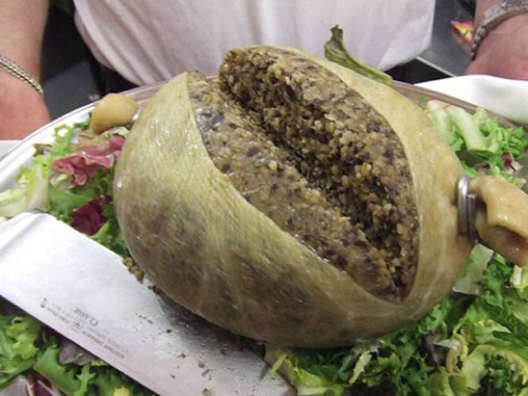
Haggis on a ... lamb stomach
But its peculiarity lies in the fact that it is a lamb stomach filled with finely chopped lambs, heart and lungs, onion, oats, vinegar, spices and salt. The stuffed stomach is boiled for about 3 hours and served with turnips, potatoes and a glass of Scotch whiskey.

Slide 8
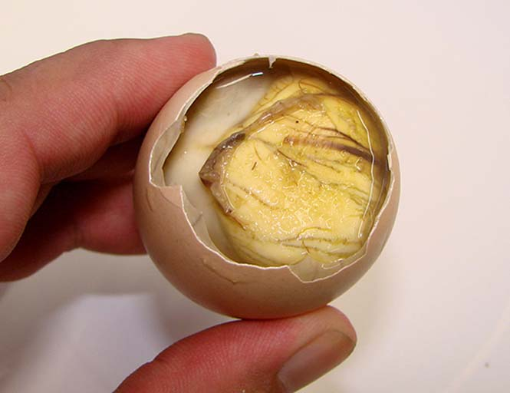
Balut, otherwise a duck or chicken embryo egg
The reason for balut, a Philippine dish, that changes the data on boiled eggs, as the shell is not the classic yolk, but a developed duck or chicken embryo, with beak, wings, nails and bones. It is very popular in the Philippines and is considered extremely nutritious, and is believed to boost libido. It is usually served with salt, lemon juice, pepper and coriander or with hot pepper and vinegar.

Slide 9

Puffin heart
The country has one of the largest puffins colonies in the world, and the Icelanders have decided to "exploit" this abundance by putting the puffins on their plate. The bird becomes smoked, roasted or fried, and its heart is considered to be a fine dish in the country and is even eaten raw!

Slide 10
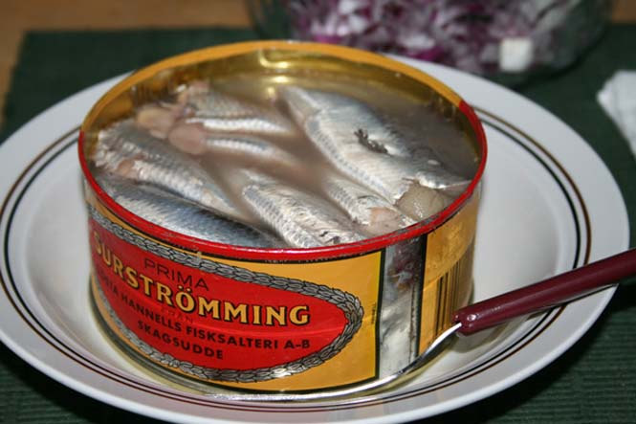
Surströmming
So Surströmming is a herring caught in the spring before breeding, put into barrels for 1-2 months to ferment and then canned, where the fermentation process that gives it its characteristic odor and slightly acidic flavor continues for several times. months. You find it on the shelves of all the super markets in Sweden and if you want to try it, like the Swedes, serve it with boiled potatoes or sandwich it with tunnbröd (butter, Swedish bread), butter, mashed potatoes and onion and accompany it cold milk.

Slide 11
NAME:Konstantinos
SURNAME:Tsintonidis
CLASS:A4

